Slide 1
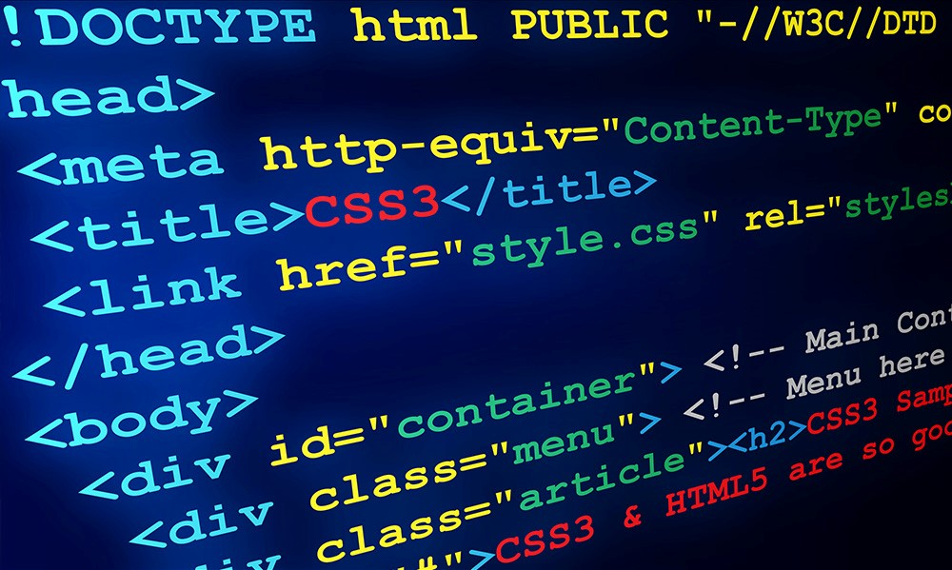


Introduction to HTML
Basic Web Development Concepts
What is HTML?
HTML = HyperText Markup Language
Defines the structure of web pages

Slide 2
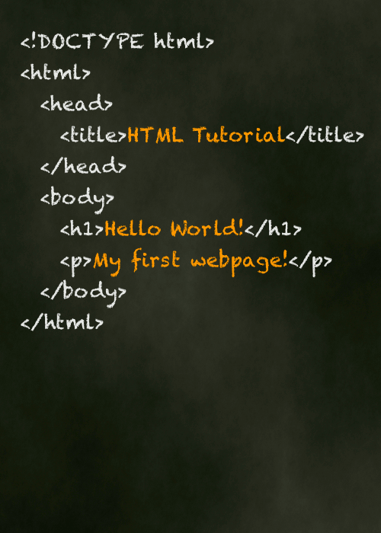
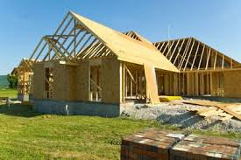
Introduction to HTML
What is HTML?
Think of it as the skeleton of a house
Works on all browsers: Chrome, Safari, Firefox, Internet Explorer to HTML

Slide 3

Introduction to HTML
HTML vs Programming Languages
HTML is not a programming language
Programming languages: Java, JavaScript, Python
HTML = structure and shape
Python = functions and logic

Slide 4
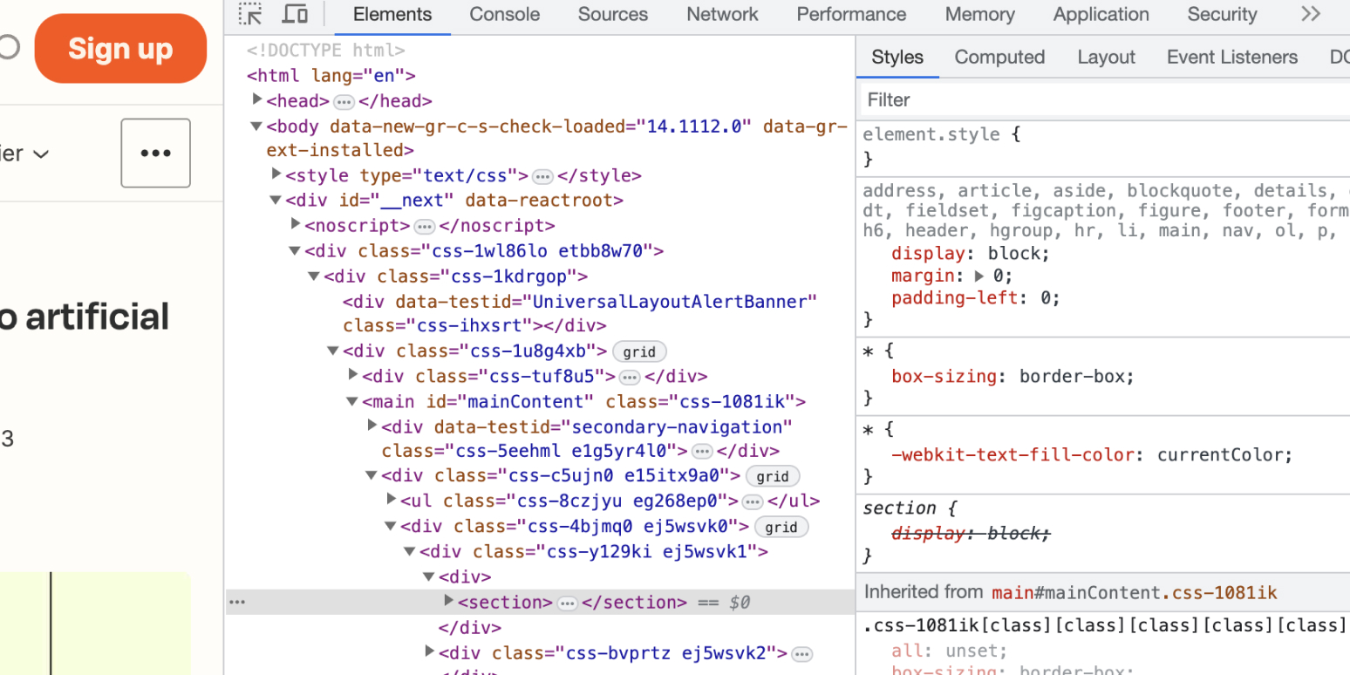
Introduction to HTML
Inspect Tool
Right-click on any website → Inspect
See the HTML code behind the page

Slide 5

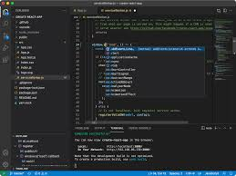

Visual Studio Code (VS Code)
VS Code = online notebook for coding
Extensions help to:
Improve visuals
Add functionality
Write code faster

Slide 6
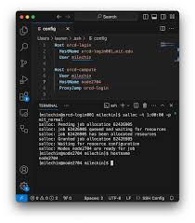
Visual Studio Code (VS Code)
Common Buttons in VS Code
New File (+ icon) → Create new file
Search (Magnifier) → Search files
Git (Branch icon) → Combine & share code
Extensions (Square icon) → Add extra tools/

Slide 7

Visual Studio Code (VS Code)
Recommended Extensions
Material Theme → Change editor theme
HTML Snippets → Write HTML faster
JS JSX Snippets → Easier JavaScript coding
Live Server → See changes live/

