Slide 1
Predicting Best Souvenir Shop Location in Antalya, TURKEY APredicting Best Souvenir Shop Location in Antalya, TURKEY B
By Ekrem Bakay

Slide 2
Selecting a business location
During touristic season, especially summer times, visitors all over the world provides a huge opportunity for souvenir shops.
Many people like to take a little something home with them as a reminder of their travels, something to show for where they have been, something they can use to look back and reminisce about the fantastic experience they had during their holiday or something that will make their loved ones happy when they return.
Selecting a good place will increase the profits

Slide 3
Data acquisition and cleaning
Lucily we have the data available on the state postal office website as a zip file on this link http://postakodu.ptt.gov.tr/.
Now our Postcodes are ready. We can start getting geolocation for each district using google maps.
 | Postcode | Province | City | District | location | point | latitude | longitude | altitude
0 | 07010 | ANTALYA | MURATPAŞA | ESKİSANAYİ | (Cumhuriyet Mahallesi, Muratpaşa, Antalya, Akd... | (36.9041492, 30.700651575000002, 0.0) | 36.904149 | 30.700652 | 0.0
1 | 07020 | ANTALYA | KEPEZ | VARSAK | (Antalya, Muratpaşa, Antalya, Akdeniz Bölgesi,... | (36.9009641, 30.6954846, 0.0) | 36.900964 | 30.695485 | 0.0
2 | 07025 | ANTALYA | KEPEZ | DOKUMA | (Özgürlük Mahallesi, Kepez, Antalya, Akdeniz B... | (36.91393495, 30.67963175, 0.0) | 36.913935 | 30.679632 | 0.0
3 | 07030 | ANTALYA | MURATPAŞA | MELTEM | (Muratpaşa, Antalya, Akdeniz Bölgesi, 07030, T... | (36.8804352369126, 30.784500713480504, 0.0) | 36.880435 | 30.784501 | 0.0
4 | 07040 | ANTALYA | MURATPAŞA | ÇARŞI | (Antalya, Muratpaşa, Antalya, Akdeniz Bölgesi,... | (36.8934522, 30.7015535, 0.0) | 36.893452 | 30.701553 | 0.0
5 | 07050 | ANTALYA | MURATPAŞA | BAHÇELİEVLER | (Aqua, Adnan Menderes Bulvarı, Sorgun, Manavga... | (36.758141, 31.4275232, 0.0) | 36.758141 | 31.427523 | 0.0

Slide 4
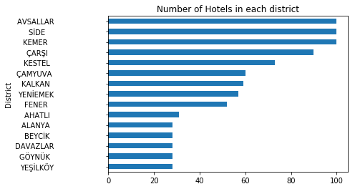
Hotel numbers in each district in Antalya

Slide 5
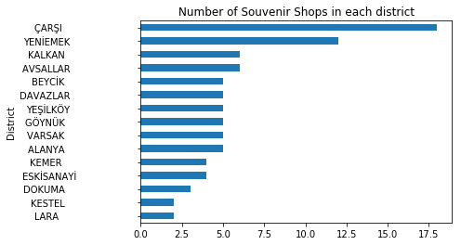
Souvenir shop numbers in each district in Antalya

Slide 6
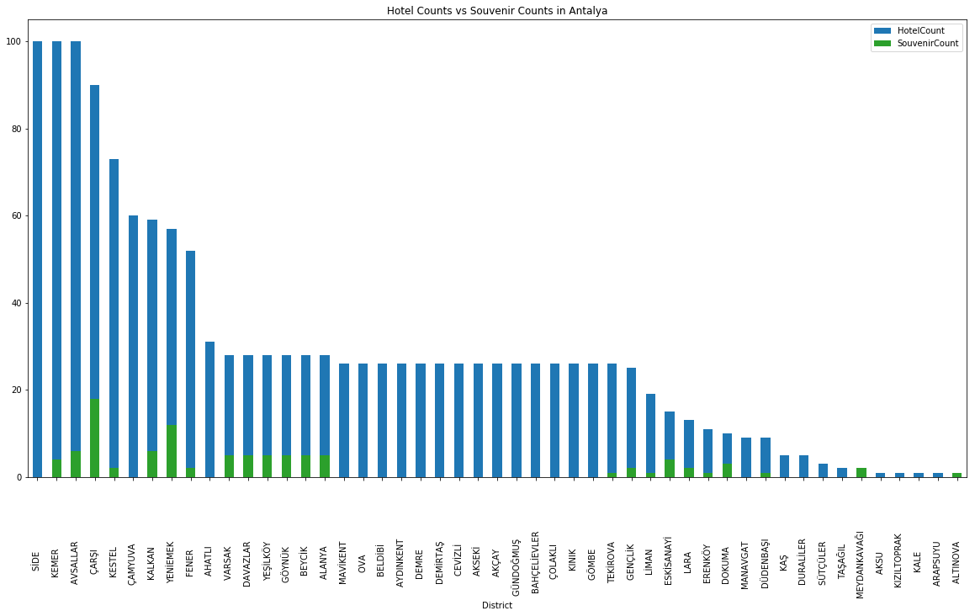
Most suitable locations for Souvenir Shop business

Slide 7
Conclusion and future directions
As a result, for people who are looking for perfect spot in their souvenir businesses in Antalya can start their business in SIDE, KEMER or AYSALLAR distirct.
We can apply same method for many other businesses and make suggestions to improve their profits

