Slide 1

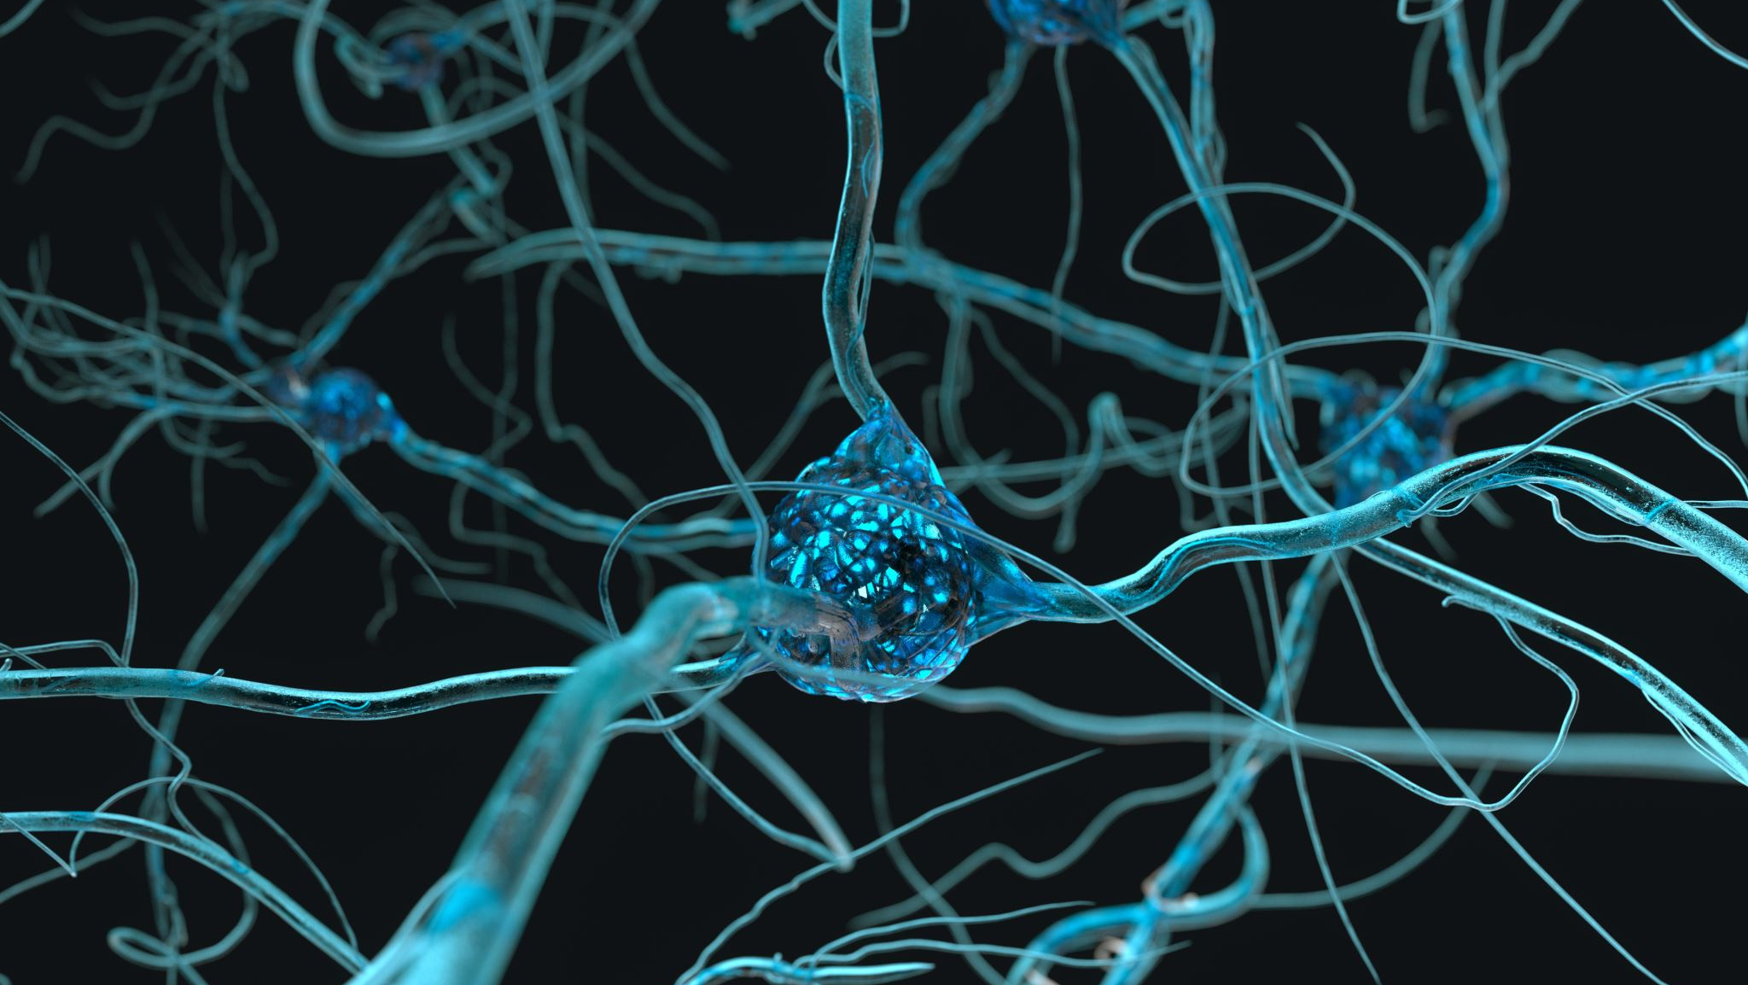
Understanding Astrocytes using calcium (II) oscillation measurements
Lavrentovich & Hemkin Model
By Ekrem Demirboga
PHYS798N: NeurophysIcs

Slide 2

Outline
Spontaneous oscillations in Astrocytes
Data and Model
How to fit?
Future direction
Conclusion

Slide 3
Spontaneous oscillations in Astrocytes
Brief Overview:
Astrocytes: Often overlooked, but crucial support cells in the brain.
Spontaneous Oscillations: Intriguing rhythmic patterns in astrocyte activity.
Understanding astrocytic oscillations can unravel mysteries surrounding neural network behavior and information processing in the brain.

Slide 4
Spontaneous oscillations in Astrocytes
Significance:
Regulatory role in brain homeostasis.
Implications for information processing and network function.

Slide 5
Data and Model

Slide 6
Data and Model

Slide 7
How to fit?

Slide 8
Future implementations

Slide 9
Conclusion

Slide 10
Thank you!

