Slide 1

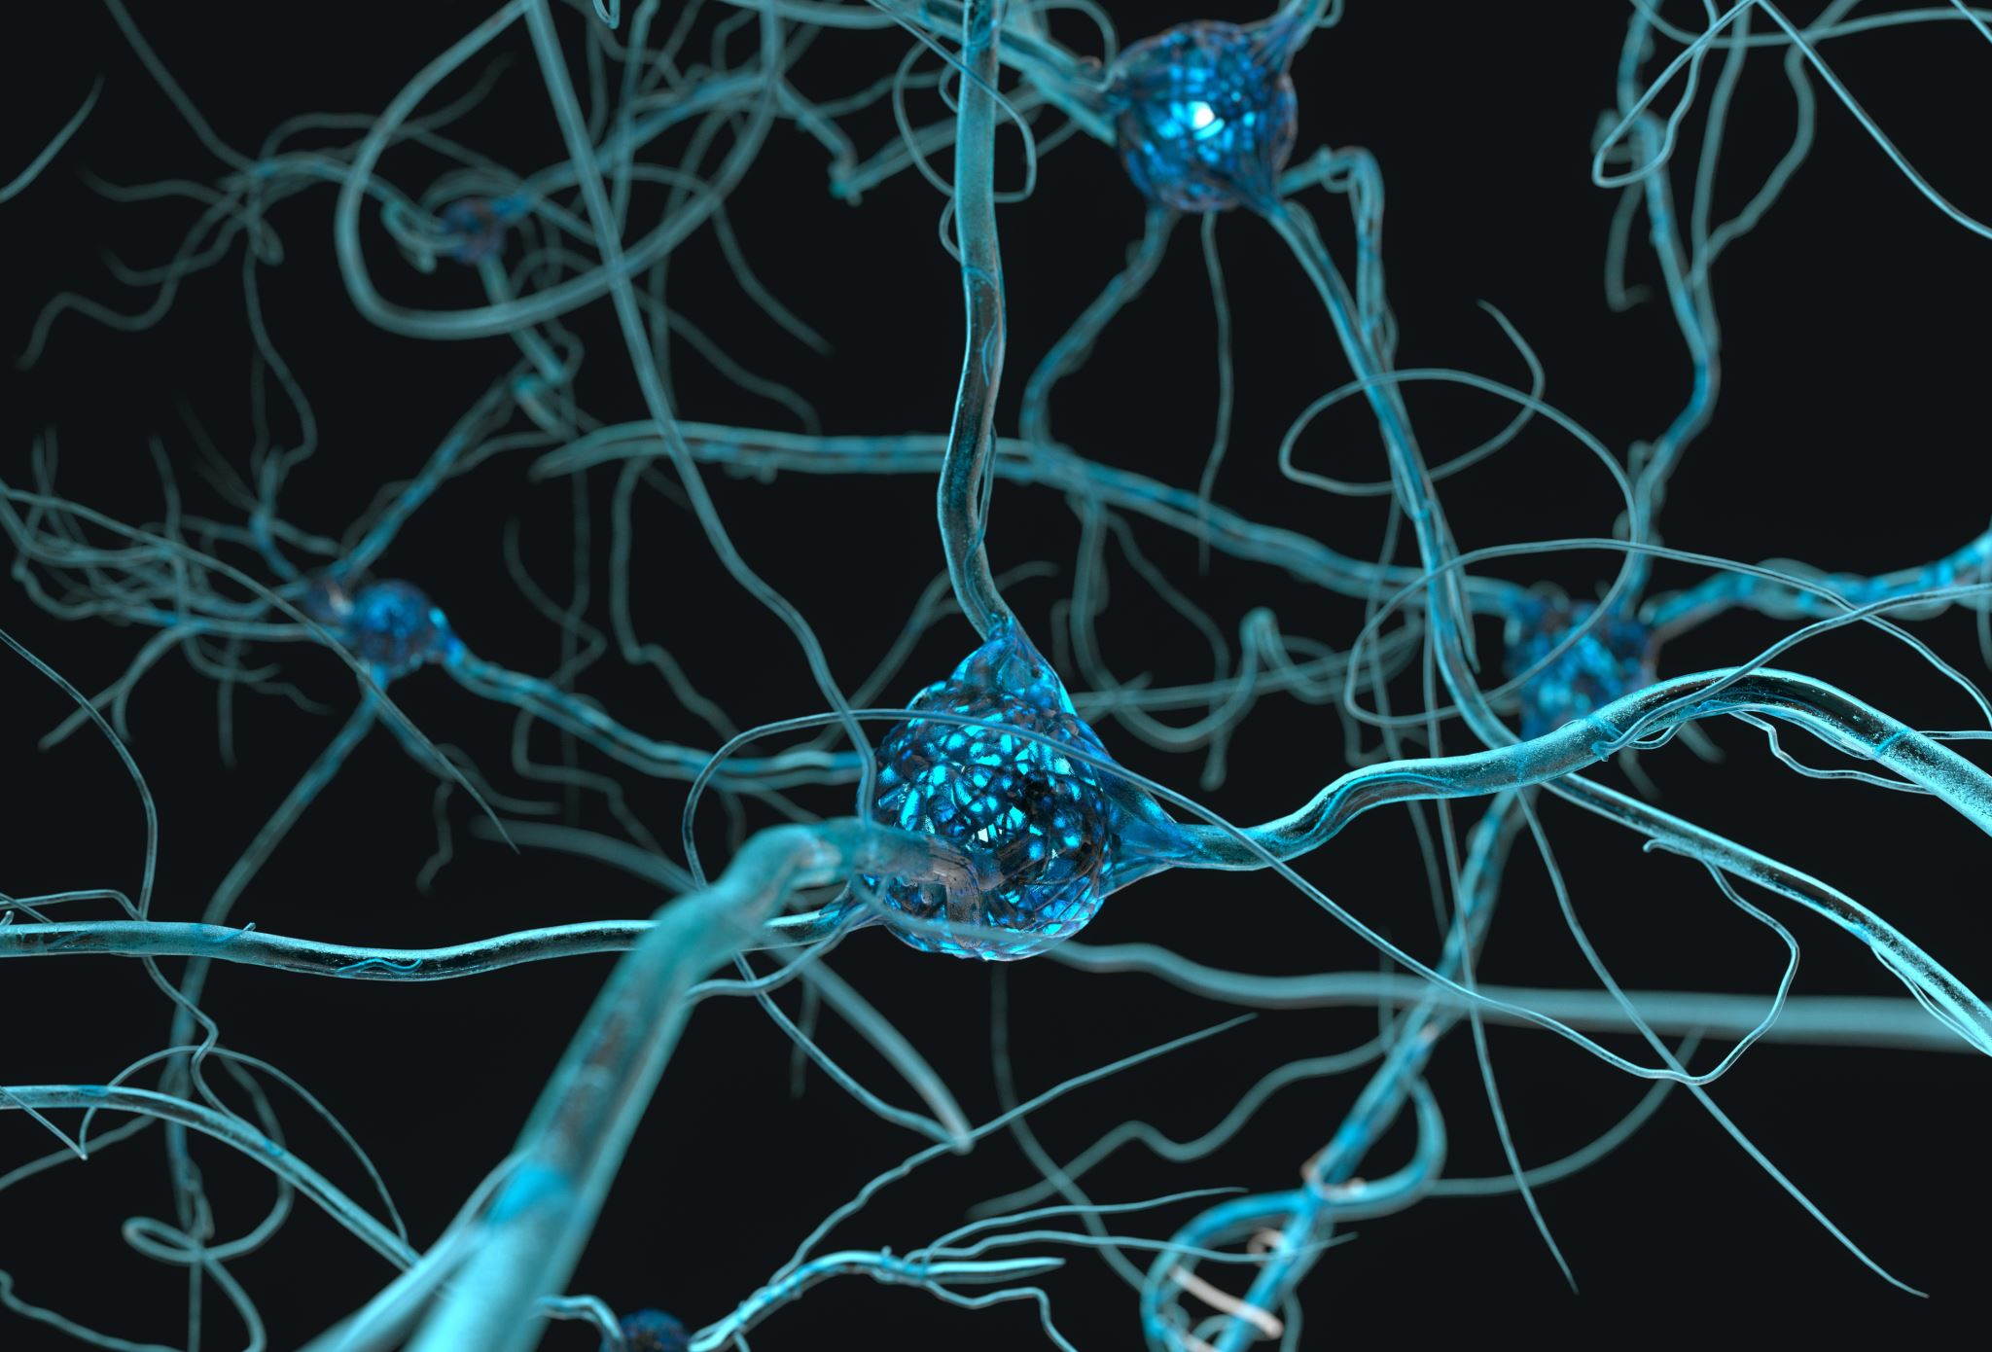
Understanding Astrocytes using calcium (II) oscillation measurements
Lavrentovich & Hemkin Model*
By Ekrem Demirboga
PHYS798N: NeurophysIcs
*Lavrentovich M, Hemkin S. A mathematical model of spontaneous calcium(II) oscillations in astrocytes. J Theor Biol. 2008 Apr 21;251(4):553-60. doi: 10.1016/j.jtbi.2007.12.011. Epub 2008 Feb 14. Erratum in: J Theor Biol. 2009 Sep 21;260(2):332. PMID: 18275973.

Slide 2

Outline
Spontaneous oscillations in Astrocytes
Data and Model
How to fit?
Future direction
Conclusion

Slide 3

Spontaneous oscillations in Astrocytes
Brief Overview:
Astrocytes: Often overlooked, but crucial support cells in the brain.
Spontaneous Oscillations: Intriguing rhythmic patterns in astrocyte activity [1].
Understanding astrocytic oscillations can unravel mysteries surrounding neural network behavior and information processing in the brain.
[1] Parri, H., Gould, T. & Crunelli, V. Spontaneous astrocytic Ca²⁺ oscillations in situ drive NMDAR-mediated neuronal excitation. Nat Neurosci 4, 803–812 (2001). https://doi.org/10.1038/90507

Slide 4
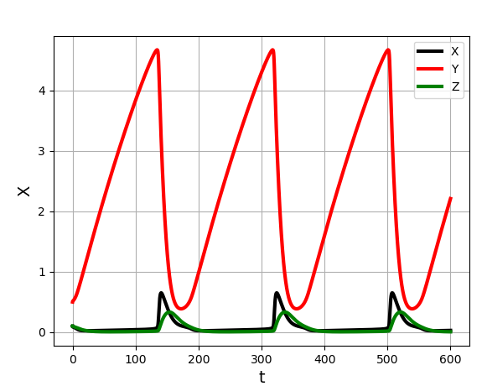
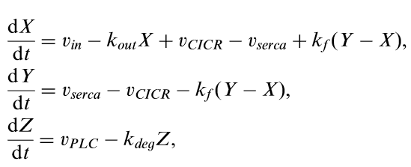
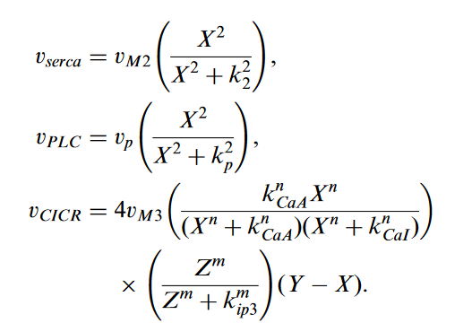
the Model
X: Ca⁺² concentration in cytosol
Y: Ca⁺² concentration in endoplasmic reticulum (ER)
Z: IP₃ (trisphosphate) concentration in the cell
V_{in}
-k_{out}X
Z (IP₃)
PLC
X (cytosol)
Small changes in X causes oscillatory behaviour as suggested by experiment (Aguado et al., 2002)
serca
Y
(ER)
CICR
leak

Slide 5

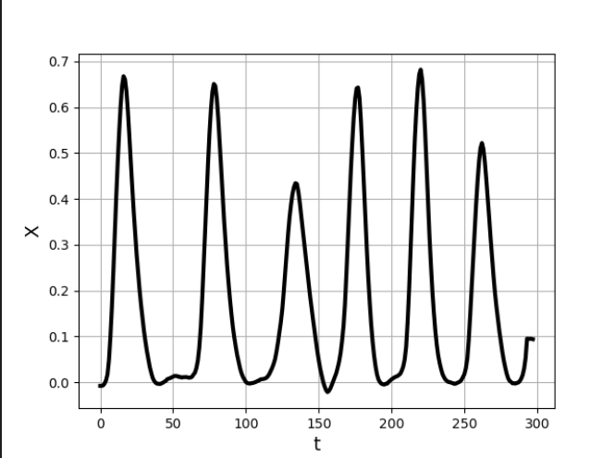
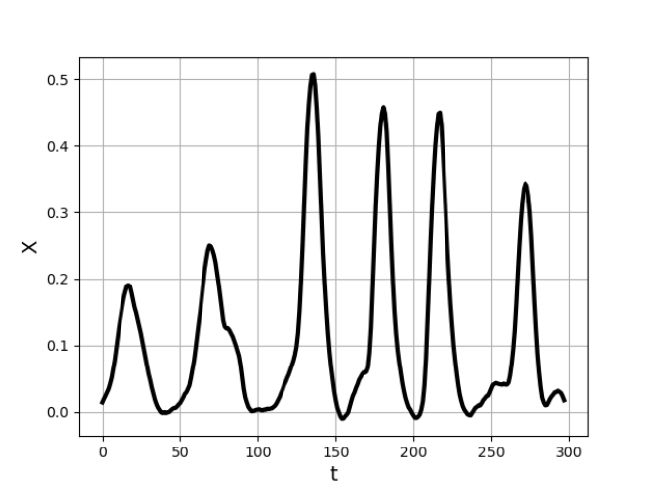
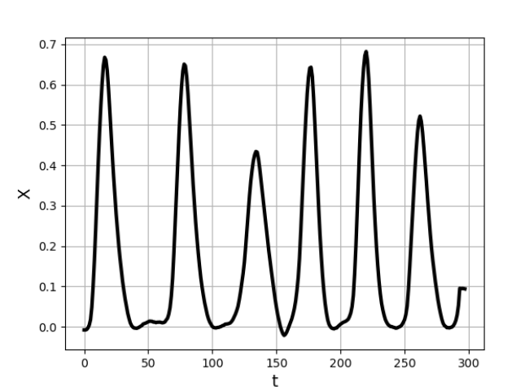
the Data
Measured by Nicholas Mennona, Losert Lab.

Slide 6
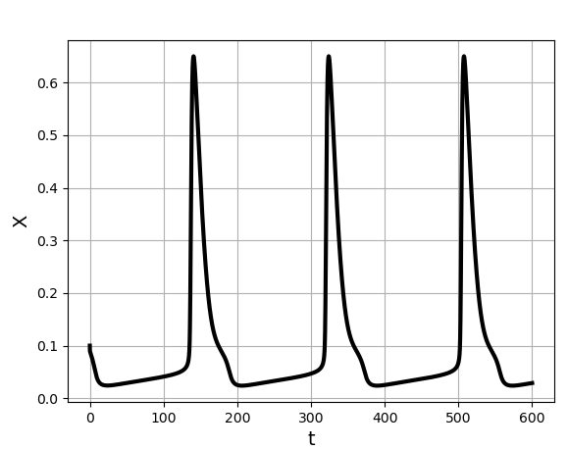
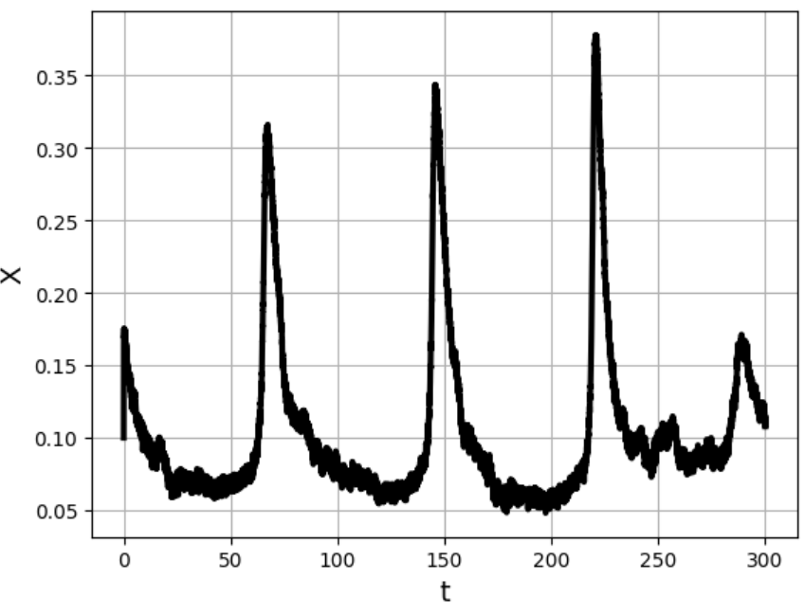
Model vs Data

Slide 7
How to fit?
We have two options:
1- Looking at single peaks
2- Using Taken’s Embedding

Slide 8
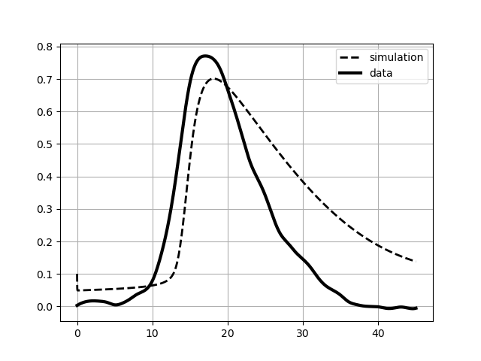
Looking at single peaks
We can look at the individual peaks to understand the underlying mechanism.

Slide 9
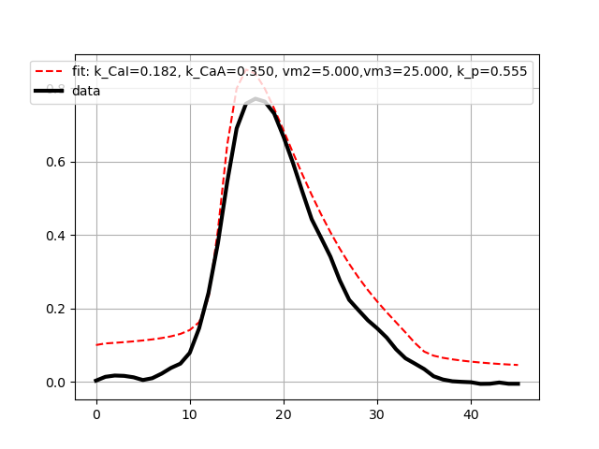
Looking at single peaks
vm2 = 15
vm3 = 40
k_CaA = 0.15
k_CaI = 0.15
k_p = 0.3
vm2 = 5
vm3 = 25
k_CaA = 0.35
k_CaI = 0.18
k_p = 0.55
What can we learn?

Slide 10
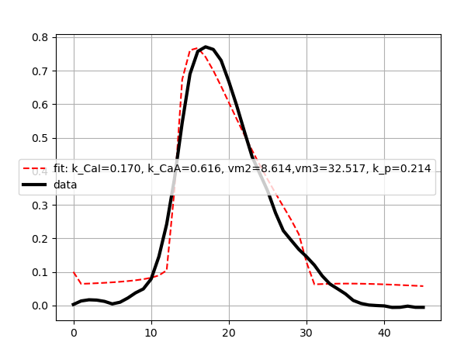
Looking at single peaks
Increasing parameter space:
vm2 = 8.6
vm3 = 32.5
k_CaA = 0.61
k_CaI = 0.17
k_p = 0.21

Slide 11
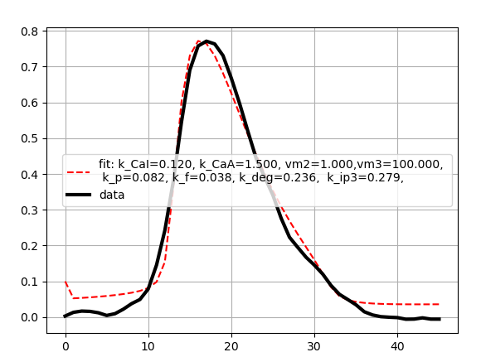
Looking at single peaks
Looking at more parameter:
vm2 = 1
vm3 = 100
k_CaA = 1.5
k_CaI = 0.12
k_p = 0.08

Slide 12
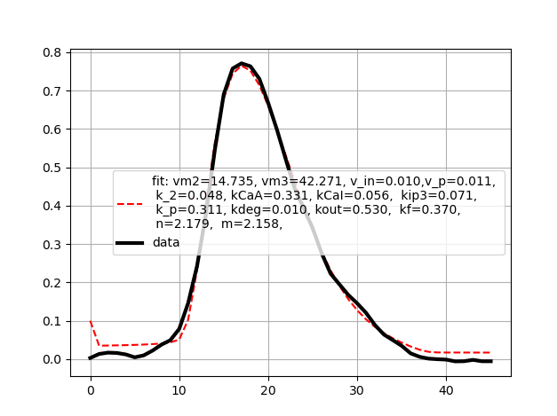
Looking at single peaks
Looking at all the parameters:
vm2 = 15 => 14.7
vm3 = 40 => 42.2
v_in = 0.05 => 0.1
v_p = 0.05 => 0.01
k_2 = 0.1 => 0.04
k_CaA = 0.15 => 0.33
k_CaI = 0.15 => 0.05
k_ip3 = 0.1 => 0.07
k_p = 0.3 => 0.31
k_deg = 0.08 => 0.01
k_out = 0.5 => 0.53
k_f = 0.5 => 0.37
n = 2.02 => 2.18
m = 2.2 => 2.15
vm2 = 14.7
vm3 = 42.2
k_CaA = 0.3
k_CaI = 0.56
k_p = 0.3

Slide 13
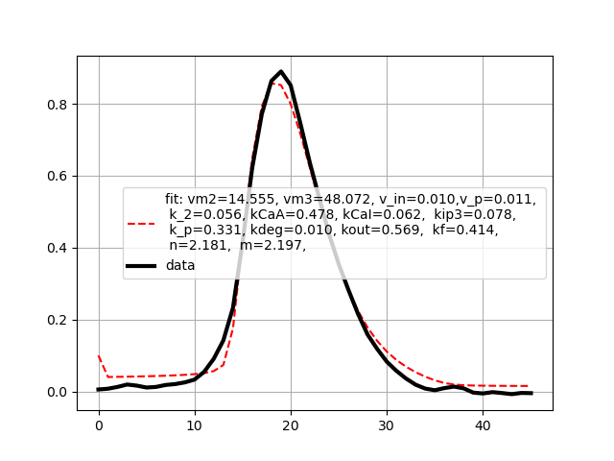
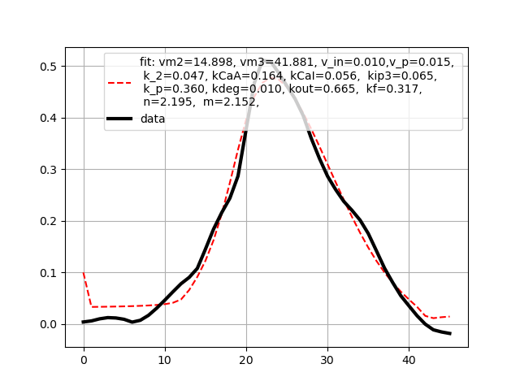
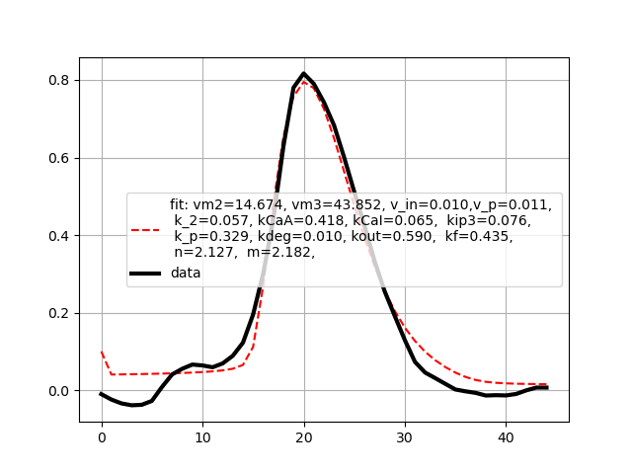
Other peaks

Slide 14
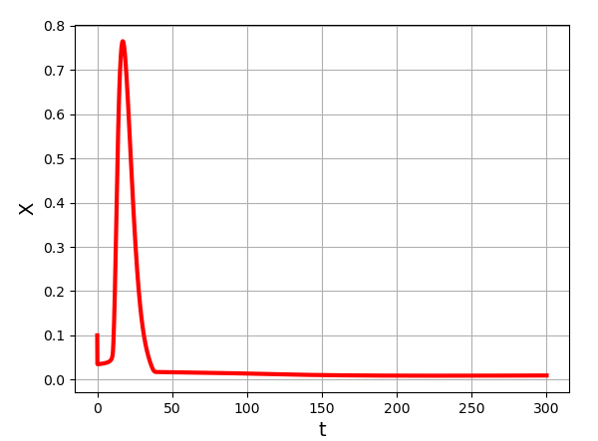
Looking at single peaks
HOWEVER;
vm2 = 15 => 14.7
vm3 = 40 => 42.2
v_in = 0.05 => 0.1
v_p = 0.05 => 0.01
k_2 = 0.1 => 0.04
k_CaA = 0.15 => 0.33
k_CaI = 0.15 => 0.05
k_ip3 = 0.1 => 0.07
k_p = 0.3 => 0.31
k_deg = 0.08 => 0.01
k_out = 0.5 => 0.53
k_f = 0.5 => 0.37
n = 2.02 => 2.18
m = 2.2 => 2.15
simulation
data

Slide 15
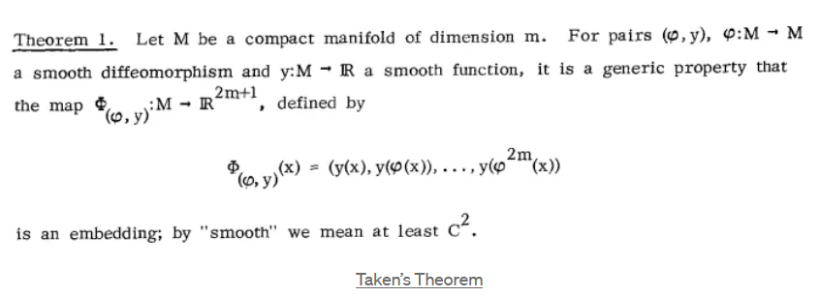
Using Taken’s Embedding

Slide 16
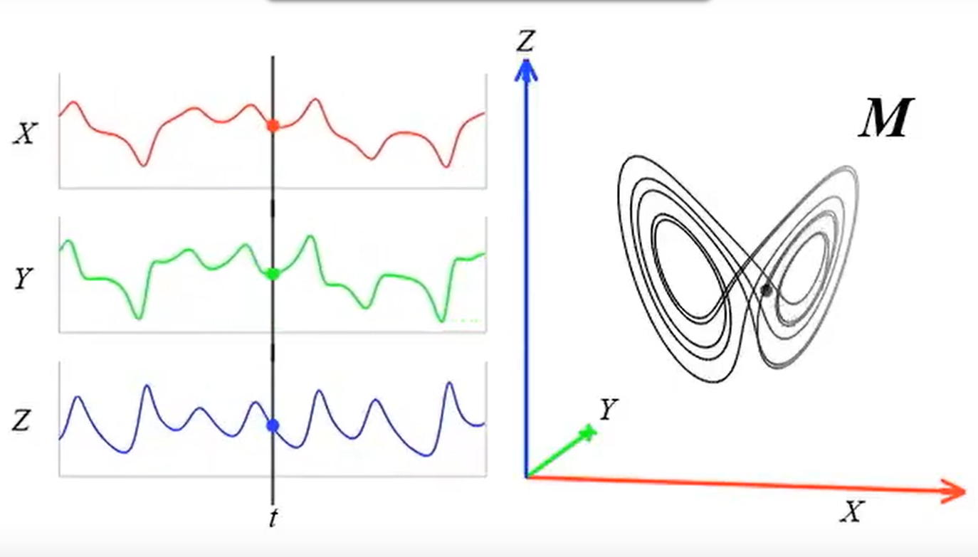
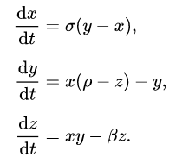
Using Taken’s Embedding
An example:
Lorentz System
Solution
Phase space
Images are taken from https://www.youtube.com/watch?v=6i57udsPKms

Slide 17
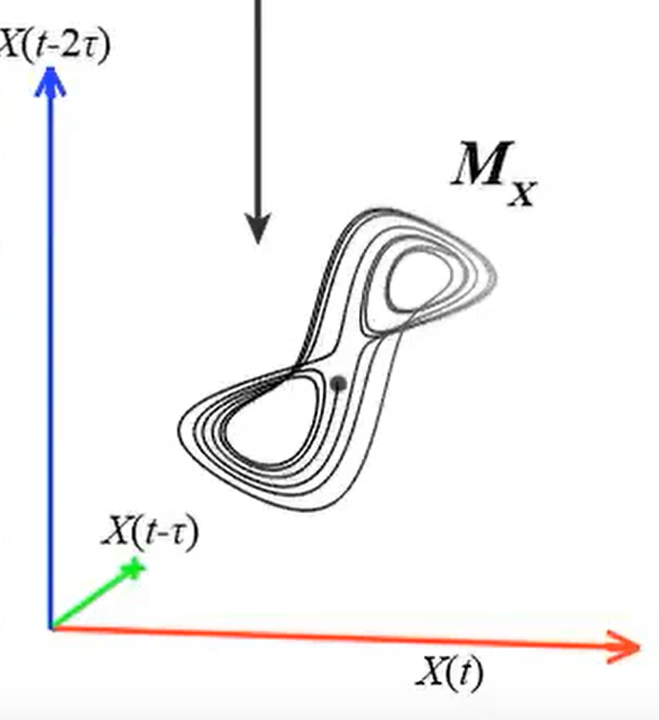
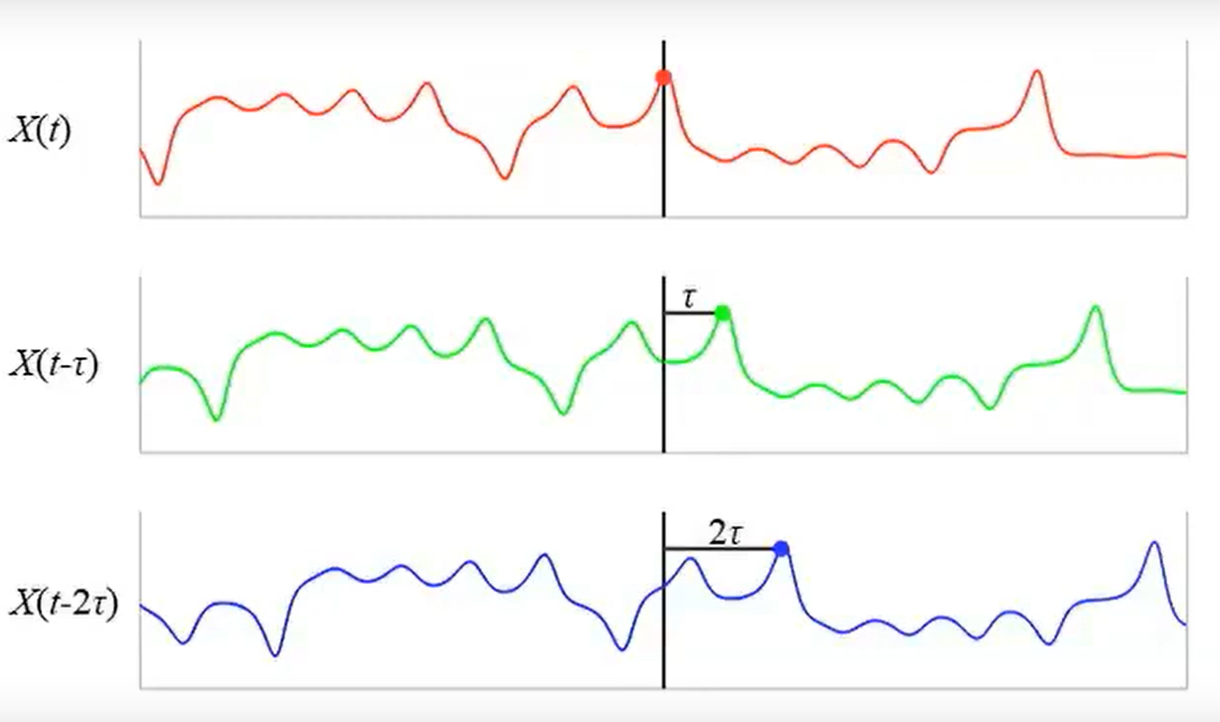
Using Taken’s Embedding
An example:
We have X(t) as a time series
Using Taken’s Theorem
Construct Phase space
Images are taken from https://www.youtube.com/watch?v=6i57udsPKms

Slide 18
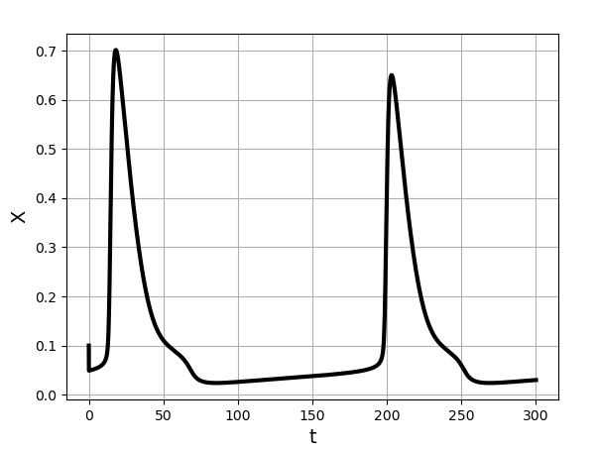
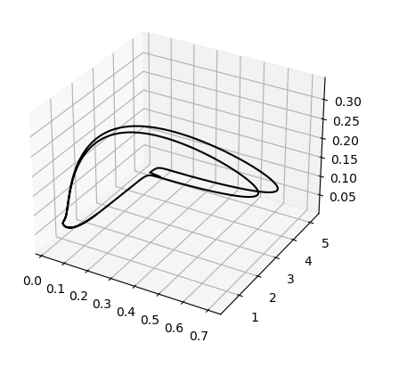
Using Taken’s Embedding
In our case:
Mathematical Model
Solutions
Phase space

Slide 19
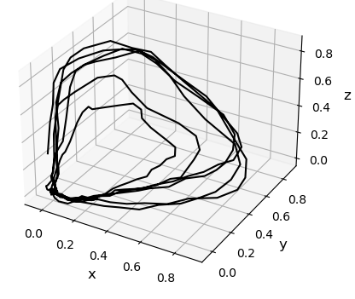
Using Taken’s Embedding
In our case:
Applying Taken’s theorem
Data X(t) is a time series
Constructed Phase space

Slide 20
Then, we can write down a cost function that measures the difference between the two, and minimize it.

Slide 21
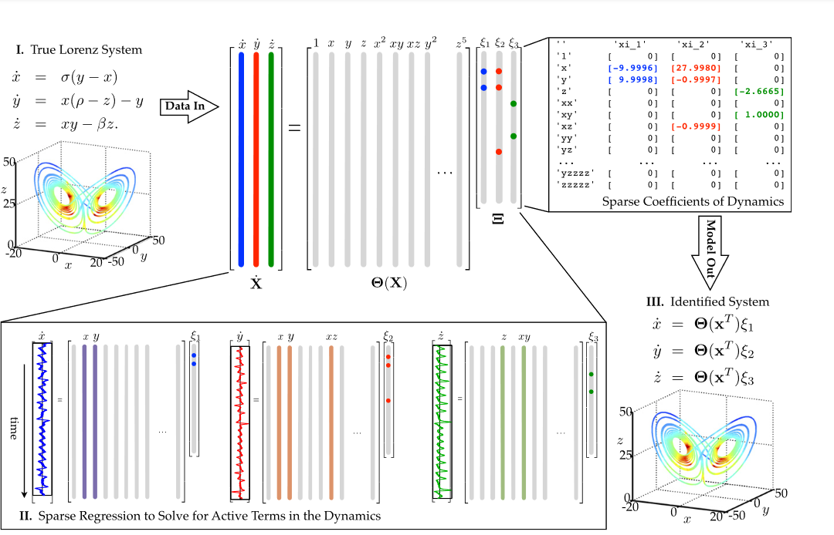
What else can be done?
Brunton, S. L., Proctor, J. L., & Kutz, J. N. (2016). Discovering governing equations from data by sparse identification of nonlinear dynamical systems. Proceedings of the National Academy of Sciences, 113(15), 3932–3937. doi:10.1073/pnas.1517384113

Slide 22
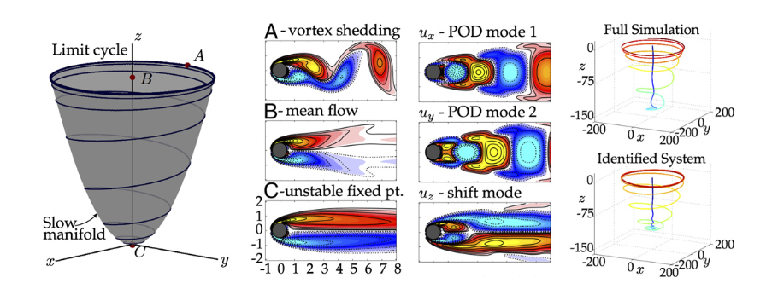
What else can be done?

Slide 23
Conclusion
Fitting single peaks potentially gives some idea but we may need a better approach
Taken’s Embedding + Optimization to find the parameters
Takens Embedding + sparse identification to find which terms are active in governing ODEs

Slide 24
Thank you!

