Slide 1

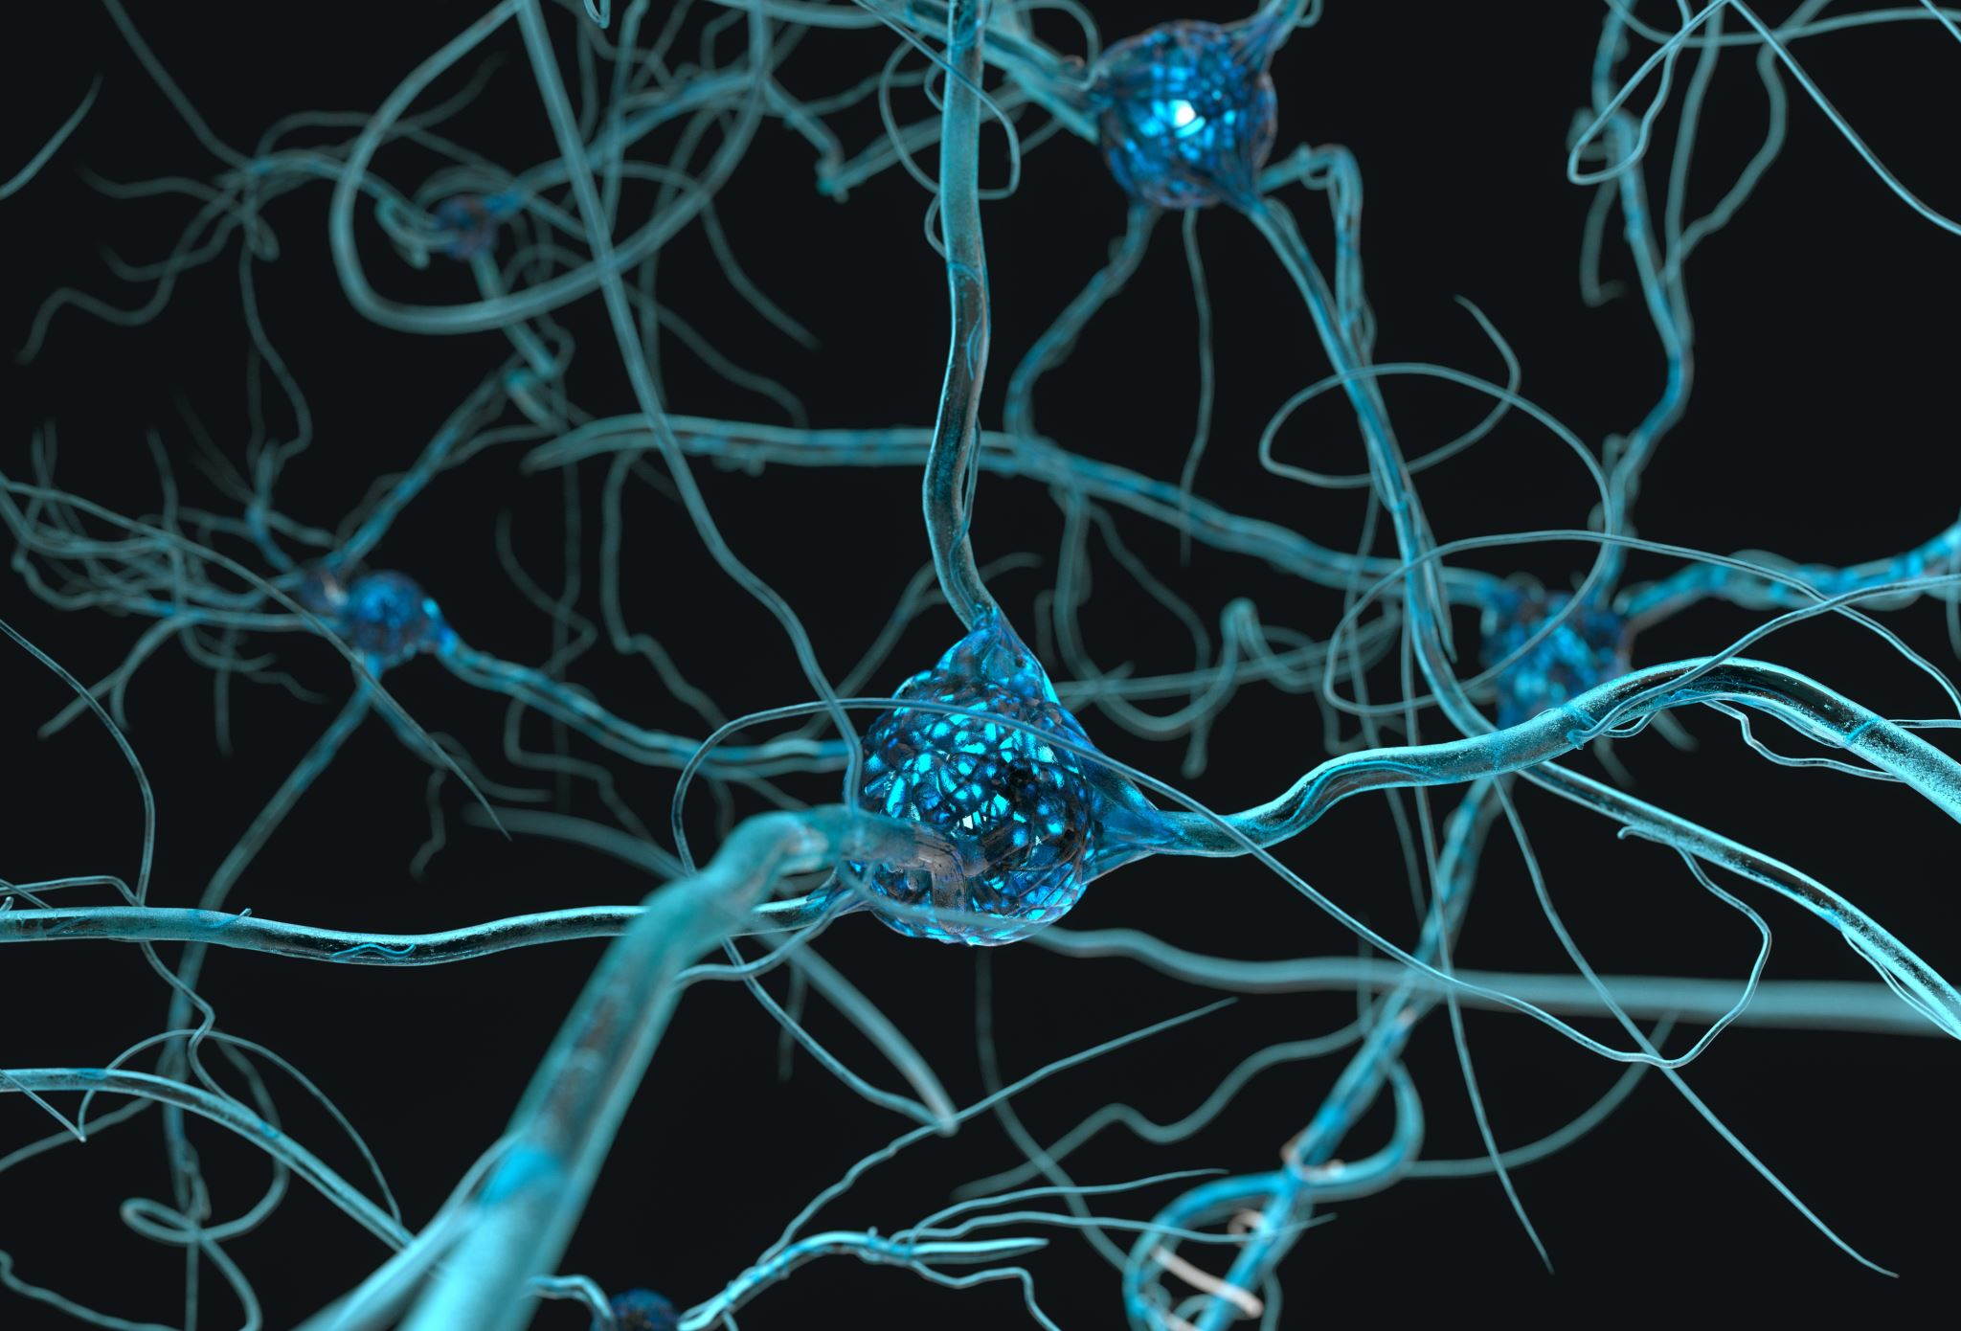
Understanding Astrocytes using calcium (II) oscillation measurements
Lavrentovich & Hemkin Model*
By Ekrem Demirboga
PHYS798N: NeurophysIcs
*Lavrentovich M, Hemkin S. A mathematical model of spontaneous calcium(II) oscillations in astrocytes. J Theor Biol. 2008 Apr 21;251(4):553-60. doi: 10.1016/j.jtbi.2007.12.011. Epub 2008 Feb 14. Erratum in: J Theor Biol. 2009 Sep 21;260(2):332. PMID: 18275973.

Slide 2

Outline
Spontaneous oscillations in Astrocytes
Data and Model
How to fit?
Future direction
Conclusion

Slide 3

Spontaneous oscillations in Astrocytes
Brief Overview:
Astrocytes: Often overlooked, but crucial support cells in the brain.
Spontaneous Oscillations: Intriguing rhythmic patterns in astrocyte activity [1].
Understanding astrocytic oscillations can unravel mysteries surrounding neural network behavior and information processing in the brain.
[1] Parri, H., Gould, T. & Crunelli, V. Spontaneous astrocytic Ca²⁺ oscillations in situ drive NMDAR-mediated neuronal excitation. Nat Neurosci 4, 803–812 (2001). https://doi.org/10.1038/90507

Slide 4
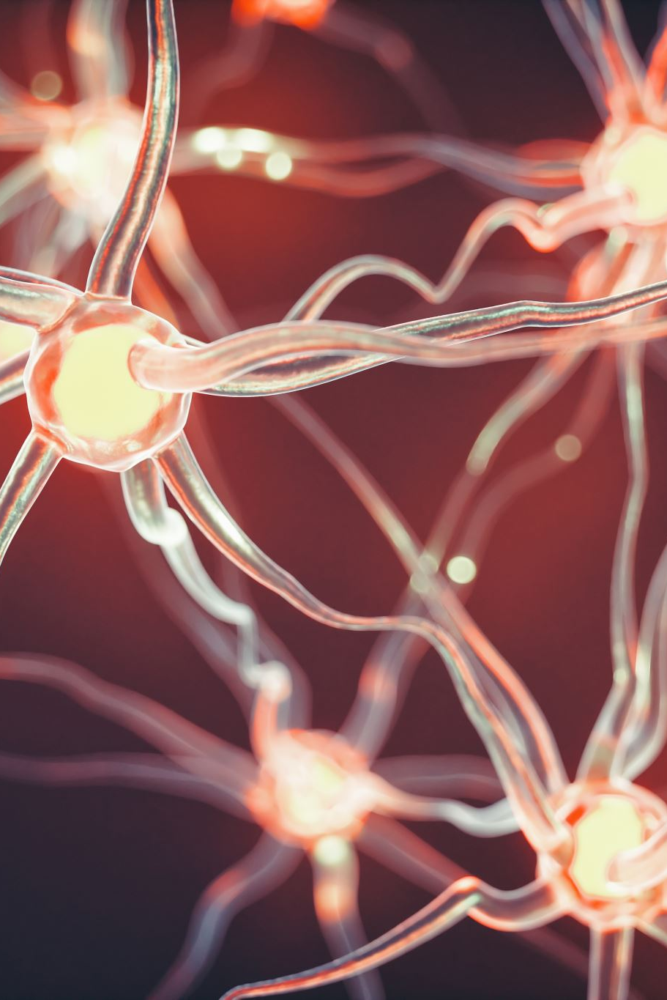
Spontaneous oscillations in Astrocytes
Significance:
Regulatory role in brain homeostasis.
Implications for information processing and network function.

Slide 5
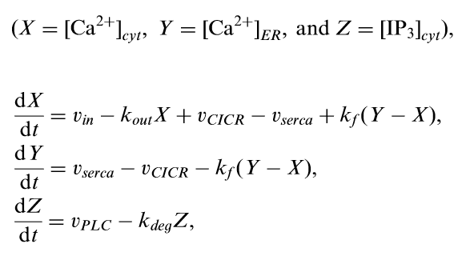
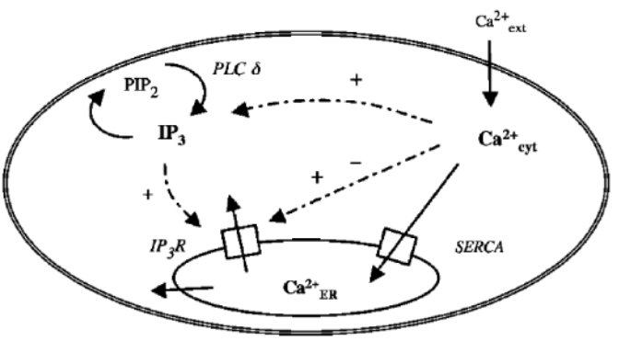
Data and Model

Slide 6
Data and Model

Slide 7
How to fit?
We have two options:
1- Looking at single peaks
2- Using Taken’s Embedding

Slide 8
Looking at single peaks

Slide 9
Using Taken’s Embedding

Slide 10
Future implementations
Kuntz Paper

Slide 11
Conclusion

Slide 12
Thank you!

