Slide 1

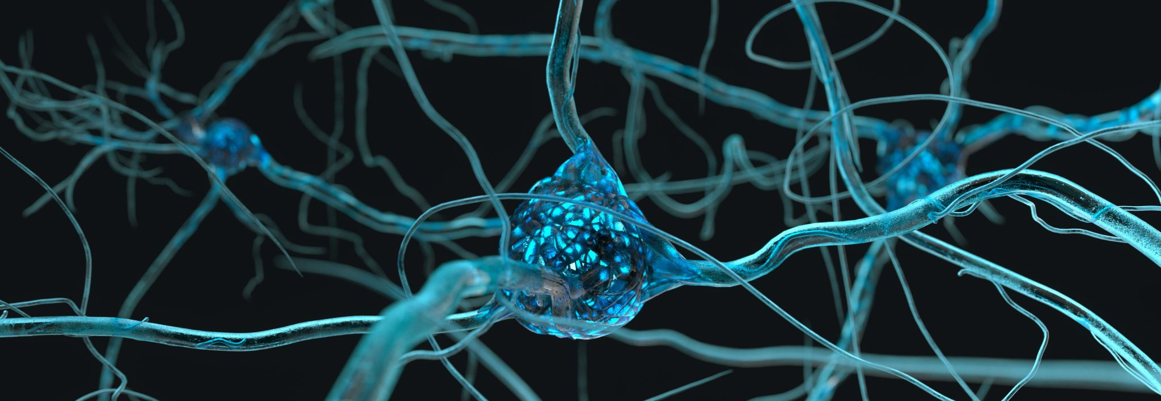

Understanding Astrocytes using calcium (II) oscillation measurements
Lavrentovich & Hemkin Model
By Ekrem Demirboga
PHYS798N: NeurophysIcs

