Slide 1
Finite Element Modelling of Gyroid-based Honeycomb

Slide 2
Aims and Objectives
Complete Finite Element analysis of proposed gyroid geometry will be performed.
Open-source tools are exploited.
Finite Element framework is established for analysing
displacement and stress fields.
Open-source frameworks are indispensable tools to handle state of the art geometries for FE modelling.
This statement wanted to be proven in this study.

Slide 3
Flowchart
Geometry Generation
Mesh Generation
Definition of Boundary Conditions
Finite Element Analysis
Visualization

Slide 4
Flowchart - Tools
Geometry Generation
Python & FreeCAD
Mesh Generation
GMSH
Definition of Boundary Conditions
DOLFINX
Finite Element Analysis
DOLFINX
Visualization
Paraview

Slide 5
Geometry Generation
Here are the steps;
Python script generates points.
Reading these points from txt file and import them into FreeCAD.
Manipulate geometry to get Gyroid-based honeycomb.
The process is fully automated.

Slide 6
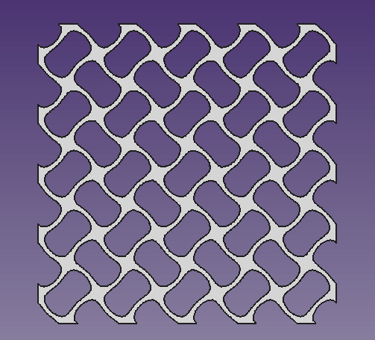
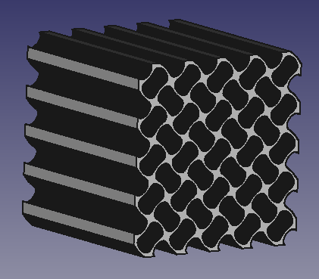
Geometry Generation
50mm
50mm

Slide 7
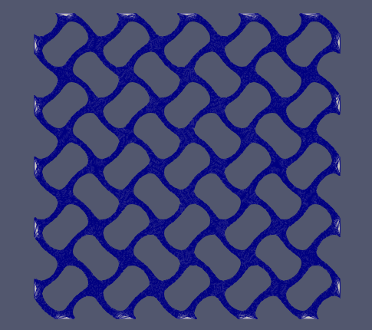
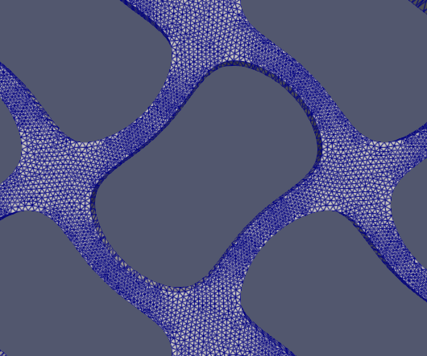
Mesh Generation
Around ~667k cells

Slide 8
Definition of Boundary Conditions
Rest of the boundaries;
Traction-Free
Displacement
boundary condition
Fixed Boundary

Slide 9
Finite Element Analysis
Dolfinx Framework has been used.
https://github.com/FEniCS/dolfinx
Linear Elasticity equations are solved.
Python interface has been utilized.

Slide 10
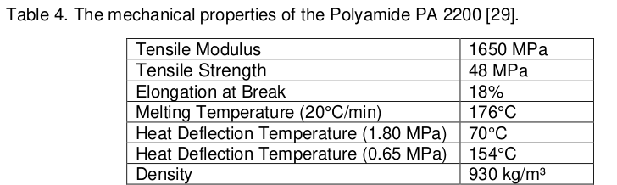
Material Properties

Slide 11
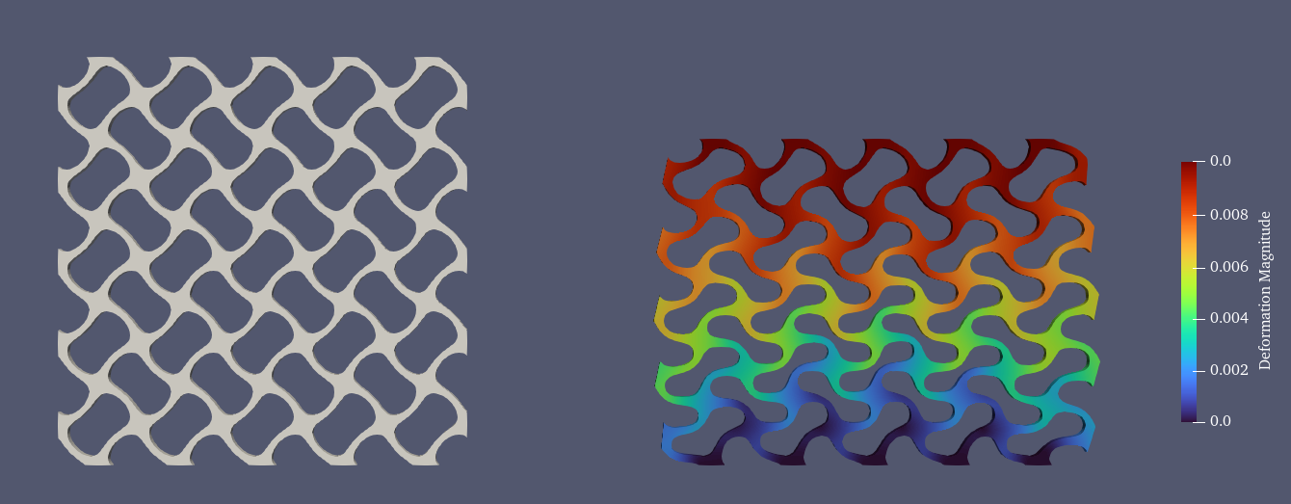
Visualization – Displacement Field
We are imposing y=-0.01m displacement from top boundary
(Compression Test)

Slide 12
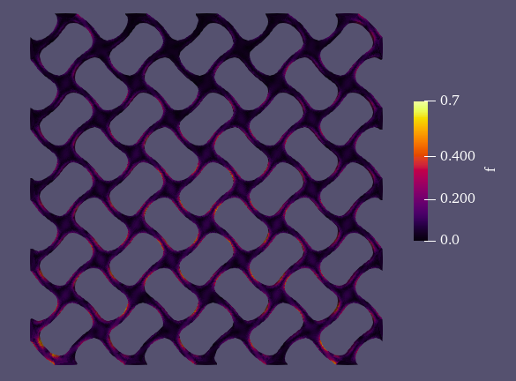
Visualization – Von Mises Stresses

Slide 13
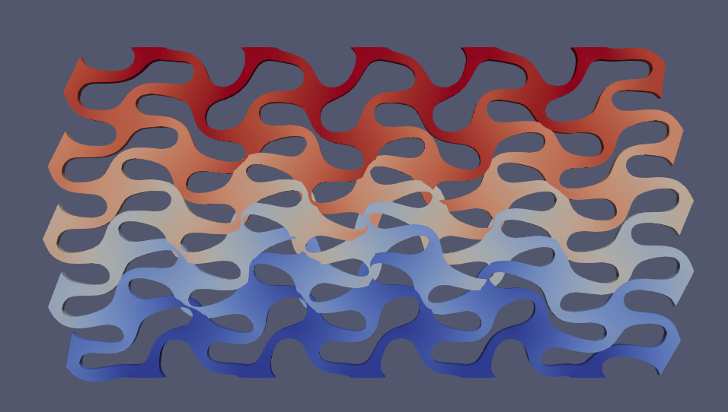
Issue - Overlapping
When displacement of the top boundary exceeds y = -0.02m, the mesh overlaps.
Contacts between internal boundaries should be defined to avoid overlapping.
Possible solutions;
1) This problem can be treated as postprocessing problem.
As we now the displacements of the each node in the mesh, we can manipulate the coordinates accordingly.
At the moment, this is not implemented in Dolfinx,
But we can implement -> it will take some time for sure (it is already ongoing PostDoc project of friend of mine).

Slide 14
Conclusion
Framework of Finite Element Analysis for Gyroid-based honeycomb geometry is established.
Material parameters are not well-defined yet, but easily doable.
More complex structures (graded, periodic) can be implemented using Python scripts.

