Slide 1
AutoML FInal Project
Summer semester ‘19
Ekrem Öztürk

Slide 2
MotIvatIon
Aim: Over %90 classification accuracy on K49 dataset.
Path: Find a well performing neural architecture and hyperparameter setting.
Method to achieve: Neural architecture search and hyperparameter optimization.
Problems
Search spaces for NAS and HPO are infinitely large. Finding a good configuration might take a lot of time.
Search needs a lot of design decisions and requires a lot of expertise.
Overall, humans are not cut out for this task.
Solution: Use your machine learning expertise to automize both NAS and HPO and also to define appropriate search spaces for both.

Slide 3
Methods and Results – DARTS*
Operations in the search space
skip connection
max pooling
average pooling
convolution
separable convolution
dilated convolution
Default HP setting of DARTS is used, which is optimized for CIFAR-10.
NAS done on KMNIST, and then final architecture is transferred to final training.
With training on KMNIST, %337 speedup achieved with training (2.30 vs 0.68 GPU-hours).
Cells
Normal:
Reduction:
* https://arxiv.org/abs/1806.09055

Slide 4
Methods and Results – BOHB*
Hyperparameters
optimizer categorical {adam, sgd} [adam]
learning rate float [10⁻⁴, 10⁻¹] [10⁻²] log
weight decay float [10⁻⁵, 10⁻¹] [10⁻³] log
weight decay bool categorical {true, false} [false]
sgd momentum float [0.2, 0.99] [0.9]
num of cells integer [1, 7] [1]
init channels integer [4, 32] [4] log
drop path probability float [0.0, 0.4] [0.2]
num of hidden layers integer [1, 3] [1]
num of hidden units integer [32, 256] [256] log
dropout ratio float [0.0, 0.6] [0.2]
Conditions:
weight decay | weight decay bool in {true}
sgd momentum | optimizer in {sgd}
Warmstarting:
2/3 of total iterations is done on KMNIST, then BOHB is restarted with its result for 1/3 of total iterations on K49. Resulting best configuration is passed to final training.
Standard vs warmstart
*https://arxiv.org/abs/1807.01774

Slide 5
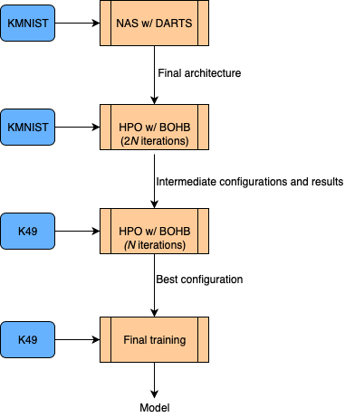
FInal Results
Unfortunately, only 1 NAS-HPO run, not reliable, not reproducible.
GPU time: 22.2 hours on Nvidia Titan Black GPU
Test score: Mean = %94.97, Std. dev. = 0.83

