Slide 1
Handwritten Digit Recognition with CNN models

Slide 2
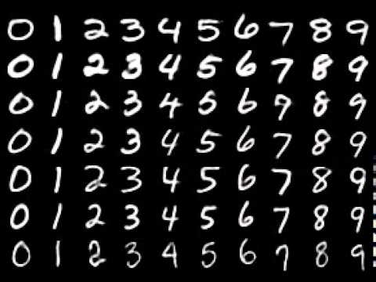
MNIST

Slide 3
Implementation
Convolutional neural network
Data augmentation
Loss function
Optimizer

Slide 4
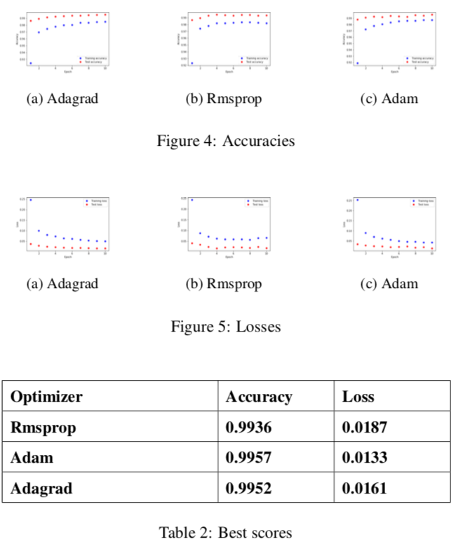
Evaluation
Optimizers

Slide 5
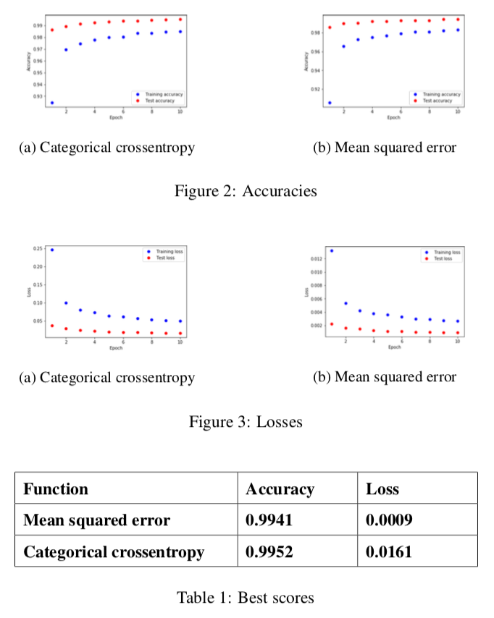
Evaluation
Loss functıons

Slide 6
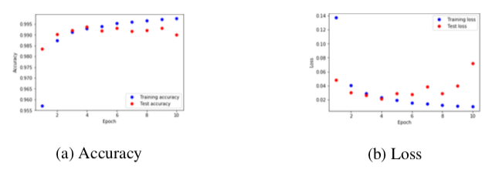
Evaluation
Preventing overfıttıng

Slide 7
References
https://beamandrew.github.io/deeplearning/2017/02/23/ deep_learning_101_part1.html
http://yann.lecun.com/exdb/mnist/
https://www.tensorflow.org
http://www.wikizero.org/index.php?q=aHR0cHM6Ly9lbi53aWtpcGVkaWEub3
http://ruder.io/optimizing-gradient-descent/
https://datascience.stackexchange.com/questions/9302/ the-cross-entropy-error-function-in-neural-networks
https://www.udemy.com/deeplearning/

