Slide 1

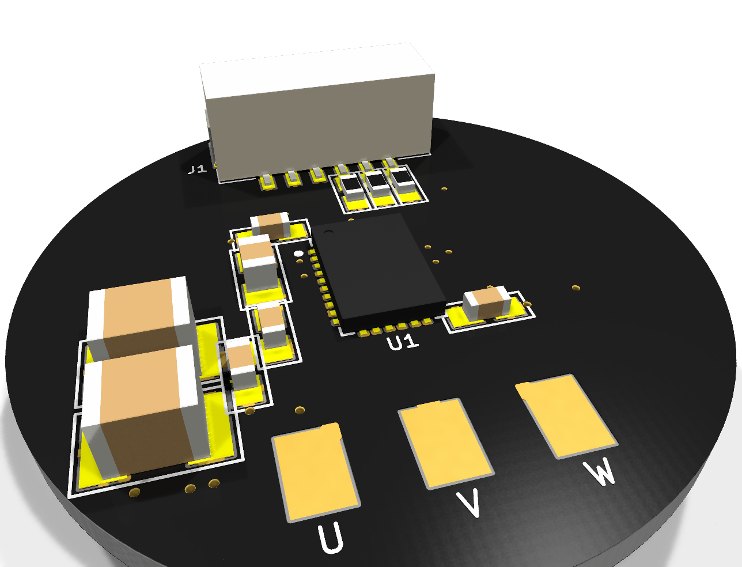
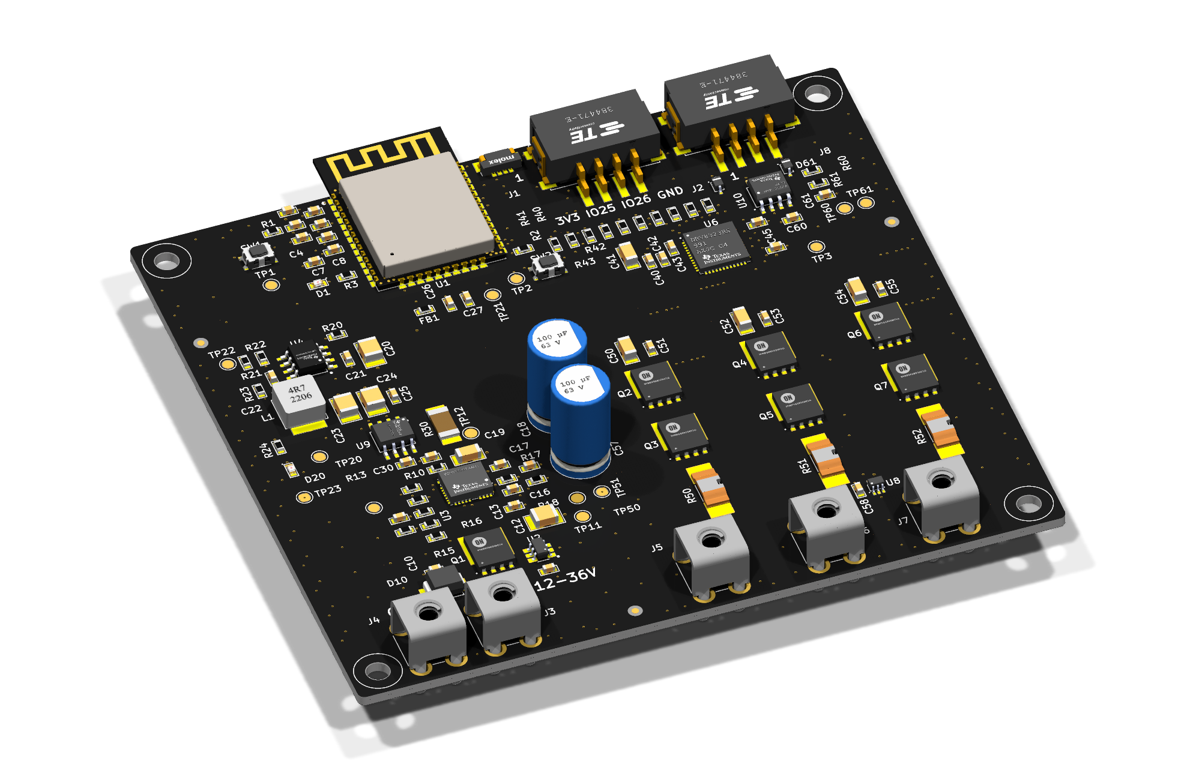
PCB Design Experiments with Claude
Ekrem Turan Fırat
09/2026

Slide 2
Contents
Logic of PCB Design with Claude
  Claude Desktop and KiCad Integration
  How the Workflow Runs
Mini Motor Driver(First Design Attempt)
  Prompt and General Infos
  Schematic Design
  PCB Design
  Claude’s Cost
Design Ruleset
  Schematic
  Fab and PCB
ESP32 ESC (Second Design Attempt)
  Prompt and General Infos
  Schematic Design
  PCB Design
  PCB Design Tools
  Library PR
  Claude’s Cost
Attempt 1 vs Attempt 2
  Attempt 1 vs Attempt 2

Slide 3
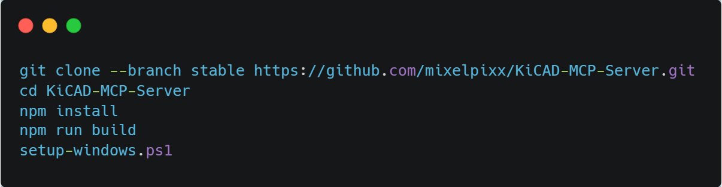
1.1 Claude Desktop and KiCad Integration
KiCad MCP ( github.com/mixelpixx/KiCAD-MCP-Server )
  KiCad 9.0+
  Node.js 18+
  Python 3.11+
3

Slide 4
1.2 How the Workflow Runs
Engineer
Requirements prompt + lab design ruleset
Claude
Researches parts, does datasheet math, writes build scripts
Tool layer
KiCad MCP server, kicad-cli, KiCad Python API, Freerouting
KiCad project
Schematic, PCB, libraries and fab outputs
ERC / DRC reports, netlist checks and 3D renders go back to Claude, which fixes and re-checks until clean
4

Slide 5
2.1 First Design Attempt (Mini Motor Driver)
Prompt: “We want to create a coin-sized 3-phase motor driver, speed must be controlled using a single signal. The driver’s IC must be all-in-one(control + gate driver + MCU).”
Components
  IC: MCF8315C
  Connectors: JST GH 6-pin, Hirose DF65 3-pin
  Libraries: symbols, footprints and 3D models generated from scratch by Claude's scripts
  github.com/odtu/MiniMotorWithIntegratedDriver
5

Slide 6
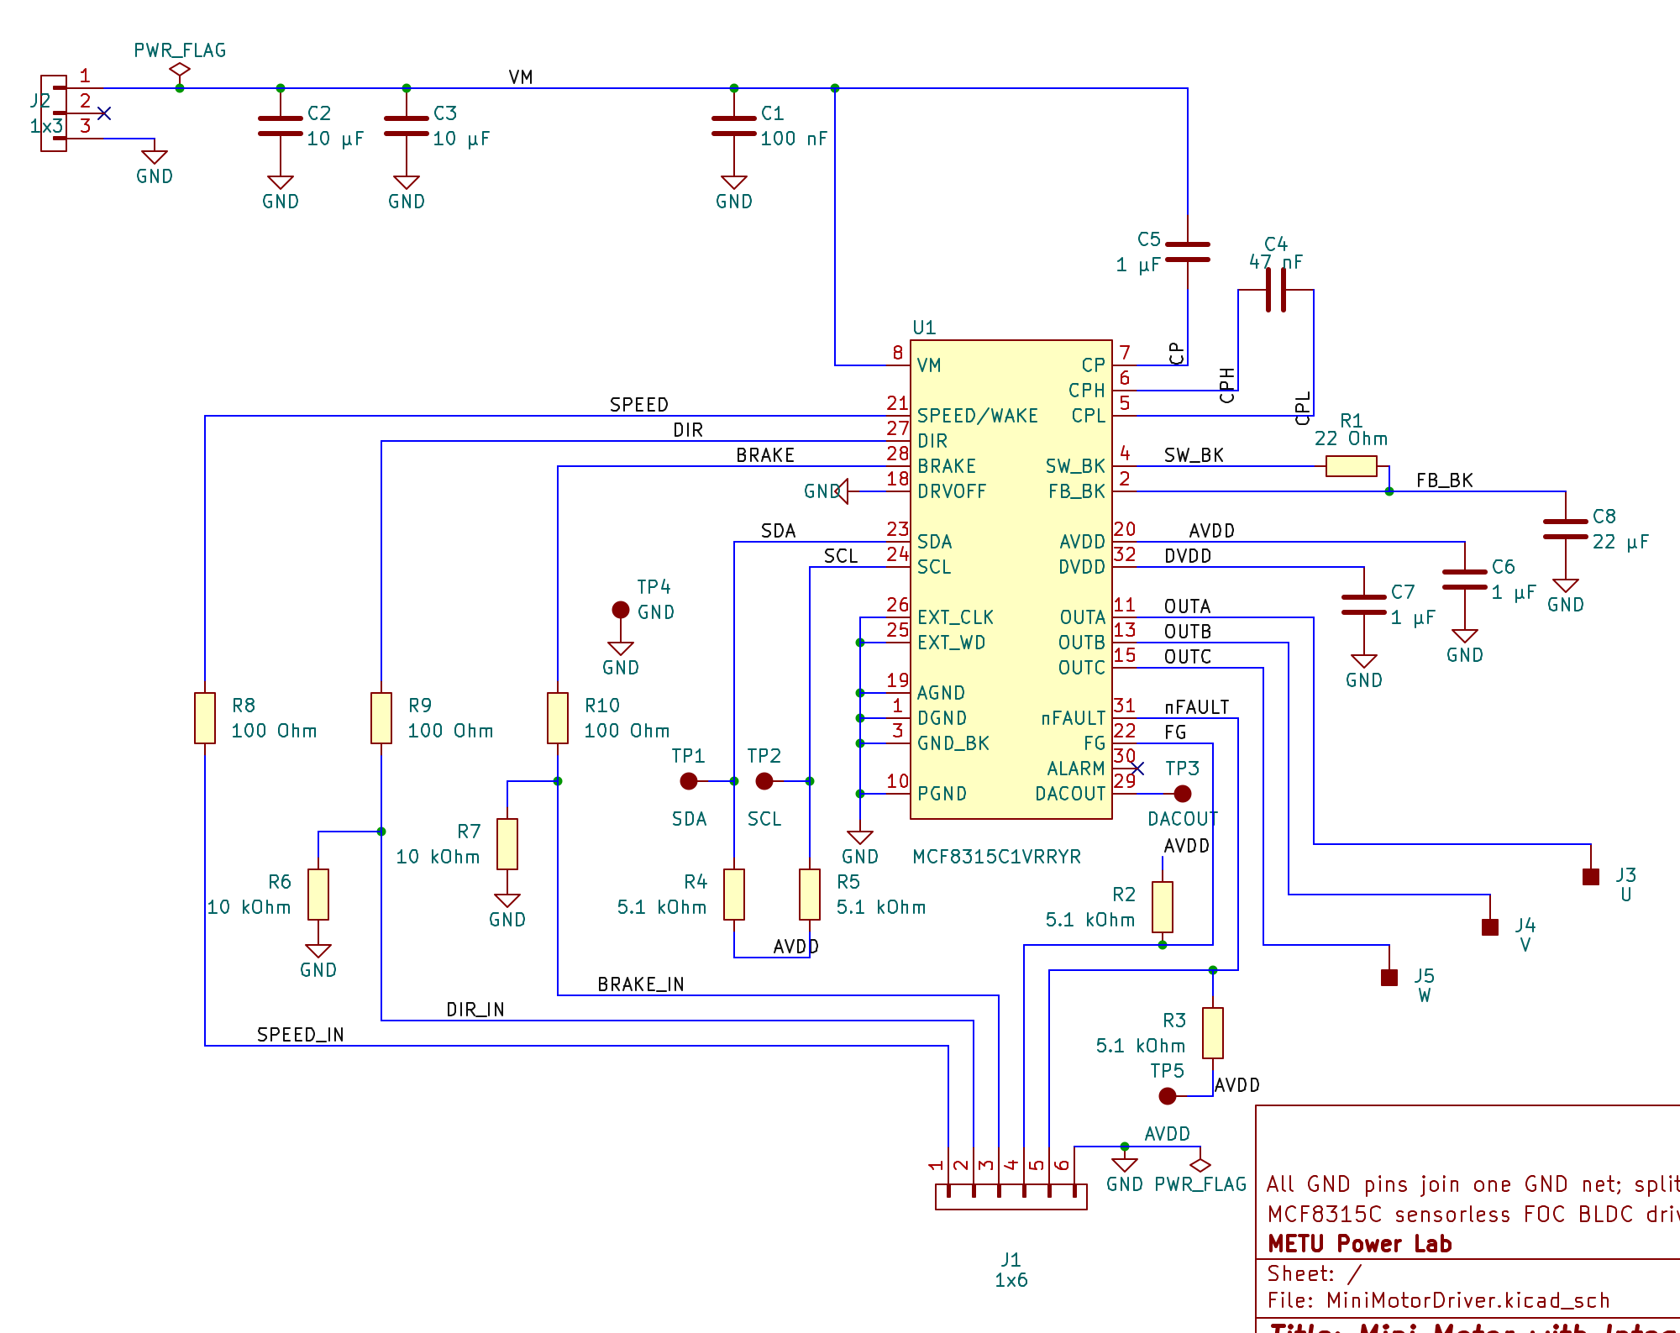
2.2 Schematic Design
U1 MCF8315C: sensorless FOC BLDC driver, control and power stage in one IC
J2 (Hirose DF65, 3-pin): supply input with bulk and bypass caps
J1 (JST GH, 6-pin): speed, direction and brake inputs
U / V / W pads to the motor, test pads TP1–TP5
One A4 sheet, cropped here to the circuit
6

Slide 7
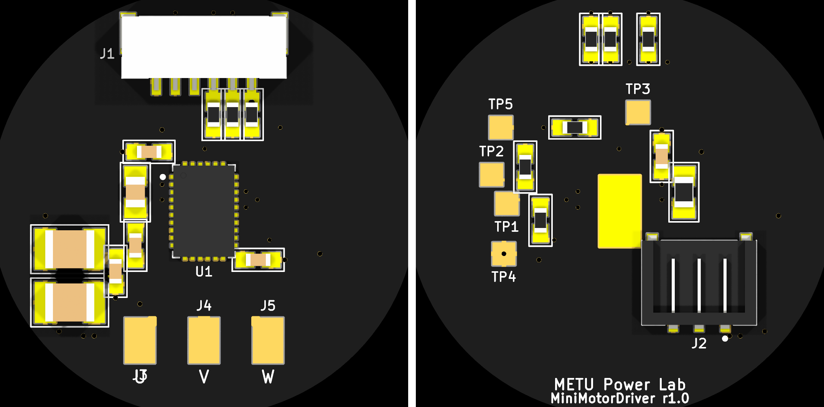
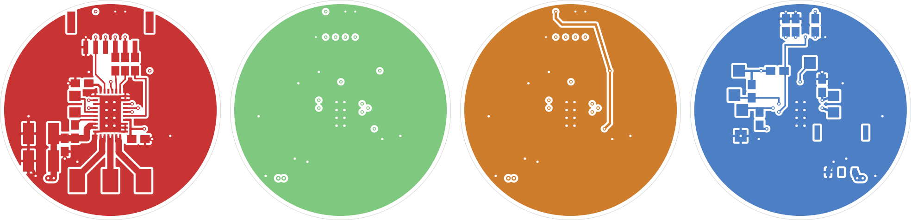
2.3 PCB Design
Top
Bottom
Ø28 mm, 4-layer board
DRC: 0 errors, 28 silkscreen warnings
Top
Bottom
7

Slide 8
2.4 Claude’s Cost
$77
total cost at API rates
154.2 M
tokens processed
96.7 %
of all tokens were cache reads ($0.20 / 1M); they make up 39 % of the cost
8

Slide 9
3.1 Design Ruleset – Schematic
Schematic Rules
  Page setup and title block
  Sheet structure
  Components: PowerLabKiCadLibraries only
  Wiring
  Net naming and power symbols
  Net classes and power-net styling
  Layout notes on the schematic
  Clean text
github.com/odtu/Powerlab/blob/master/KiCAD/PCB_DESIGN_RULES.md
9

Slide 10
3.2 Design Ruleset – PCB
Fab limits and DRC values (PCBWay)
PCB layout rules
  Board setup, outline and fixed parts
  Placement
  Routing
  Vias
  Copper pours
  Silkscreen and board information
github.com/odtu/Powerlab/blob/master/KiCAD/PCB_DESIGN_RULES.md
10

Slide 11
4.1 Second Design Attempt (ESP32 ESC)
Prompt: “I want to create a 3-Phase ESC with ESP32-Wroom. Input voltage range must be 12-36V and continuous phase current is 5-10A. Make PCB design according to ruleset.”
Input & protection
TVS, LM74700 reverse polarity, TPS16890 eFuse
DC-bus sensing
5 mΩ shunt + INA240A1
Power stage
3 half bridges, 80 V MOSFETs
Motor
Phases A / B / C
gates
CAN + UART
SN65HVD230 transceiver
ESP32-WROOM-32E
PWM, ADC, SPI, CAN
PWM
Gate driver
DRV8323RS + current-sense amps
3.3 V supply
LMR38020 buck from the bus
github.com/ekremturanfirat/ClaudeTestPCB
11

Slide 12
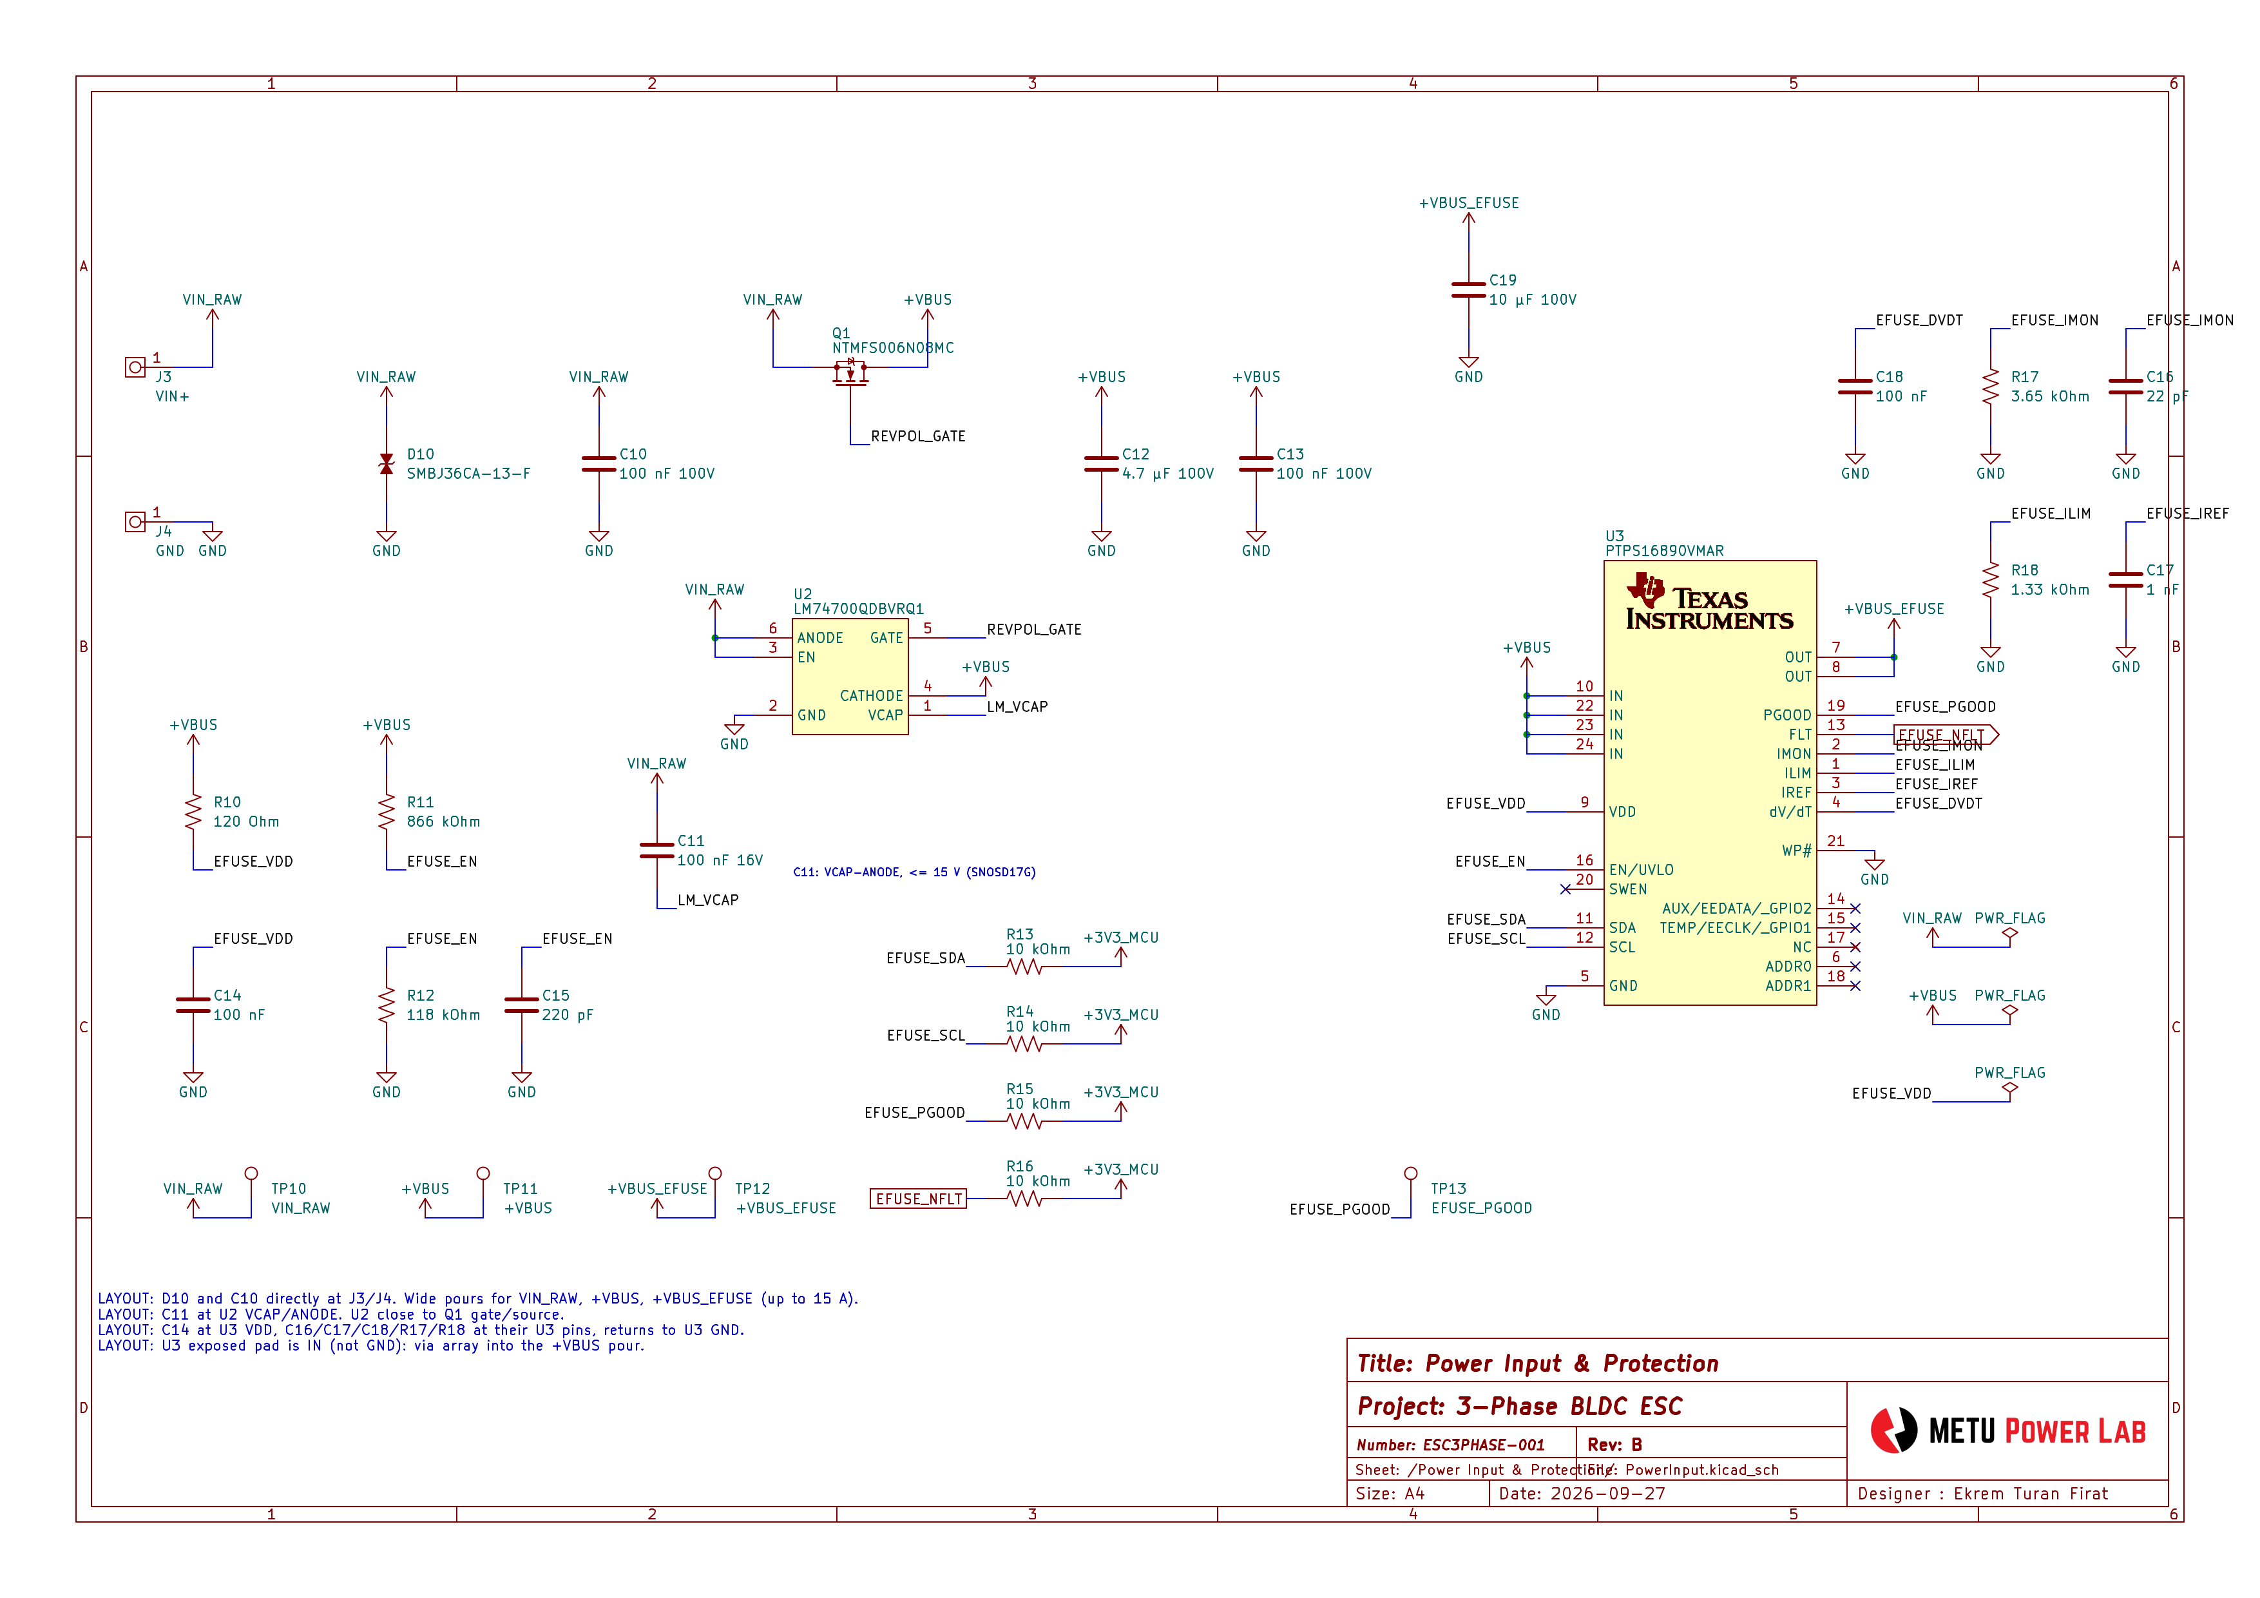
4.2 Schematic Design
11 hierarchical sheets
Overview (root)
Power input & protection
3.3 V power supply
DC-bus current sensing
MCU core (ESP32)
Gate drive (DRV8323RS)
Power stage
Half bridge A / B / C (one sheet, used 3×)
Communication (CAN)
Checks
ERC: 0 errors
Netlist check: 79 nets, 0 shorts, 0 opens
12

Slide 13
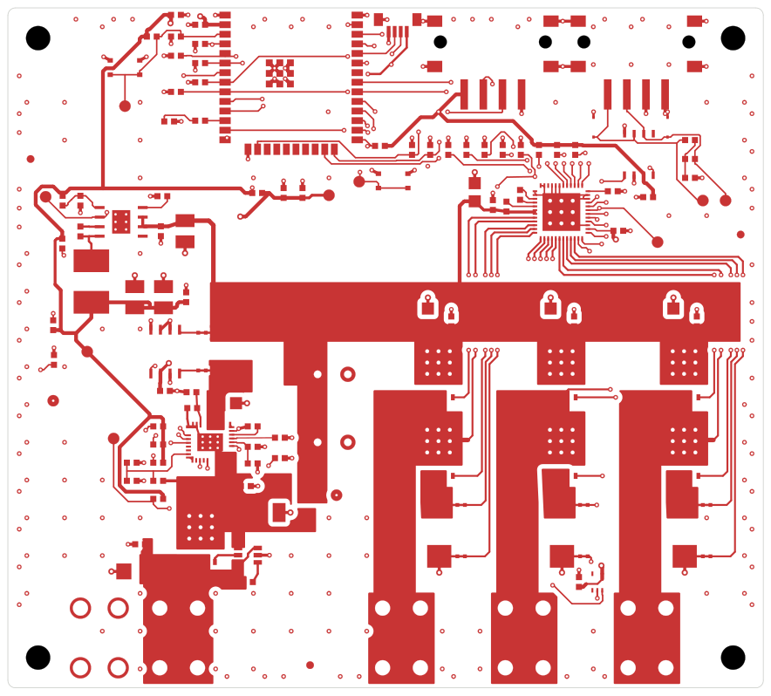
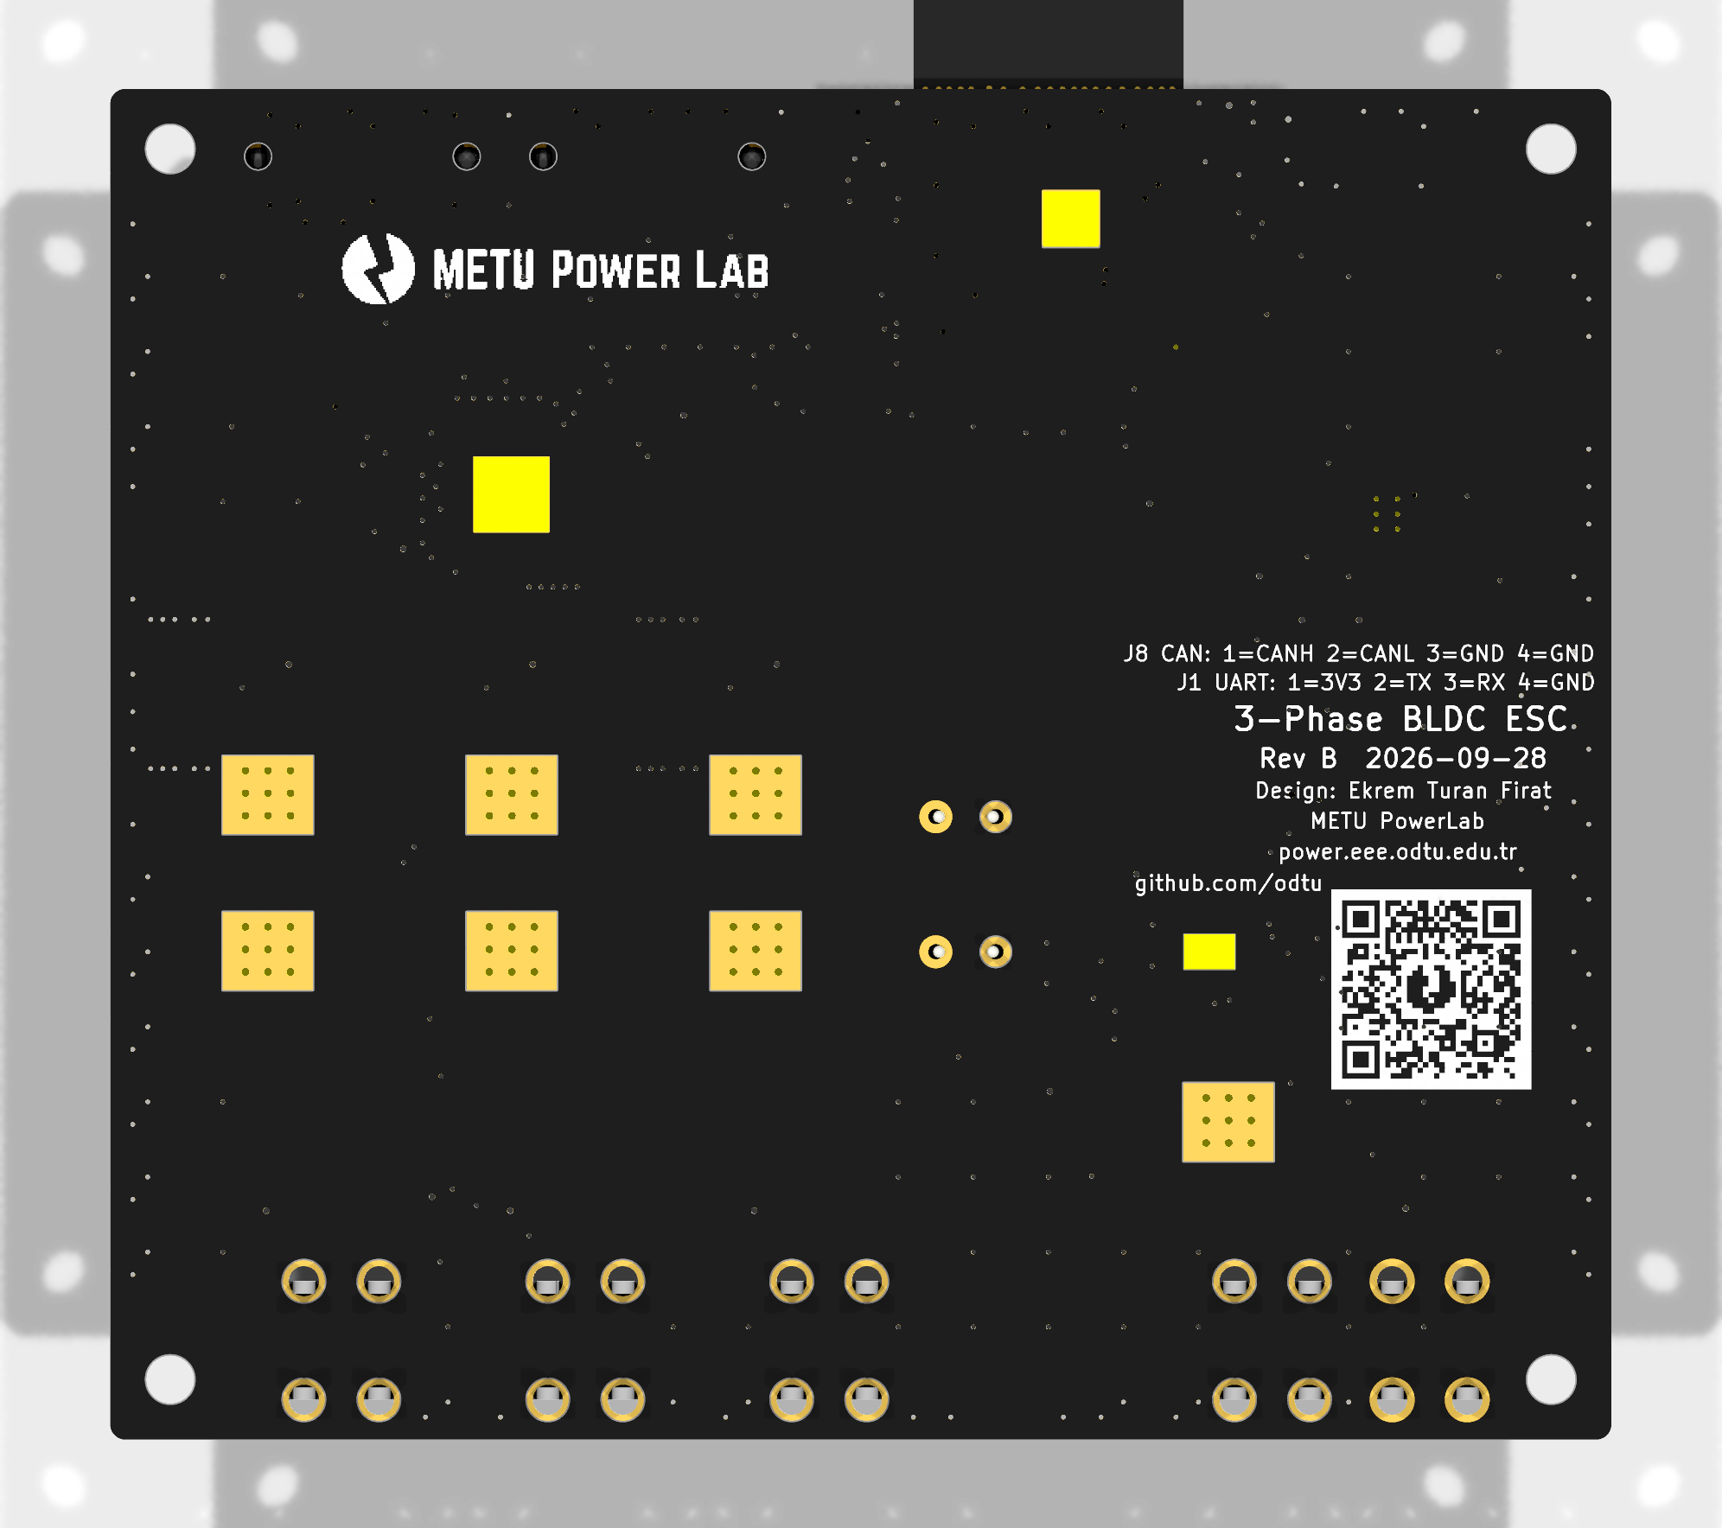
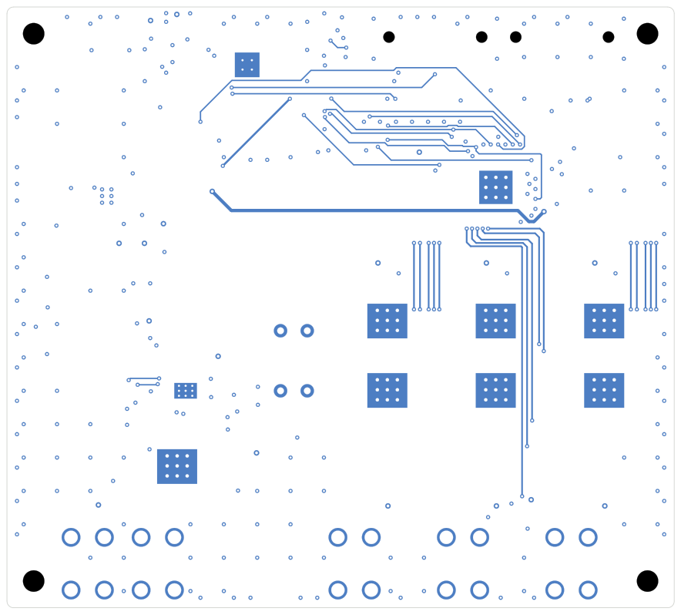
4.3 PCB Design
100 × 90 mm, 4-layer board
DRC: 0 errors, 2 silkscreen warnings
13

Slide 14
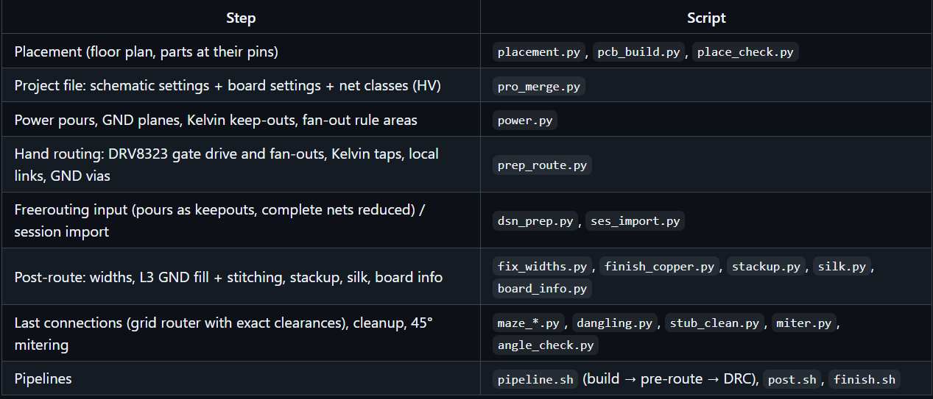
4.4 PCB Design Tools
Freerouting 2.4.1
Java 25
github.com/ekremturanfirat/ClaudeTestPCB/tree/main/hardware/tools/pcb
14

Slide 15
4.5 Library Contributions
Parts that were missing or wrong in PowerLabKiCadLibraries were fixed at the source during the ESC work. All three pull requests are merged.
PR #2
New part
ESP32-WROOM-32E symbol and footprint
Needed for the ESC's MCU
PR #3
Additions and fixes
Power symbols, mounting holes, fiducials
Test pads and net ties
ESP32 footprint fix
PR #5
Fixes found during layout
Mask margin 0.1 → 0.05 mm on 0.5 mm-pitch QFNs
Exposed pads and 0.6 mm thermal vias
Logo + QR graphics, ESP32 3D model
merged
merged
merged
github.com/odtu/PowerLabKiCadLibraries
15

Slide 16
4.7 Claude’s Cost
$167
total cost at API rates
540 M
tokens processed
98.6 %
of all tokens were cache reads ($0.20 / 1M); they make up 64 % of the cost
16

Slide 17
5.1 Attempt 1 vs Attempt 2
 | Attempt 1: Mini Motor Driver | Attempt 2: ESP32 ESC
Board | Ø28 mm, 4 layers | 100 × 90 mm, 4 layers
Footprints on board | 29 | 141
Schematic | 1 sheet | 11 sheets (hierarchical)
Lab design ruleset | Not used | Used
DRC result | 0 errors, 28 silkscreen warnings | 0 errors, 2 silkscreen warnings
Design Time | 10 Hours | 10 Hours
Tokens | 154 M | 540 M
Cost at API rates | $77 | $167
17

Slide 18
Thank you
Q/A
github.com/ekremturanfirat/ClaudeTestPCB
github.com/odtu/MiniMotorWithIntegratedDriver

