Slide 1
ML Visuals
By dair.ai
https://github.com/dair-ai/ml-visuals
Notes:
IMPORTANT NOTE: Please don’t request editing permission if you do not plan to add anything to the slides. If you want to edit the slides for your own purposes, just make a copy of the slides.
ML Visuals is a new collaborative effort to help the machine learning community in improving science communication by using more professional, compelling and adequate visuals and figures. You are free to use the visuals in your presentations or blog posts. You don’t need to ask permission to use any of the visuals but it will be nice if you can provide credit to the designer/author (author information found in the slide notes).
This is a project made by the dair.ai community and maintained in this GitHub repo. Our community members will continue to add more common figures and basic elements in upcoming versions. Think of this as free and open artefacts and templates which you can freely and easily download, copy, distribute, reuse and customize to your own needs. I am maintaining this set of slides on a bi-weekly basis where I will regularly organize and keep the slides clean from spam or unfinished content.
Contributing: To add your own custom figures, simply add a new slide and reuse any of the basic visual components (remember to request edit permissions). We encourage authors/designers to add their visuals here and allow others to reuse them. Make sure to include your author information (in the notes section of the slide) so that others can provide the proper credit if they use the visuals elsewhere (e.g. blog/presentations). Add your name and email just in case someone has any questions related to the figures you added. Also, provide a short description of your visual to help the user understand what it is about and how they can use it. If you need "Edit" permission, just click on the "request edit access" option under the "view only" toolbar above or send me an email at ellfae@gmail.com. If you have editing rights, please make sure not to delete any of the work that other authors have added. You can try to improve it by creating a new slide and adding that improved version (that’s actually encouraged).
Downloading a figure from any of the slides is easy. Just click on File→Download→(choose your format).
If you need help with customizing a figure or have an idea of something that could be valuable to others, we can help. Just open an issue here and we will do our best to come up with the visual. Thanks.

Slide 3
Basic ML Visuals
Notes:
Note:
Basic components go here.

Slide 4
Notes:
Note:
This is a simple round rectangle that can represent some process, operation, or transformation
Author: Elvis Saravia (ellfae@gmail.com)

Slide 5
Notes:
Note:
This can be used to represent a vector. If you want to edit the distance between each element, you can “ungroup” the shapes and then modify the distance between the individual lines.
Author: Elvis Saravia (ellfae@gmail.com)

Slide 6
Notes:
Symbolizing an embedding

Slide 7
Notes:
Note:
Can represent a neuron or some arbitrary operation
Author: Elvis Saravia (ellfae@gmail.com)

Slide 8
Notes:
Note:
These visuals can represent a multi-directional array (3D) input, tensor, etc.
Author: Elvis Saravia (ellfae@gmail.com)

Slide 9




Softmax
Convolve
Sharpen
Notes:
Note:
These visuals could represent transformations (left) or operations (right)
The visuals on the right use the Math Equations Add on for Google Slides.
If you click on the equation you are able to modify it by:
Selecting Add Ons → Math Equations → Menu
While the equation is selected, click “Connect to Equation” on the “Math Equations UI”
Then change the properties like color, size, etc.
Author: Elvis Saravia (ellfae@gmail.com)

Slide 10




Softmax
Convolve
Sharpen
Notes:
Note:
These visuals could represent transformations (left) or operations (right)
The visuals on the right use the Math Equations Add on for Google Slides.
If you click on the equation you are able to modify it by:
Selecting Add Ons → Math Equations → Menu
While the equation is selected, click “Connect to Equation” on the “Math Equations UI”
Then change the properties like color, size, etc.
Author: Elvis Saravia (ellfae@gmail.com)
Log:
Added a dark theme version of the previous slide

Slide 11
Softmax
Linear
Add & Norm
Feed
Forward
Add & Norm
Add & Norm
Feed
Forward
Multi-Head
Attention
Add & Norm
Add & Norm
Multi-Head
Attention
Masked
Multi-Head
Attention
Positional
Encoding
Positional
Encoding
Input
Embedding
Output
Embedding
Inputs
Outputs(shifted right)
Notes:
Note:
Using the same visual components from before and a few new custom ones, I was able to come up with the Transformer architecture
This is a reproduction of the Transformer architecture figure presented in the work of Vaswani et al. 2017
You can further customize it however you want
Author: Elvis Saravia (ellfae@gmail.com)

Slide 12
Softmax
Linear
Add & Norm
Feed
Forward
Add & Norm
Add & Norm
Multi-Head
Attention
Feed
Forward
Add & Norm
Add & Norm
Masked
Multi-Head
Attention
Multi-Head
Attention
Positional
Encoding
Positional
Encoding
Input
Embedding
Output
Embedding
Inputs
Outputs (shifted right)
Notes:
Note:
Using the same visual components from before and a few new custom ones, I was able to come up with the Transformer architecture
This is a reproduction of the Transformer architecture figure presented in the work of Vaswani et al. 2017
You can further customize it however you want
Author: Elvis Saravia (ellfae@gmail.com)

Slide 13
I
love
coding
and
writing
Tokenize
“I love coding and writing”
Notes:
Note:
This figure aims to demonstrate the process of tokenization
If you want to change the gradient colors of this shape, you can simply click on the shape and then select “Fill color” (the bucket looking icon at the top).
This is a gradient color so you can customize however you want
Author: Elvis Saravia (ellfae@gmail.com)

Slide 14
Hidden Layers
Input Layer
a^{[2]}₁
a^{[3]}₁
Output Layer
a^{[2]}₂
a^{[3]}₂
a^{[4]}
Ŷ
X
a^{[2]}₃
a^{[3]}₃
a^{[1]}_{n}
a^{[2]}_{n}
a^{[3]}_{n}
X = A^{[0]}
A^{[1]}
A^{[2]}
A^{[3]}
A^{[4]}
Notes:
Created By @srvmshr
sourav@yahoo.com

Slide 15
Hidden Layers
Input Layer
a^{[1]}₁
a^{[2]}₁
a^{[3]}₁
Output Layer
a^{[1]}₂
a^{[2]}₂
a^{[3]}₂
a^{[4]}
Ŷ
X
a^{[1]}₃
a^{[2]}₃
a^{[3]}₃
a^{[1]}_{n}
a^{[2]}_{n}
a^{[3]}_{n}
X = A^{[0]}
A^{[4]}
A^{[1]}
A^{[2]}
A^{[3]}
Notes:
Original by @srvmshr
sourav@yahoo.com
Dark themed version by (Elvis Saravia - ellfae@gmail.com)

Slide 16
Hidden Layers
Input Layer
^{[1}a]₁
a^{[2]}₁
a^{[3]}₁
Output Layer
a^{[1]}₂
a^{[2]}₂
a^{[3]}₂
a^{[4]}
Ŷ
X
a^{[1]}₃
a^{[2]}₃
a^{[3]}₃
a^{[1]}_{n}
a^{[2]}_{n}
a^{[3]}_{n}
X = A^{[0]}
A^{[1]}
A^{[2]}
A^{[3]}
A^{[4]}
Notes:
Created By @srvmshr
sourav@yahoo.com

Slide 17
CONV operation
MxM
ReLU
+b1
+b1
MxMX2
+b2
+b2
NxNx3
MxM
ReLU
a^{[l-1]}
a^{[l]}
Notes:
Added by @srvmshr
Sourav @ yahoo.com

Slide 18
CONV operation
MxM
ReLU
+b1
+b1
MxMX2
+b2
+b2
NxNx3
MxM
ReLU
Notes:
Added by @srvmshr
Sourav @ yahoo.com

Slide 19



SparseTSF
Model
$$1×(⌊\frac{w}{2}⌋+L+ ⌊\frac{w}{2}⌋)×1$$
1xLx1
1xLx1
$$+$$
0
0
0
0
1xLxC
$$+$$
0
0
0
0
zero-padding
1D convolution
sliding aggregation
Notes:
Added by @srvmshr
Sourav @ yahoo.com

Slide 20
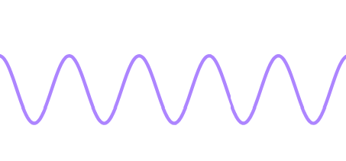
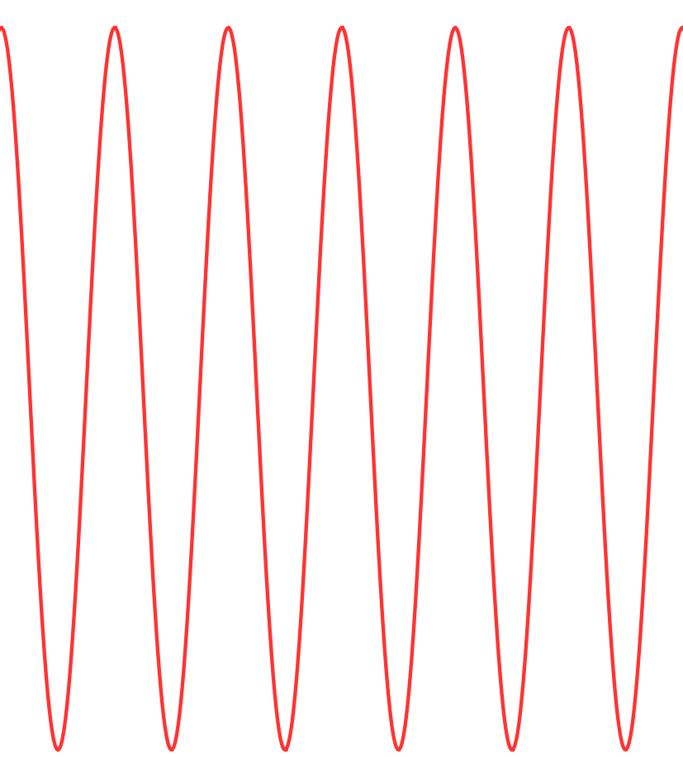
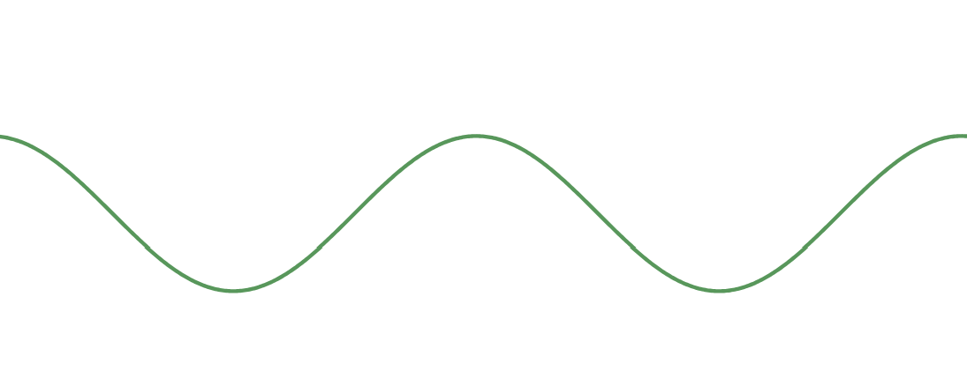

BxCxL
FFT
Band-pass filtering
Amplitude Filtering
Input
Conv1D
period parameter
Reshape
Down sampling
Sparse Forecast
Conv1D
$${\text{BC}×ω_{i}×N}_{i}$$
BxCxLx5
Output

Slide 21
FFT
low-pass filtering
Amplitude Filtering
period parameter
1xLxCx5
weight
1xLxC
Original Sequence
SparseTSF
Average
Input
Copy
Output

Slide 22
nxw
wxn
Linear Layer(nxm)
wxm
mxw
1xHx1
1xHxC
Downsample
Transpose
Sliding Prediction
Transpose
Upsample
Notes:
Added by @srvmshr
Sourav @ yahoo.com

Slide 23
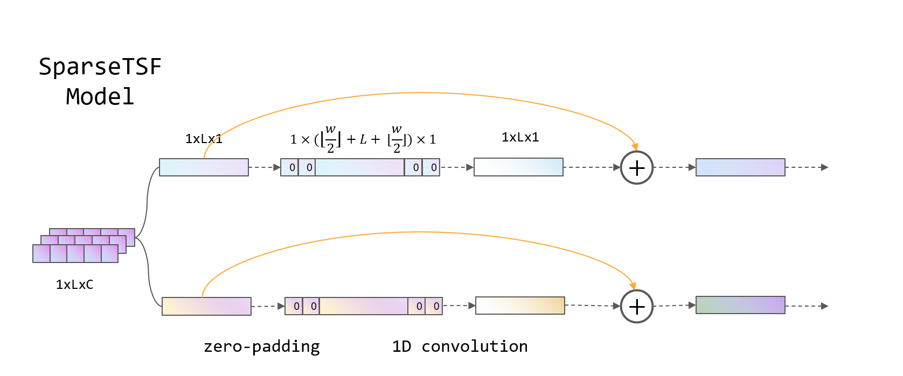
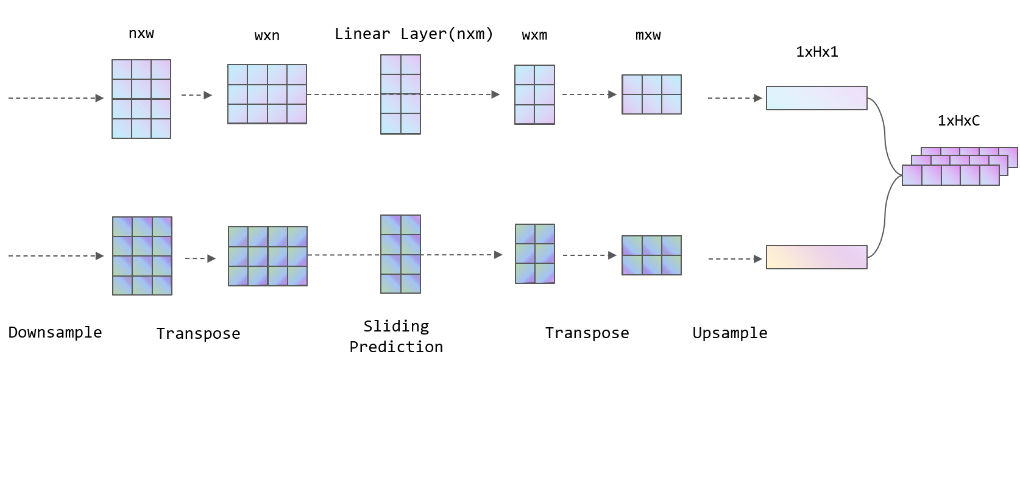

Slide 24
wxn
wxn
0
0
0
0
0
0
0
0
Sliding Aggregation

Slide 25
CONV operation
MxM
ReLU
+b1
+b1
MxMX2
+b2
+b2
NxNx3
MxM
ReLU
Notes:
Added by @srvmshr
Sourav @ yahoo.com

Slide 26
Abstract backgrounds
Notes:
Note:
You can add abstract backgrounds here

Slide 27
Notes:
Note:
You can change the gradient of each component
Author: Elvis Saravia

Slide 28
DAIR.AI
Notes:
Note:
This is the header I use for the dair.ai NLP Newsletter
You can change the gradient of each component
You can customize the background as well by right clicking and changing to another gradient or static color
Author: Elvis Saravia

Slide 29
Notes:
Note:
This is the header I use for the dair.ai NLP Newsletter
You can change the gradient of each component
Author: Elvis Saravia

Slide 30
Notes:
Note:
This is the header I use for the dair.ai NLP Newsletter
You can change the gradient of each component
Author: Elvis Saravia

Slide 31
Gradient Backgrounds
Notes:
Note:
Gradient background shows some inspirations and ideas for color themes that could be used for backgrounds
The examples used in this section are inspired by https://uigradients.com

Slide 35
Community Contributions
Notes:
Note:
You can add abstract backgrounds here

Slide 36
Striding in CONV
S=1
S=2
Notes:
Created by @srvmshr
Sourav @ yahoo.com

Slide 37
Notes:
Created by @srvmshr
Sourav @ yahoo.com

Slide 39
MaxPool Same s=1
Inception Module
5x5 Same
3x3 Same
NxNx192
1x1 Same
NxNx192
NxNx128
NxNx32
NxNx64
Notes:
Created by @srvmshr
Sourav @ yahoo.com

Slide 40
t-1
t
Retraining w/o expansion
Notes:
Note:
1 hidden layer neural network
Author: Elvis Saravia (ellfae@gmail.com)

Slide 41
No-Retraining w/ expansion
Partial Retraining w/ expansion
Notes:
Note:
1 hidden layer neural network
Author: Elvis Saravia (ellfae@gmail.com)

Slide 42
t-1
t
t-1
t
No-Retraining w/ expansion
Partial Retraining w/ expansion
Notes:
Note:
1 hidden layer neural network
Author: Elvis Saravia (ellfae@gmail.com)

Slide 43
t-1
t
t-1
t
t-1
t
Retraining expansion
No-Retraining expansion
Partial Retraining expansion
Notes:
Note:
1 hidden layer neural network
Author: Elvis Saravia (ellfae@gmail.com)

Slide 44
Size
Family?
X
Y
#bed
Walk?
PRICE ŷ
Basic Neuron Model
ZIP
School
How does NN work (Insprired from Coursera)
Wealth
Ŷ = 0
X
Logistic Regression
Ŷ = 1
Notes:
By @srvmshr
sourav@yahoo.com

Slide 45
Linear regression
ReLU(x)
$
$
Size
Size
Notes:
By @srvmshr
sourav@yahoo.com

Slide 46
Training
CONV
3
CONV
1
CONV
2
CONV
5
CONV
6
CONV
7
I
I1
CONV
4
128*128*1
128*128*1
Encoder
Decoder
Decoder
V1
V
ENcoder
128*128*1
128*128*1
Notes:
By @srvmshr
sourav@yahoo.com

Slide 47
Large NN
Med NN
η
Small NN
SVM,LR etc
Amount of Data
Why does Deep learning work?
Notes:
By @srvmshr
sourav@yahoo.com

Slide 48
Hidden
Input
Output
a^{[1]}₁
a^{[1]}₂
One hidden layer neural network
X
a^{[2]}
Ŷ
a^{[1]}₃
a^{[1]}₄
X = A^{[0]}
A^{[1]}
A^{[2]}
Notes:
By @srvmshr
sourav@yahoo.com

Slide 49
a^{[1]}₁
x_{[1]}
a^{[2]}
a^{[1]}₂
x_{[2]}
x_{[1]}
x_{[2]}
x_{[3]}
Neural network templates
Notes:
By @srvmshr
sourav@yahoo.com

Slide 50
a^{[1]}₁
x_{[1]}
a^{[2]}
a^{[1]}₂
x_{[2]}
x_{[1]}
x_{[2]}
x_{[3]}
Neural network templates
Notes:
By @srvmshr
sourav@yahoo.com

Slide 51
Train
Valid
Test
Underfitting
Good fit
Overfitting
x2
x2
x2
x1
x1
x1
Train-Dev-Test vs. Model fitting
Notes:
By @srvmshr
sourav@yahoo.com

Slide 52
x_{[1]}
x_{[2]}
a_{[L]}
DropOut
x_{[3]}
x2
r=1
x2
Normalization
x1
x1
Notes:
By @srvmshr
sourav@yahoo.com

Slide 53
J
w2
Early stopping
Err
w1
w1
w2
Before Normalization
Dev
Train
it.
J
w2
w1
w1
After Normalization
w2
Notes:
By @srvmshr
sourav@yahoo.com

Slide 54
x₁
x₂
w[L]
w[1]
w[2]
w[L-2]
w[L-1]
Deep neural networks
FN
TN
TP
FP
Understanding
Precision & Recall
Notes:
By @srvmshr
sourav@yahoo.com

Slide 55
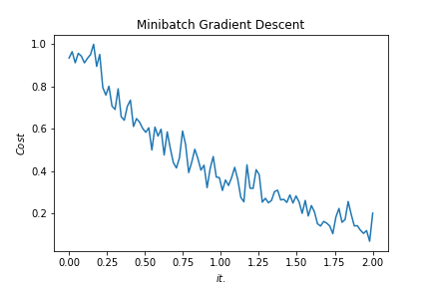
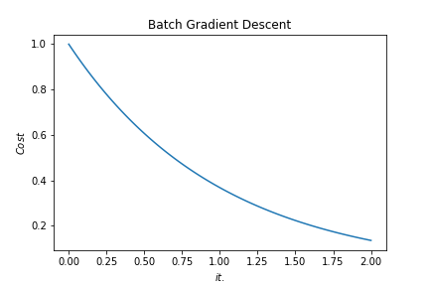
Batch vs. Mini-batch Gradient Descent
w2
w2
BGD
SGD
Batch Gradient Descent vs. SGD
SGD
w1
w1
Notes:
By @srvmshr
sourav@yahoo.com

Slide 56
x_{[1]}
p_{[1]}
x_{[2]}
p_{[2]}
x_{[3]}
Softmax Prediction with 2 outputs
Notes:
By @srvmshr
sourav@yahoo.com

Slide 57
Miscellaneous

Slide 58
16
16+32
16
16
1
3
Convolution 3x3
Convolution 1x1
Dropout 0.1
16
Max Pooling 2x2
Skip connection
Dropout 0.2
Up Sampling 2x2
Block copied
Dropout 0.3
32
32
32+64
32
64
64
64+128
64
128
128
128+256
128
256
256
Notes:
By @avsthiago

Slide 59
Layer1
Layer2
Layer3
Input
Output
Conv3-32
Conv3-32
Conv3-32
Conv3-32
Max-Pool
Conv3-64
Max-Pool
Conv3-128
Max-Pool
Conv3-64
FC-512
Softmax
FC
Layer4
FC
Layer3
Max-Pool
Layer1
Layer2
Layer3
Layer4
Conv
Layer2
Max-Pool
Conv3-32
Output
Conv3-32
Conv3-32
Conv3-32
Max-Pool
Conv3-64
Max-Pool
Conv3-128
Max-Pool
Conv3-64
FC-512
Conv
Layer1
Input
Notes:
By @avsthiago

Slide 60
Filter concatenation
3x3 convolutions
5x5 convolutions
1x1 convolutions
1x1 convolutions
1x1 convolutions
1x1 convolutions
3x3 max pooling
Previous layer
Notes:
By @avsthiago

Slide 61
Previous layer
1x3 conv,
1 padding
1x3 conv,
1 padding
1x7 conv,
3 padding
1x3 conv,
1 padding
1x5 conv,
2 padding
1x3 conv,
1 padding
Filter concatenation

Slide 62
Avg-Pool
Auxiliary Classifier
Conv
FC
FC
Softmax
Inception
Input
Inception
Conv
Max-Pool
Conv
Max-Pool
Conv
Max-Pool
Inception
Inception
Max-Pool
Inception
Inception
Inception
Inception
Inception
Max-Pool
Avg-Pool
Conv
FC
Softmax
Avg-Pool
Auxiliary Classifier
Conv
FC
FC
Softmax
Input
ConvTranspose2d
Max-Pool
Conv
Max-Pool
Notes:
By @avsthiago

Slide 63
Filter concatenation
Filter concatenation
3x3 conv.
1x3 conv.
3x1 conv.
1x1 conv.
3x3 conv.
3x3 conv.
1x1 conv.
1x3 conv.
3x1 conv.
3x3 conv.
1x1 conv.
1x1 conv.
Pool
1x1 conv.
1x1 conv.
Pool
1x1 conv.
1x1 conv.
Previous layer
Previous layer
(a)
(b)
Notes:
By @avsthiago

Slide 64
Previous input
Previous input
x
x
F(x)
F(x)
Stacked layers
Stacked layers
x
identity
+
y=F(x)
y=F(x)+x
R1
R1
R2
R1
R1
R2
R3
R1
R2
R3
Notes:
By @avsthiago

Slide 65
Dense Block 1
Dense Block 2
Dense Block 3
Softmax
FC
Avg-Pool
Avg-Pool
Conv
Conv
Input
Avg-Pool
Conv
Transition layers
Notes:
By @avsthiago

Slide 66
h_{i+1}
Filter concatenation
h_{i+1}
add
add
Filter concatenation
3x3 max
3x3 conv
3x3 avg
identity
add
add
add
add
add
add
add
add
3x3 conv
identity
3x3 conv
5x5 conv
3x3 avg
identity
3x3 avg
3x3 avg
3x3 conv
5x5 conv
7x7 conv
5x5 conv
3x3 max
7x7 conv
3x3 avg
5x5 conv
h_{i}
h_{i}
...
...
h_{i-1}
h_{i-1}
(a)
(b)
Notes:
By @avsthiago

Slide 67
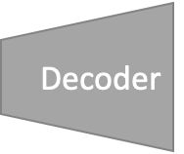
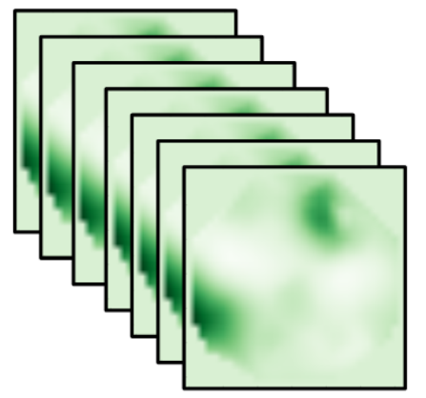
=
14*14
28*28
56*56
112*112
224*224
Notes:
By @avsthiago

Slide 68
Notes:
By @avsthiago
Dark-theme version of the previous (by Elvis Saravia)

Slide 69
Max(1,1,5,6) = 6
Y
1
1
2
4
5
6
7
8
6
8
3
2
1
0
Pooling performed with a 2x2 kernel and a stride of 2
3
4
1
2
3
4
X
Image Representation
Notes:
By @avsthiago

Slide 70
时间规划
第一周（9月21日 - 9月27日）
目标：理解论文内容，初步分析关键部分，开展小组讨论。
小组会议（9月21日）
讨论作业要求和时间规划。
确定每位成员的分工。
论文初读（9月22日 - 9月24日）
每位组员独立阅读论文的摘要、引言和结论部分，初步理解论文的背景和目标。
小组讨论（9月25日）
交流初步阅读的感受和理解，讨论论文解决的问题、研究动机。
细读分配（9月26日 - 9月27日）
按照小组成员的兴趣和擅长领域，分配论文的各个部分进行深入阅读
第二周（9月28日 - 10月4日）
目标：完成论文的深入阅读，开始撰写报告。
深入阅读（9月28日 - 10月1日）
每位成员深入阅读自己负责的部分，并做好笔记，准备分析内容。
小组讨论（10月2日）
各成员分享各自负责部分的关键发现，讨论方法、贡献和实验设计。
开始收集各部分的关键点和数据，进行汇总。
报告撰写（10月3日 - 10月4日）
各成员根据讨论结果撰写自己负责的部分。
统一报告格式，并确保每个部分逻辑连贯
第三周（10月5日 - 10月13日）
目标：完成报告，进行修改和准备汇报。
报告整合与修改（10月5日 - 10月8日）
合并各部分，进行整体修改，确保一致性和流畅性。
邀请小组外的人进行审核，获取反馈。
最终小组会议（10月12日）
汇报材料的最后审核和修订，确保一切准备就绪。
提交报告和汇报（10月13日）
在截止日期前提交报告，进行最终的口头汇报。

Slide 71
第一周
第二周
第三周
目标：理解论文内容，初步分析关键部分，开展小组讨论。
小组会议（9.21）
讨论作业要求和时间规划。
确定每位成员的分工。
论文初读（9.22 – 9.24）
每位组员独立阅读论文的摘要、引言和结论部分，初步理解论文的背景和目标。
小组讨论（9.25）
交流初步阅读的感受和理解，讨论论文解决的问题、研究动机。
细读分配（9.26 – 9.27）
按照小组成员的兴趣和擅长领域，分配论文的各个部分进行深入阅读
目标：完成论文的深入阅读，开始撰写报告。
深入阅读（9.28 – 10.1）
每位成员深入阅读自己负责的部分，并做好笔记，准备分析内容。
小组讨论（10.2）
各成员分享各自负责部分的关键发现，讨论方法、贡献和实验设计。
开始收集各部分的关键点和数据，进行汇总。
报告撰写（10.3 – 10.4）
各成员根据讨论结果撰写自己负责的部分。
统一报告格式，并确保每个部分逻辑连贯
目标：完成报告，进行修改和准备汇报。
报告整合与修改（10.5 – 10.8）
合并各部分，进行整体修改，确保一致性和流畅性。
邀请小组外的人进行审核，获取反馈。
最终小组会议（10.12）
材料的最后审核和修订，确保一切准备就绪。
提交报告和汇报（10.13）
在截止日期前提交报告。

