Slide 1
Embedding Size
Are
You
OK?
Number of Tokens

Slide 2

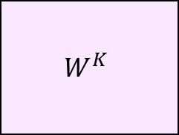

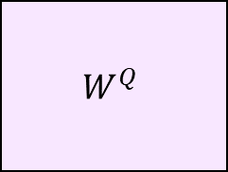

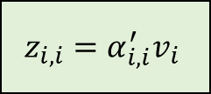

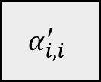

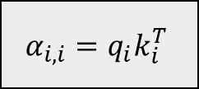
$$W^{Q}$$
$$q_{i}$$
$$W^{K}$$
$${α_{i,i}=q}_{i}k_{i}^{T}$$
$$α_{i,i}^{′}$$
$$x_{i}$$
$$k_{i}$$
$$W^{V}$$
$$v_{i}$$
$$z_{i,i}=α_{i,i}^{′}v_{i}$$

Slide 3
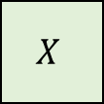
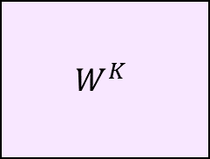
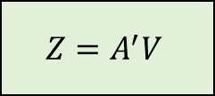
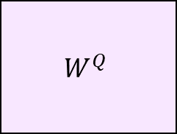
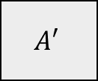
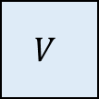
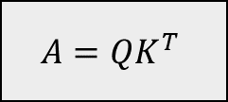
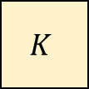
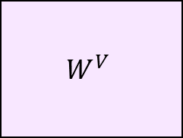
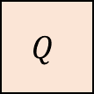
$$W^{Q}$$
$$Q$$
$$W^{K}$$
$$X$$
$$K$$
$$A=QK^{T}$$
$$A′$$
$$W^{V}$$
$$V$$
$$Z=A^{′}V$$

Slide 4




Are
Are
You
$$×$$
$$=$$
You
OK?
OK?
Are
Are
You
You
OK?
OK?
Are
Are
Are
You
$$×$$
You
$$=$$
You
OK?
Are
OK?
OK?
You
OK?

Slide 5




$$a$$
$$b$$
$$θ$$
$$\left|a\right|\cos{θ}$$

Slide 6








$$x_{1}$$
$$q_{1}$$
$$α_{1,2}$$
??
$$x_{2}$$
$$q_{2}$$
$$α_{2,1}$$
$$x_{3}$$
$$q_{3}$$

Slide 7
Are
1
0
0
0
0
1
0
You
0
1
0
0
1
0
0
OK?
0
0
0
1
0
0
1

Slide 8
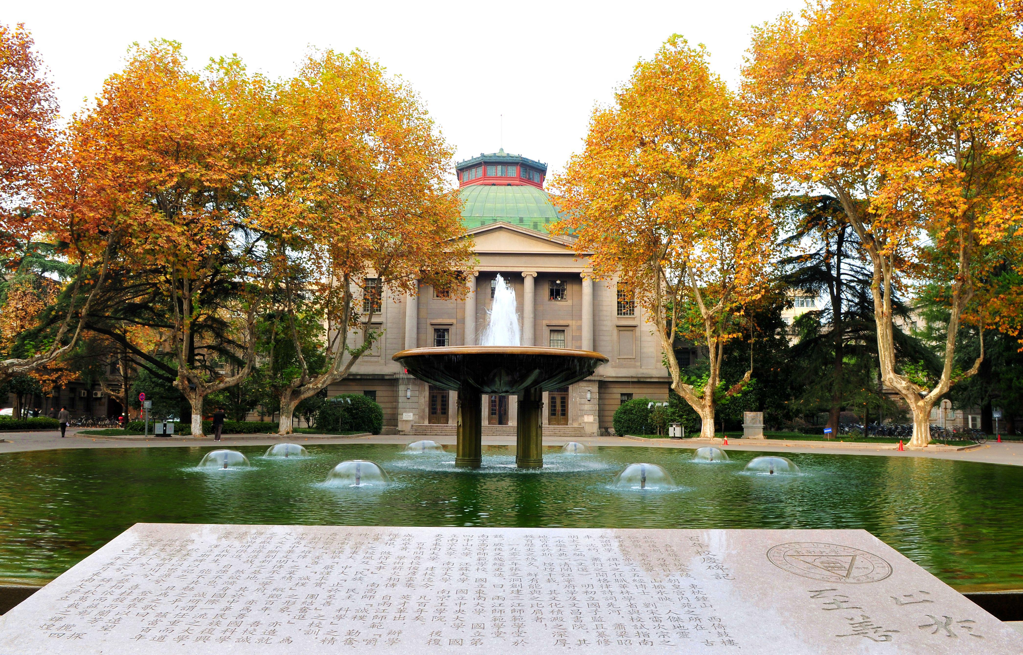





$$⋯$$
$1$Image $×[224×224×3]$
$196$ Patches $×[16×16×3]$
$196$ tokens $×[768]$
Input
$$196×768$$

