Slide 1
Project Scheduling

Slide 2
General Practices
On large projects, hundreds of small tasks must occur to accomplish a larger goal
Project manager's objectives
Define all project tasks
Build an activity network that depicts their interdependencies
Identify the tasks that are critical within the activity network
Build a timeline depicting the planned and actual progress of each task
Track task progress to ensure that delay is recognized "one day at a time"
To do this, the schedule should allow progress to be monitored and the project to be controlled
‏

Slide 3
General Practices (continued)‏
Software project scheduling distributes estimated effort across the planned project duration by allocating the effort to specific tasks
Scheduling for projects can be viewed from two different perspectives
In the first view, an end-date for release of a computer-based system has already been established and fixed
The software organization is constrained to distribute effort within the prescribed time frame
In the second view, assume that rough chronological bounds have been discussed but that the end-date is set by the software engineering organization
Effort is distributed to make best use of resources and an end-date is defined after careful analysis of the software
The first view is encountered far more often that the second

Slide 4
Basic Principles for Project Scheduling
Compartmentalization
The project must be compartmentalized into a number of manageable activities, actions, and tasks; both the product and the process are decomposed
Interdependency
The interdependency of each compartmentalized activity, action, or task must be determined
Some tasks must occur in sequence while others can occur in parallel
Some actions or activities cannot commence until the work product produced by another is available
Time allocation
Each task to be scheduled must be allocated some number of work units
In addition, each task must be assigned a start date and a completion date that are a function of the interdependencies
Start and stop dates are also established based on whether work will be conducted on a full-time or part-time basis
(More on next slide)‏

Slide 5
Basic Principles for Project Scheduling (continued)‏
Effort validation
Every project has a defined number of people on the team
As time allocation occurs, the project manager must ensure that no more than the allocated number of people have been scheduled at any given time
Defined responsibilities
Every task that is scheduled should be assigned to a specific team member
Defined outcomes
Every task that is scheduled should have a defined outcome for software projects such as a work product or part of a work product
Work products are often combined in deliverables
Defined milestones
Every task or group of tasks should be associated with a project milestone
A milestone is accomplished when one or more work products has been reviewed for quality and has been approved

Slide 6
Selecting Project Tasks
Milestone = end-point of a specific, distinct software process activity or task (for each milestone a report should be presented to the management)
Deliverable = project result delivered to the client
In order to establish milestones the phases of the software process phases need be divided in basic activities/tasks.

Slide 7
Task Network

Slide 8
Defining a Task Set
A task set is the work breakdown structure for the project
No single task set is appropriate for all projects and process models
It varies depending on the project type and the degree of rigor (based on influential factors) with which the team plans to work
The task set should provide enough discipline to achieve high software quality
But it must not burden the project team with unnecessary work

Slide 9
Types of Software Projects
Concept development projects
Explore some new business concept or application of some new technology
New application development
Undertaken as a consequence of a specific customer request
Application enhancement
Occur when existing software undergoes major modifications to function, performance, or interfaces that are observable by the end user
Application maintenance
Correct, adapt, or extend existing software in ways that may not be immediately obvious to the end user
Reengineering projects
Undertaken with the intent of rebuilding an existing (legacy) system in whole or in part

Slide 10
Factors that Influence a Project’s Schedule
Size of the project
Number of potential users
Application longevity
Stability of requirements
Ease of customer/developer communication
Maturity of applicable technology
Performance constraints
Embedded and non-embedded characteristics
Project staff
Reengineering factors

Slide 11
Purpose of a Task Network
Also called an activity network
It is a graphic representation of the task flow for a project
It depicts task length, sequence, concurrency, and dependency
Points out inter-task dependencies to help the manager ensure continuous progress toward project completion
The critical path
A single path leading from start to finish in a task network
It contains the sequence of tasks that must be completed on schedule if the project as a whole is to be completed on schedule
It also determines the minimum duration of the project

Slide 12
Example Task Network
Task F
2
Task G
3
Task H
5
Task B
3
Task N
2
Task A
3
Task C
7
Task E
8
Task I
4
Task J
5
Task M
0
Task D
5
Task K
3
Task L
10
Where is the critical path and what tasks are on it?

Slide 13
Pert Chart
A simple PERT chart comprises circles (nodes) to represent events within the development lifecycle
For example commencement / completion of tasks, and lines (edges) which represent the the tasks. The lines are additionally labeled by the estimated duration of the task.
Note: there are a number of variations to this notation. A real PERT chart shows earliest time to completion, latest time to completion, and slack in the circles also.

Slide 14
How to construct a PERT chart
The basic steps to constructing a PERT chart are:
Identify tasks and estimate duration of times
Identify a single start and end event
Arrange events in sequence (give events a unique number)
Establish start and finish times of each task. Keep in mind the estimates made for duration and effort.
Determine float
Revise

Slide 15
Pert Chart
As an example of using a PERT chart, consider the following simple chart showing a project with tasks A,B,C,D and E
This diagram states that tasks A,B,C and E will take 2 days (assume d is abbreviation for days) and task D has a planned duration of 5 days.
Task D is dependent on completion of task B, etc.
2
C
2d
4
A
2d
E
2d
1
5
B
2d
D
5d
3

Slide 16
The Critical Path
The critical path is the path between the start event and end event which takes the longest time.
Note that:
No task on the critical path can take longer without extending the end date of the project.
Tasks on the critical path are called critical tasks.
No critical task can have any slack.
Tasks on the critical path must be carefully monitored.

Slide 17
Project Scheduling
Program Evaluation and Review Technique (PERT)
Critical Path Method (CPM)

Slide 18
Project Scheduling
Both techniques (PERT and CPM) are driven by information already developed in earlier project planning activities:
Estimates of efforts
Decomposition of product function
selection of appropriate process model and task set
Decomposition of tasks

Slide 19
Project Scheduling
Both PERT and CPM provides quantitative tools to
determine the critical path
establish the most likely time estimated for individual tasks by applying statistical models
calculate boundary time (window) for a particular task

Slide 20
Example Task Network with Critical Path Marked
Task F
2
Task G
3
Task H
5
Task B
3
Task N
2
Task A
3
Task C
7
Task E
8
Task I
4
Task J
5
Task M
0
Task D
5
Task K
3
Task L
10
Critical path: A-B-C-E-K-L-M-N

Slide 21
Timeline Chart

Slide 22
Mechanics of a Timeline Chart
Also called a Gantt chart;
All project tasks are listed in the far left column
The next few columns may list the following for each task: projected start date, projected stop date, projected duration, actual start date, actual stop date, actual duration, task inter-dependencies (i.e., predecessors)‏
To the far right are columns representing dates on a calendar
The length of a horizontal bar on the calendar indicates the duration of the task
When multiple bars occur at the same time interval on the calendar, this implies task concurrency
A diamond in the calendar area of a specific task indicates that the task is a milestone; a milestone has a time duration of zero
Jan Feb Mar Apr May Jun Jul Aug Sep Oct
Task #
Task Name
Duration
Start
Finish
Pred.
1
Task A
2 months
1/1
2/28
None
2
Milestone N
0
3/1
3/1
1

Slide 23
SOLUTION
Timeline chart:
4/1 4/8 4/15 4/22 4/29 5/6 5/13 5/20 5/27 6/3
Task #
Task Name
Duration
Start
Finish
Pred.
A
Establish increments
3
4/1
4/3
None
B
Analyze Inc One
3
4/4
4/6
A
C
Design Inc One
8
4/7
4/14
B
D
Code Inc One
7
4/15
4/21
C
E
Test Inc One
10
4/22
5/1
D
F
Install Inc One
5
5/2
5/6
E
G
Analyze Inc Two
7
4/7
4/13
A, B
H
Design Inc Two
5
4/14
4/18
G
I
Code Inc Two
4
4/19
4/22
H
J
Test Inc Two
6
5/2
5/7
E, I
K
Install Inc Two
2
5/8
5/9
J
L
Close out project
2
5/10
5/11
F, K
Task network and the critical path:
A-B-C-D-E-J-K-L
B. Analyze
Inc One
3
C. Design
Inc One
8
D. Code
Inc One
7
E. Test
Inc One
10
F. Install
Inc One
5
A. Establish
Increments
3
L. Close out
Project
2
G. Analyze
Inc Two
7
H. Design
Inc Two
5
I. Code
Inc Two
4
J. Test
Inc Two
6
K. Install
Inc Two
2

Slide 24
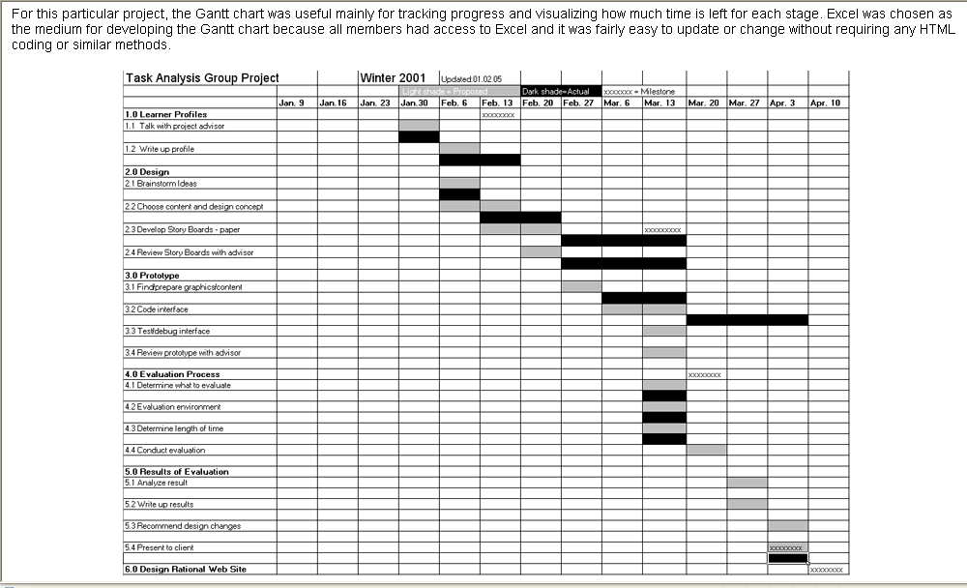
Example Timeline Chart

Slide 25
Methods for Tracking the Schedule
Qualitative approaches
Conduct periodic project status meetings in which each team member reports progress and problems
Evaluate the results of all reviews conducted throughout the software engineering process
Determine whether formal project milestones (i.e., diamonds) have been accomplished by the scheduled date
Compare actual start date to planned start date for each project task listed in the timeline chart
Meet informally with the software engineering team to obtain their subjective assessment of progress to date and problems on the horizon
Quantitative approach
Use earned value analysis to assess progress quantitatively

