Slide 1
Data Redaction using Named Entity Recognition
By Miss. Ekta Chaugule

Slide 2
Contents
INTRODUCTION | 1
LITERATURE SURVEY | 2
MOTIVATION | 3
METHODOLOGY | 4
APPLICATION ADVANTAGES AND DISADVANTAGES | 10
CONCLUSION REFERENCES | 13

Slide 3
INTRODUCTION
What is Data Redaction? Data redaction is the process of hiding or removing confidential information from documents. Traditionally, this has been done manually, which is time-consuming and prone to errors.
Automating Redaction with NER Named Entity Recognition (NER), a tool from Natural Language Processing (NLP), automates the identification of key information such as names, dates, and locations. This streamlines the redaction process, making it faster and more accurate.
Presentation Overview We will explore how NER works, its benefits for data redaction, and its role in protecting important information efficiently.

Slide 4
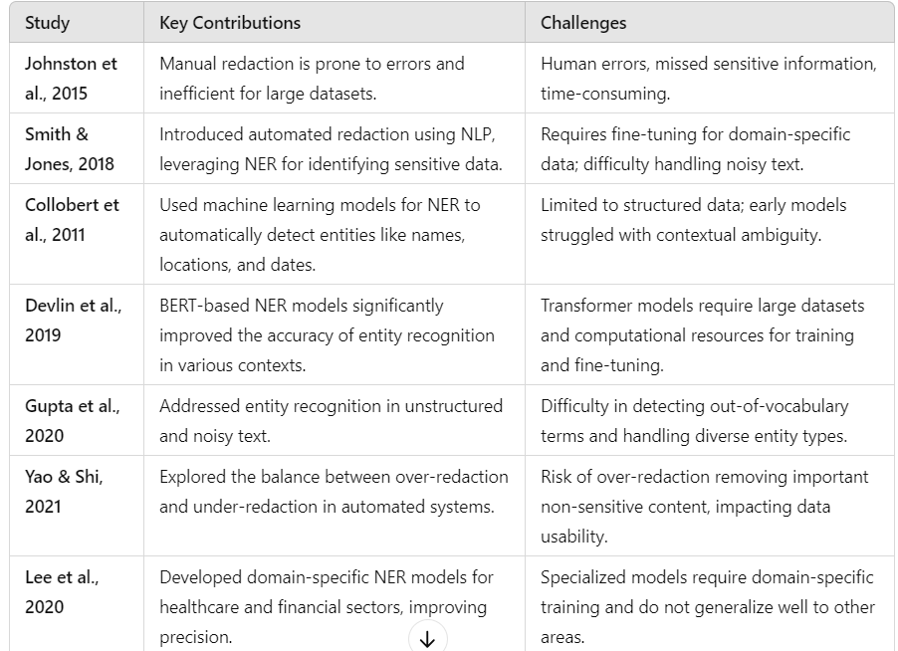
LITERATURE SURVEY

Slide 5

MOTIVATION
1.Gaming Sensitive Data
As more data is stored and shared digitally, protecting sensitive information like personal, financial, and medical data has become critical to prevent identity theft and misuse.
2.Inefficiency of Manual Processes
Traditional manual redaction methods are slow and prone to human error. This inefficiency not only risks the exposure of sensitive information but also compromises data usability, leading to potential liabilities.
3.Advancements in NLP
Modern techniques like Named Entity Recognition (NER) utilize machine learning to automate and improve the accuracy of data redaction. These advancements enable organizations to handle larger volumes of data with greater precision.

Slide 6
METHODOLOGY

Slide 7
Automatic Redaction System Overview
The Automatic Redaction System is designed to identify and manage sensitive content in documents through Named Entity Recognition (NER). This method is essential for tagging and categorizing words based on their context within sentences.
Key Concepts
1. Named Entity Recognition (NER):- NER is a natural language processing technique that classifies words into categories. For example, in the sentence "Neha works in India," "Neha" is tagged as a Person entity, and "India" is categorized as a Geopolitical Entity (GPE). This tagging is crucial for identifying personally identifiable information (PII), including:
Names
Places
Bank account numbers
Social Security Numbers
Aadhaar numbers
Dates of birth

Slide 8
2. User Interaction:- Users can select specific entities they wish to redact from their documents, such as names and Aadhaar numbers. This feature provides flexibility and control over the redaction process.
Components of the System
1. Automatic Redactor:- This component takes user-provided text, identifies sensitive entities, and presents a redacted copy of the document. It automates the redaction process, ensuring that sensitive information is effectively removed.
2. User Choice Redaction:- This functionality allows the system to find sensitive terms in a user’s content and enables users to choose which ones to redact. This approach ensures a customized redaction experience.
3. Redaction Process:- After identifying entities, they are passed as input parameters to a Python script designed for redaction. This script utilizes the py-redact module, which searches for the identified words using regular expressions (regex) and performs the redaction by replacing them with placeholders (e.g., "[REDACTED]").

Slide 9
Different Models of NER
• Transfer Learning on SpaCy:
NER identifies and classifies entities in text into predefined classes like ‘person’ or ‘location.’ Existing SpaCy models can be trained on custom data to improve accuracy for specific document contexts.
• Using CRF and BiLSTM:
BILSTM, a neural network model based on RNN, combines forward and backward LSTM. It retains relevant information in the data context and captures dependencies of each word before and after.
• Using PyTorch and BERT:
BERT performs well in various NLP tasks due to Semi-Supervised Learning. It utilizes a transformer architecture with an encoder stack and self-attention, generating hidden-size output vectors for various tasks, such as classification and translation.

Slide 10
STEPS OF REDACTION
Data Input:
User uploads a document containing sensitive information (e.g., names, addresses, numbers).
NER Application:
A pre-trained NER model (e.g., spaCy) scans the document and identifies entities like names, places, dates, and other sensitive information.
Entity Classification:
The identified entities are classified into predefined categories such as PERSON, ORGANIZATION, DATE, etc.
Redaction Process:
The system automatically redacts the identified sensitive entities, replacing them with labels (e.g., PERSON, LOCATION) or masking the content (e.g., blacking out text).
$100 M

Slide 11
STEPS OF REDACTION
User Review (Optional):
The user is given the option to review the redacted terms and choose which to keep or remove.
Output:
The redacted document is presented or downloaded, free of sensitive data.

Slide 12
APPLICATIONS
1. Healthcare Patient Privacy: Automatically redact sensitive patient information, such as names, Social Security numbers, and medical records, to comply with HIPAA regulations. 2. Finance Fraud Prevention: Redact sensitive financial data from documents and reports to prevent identity theft and fraud. 3. Legal Legal Document Management: Redact names, addresses, and other sensitive information from legal filings, contracts, and court documents.
4. Government Public Records: Redact sensitive information from public records before they are released, ensuring citizen privacy.

Slide 13
ADVANTAGES
Automated Process: NER automates the identification of sensitive information, significantly reducing the time and effort required for manual redaction.
Increased Accuracy:
Advanced NER models can achieve high accuracy in recognizing entities
Scalability: NER systems can efficiently handle large volumes of documents, making them suitable for organizations
Consistency: Automated systems provide consistent results across different documents.

Slide 14

DISADVANTAGES
Initial Setup Complexity: Setting up an NER system can be complex and may require significant time, resources, and expertise to train the models effectively.
Context Sensitivity: NER can struggle with context-specific terms or jargon, making it challenging to accurately recognize sensitive information in specialized fields.
False Positives and Negatives: NER may misidentify entities, leading to false positives (incorrectly tagging non-sensitive information) or false negatives
Language Limitations: Many NER models are primarily trained on English data, which may limit their effectiveness in recognizing entities in other languages or dialects.

Slide 15
CONCLUSION
Named Entity Recognition (NER) Is Essential For Automatically Removing Sensitive Information From Documents In Various Fields. It Improves Efficiency, Accuracy, And Consistency, Making It A Valuable Tool For Protecting Sensitive Data. .

Slide 16
REFERENCES
Shashi Prakash Tripathi, Harshita Rai, “SimNER- An Accurate and Faster Algo rithm for Named Entity Recognition,” Second International Conference on Ad vances in Computing, Control and Communication Technology (IAC3T), 2018.
Eric Bier, Richard Chow, Philippe Golle, Tracy Holloway King, Jessica Staddon, “The Rules of Redaction- Identity, Protect, Review (and Repeat),” The IEEE Computer and Reliability Societies, 2019.
Du Yanrui ,Zhao Weixiang, “NamedEntityRecognitionMethodwithWordPosition,” 2020 International Workshop on Electronic Communication and Artificial Intelligence (IWECAI), 2020, pp. 154-159, doi: 10.1109/IWECAI50956.2020.00038.
spaCy. [GitHub]. [2021.4] https://github.com/explosion/spaCy
P. Sun, X. Yang, X. Zhao and Z. Wang, “An Overview of Named Entity Recognition,” 2018 International Conference on Asian Language Processing (IALP), Bandung, Indonesia.
Named Entity Recognition using SpaCy and TensorFlow. https://aihub.cloud.google.com/u/0/p/products
K. Elissa, “Named Entity Recognition Method with Word Position,” 2020 In ternational Workshop on Electronic Communication and Artificial Intelligence (IWECAI), IEEE. Department of Computer Engineerin

Slide 17

THANK YOU!

