Slide 1
ME-BOT
SPOTIFY MUSIC SPECIALIZER

Slide 2
PROBLEM STATEMENT
The most effective uses of dialog systems in the recent times have been in personalized recommendation systems where the system acts as a goal-oriented personal assistant or a bot by understanding the user’s request and providing the user with the necessary information accordingly.
Our goal is to build a goal-oriented dialogue based chatbot which has been trained for a specific tasks and communicates with the user helping them attain their goal
We have chosen the goal of fetching and suggesting spotify music for the user
The bot communicates with the user to gain the music details that the user wishes to listen and fetches the spotify link for the user to listen to the music

Slide 3
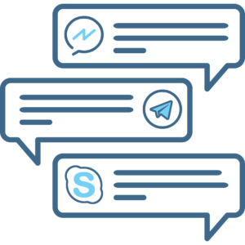
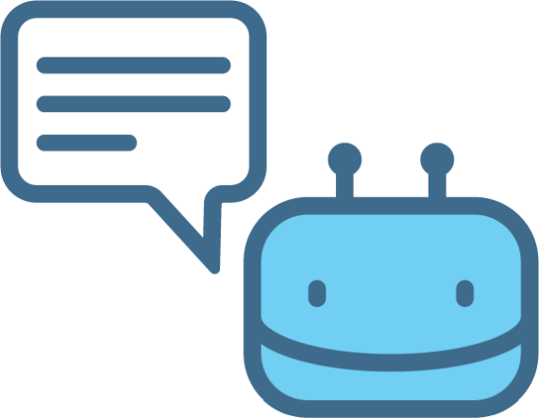
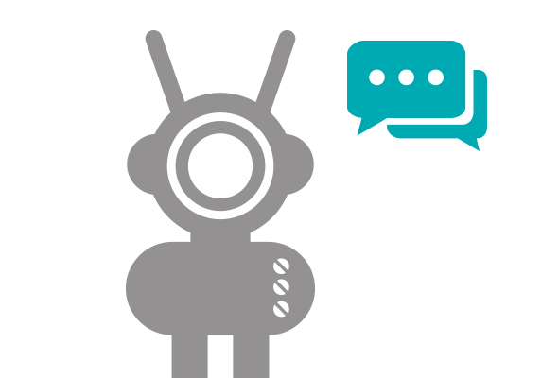
CONVERSATION FLOW
Motion design
User experience
Physical Computing
HTML, CSS,JS

Slide 4
DATASET

Slide 5
DATASET
For training process, we have taken reference from bAbI dialogue dataset
English wikipedia dump for training the word2vec model
The custom data for our domain was build using the information from Spotify API
The training dataset consists of episodes of dialogues between user and a bot that specializes in music recommendation and takes user inputs to return URL links to recommended tracks on Spotify
Example:
1 Hi → Hello
2 I’d like to listen to some music today → which artist would you like to hear
3 Ed Sheeran please → Here is your link https://open.spotify.com/artist/6eUKZXaKkcviH0Ku9w2n3V
We have around 240 conversation episodes where each conversation consists of 28-30 back and forth communication dialogues between the user and the chatbot

Slide 6
DATASET (CONT..)
KNOWLEDGE BASE
A goal-oriented system requires a Knowledge Base pertaining to the domain and utilizes this information while building the response for the user’s utterance.
We build a custom knowledge base for our Spotify Knowledge Base which consisted of all possible combination of Artists, Albums and Tracks
Example:
1 spotify_music_Life_DrakeMore_Blem R_spotify_link https://open.spotify.com/album/1lXY618HWkwYKJWBRYR4MK
1 spotify_music_Life_DrakeMore_Blem R_genre hip-hop
1 spotify_music_Life_DrakeMore_Blem R_artist DrakeMore
1 spotify_music_Life_DrakeMore_Blem R_album Life

Slide 7
ARCHITECTURE

Slide 8
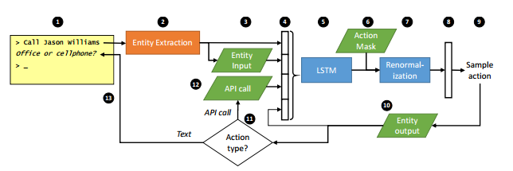
HCN Architecture

Slide 9
Technology Stack
- TensorFlow
- Python 3.5
- Gensim
- CUDA
- AWS-EC2

Slide 10
HYBRID CODE NETWORK
A Hybrid Code Network combines Recurrent Neural Networks, domain-specific knowledge encoded, system action templates and entity extraction module to identify the entities in the user’s utterance
HCN can be optimised with supervised learning, reinforcement learning or both
Why HCN?
Using a Neural Network or simply an RNN infers the state labels however they cannot build a general mechanism for injecting domain knowledge and constraints. HCN is more suitable for building domain specific knowledge
HCNs considerably reduce the amount of training data required

Slide 11
FLOW
Step 1: The user provides an utterance, as text
Step 2: The utterance is featurized using Bag of Words
Step 3: An utterance embedding is formed, using word2vec pre-built utterance embedding model
Step 4: An entity extraction module identifies entity mentioned in the text eg: identify Ed Sheeran as <artist>
Step 5: The text and the entities are mapped to the domain specific Knowledge Base which returns an action mask, indicating actions which are permitted at the current timestep, as a bit vector
Step 6: The context features are built which are the features essential for identifying if the entities are currently present or not (Step 1-5 are combined to form the step 6)
Step 7: This vector is passed to an RNN with LSTM. The RNN computes a hidden state (vector), which is retained for the next timestep

Slide 12
FLOW
Step 8: The output returns number of distinct system action templates.
Step 9: The action mask is applied as an element-wise multiplication, and the result is normalized back to a probability distribution. This forces non-permitted actions to take on probability zero.
Step 10: Based on this an action is selected
Step 11: The selected action is then passed to Entity output or can make an API call
Step 12: The text is then returned back to the user
Step 13: This cycle is then repeated and the chosen action is fed to the RNN for the next time step

Slide 13
WORD EMBEDDING
An information retrieval system work very well on dialog tasks.
TF-IDF: For each possible candidate response, we compute a matching score between the input and the response, and rank the responses by score. The score is the TF–IDF weighted cosine similarity between the bag-of-words of the input and bag-of-words of the candidate response.
The embedding vectors are trained directly for this goal. The word2vec model is suitable for building context on unsupervised training on raw texts wherein the middle word is predicted given the surrounding word and vice versa. Since our training consists of (utterance, responses) pairs this would help us predict the response given the previous conversation. The candidate’s response y is scored against the input x:
f(x, y) = (Ax) >By, where A and B are d × V word embedding matrices, i.e. input and response are treated as summed bags-of-embedding

Slide 14
ENTITIES
Key Information in the conversation to get contextual reference of the specific domain
Extracted by the bot and stored in the memory for decision making of future conversation
List of Entities:
Artist
Album
Track
Genre

Slide 15
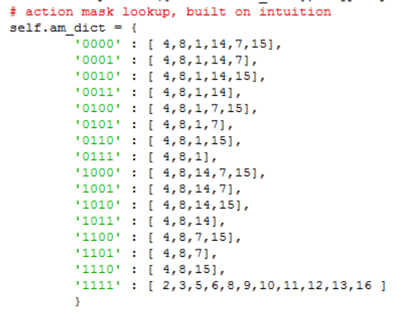
ACTIONS/ ACTION MASK/ ACTION TEMPLATES
Actions are possible responses that the bot could have for user input
Action Templates are unique response templates that are stored in the Action Mask
An Action Mask is an essential part of HCN
Consists of the logic for choosing the next Action Templates depending on the Entity Extraction out of the input utterance
A key representation of 0 and 1 for the state of current entities extracted
An Action Mask Dictionary consists of mapping of entity state keys to the actions that need to be taken

Slide 16
Context Vectors
When an utterance is passed to the system as an input, entities are extracted and context features are created for entities in the form of 0s and 1s
For Ex:
>>>Can I listen to rap----> <genre>
Context Feature: ‘0001’
This feature vector is then fed to the RNN

Slide 17
RNN and LSTM cells
When the feature vector is passed along with the Action Mask to the RNN
The feature vector is distributed over all the action templates in the action mask
LSTM is used to remember the state of the previous entities at a given point
Zero probability templates are filtered out
Finally from the eligible action templates, the action with the highest probability is chosen
This is then stored in the memory before the next cycle starts

Slide 18
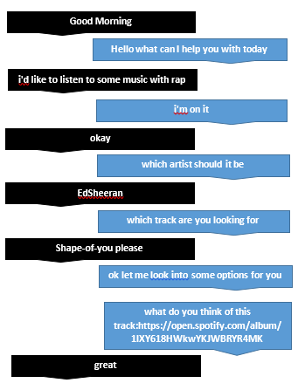
DEMO

Slide 19
APPROACHES USED:
Approach 1: Build a sequence to sequence model using the open source Reddit dataset
Problems faced: The response given by the chatbot where words from other languages
Possible reasons: The Reddit comments might have users commenting in their native language
Approach 2: Build an RNN to train the facebook BABI dataset
Problems faced: The accuracy of the model was very low 19%, due to which the chat-bot repeatedly asked the same question multiple times. Hyper parameter tuning did not improve the accuracy of the model
Possible reasons: RNN alone are not suitable for goal-oriented tasks

Slide 20
CHALLENGES FACED:
Understanding the most suitable architecture for building a goal-oriented chatbot
Weighing the pros and cons of the Sequence-to-Sequence, RNN, HCN architecture
Building customized goal-oriented dataset by collaborating with the Spotify API
Build the logic for building the HCN model suitable for our goal oriented dataset
Tuning the parameters (action-mask combination, data split, number of epoch) to get a suitable accuracy model

Slide 21
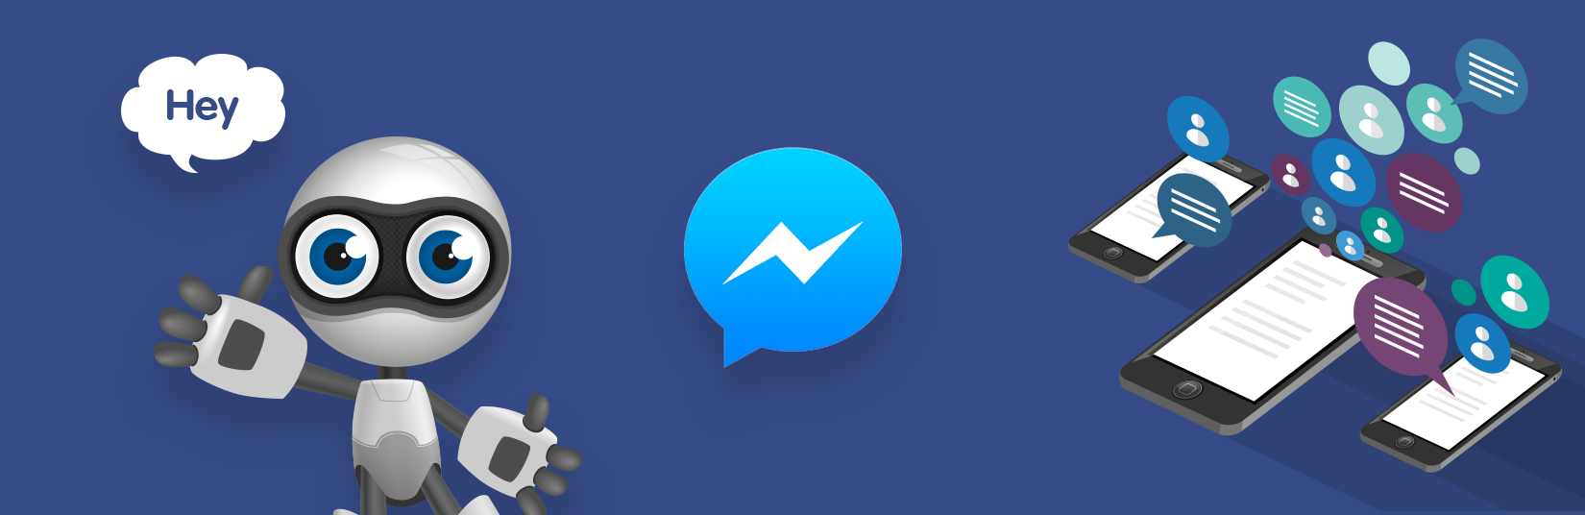
Code and Demo Instructions
https://github.com/ekta2391/Deep-Learning-implementation-of-Chatbot

Slide 22
REFERENCES
[1] Jason D. Williams, Kavosh Asadi, Geoffrey Zweig: Hybrid Code Networks: practical and efficient end-to-end dialog control with supervised and reinforcement learning https://arxiv.org/pdf/1702.03274.pdf
[2] Antoine Bordes, Y-Lan Boureau & Jason Weston: Learning End to End goal oriented dialogue system https://arxiv.org/pdf/1605.07683.pdf
[3] Jason D. Williams and Geoffrey Zweig: End-to-end LSTM-based dialog control optimized with supervised and reinforcement learning https://arxiv.org/pdf/1606.01269v1.pdf
[4] Facebook Research bAbI dialogue dataset: https://research.fb.com/downloads/babi
[5] vyraun: chatbot-MemN2N-tensorflow https://github.com/vyraun/chatbot-MemN2N-tensorflow

