Slide 1
Decarbonizing Business Travel
A Process Intelligence & Predictive AI Approach
From Carbon Visibility To Intelligent Travel Decisions
Summer Analytics 2026 Capstone
Name: Ekta Yadav
Institute: IIT Guwahati
Branch: Chemical Engineering
Email: ektayadav1618@gmail.com

Slide 2
Executive Summary – Results at a Glance
178M kg
Total CO₂ Emissions
65,289
Business Trips
16,326
High-Carbon Trips
25% of total
99.16%
ML Prediction Accuracy
(Random Forest)
Top Insights
Business Class Flights are the largest emission source (73.1M kg CO₂).
Europe has the highest emissions; Asia has the highest CO₂ per trip.
Sales and Customer Visits drive the largest carbon footprint.
Strategic Recommendations
Shift eligible short-haul flights to rail.
Reduce unnecessary Business & First Class travel.
Prioritize Europe and Sales for emission reduction.
Use AI to flag high-carbon trips before approval.
Projected 3-Year Impact
Replace 30% of eligible Business Class trips with Economy Class.
≈ 6.95M kg CO₂ avoided
≈ $9M travel cost savings
Why This Matters
Business travel is Celonis' largest Scope 3 emission source. Process Mining + AI enables smarter, lower-carbon travel decisions.

Slide 3
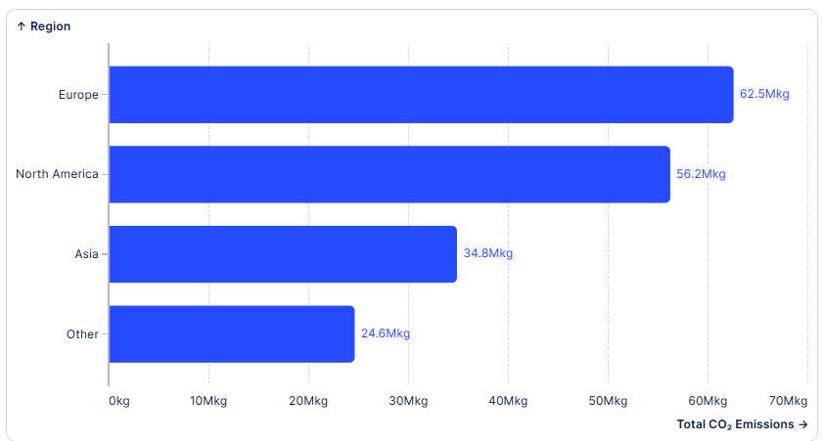
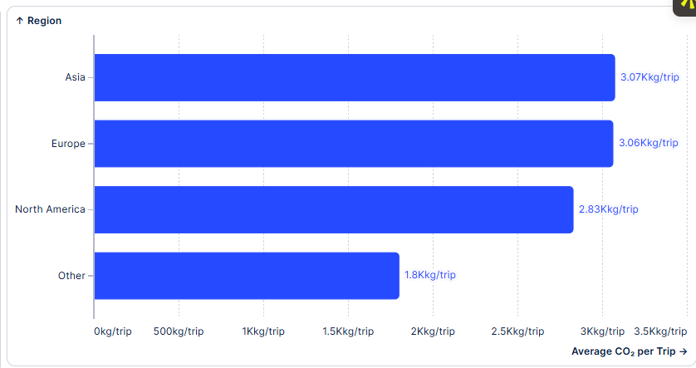
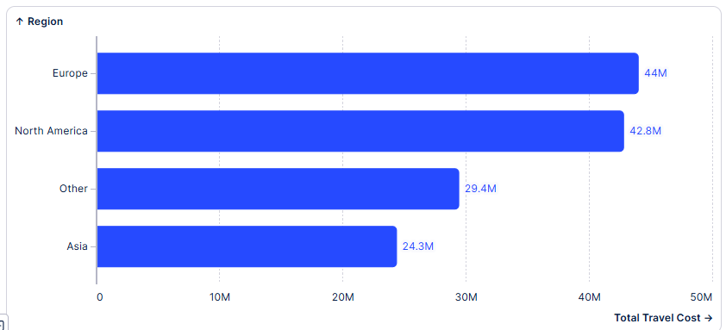
Emissions Profile & Regional Benchmarking
Key Findings
Europe records the highest total emissions (62.5M kg CO₂).
Asia has the highest emissions per trip (3.07 kg/trip).
Europe and North America account for the highest travel spending.
Emissions and travel costs are concentrated in a few key regions.
Business Impact
Prioritize Europe & North America for carbon reduction while improving travel efficiency in Asia.
Executive Takeaway
Regional benchmarking enables targeted, high-impact sustainability policies.

Slide 4
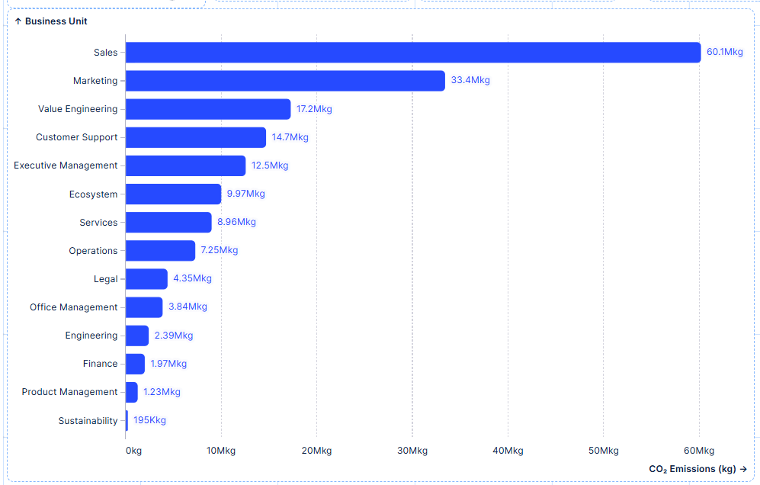
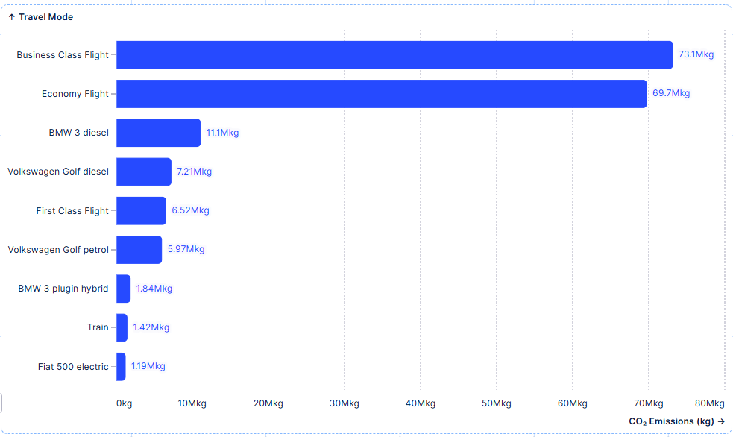
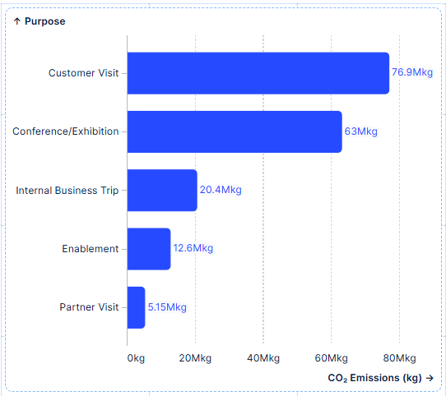
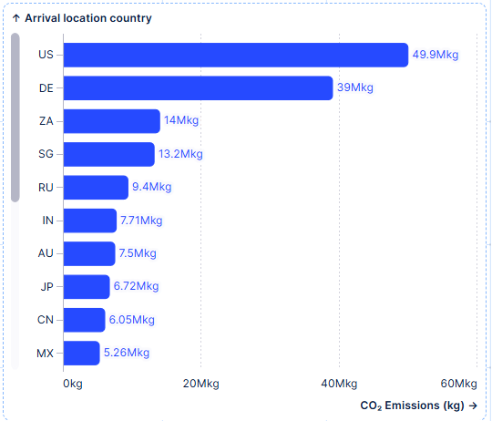
Emission Hotspot Analysis
Key Findings
Business Class Flights generate the highest emissions (73.1M kg CO₂).
Sales is the largest emitting business unit (60.1M kg CO₂).
Customer Visits account for the highest travel emissions (76.9M kg CO₂).
United States and Germany are the highest-emission destinations.
Business Impact
Air travel, Sales, and Customer Visits are the highest-impact areas for carbon reduction.
Executive Takeaway
Targeting these hotspots will deliver the largest carbon reduction with focused policy changes

Slide 5
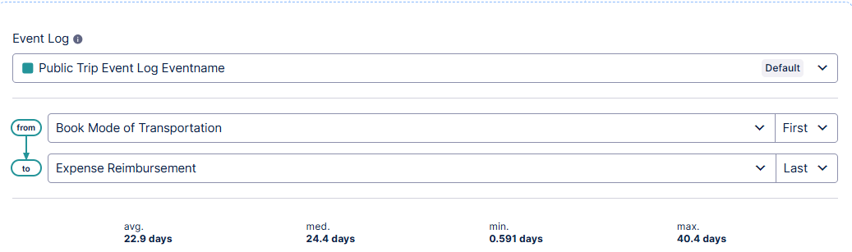
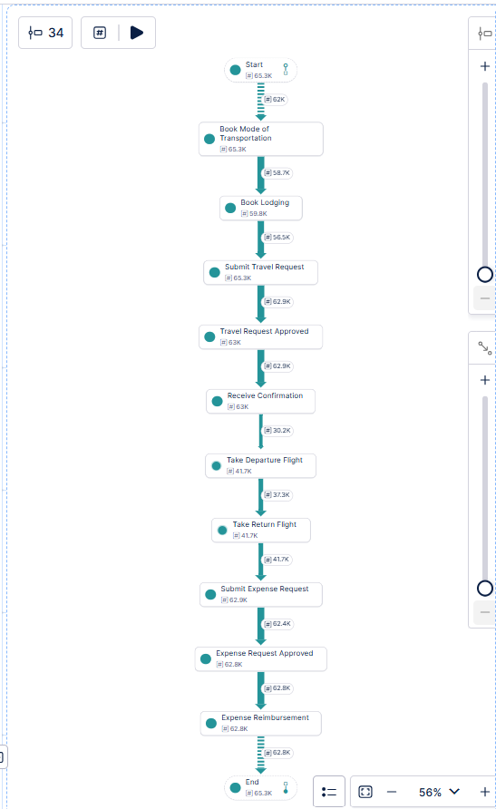
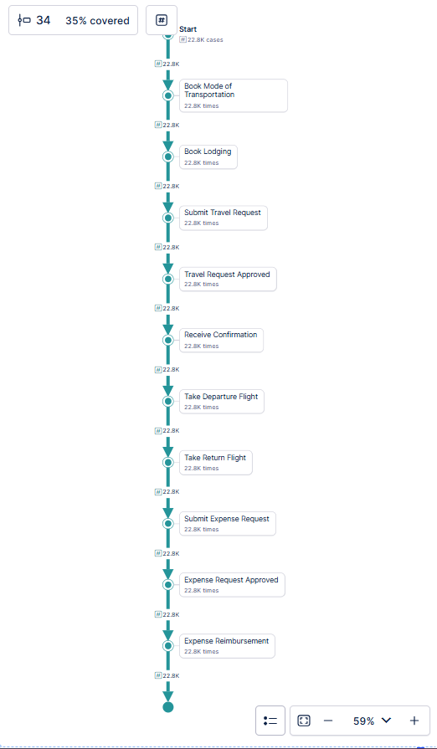
Process Mining: Inefficiencies & Pain Points
Key Findings
Average travel process takes 22.9 days.
Some trips require up to 40.4 days.
Most trips follow a single standard process variant.
Expense reimbursement is the longest stage.
Business Impact
Long processing times delay reimbursements and reduce operational efficiency.
Recommendations
Automate approval and reimbursement workflows.
Monitor delayed cases with automated alerts.
Prioritize carbon-aware approvals for high-emission trips.
Executive Takeaway
Process Mining reveals operational bottlenecks that can be automated to improve efficiency and sustainability.

Slide 6
Low-Carbon Recommendations & AI Solution
Quantified Recommendations
1. Shift Business Class → Economy
30% of eligible trips
• ≈ 6.95M kg CO₂ avoided (3 years)
• ≈ $9M travel cost savings
2. Increase Rail Adoption
• Replace short-haul flights with rail
• Train has the lowest average emissions
• 0 High-Carbon trips
3. Reduce Premium Travel
• Restrict unnecessary Business & First Class travel
• Prioritize virtual meetings where feasible
3-Year Roadmap
Phase 1 (0–6 Months)
• Deploy AI screening
• Promote rail travel
• Reduce Business Class usage
Phase 2 (6–18 Months)
• Carbon-aware approvals
• Department carbon budgets
• Automated policy checks
Phase 3 (18–36 Months)
• Enterprise carbon optimization
• Continuous AI monitoring
• Progress toward Net Zero 2030
AI-Powered Travel Approval
Random Forest Model
Accuracy: 99.16%
ROC-AUC: 0.9976
The model predicts High-Carbon Trips before approval, enabling sustainable travel recommendations.
Travel Request
AI Prediction
(Random Forest)
Low Carbon
High Carbon
Approve
Suggest Rail / Economy / Virtual Meeting
Executive Takeaway
Combining Process Mining with AI enables proactive, data-driven travel decisions that reduce emissions while maintaining business efficiency.

Slide 7
Strategic Integration Roadmap
.
Implementation Journey
Phase 1
Deploy AI-based trip screening
Introduce carbon-aware approvals
Promote rail for short-haul travel
Phase 2
Automate sustainability policy checks
Department-level carbon dashboards
Monitor emission KPIs monthly
Phase 3
Enterprise-wide carbon optimization
Continuous AI model improvement
Achieve Net Zero 2030 targets
Expected Business Value
Environmental
Lower travel emissions
Fewer high-carbon trips
Faster progress toward Net Zero
Financial
Lower travel costs
Better budget control
Reduced premium travel
Operational
Faster approvals
Automated policy compliance
Better visibility into travel decisions
Executive Takeaway
Integrating Process Mining, dashboards, and AI creates a scalable framework for sustainable business travel.

Slide 8
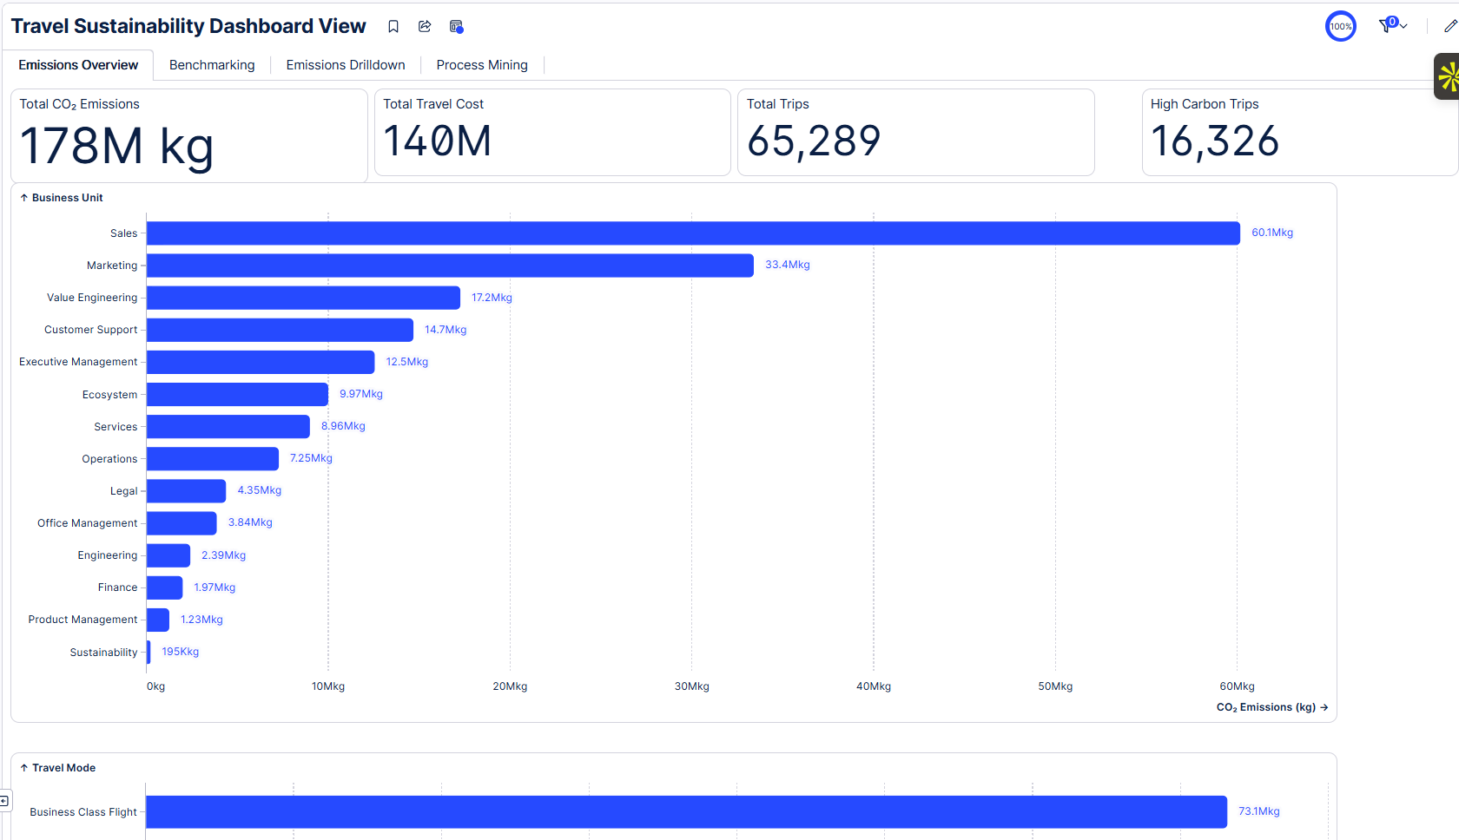
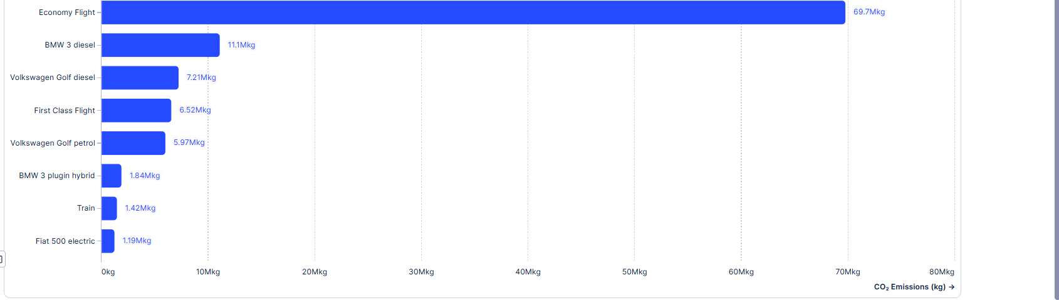
Dashboard View – Emissions Overview
.

Slide 9
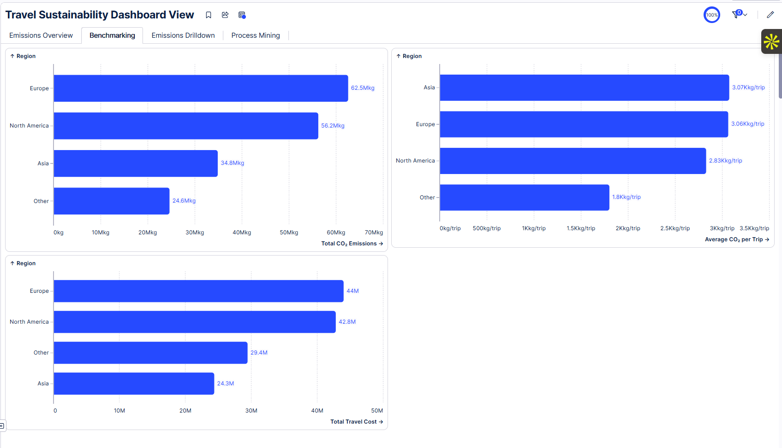
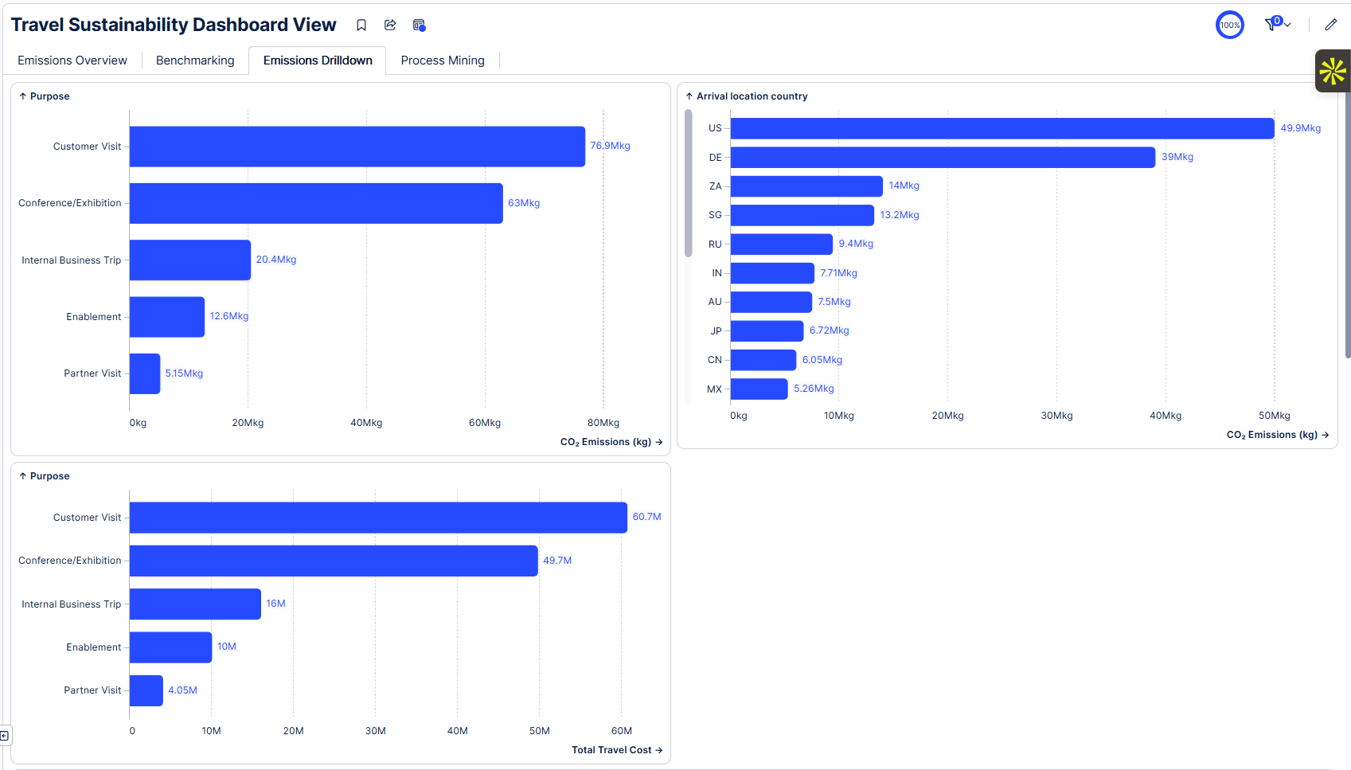
Dashboard View – Benchmarking & Emissions Drilldown

Slide 10
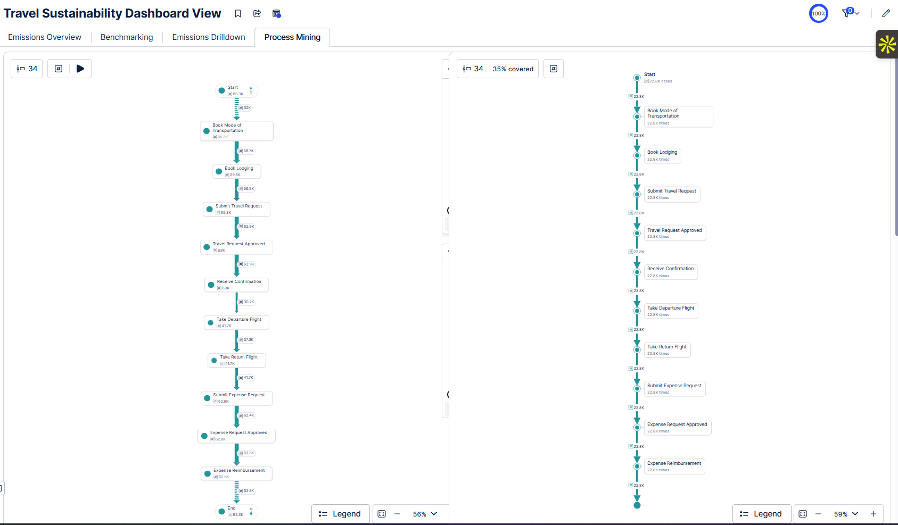
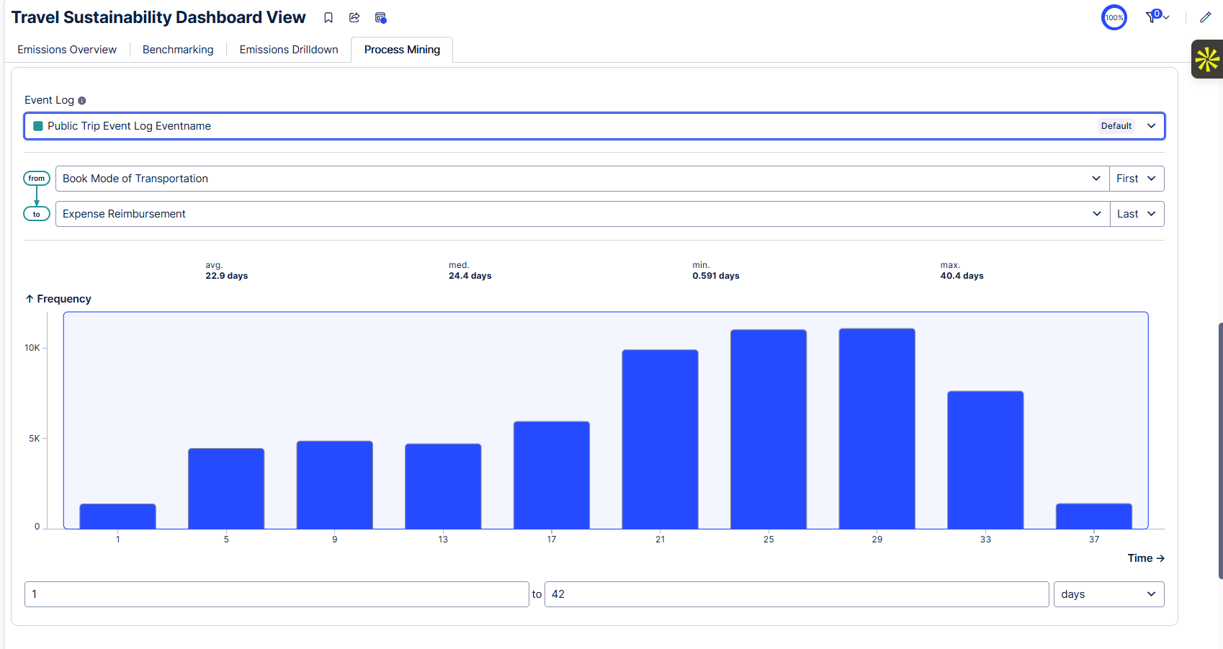
Dashboard View – Process Mining (Process Explorer + Variant Explorer + Throughput)

