Slide 1
Data flow
Spectrum info: dose,
angle etc.
Load data:
- new file (user selected)
- previous session (from pixek.ini)
Plot data (optional)
Plot data (optional)
Plot data (optional)
Plot data (optional)
SpectrumData
modules/InputData.py
spectrum.Xi
spectrum.Yi
spectrum=SpectrumData()
loadSpectrum(self)
Calibration
(optional)
dataMapped(self):
xmapping=XaxisMapping()
Spectrum.dataMapped()
Data (optional) reduction, range
dataReduce(self):
Spectrum.dataReduce(self)
Denoising
(optional)
modules/filteringData.py
filterData(self):
filtr=Filter()
self.filtr(….)
Background
Removing
plotRemoveBackground
Save calibrated spectrum
Open calibrated spectra (Multispectra analysis)
Angular scan

Slide 2
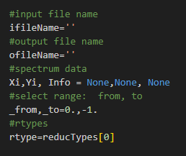
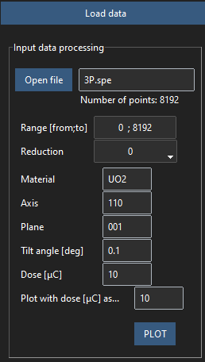
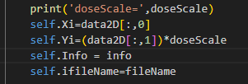

Slide 3
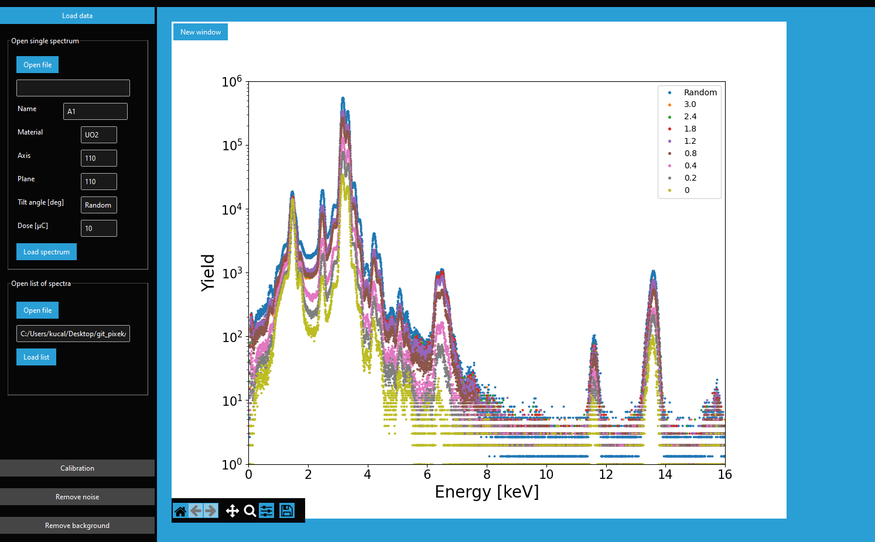

Slide 4
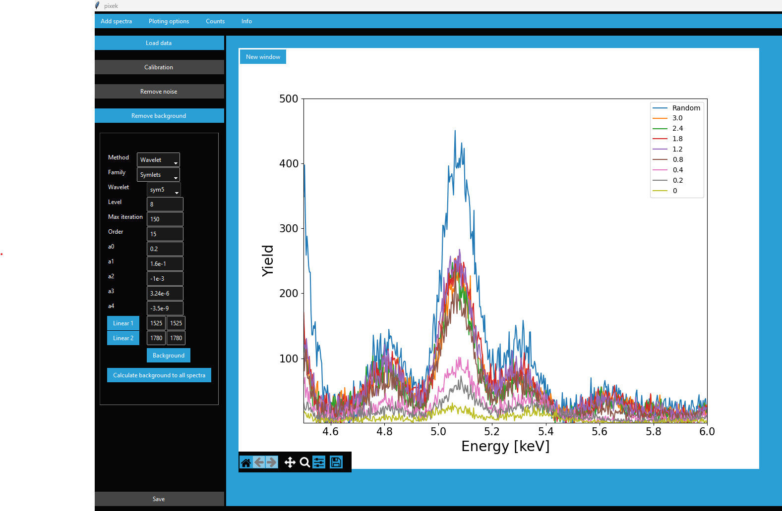

Slide 5
