Slide 1
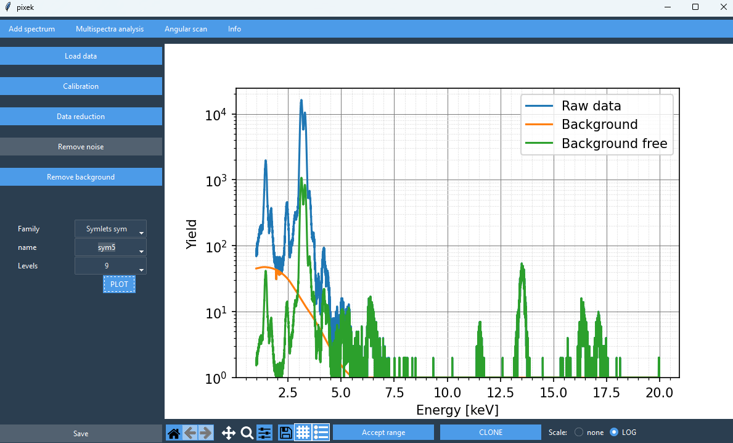
pixek
The PIXEK code developed for PIXE/C analysis:
Python-based code
Wavelet analysis is used for beckground reduction
For each spectrum the code provides the intensity of the relevant signal peaks
Multiple spectra can be analyzed in the same time
The final result is angular scan for the selected energy spectrum
Important feature: ability to operate efficiently with minimum user intervention
Authors: E. Kucal, K. Skrobas, C. Mieszczyński
Copyright (C) 2025
pixek.py is free software: you can redistribute it and/or modify it under the terms of the GNU General Public License as published by the Free Software Foundation, either version 3 of the License, or (at your option) any later version. pixek.py is distributed in the hope that it will be useful, but WITHOUT ANY WARRANTY; without even the implied warranty of MERCHANTABILITY or FITNESS FOR A PARTICULAR PURPOSE. See the GNU General Public License for more details. You should have received a copy of the GNU General Public License along with this program. If not, see http://www.gnu.org/licenses/.

Slide 2
pixek
Before start:
install the following packges:
scikit-ued package from: https://github.com/LaurentRDC/scikit-ued/tree/master tkinter,e.g.:
pip install tk PyWavelets: https://github.com/PyWavelets/pywt
pip install PyWavelets
matplotlib, scipy, numpy packages: pip install matplotlib, numpy scipy
----------------------------------------------------------------------------------------------------------------------------------
Run program:
$ python3 ./pixek.py

Slide 3
pixek
The main interface (on the top of app) contain four options for analysis:
Add spectra,
Mulitispectra analysis,
Angular Scan,
Info.
The options appear after selecting a choice.
Begin by loading the data into the pixek.
You can find this option by selecting the ‘Add spectra’.

Slide 4
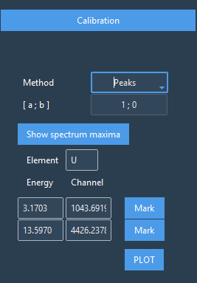
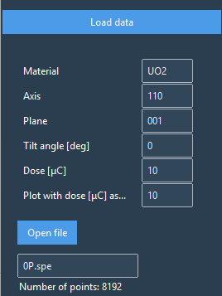
Add spectrum
Load data
The first step is to add the spectrum – choosing file is possible by click to Open file. The user should load spectra with adding necessary information about experimental spectra, later on needed to create angular scan like tilt angle or dose. Information about the dose are important to rescale the spectrum and have possibility to compare spectra collected with different tilt angles.
Note: Once the file is uploaded, all information provided in the labels is assigned to our spectrum. Opening file save a new spectra with data that are in labels, so after notice mistake in info, please reload spectra.
Calibration
There are two calibration methods:
- E=ax+b with parameters a and b (if it was provided after experiment)
- Peaks with finding characteristic peak for elements that occur in investigated matrix, the code can help to find maximum of the spectra by Show spectrum maximum and than you can input known energy of the peak for calibration and Mark it on the plot. Calibration occurs after click on PLOT button.
Run calibration
Calibrated spectra automatically are send to multispectral analysis, in case user wants to perform multispectral analysis.
Open spectrum
and load spectrum data

Slide 5
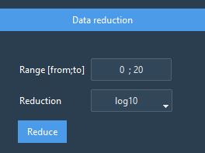
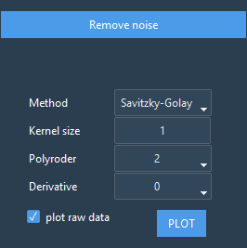
Add spectrum
Data reduction & Remove noise
For continuation of the analysis data reduction is possible, it is recommended to cut spectra for interested part and also reduction data to sqrt or log (don’t worry, later on data will be plot as there was no reduction, it is needed just to better background reduction)
If there is need the noise can be removed from the data by two options: moving-average and Savitzky-Golay filter.

Slide 6
Add spectrum
Next step is background removal with wavelet method.
The user can choose from five families of wavelet and than
specify name and also level of wavelet.

Slide 7
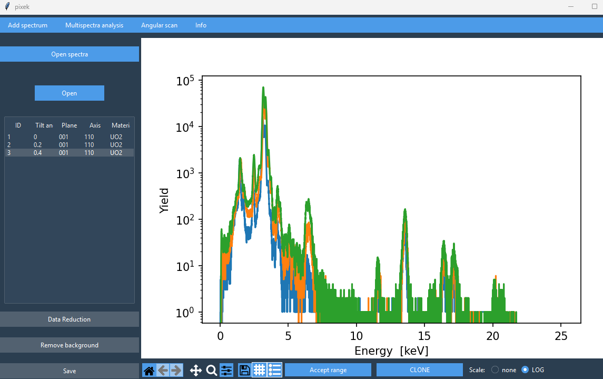
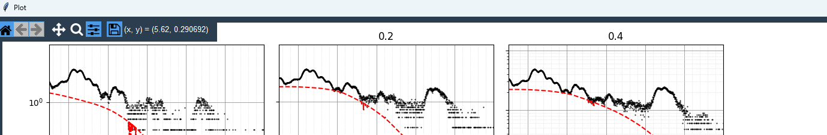
Multispectra analysis
Earlier calibrated spectra are transferred automatically to multispectral analysis,
And thus it is possible to make background removal in the same time for all of spectra, in multispectral analysis it is possible to make data reduction
(the same as for one spectrum analysis) for cut data range and make a log or sqrt from function, later on wavelet analysis can be done for background removal.
The code automatically are sending analized
spectra to Angular scan option.

Slide 8
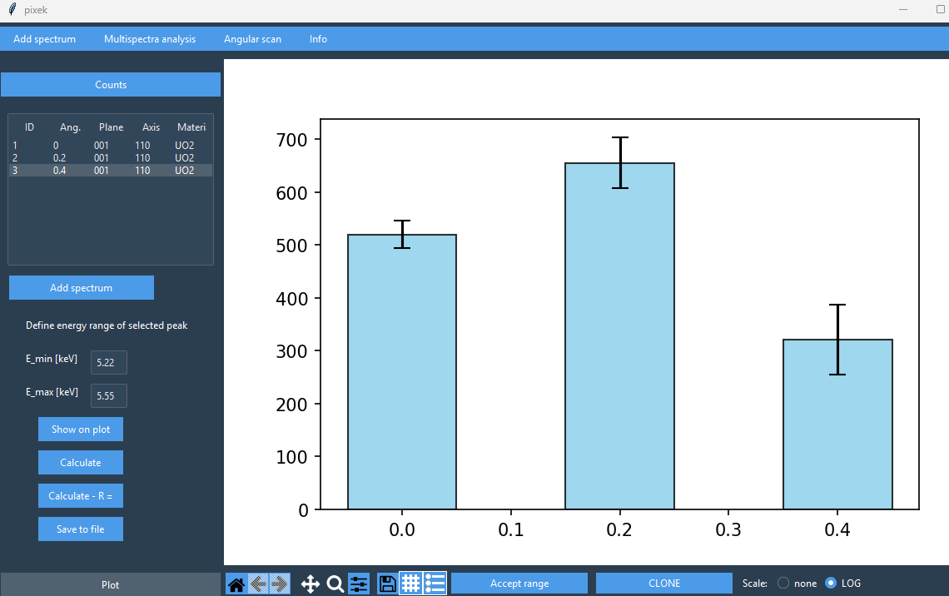
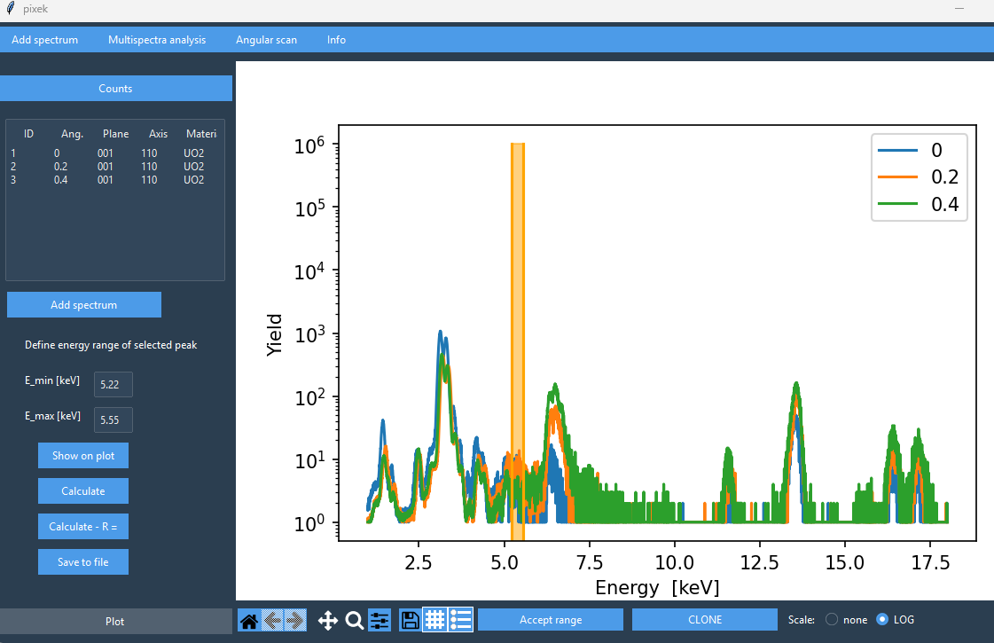
Angular scan
Pixek integrated counting from selected energy range for previously analyzed spectra. In PIXE/C counting the calculation can be done also with normalization to random calculation. Please note that this option is possible only when random spectra was added as name R. Analysis is made for choosen angles and later on data can be saved with chosen name. This date with the same name as was declared for file name are sent to angular scan option.

