Slide 1
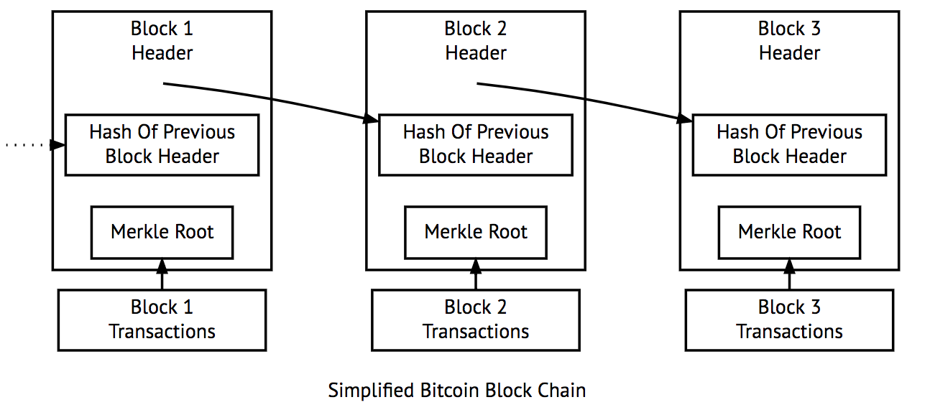
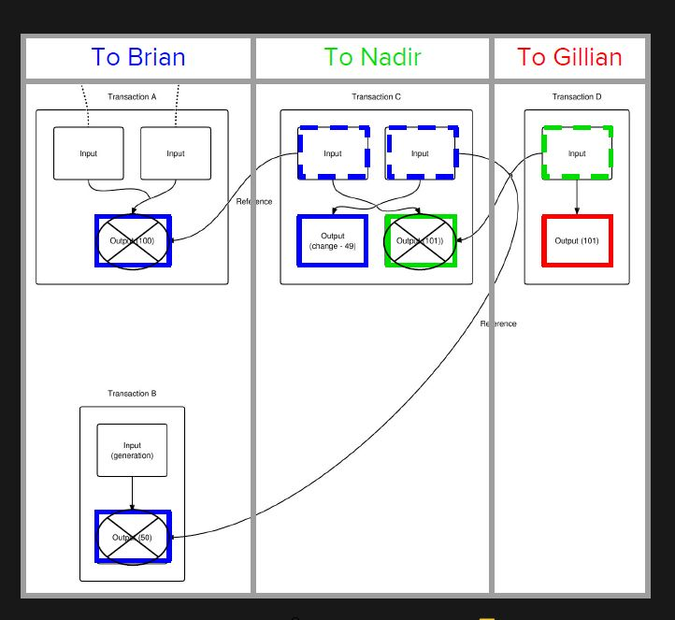
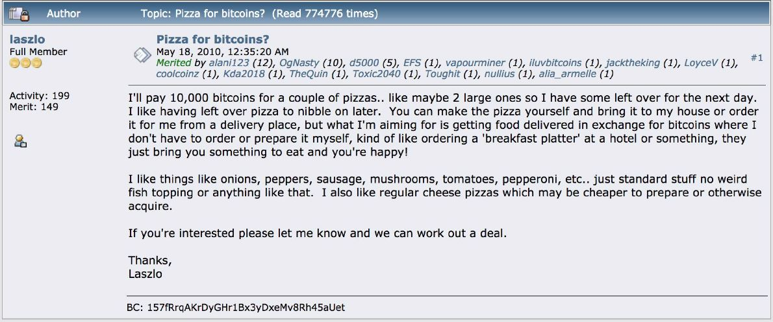
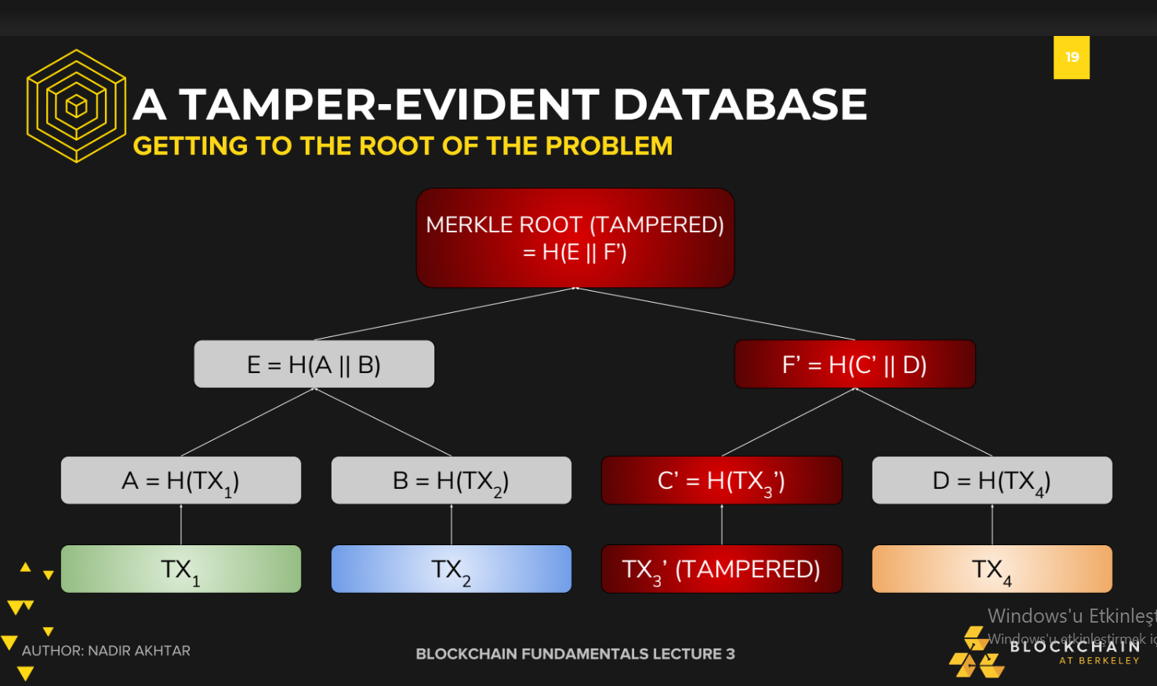
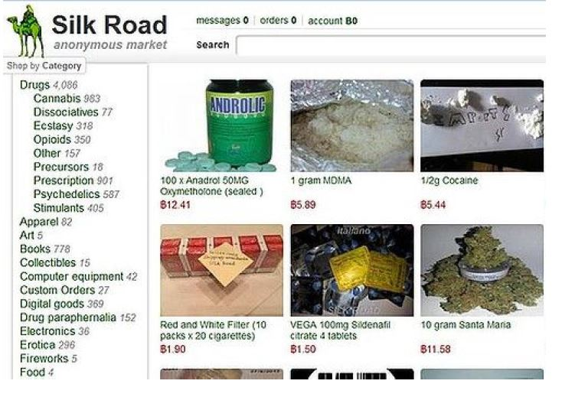
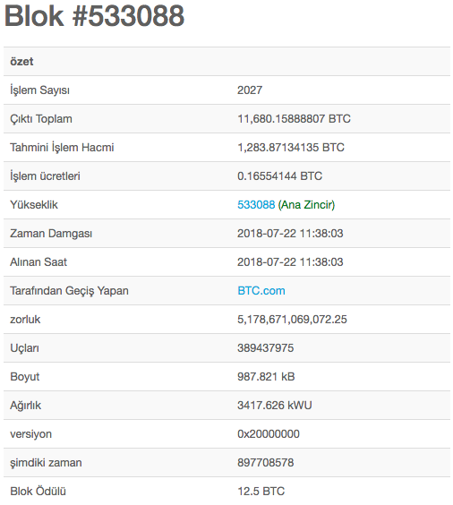

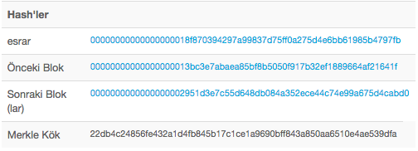
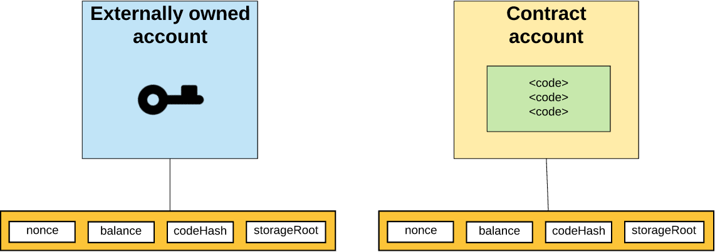
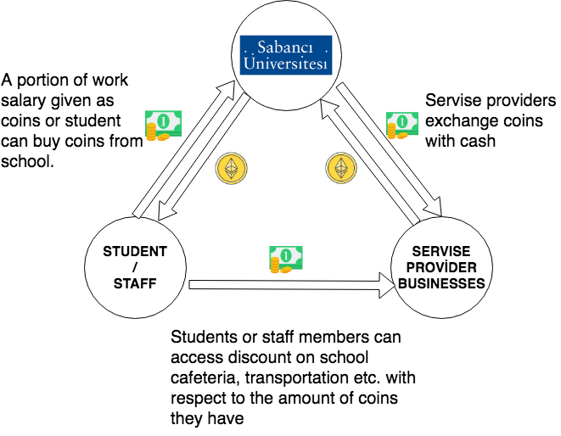
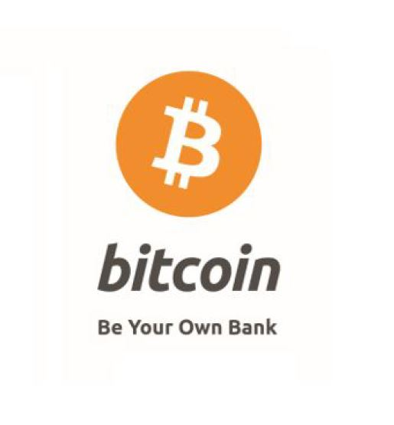
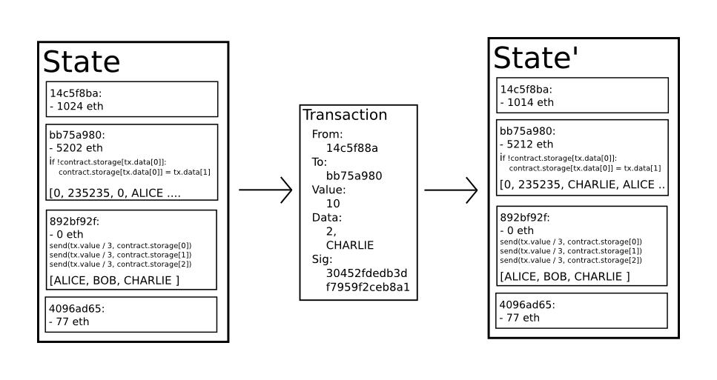
BLOCKCHAIN TECHNOLOGIES
Ekin Oskay Görkem Kir
Umut Barut Orhun Barış
Kamer Kaya
What is Blockchain ?
Identity
With identity, people can receive, claim, spend the Bitcoin. Identity provides a random private key, then public key is created corresponding private key. Public key is for receiving money, private key is for accessing the account to manage.
Transaction
Transaction is valid when three conditions are satisfied;
Proof of ownership: There must be a signature of ownership.
Available funds: Users must have enough amount of Bitcoin.
No double spending: Other transactions can’t use the same funds.
Record Keeping:The Blockchain
Transaction ledger is stored with distributed database, everyone on the
system stores the ledger.
Consensus (Proof-of-Work)
To prevent double spending, every transaction must be validated by the other peers. Bitcoin has anonymous identity, so people can have multiple accounts to take opportunities of cast vote. That is why Bitcoin validation protocol uses resources instead of cast votes. Peers use their CPU power to vote. They have voting power as much as used power. (System assumes majority of the network is honest)
Some History of Bitcoin
$74 million = 2 Pizzas
Bitcoin is the most valuable cryptocurrency today.
Before the Bitcoin gets valued, there was a trade
which a guy bought two pizzas for 10,000 Bitcoin,
today it’s value is ~$74 million.
Bitcoin Theft
Mt. Gox was the biggest online bitcoin exchange
market. More than %70 of transactions were being
occurred via Mt. Gox. In 2014, Mt. Gox lost 744,408
bitcoins in a theft, then Mt. Gox declared bankruptcy.
Bitcoin in Illegal Use
Due to Bitcoin anonymous protocol, it is used in the
black market for illegal goods. Silk Road was one of
them, it was sold goods for Bitcoin via Tor network.
It was shut down by FBI with seizing $3.5m in Bitcoin.
A blockchain is a distributed ledger that basically holds a list of records in semi-ordered manner. A copy of this list exists at every computer within the Blockchain network. In this project, we are interested in the technical details and use cases of this new technology.
Blockchain could be public or private, it depends on the cryptocurrency, but in Bitcoin, the blockchain is public.
In blockchain, every block has many transactions which contain key information like amount, sender, receiver (in our bitcoin case).
Every block has a header which holds “Merkle Root” and “Hash of previous block header” and every block has a list of transactions within its body.
In header, hash of previous header is there for making sure that block is not altered. When someone changes the previous block, its hash value changes which affects all the chain and makes the malicious activity visible to anyone.
Merkle root is a sort of signature of transactions witin that block’s body part.
Here, when someone changes a transaction it would change specific hashes and it will result in a different Merkle root and which makes blockchain unconsistent
Hash of the previous block, merkle root and nonce must be smaller than the target.
Computers are continually tries to guess this value. They try random values at hash them together and check if it satisfies the condition, if not they try it again until target is reached.
MINING PROCESS
Miners are people that are trying to find a “Nonce” that satisfies that given target. It could be assumed as throwing darts blindfolded. While you are blindfolded, throwing to any place is equally likely but if you throw faster, you can hit the target faster. In Bitcoin, if you have superior hardware, you have the advantage in this challenge. Miners are earning bitcoin by verifying the blocks
What is Ethereum?
Ethereum
Ethereum is a decentralized platform that use smart contracts to run applications on a custom blockchain. This blockchain has powerful associated global connections that can share valuable items and contain ownership of possessions.
This features give opportunities to create markets, store given promises or record of charges, make action with funds based on instructions given in past and many different things that have not been think about yet.
Vitalik Buterin is a developer from Toronto who is the creator of Ethereum. He focused on the blockchain, crypto technologies and Bitcoin in 2011. Then, he came up with an idea of a platform that gives the opportunity to develop other decentralized application beyond the financial usage with the smart contract.
Ethereum design based on the following 5 principles:
Simplicity: Ethereum protocol should be as simple as possible to protect over data storage or time efficiency.
Universality: Ethereum provides its own script language which developers can use to create contract or transaction type.
Modularity: Ethereum created as possible as modular and separable.
Agility: There is the opportunity to make the change on high-level constructs
Non-discrimination and Non-censorship: Ethereum protocols should prevent to attempt any restriction and any discrimination which come from central authorities.
Puregold
Puregold is a cryptocurrency idea that was designed by team and supervisor in order to research the common uses of blockchain and cryptocurrencies and implement a version for in-campus usage.
Puregold rewards a discount for in-campus purchases with respect to currently stored puregold count in users account. This idea was designed to raise awareness about blockchain in general.
Accounts
Accounts are objects that able to interact with each other. There are two types of account which are external owned account and contract account. External owned accounts can create signed transaction with its own private key then can send a message to any other external owned account or contract account. Ethereum accounts occurred by four states which are nonce, ether balance, hashed code and storage.
As diagram states, puregold idea aims to bring a in-campus usage for blockchain within cryptocurrencies. Puregold is being generated by school and distributed via work salary/direct purchase. After discount benefit is used. Puregold is collected by service providers in campus and then exchanged with money with school to complete the cycle.
Transaction and Messages
Basically, transactions are data package that generated and singed by external owned accounts and includes message, then submitted to blockchain.
All transactions contain:
Nonce : count of number of transactions sent by sender.
The recipient of the message
The address of the sender
The amount of the ether to transfer
Optional data field
The maximum amount of the gas that sender will pay to execute transfer
Gas price
Proof of Stake
Proof of Stake is the consensus protocols as an alternative to proof of work, to use consensus on which block will be the next in blockchain. Creator of next block selected by the randomized system according to how much cryptocurrency account have or how long account has been holding that particular currency rather than computational power as proof of work system.
Possible advantages of proof of stake against proof of work are that:
It reduce to energy consumption while add the new block on blockchain.
There is no need to create many new coins in order to encourage miner to continue mining process.
Proof of stake more secure against %51 attack than the proof of work.
What is Bitcoin?
Bitcoin is a kind of cryptocurrency which exists purely in the digital realm first
time used in 2009. It born out of the Cypherpunk movement, a libertarian
struggle for privacy and self-governance. Invention of blockchain inspired the
creation of Bitcoin by Satoshi Nakamoto who an anonymous identity.
What does Bitcoin provide?
- Account and identity management: Every user has an address and each
of them relevant with amounts of currency.
- Services: Users can do transactions between each other via other users.
- Record management: Redundant information is stored by other users which
are on the system via a blockchain.
- Trust: Trust comes from personal encouragement aligning with community goals.
BIBLIOGRAPHY
https://www.g2crowd.com/categories/blockchain
https://medium.com/fluree/blockchain-for-2018-and-beyond-a-growing-list-of-blockchain-use-cases-37db7c19fb99
https://hackernoon.com/bitcoin-ethereum-blockchain-tokens-icos-why-should-anyone-care-890b868cec06 -resim2
https://www.youtube.com/watch?v=Lx9zgZCMqXE
https://www.youtube.com/watch?v=V6gLY-1G4Mc
Lecture 01 - Bitcoin Protocol and Consensus_ A High Level Overview- Blockchain at Berkeley.
Lecture 02 - Bitcoin to Blockchain History- Blockchain at Berkeley
Lecture 03 - Bitcoin Mechanics and Optimizations_ A Technical Overview- Blockchain at Berkeley. (3 ve 4. resimler)

