Slide 1
NYC Neighborhoods transformation & development
JC Soliman
Emmy Kuo
Michana Pubien

Slide 2
What neighborhoods should we invest in?

Slide 3



our journey
immense potential in NYC real estate investing
complex landscape requires methodical analysis
stage theory tells us when to invest
insights are in the 3 Ps
data is gold but requires patient digging
technology is key but requires effective design thinking

Slide 4
our technologies
SQL
tabula py
holoviews
APIs
socrata
pandas

Slide 5
our approach
construct an accurate snapshot of NYC neighborhoods
explore growth trends by neighborhood
develop a method to rank investment worthiness
evaluate the effectiveness of each method

Slide 6
the variables
people
place
policy
income & crime
sales & development
opportunity zone
IRS NYPD
DOF DOB
NY ESD

Slide 7




data exploration
Crime >> NYPD
Challenges :
- Not enough reliable data
- No available precinct mapping
Opportunity Zone >> NY State
Challenges :
- Only available as a PDF
Sales >> NYC DOF
Challenges :
- Unexpected data types
- Errors merging dataframes
Income >> IRS
Challenges :
- Inconsistent data structures
- Dealing with several data files

Slide 8
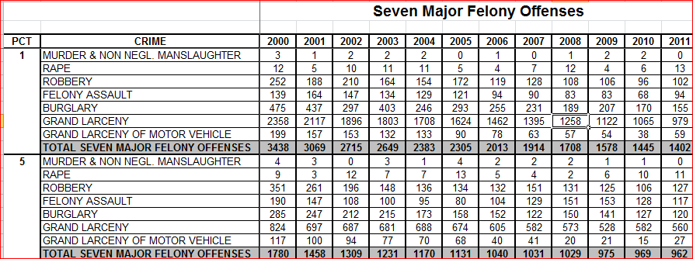
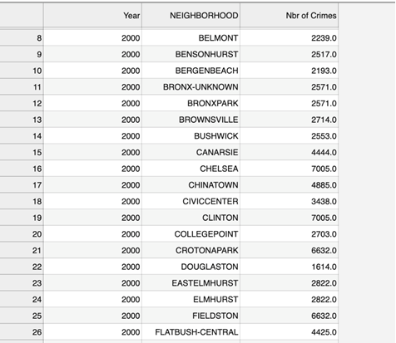
our data -> crime
Raw Crime Data by Precinct
Cleaned data by Neighborhood
Data was unstacked, melted & cleaned
Mapped Pct to nbhd’s
Mapped nbhd’s to JUNCTION neighs.

Slide 9
our data -> sales
80 spreadsheets
1 SQL database
5 csv files
Combined sales dataframe
Calculated sales metrics
JUNCTION TABLE

Slide 10
our data -> development
OPEN DATA API
Dataframe
Dataframe with Neighborhood
Calculated development metrics
JUNCTION TABLE

Slide 11
our data -> income
file names
title rows
1 df
nuanced nulls
ZIP
ZIP- neighbor-hood
column orders
column names
merged cells
inconsistent
missing pk
normalized

Slide 12


our data -> opportunity zone
PDF
tabula py
clean up
normalize

Slide 13
putting it together
Crime
Precinct #
Opp. Zone
Census tract
JUNCTION TABLE
Neighborhood
Borough
Income
Devt.
Block
ZIpcode
Zipcode
Borough
Block
Precinct to Neighborhood
Census tract to Zipcode
Sales
Neighborhood
Borough
Block
ZIpcode

Slide 14

measuring growth
- average rate of change per variable
- average rate of change in the last 3 year
- average rate of change in the last 5 years
- comparing the recent ROC to the historic ROC

Slide 15
our model
Equal Weights for all Variables

Slide 16
our model
Weighting by Completeness of Data (years)
Weighting by Reliability of Data after Cleaning

Slide 17
our model
Incorporating Opportunity Zones
Equal Weights for all Variables
Weighting by Completeness of Data (years)
Weighting by Reliability of Data after Cleaning

Slide 18
our data visualized

Slide 19
our neighborhoods
Soundview
Gowanus
Woodhaven
East Tremont
Rego Park
Jamaica
Longwood
Crotona Park
Redhook
Corona

Slide 20
our recommendations
employ more accurate estimation methodologies such as linear regression
use research-based weighting of variables
explore more sources of data

Slide 21
questions?

