Slide 1
Gemini Data Service Design Review

Slide 2
Purpose
DHS too complex
Difficult to maintain and modify.
Compatibility with GIAPI
Requirements of GIAPI-based Instruments

Slide 3
Overview
Listen for observation events from the instrument
Gather data from observatory systems
Accept external input from systems that cannot be queried externally like Seqexec
Complete the FITS files with data collected during an observation

Slide 4
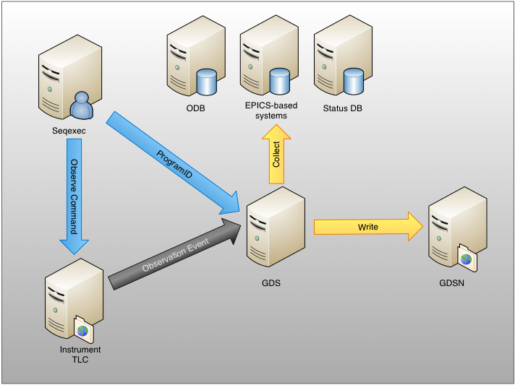
System Diagram

Slide 5
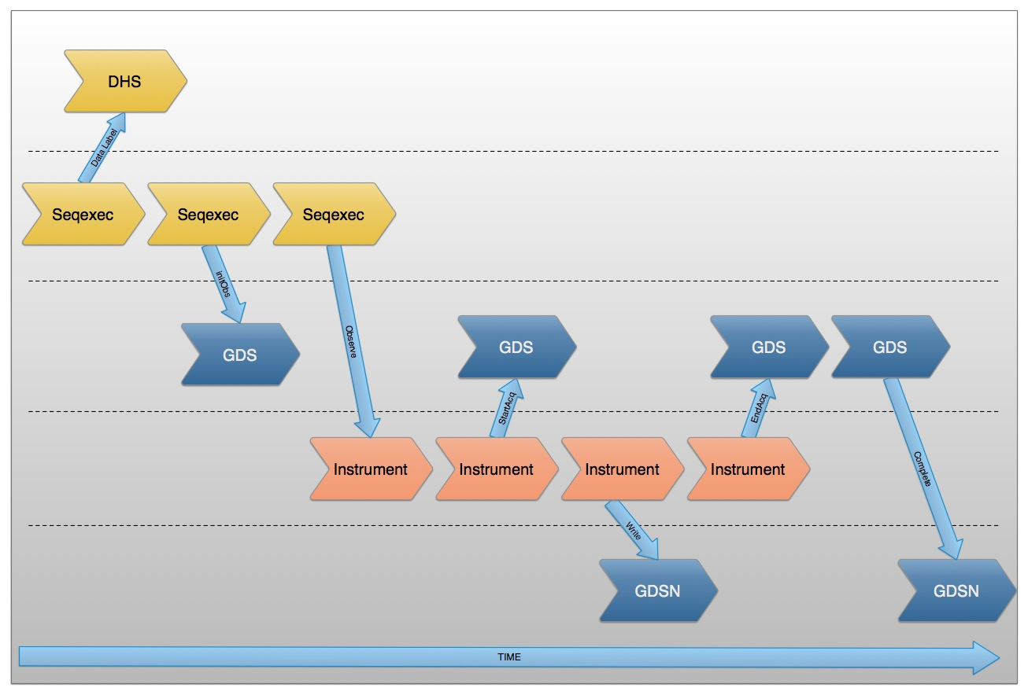
Observation Sequence

Slide 6
Data Values Composition
Listen for Observation Events
Sample data
Add data to the file

Slide 7
Observation Event Driven Data Collection
OBS_PREP
OBS_START_ACQ
OBS_END_ACQ
OBS_START_READOUT
OBS_END_READOUT
OBS_START_DSET_WRITE
OBS_END_DSET_WRITE

Slide 8
Completion of FITS Files
Instrument writes FITS to NFS drive
GDS adds FITS headers

Slide 9
Sending FITS Headers from Seqexec to GDS
XMLRPC

Slide 10
DataLabel Generation
Three alternatives
Keep current setup assuming DHS supports providing DataLabels that will not be populated
Extract common DataLabel Generator Component from DHS
Use independent DataLabel naming conventio

Slide 11
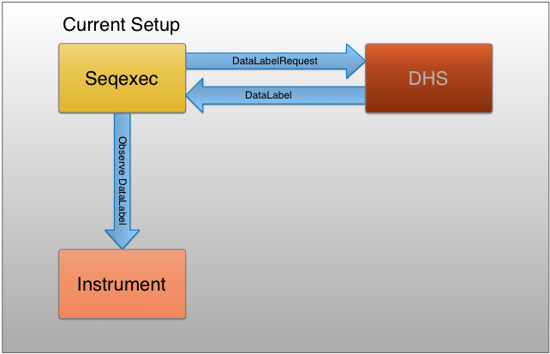

Slide 12
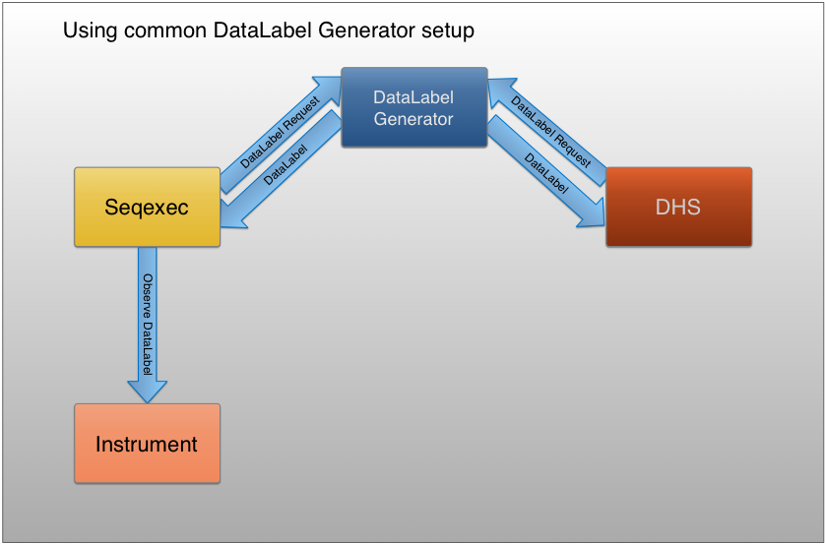

Slide 13
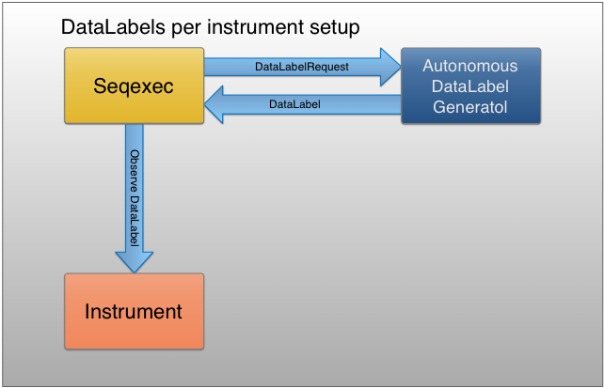

Slide 14
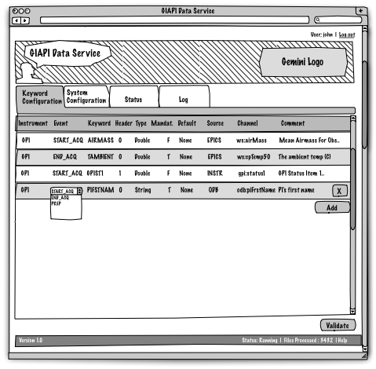
Keyword configuration in edit mode

Slide 15
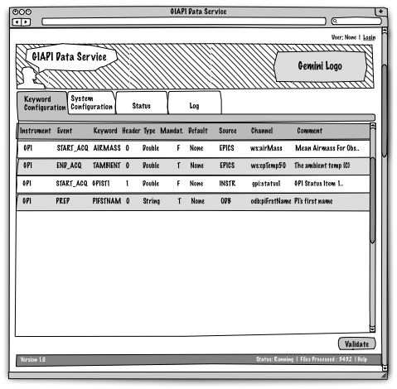
Keyword configuration in read-only mode

Slide 16
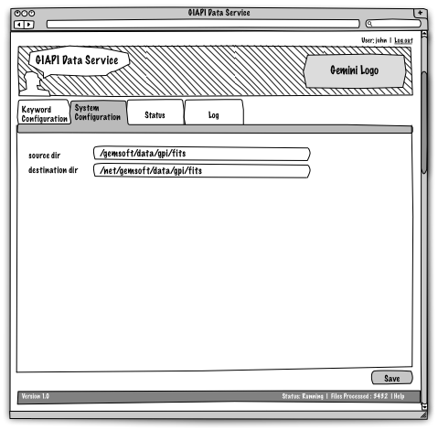
System configuration

Slide 17
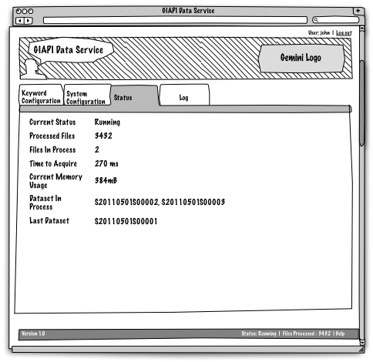
GDS Status

Slide 18
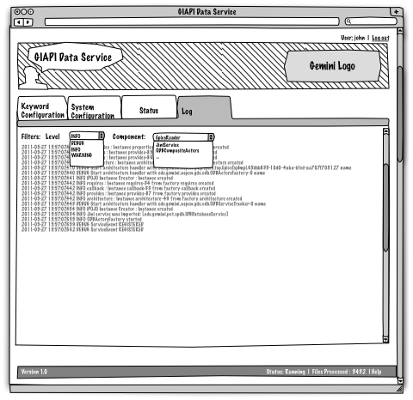
GDS Log

Slide 19
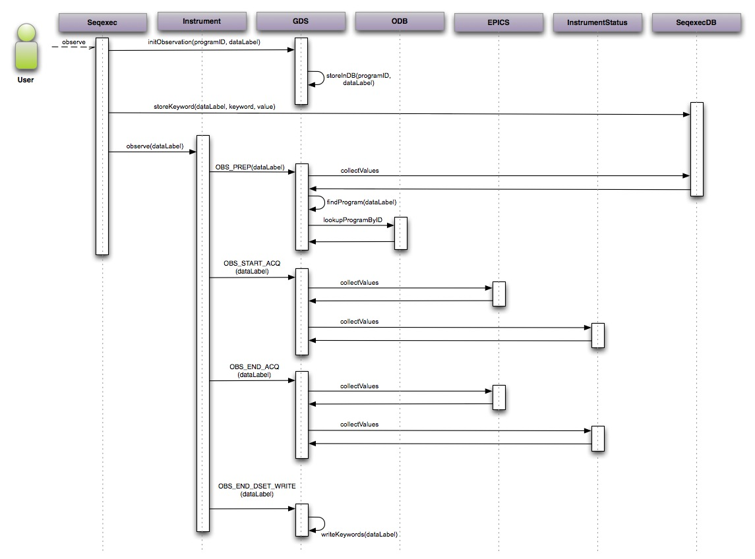

Slide 20
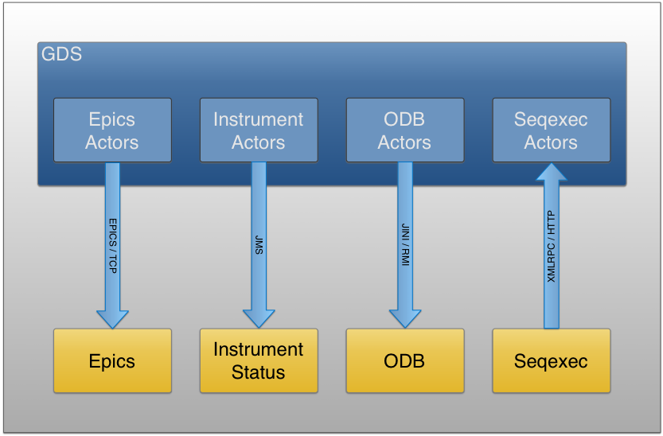
Protocols
EPICS
JMS
XMLRPC
Jini/RMI

Slide 21
Scala
Compiles to bytecode, runs on a standard JVM and transparently interoperates with Java.
Statically typed combined with a type inference mechanism.
Combination of functional and object-oriented paradigms.
The actor concurrency model provides a safe way to build concurrent applications that scale easily.

Slide 22
Operational Aspects
Startup/Shutdown Procedure
Logging
Troubleshooting

