Slide 1
Gemini Data Service Design Review
Carlos Quiroz, Nicolás A. Barriga, Arturo Nuñez

Slide 2
GDS Motivation
Required for GIAPI-based instruments that are not connected to the DHS
Compatibility with GIAPI
Reduce the dependency on DHS complexity
DHS is difficult to maintain and modify
GDS is decoupled from the instrument
Simplified operation?

Slide 3
GDS Overview

Slide 4
Overview
GIAPI based instruments write standard FITS files with a basic set of keywords
GDS completes the FITS files with values collected during an observation
GDS listens for observation events from the instrument that trigger data collection
GDS collects FITS keyword values from observatory systems (OCS, TCS) and instruments
GDS accepts FITS keyword values from external systems that cannot be queried externally like Seqexec

Slide 5
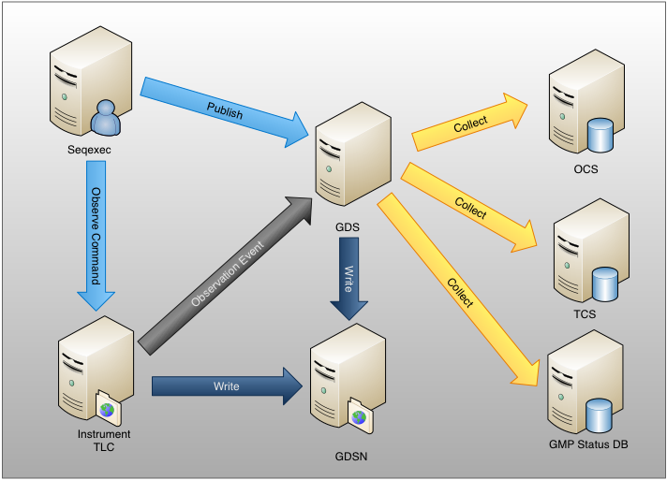
GDS Interactions

Slide 6
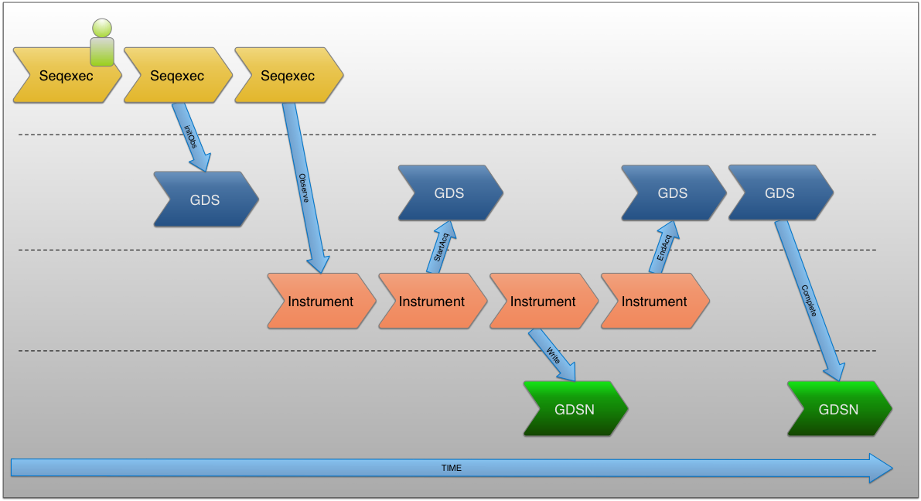
Observation Sequence

Slide 7
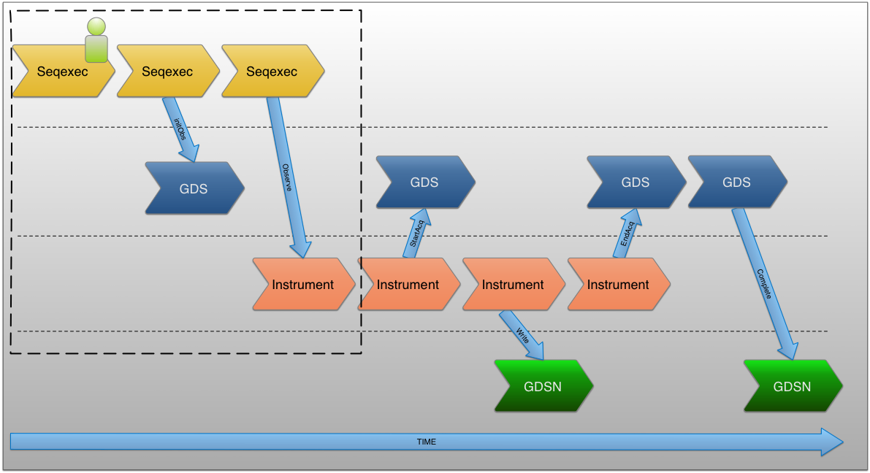
Starting an Observation

Slide 8
Starting an Observation
User initiates an observe through the Seqexec
Seqexec gets DataLabel for the observation’s DataSet
Seqexec sends to GDS the DataLabel and Program ID
Seqexec can send FITS keywords for the current observation to the GDS
Seqexec sends an Observe Sequence Command to the instrument with the DataLabel

Slide 9
Observation Event Driven Data Collection
During the observation the instrument publishes the following observation events
OBS_PREP
OBS_START_ACQ
OBS_END_ACQ
OBS_START_READOUT
OBS_END_READOUT
OBS_START_DSET_WRITE
OBS_END_DSET_WRITE

Slide 10

FITS Keywords Composition

Slide 11
FITS Keywords Composition
GDS listens to Instrument generated Observation Events
GDS collects FITS keywords
It can also accept FITS keywords published by other systems like the Seqexec as explained earlier

Slide 12

Completion of FITS Files

Slide 13
Completion of FITS Files
Instrument writes FITS to GDSN
GDS completes the full set of FITS keywords to the FITS file
Original files are preserved

Slide 14
Implementation Details

Slide 15
DataLabel Generation
Three alternatives
Keep current setup assuming DHS supports providing DataLabels that will not be populated
Extract common DataLabel Generator Component from DHS
Use independent DataLabel naming convention

Slide 16
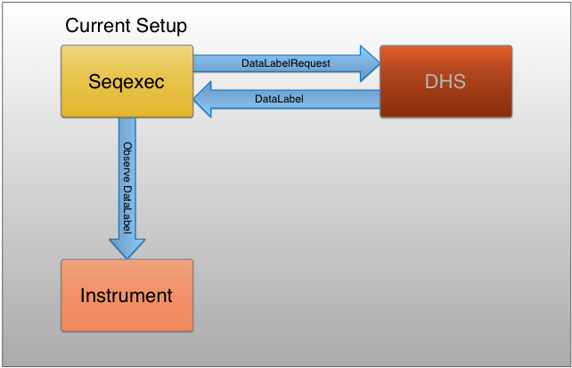

Slide 17
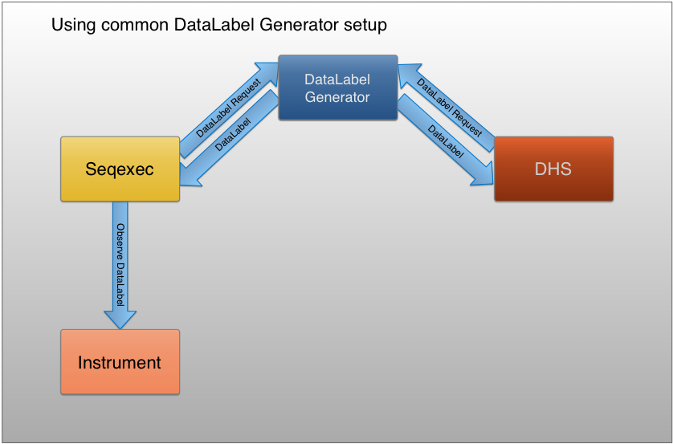

Slide 18
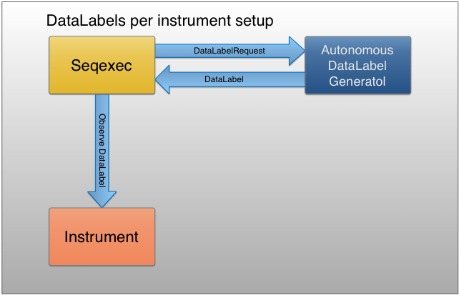

Slide 19
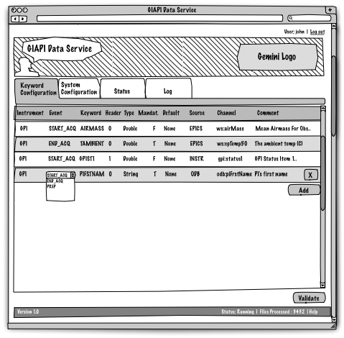
Keyword configuration in edit mode

Slide 20
User Interface
Observations are started form Seqexec
Web-based interface for configuration and status check
Heartbeat and status published for other systems

Slide 21
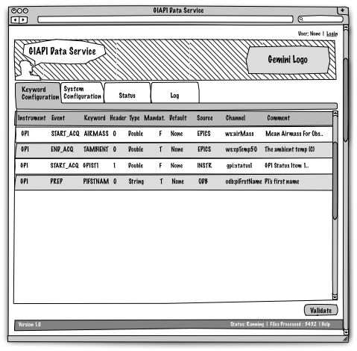
Keyword configuration in read-only mode

Slide 22
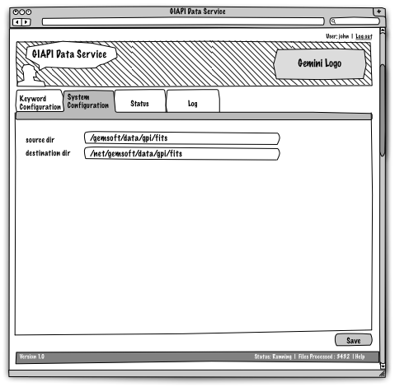
System configuration

Slide 23
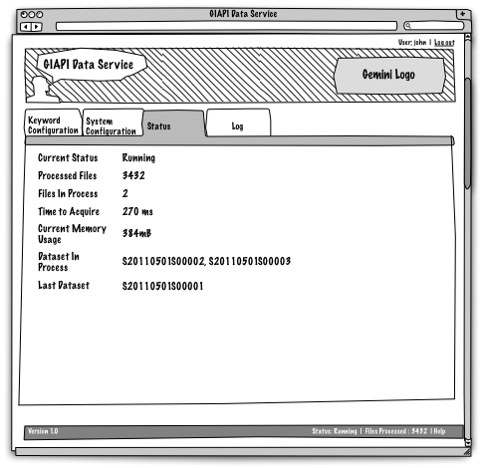
GDS Status

Slide 24
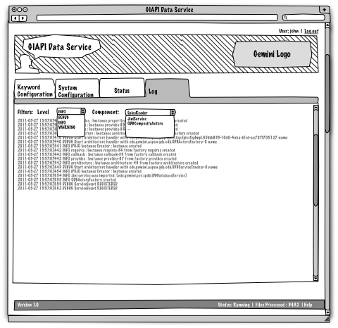
GDS Log

Slide 25
Operational Aspects
Startup/Shutdown Procedure
Logging
Troubleshooting
Heartbeat and status

Slide 26
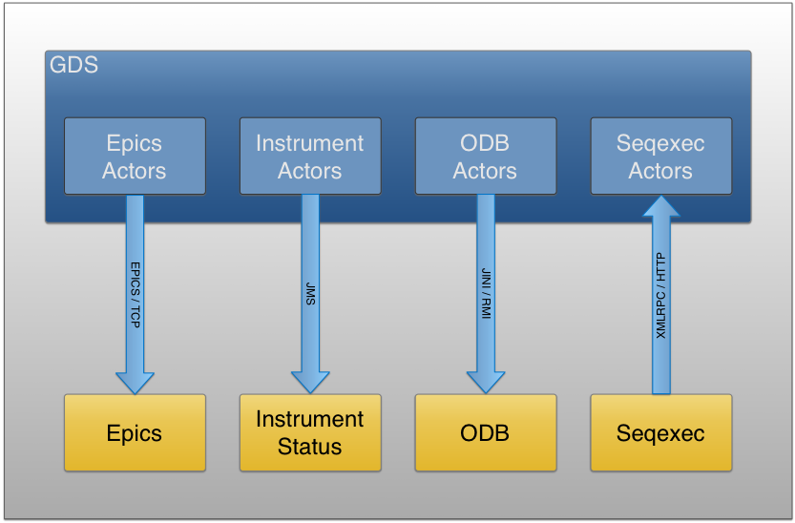
Protocols
EPICS
JMS
XMLRPC
Jini/RMI

Slide 27
Scala
Compiles to bytecode, runs on a standard JVM and transparently interoperates with Java.
Statically typed combined with a type inference mechanism.
Combination of functional and object-oriented paradigms.
The actor concurrency model provides a safe way to build concurrent applications that scale easily.

Slide 28
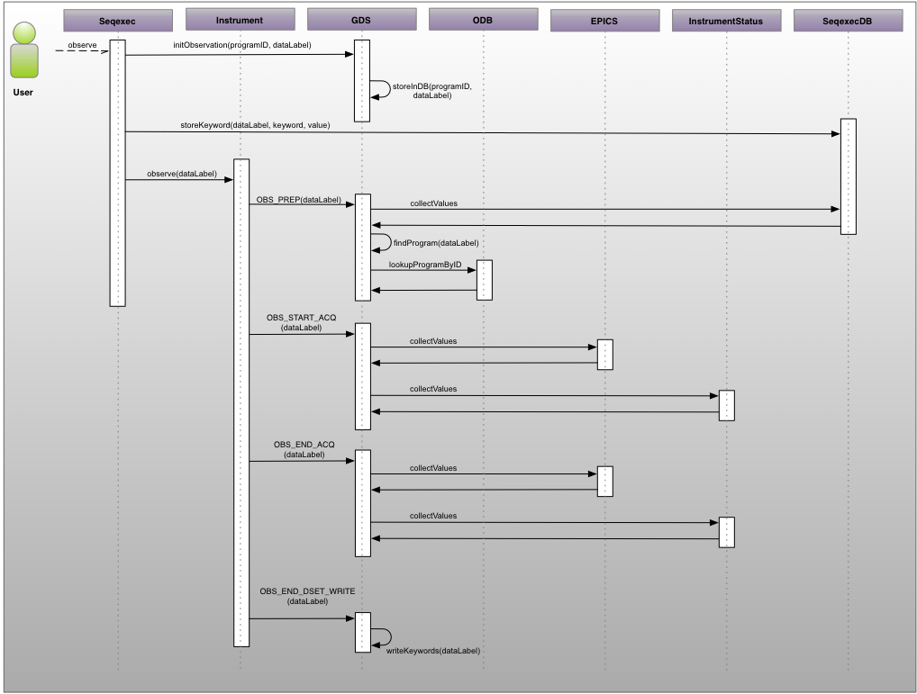
Observation Sequence in Detail

