Slide 1
Gemini Data Service Design Review
Carlos Quiroz, Nicolás A. Barriga, Arturo Nuñez

Slide 2
GDS Motivation
Required for GIAPI-based instruments that are not connected to the DHS
Compatibility with GIAPI
Reduce the dependency on DHS complexity
DHS is difficult to maintain and modify
GDS is decoupled from the instrument
Simplified operation?

Slide 3
GDS Overview

Slide 4
Overview
GIAPI-based instruments write standard FITS files with a basic set of keywords
GDS completes those FITS files with values collected during an observation
GDS listens for observation events from the instrument that trigger data collection
GDS collects FITS keyword values from observatory systems (OCS, TCS) and instruments
GDS accepts FITS keyword values from external systems that cannot be queried externally like Seqexec

Slide 5
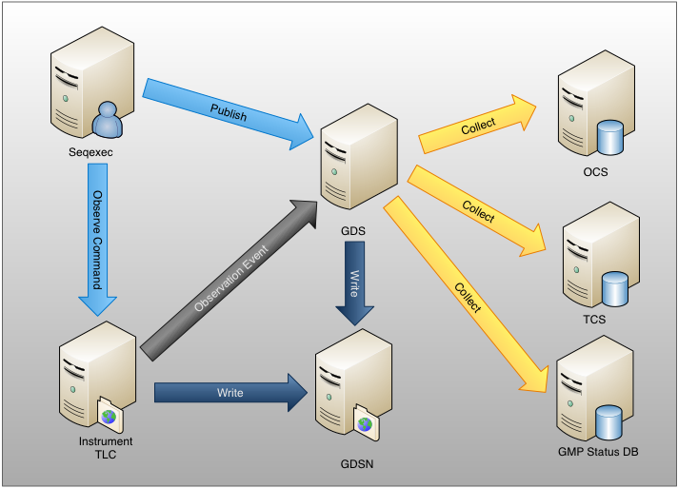
GDS Interactions

Slide 6
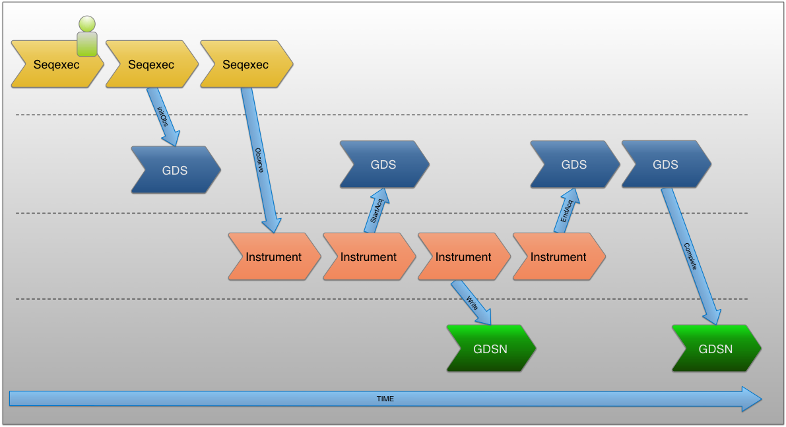
Observation Sequence

Slide 7
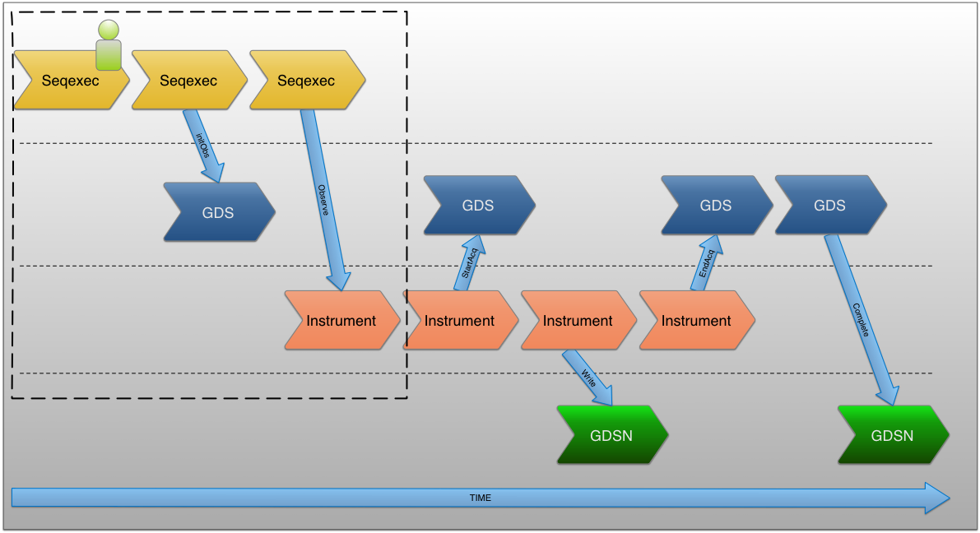
Starting an Observation

Slide 8
Starting an Observation
User signals an observation on Seqexec
Seqexec gets a DataLabel for the observation’s DataSet
Seqexec sends to GDS the DataLabel and Program ID
Seqexec may alos send FITS keywords for the current observation to the GDS
Seqexec sends an Observe Sequence Command to the instrument with the DataLabel

Slide 9
Observation Event Driven Data Collection
During the observation the instrument publishes the following observation events
Event Time | GIAPI Observation Event | Used in GDS
T1 | OBS_PREP | Yes
T2 | OBS_START_ACQ | Yes
T3 | OBS_END_ACQ | Yes
T4 | OBS_START_READOUT | No
T5 | OBS_END_READOUT | No
T6 | OBS_START_DSET_WRITE | No
T7 | OBS_END_DSET_WRITE | Yes

Slide 10

FITS Keywords Composition

Slide 11
FITS Keywords Composition
GDS listens to Observation Events while the Instrument executes an observation
GDS collects FITS keywords on certain events
It can also accept FITS keywords published by other systems like the Seqexec as explained earlier

Slide 12

Completion of FITS Files

Slide 13
Completion of FITS Files
Instrument writes base FITS to GDSN
GDS completes the full set of FITS keywords to the FITS file
Original files are preserved

Slide 14
Implementation Details

Slide 15
DataLabel Generation Alternatives
Keep current setup assuming DHS supports providing DataLabels that will not be populated
Extract common DataLabel Generator Component from DHS
Use independent DataLabel naming convention

Slide 16
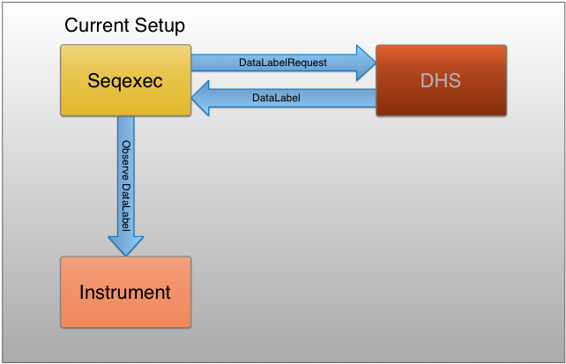
Current setup

Slide 17
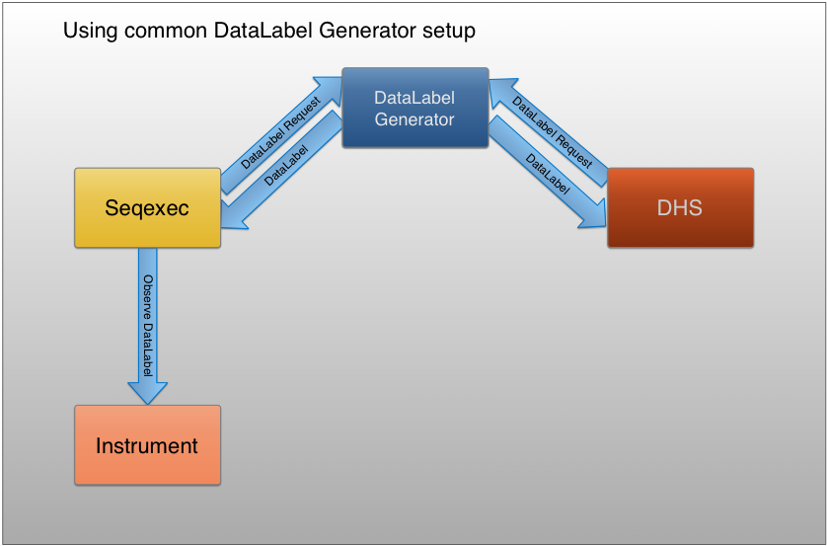
Extraction of common DataLabel generator

Slide 18
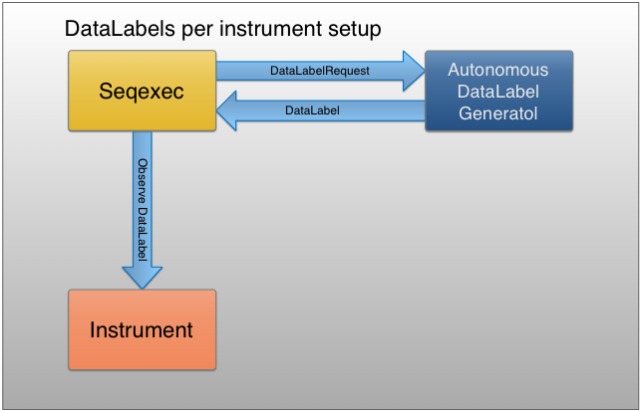
Independent naming

Slide 19
User Interface

Slide 20
User Interface
Observations are triggered form Seqexec
Web-based interface for configuration and status check
Heartbeat and status published for other systems

Slide 21
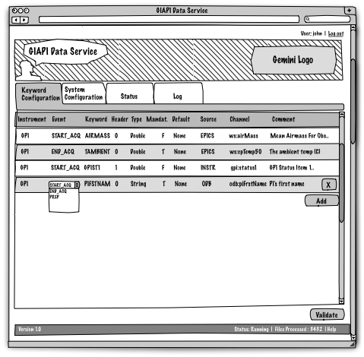
Keyword configuration in edit mode

Slide 22
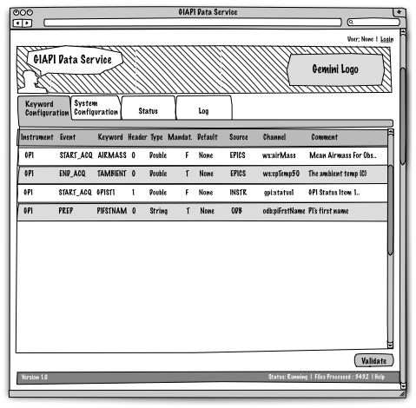
Keyword configuration in read-only mode

Slide 23
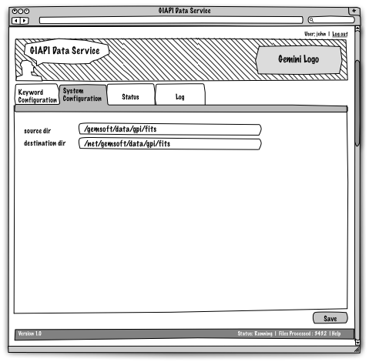
System configuration

Slide 24
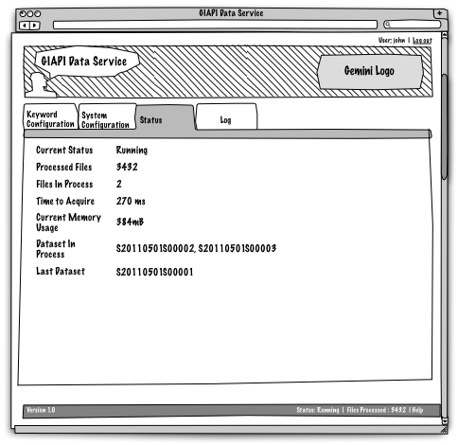
GDS Status

Slide 25
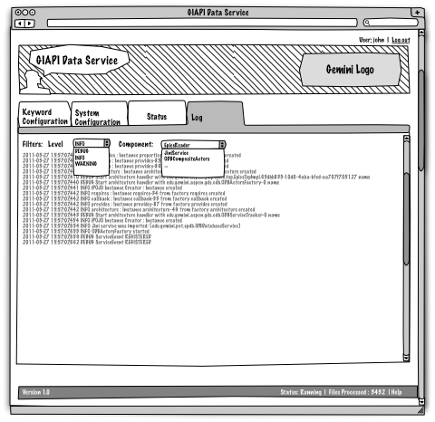
GDS Log

Slide 26
Operational Aspects
Startup/Shutdown Procedure
Logging
Troubleshooting
Heartbeat and status

Slide 27
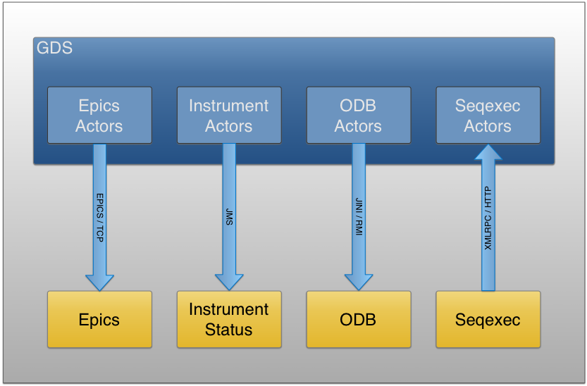
Protocols
EPICS
JMS
XMLRPC
Jini/RMI

Slide 28
Scala
Compiles to bytecode, runs on a standard JVM and transparently interoperates with Java.
Statically typed combined with a type inference mechanism.
Combination of functional and object-oriented paradigms.
The actor concurrency model provides a safe way to build concurrent applications that scale easily.

Slide 29
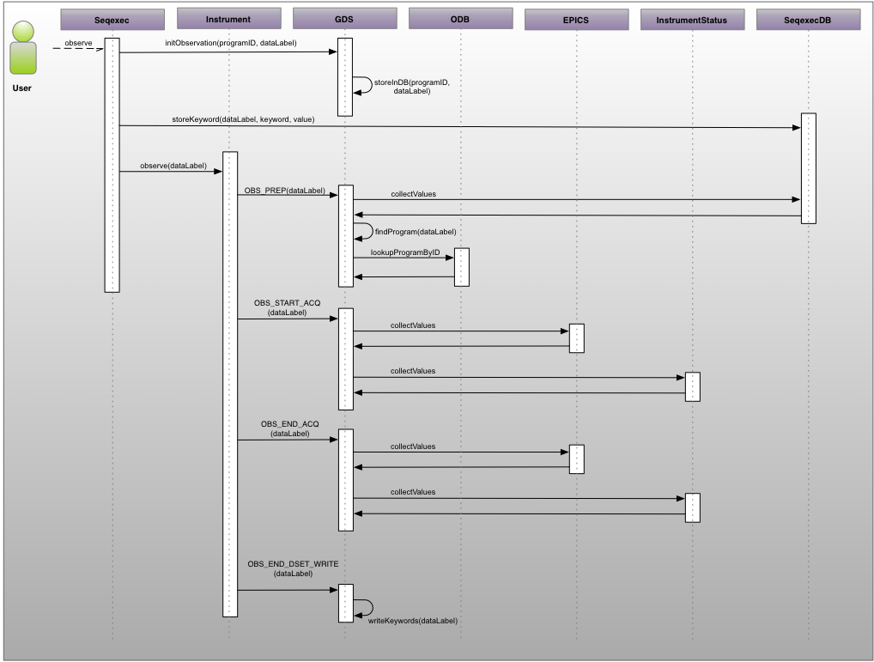
Observation Sequence in Detail

