Slide 1
ENSC 351
UART Performance Monitor
Final Demo
Group Members
Terry Hannon
Evgeny Kuznetsov
Seyed Amir Hossein Bashi
Apassara Jurapan

Slide 2
Outline
Workflow – who did what
Design decisions – how do we approach this task
Timer Driver
HW/SW Timers
Statistics Calculations
VGA Driver
VGA Implementation
Statistics Display
Demonstration – results of our efforts
Conclusion – skills learned

Slide 3
Workflow
Stream1 – Amir, Apassara
Stream2 – Terry, Evgeny
Timer Driver
Console Performance Monitor
VGA Console
VGA Driver
Graphical UART Performance Monitor

Slide 4
Design decisions - Timer Driver
The design of this driver is based on the template module created by linux and the led_driver in Lab 5:
Implementing copy_from/to_user function to write/read to the kermit
timer_fasync():handles the asynchronous calls and handles CPU-interrupt communication
timer_interrupt():checks the async_queue, kill the interrupt if there is one and return IRQ_HANDLED
fasync_help(): return the value from fasync_helper()
kill_fasync(): used to signal the interested processes when data arrives
the cpu contains only one line for the interrupts so an interrupt handler is required. In the interrupt handler the line assigned for the timer is at 91, so whenever the IRQ is set at 91, the cpu handles timers’ interrupt.
We use the register offset defined in the timer_ioctl.h to set up
We found the irq number from the .dts file, needed to add 32 due to the memory setting of the board.
Notes:
irq is used in timer_interrupt()
http://www.makelinux.net/ldd3/chp-6-sect-4

Slide 5
Design decisions - HW/SW Timer
When to use a SW timer?
For long intervals
read time, (char received by the kermit)
When the frequency of interruption required is low
less precise
When to use a HW timer?
For short intervals
Limited to 42sec
write time, (char sent to the kermit)
more accurate

Slide 6
Design decisions - Statistics Calculation
For counting and distinguishing the inputted characters the ASCII numbers were utilized in a way that each char is located in one of the capital, small, number or space category.
System("uptime"); -> time from system start
Console timer= end of application - timer driver opened
Read time= time which characters received from kermit - initial time (the time right before reading the serial port).
HW/SW timer was used to calculate the write/read time

Slide 7
Design decisions - VGA driver
vga_mmap – perform mapping of VGA physical address to the virtual memory so user application can access it when calling mmap
mmap is chosen over ioctl because it is simpler to specify which memory location to write as a char array rather than specifying register offset

Slide 8
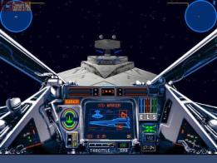

Design decisions - VGA Implementation
Loading Raw Image
Display Filled Rectangles
Display Empty Rectangles
Display Alpha Blending
Display Clipped Images
User Input Feature
Image swapping
Draw a circle

Slide 9
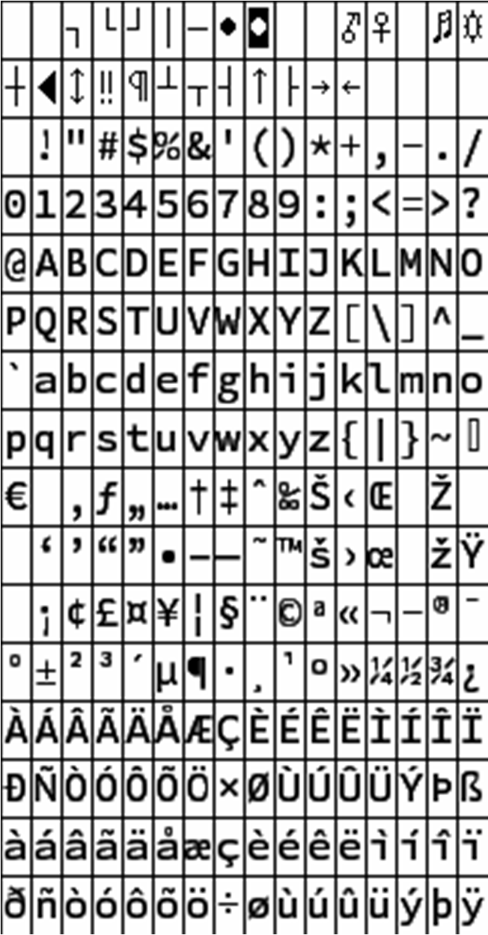
Design decisions - ASCII table
Read in typed character
Convert character to ASCII code and to hexadecimal equivalent
The first value is the row and the second value is the column
Columns and rows start at 0
E.g. ‘a’ has hexadecimal value 61
The letter ‘a’ is in row 6 column 1
Multiply row times 23 and column by 12 to get associated x and y position for letter block beginning
Display character in display using alpha blending at X and Y position on a screen

Slide 10
Design decisions - Display Statistics
Draw bar graph on the display for reads/writes
Displays number of Reads/Writes with associated bar graph (1 pixel height for each 10 operations) along with actual number
‘Enter’ key count only as read
Display statistics as numbers
Convert integer and float values
Convert each digit to char
Determine each number through calculation
Add 48 to each number to translate to ASCII code
Convert to character
Use ASCII code to display correct value on display
See Design Decisions - ASCII table

Slide 11
Demonstration
Editor type application
Accept key entry into the console
Display characters on the monitor
Auto-wraps to the next line when line is filled
Clears screen when all lines have been used
‘Enter’ key moves to the next line
Calculate Statistics
Uses HW/SW timers to calculate key entry statistics
Display Statistics
Most statistics displayed as number beside descriptor
Amount of Reads/Writes also displayed as bar-graphs

Slide 12
Conclusion and Skills Learned
Teamwork – provide and seek help from each other and other groups
Developing drivers – fundamentals understanding of how drivers works and how to program them
Enhanced programming in C – final project is more than 1000 line of code
ICE (In Circuit Emulation) – using Kermit and SSH to communicate with the board. Debugging hardware problems

