Slide 1
DISTRIBUTED MULTI-MODEL ANALYTICS
FOR E-COMMERCE DATA
MongoDB | HBase | Apache Spark | Data Visualization
Final Big Data Project - November 2026
Student / Group: Add names and IDs

Slide 2
Project Objectives
- Generate and validate a large e-commerce dataset.
- Store document data in MongoDB.
- Store browsing and cart metrics in HBase.
- Process transactions using Apache Spark.
- Integrate data sources and visualize business findings.

Slide 3
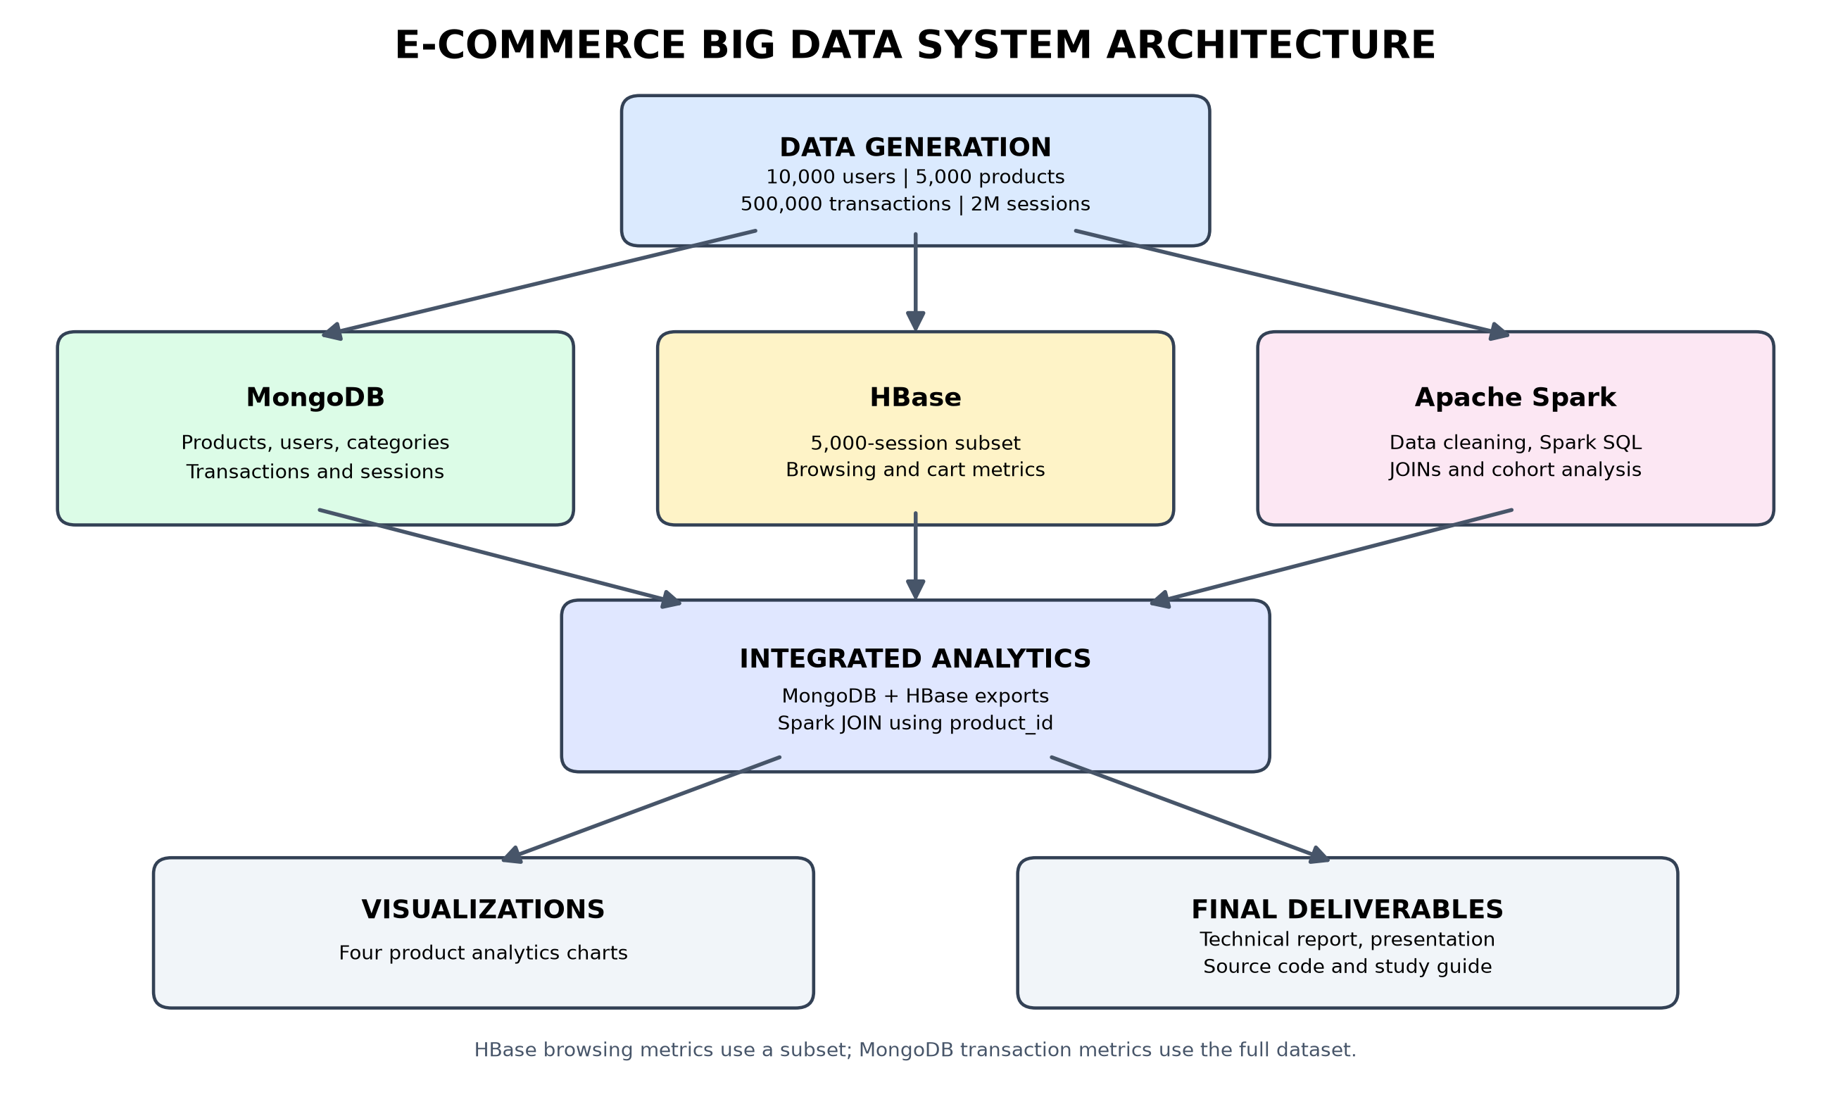
System Architecture

Slide 4
Dataset Generation and MongoDB
- Generated 10,000 users and 5,000 products.
- Generated 25 categories and 500,000 transactions.
- Generated 2,000,000 browsing sessions.
- Stored 2,515,025 documents in MongoDB.
- Used document collections and aggregation queries.

Slide 5
HBase Implementation
- Created fp_user_sessions and fp_product_metrics tables.
- Loaded 5,000 browsing sessions as a deterministic subset.
- Stored 16,804 product-date metric records.
- Recorded product-detail views and cart quantities.
- Designed row keys to support user and product access.

Slide 6
Apache Spark Data Processing
- Processed 500,000 transactions using PySpark.
- Converted transaction JSON to NDJSON for Spark.
- Checked invalid records and duplicate transaction IDs.
- Found zero invalid and zero duplicate transactions.
- Saved cleaned data in Parquet format.

Slide 7
Spark SQL and Cohort Analysis
- Completed transactions: 317,055.
- Total transaction value: 466,576,163.45.
- Analyzed August, September and October 2026.
- Joined customers with transactions using user_id.
- Monthly cohort activity rate was 100% in the synthetic dataset.

Slide 8
Integrated Analytics: MongoDB + HBase + Spark
- Business question: Which products attract browsing interest?
- Exported product and transaction metrics from MongoDB.
- Exported product views and cart quantities from HBase.
- Joined datasets in Spark using product_id.
- Successfully integrated all 5,000 products.

Slide 9
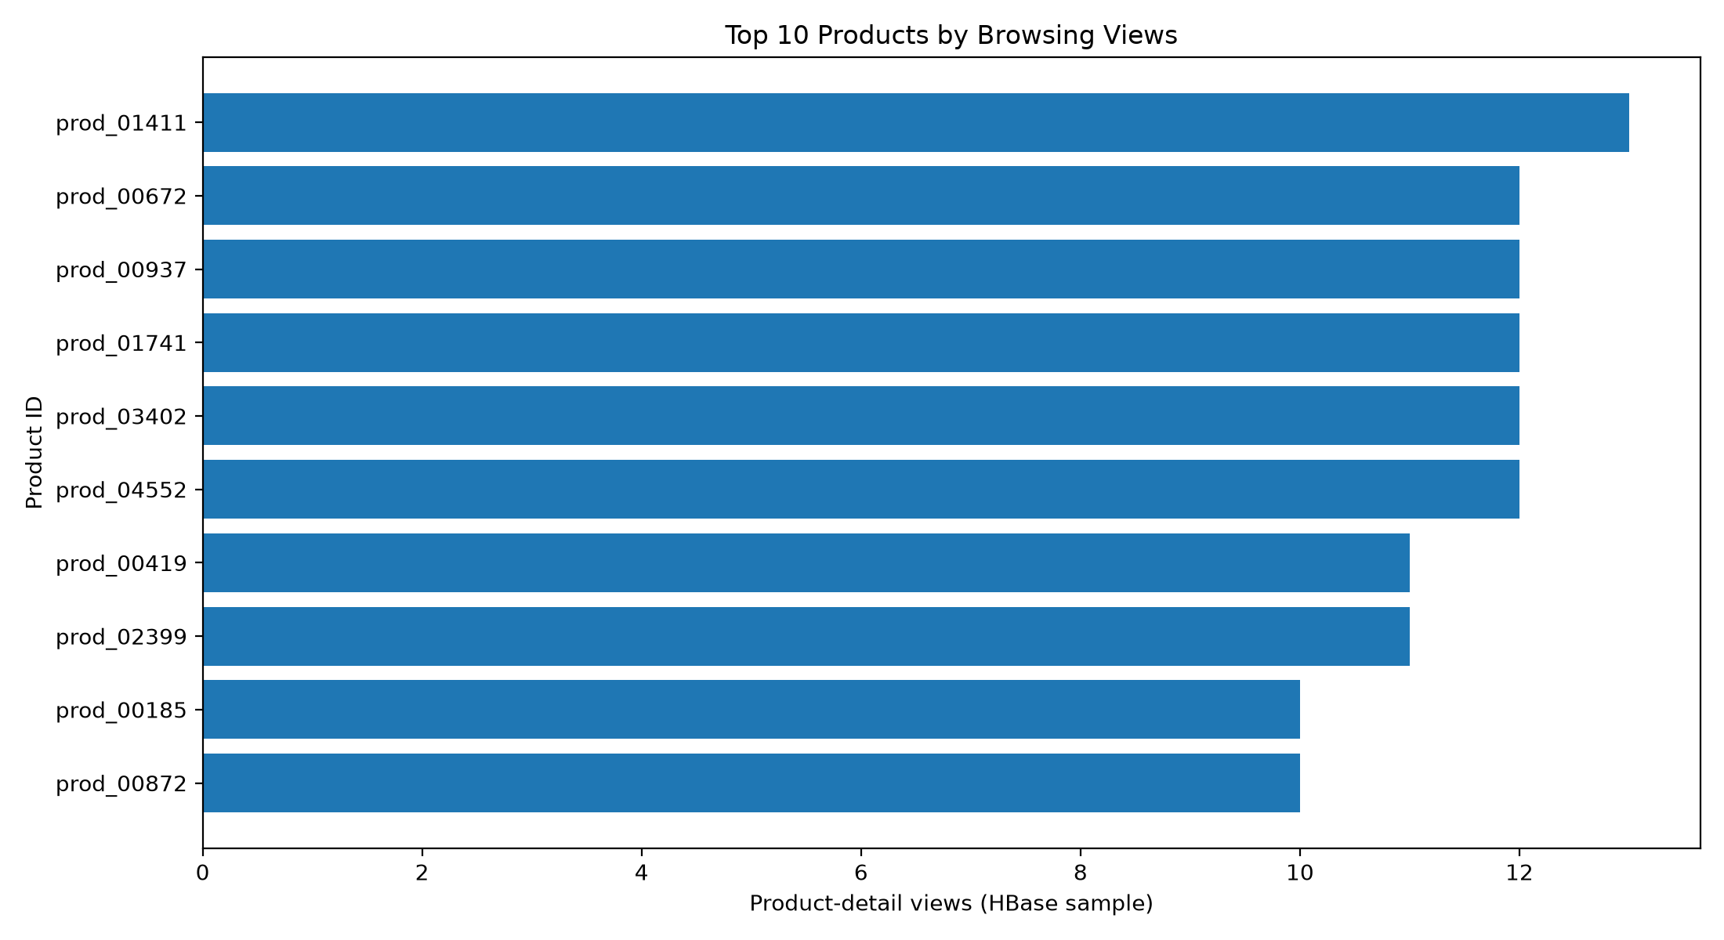
Top Products by Browsing Views
Product prod_01411 had the highest observed views (13) in the 5,000-session HBase subset.

Slide 10
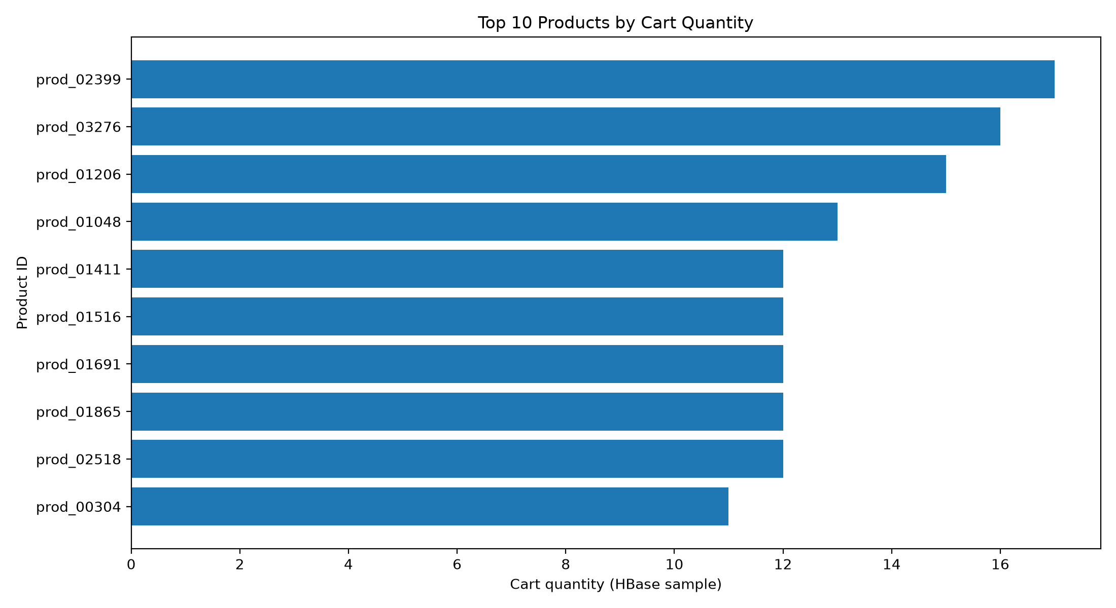
Top Products by Cart Quantity
This chart compares product quantities recorded in shopping carts in the HBase subset.

Slide 11
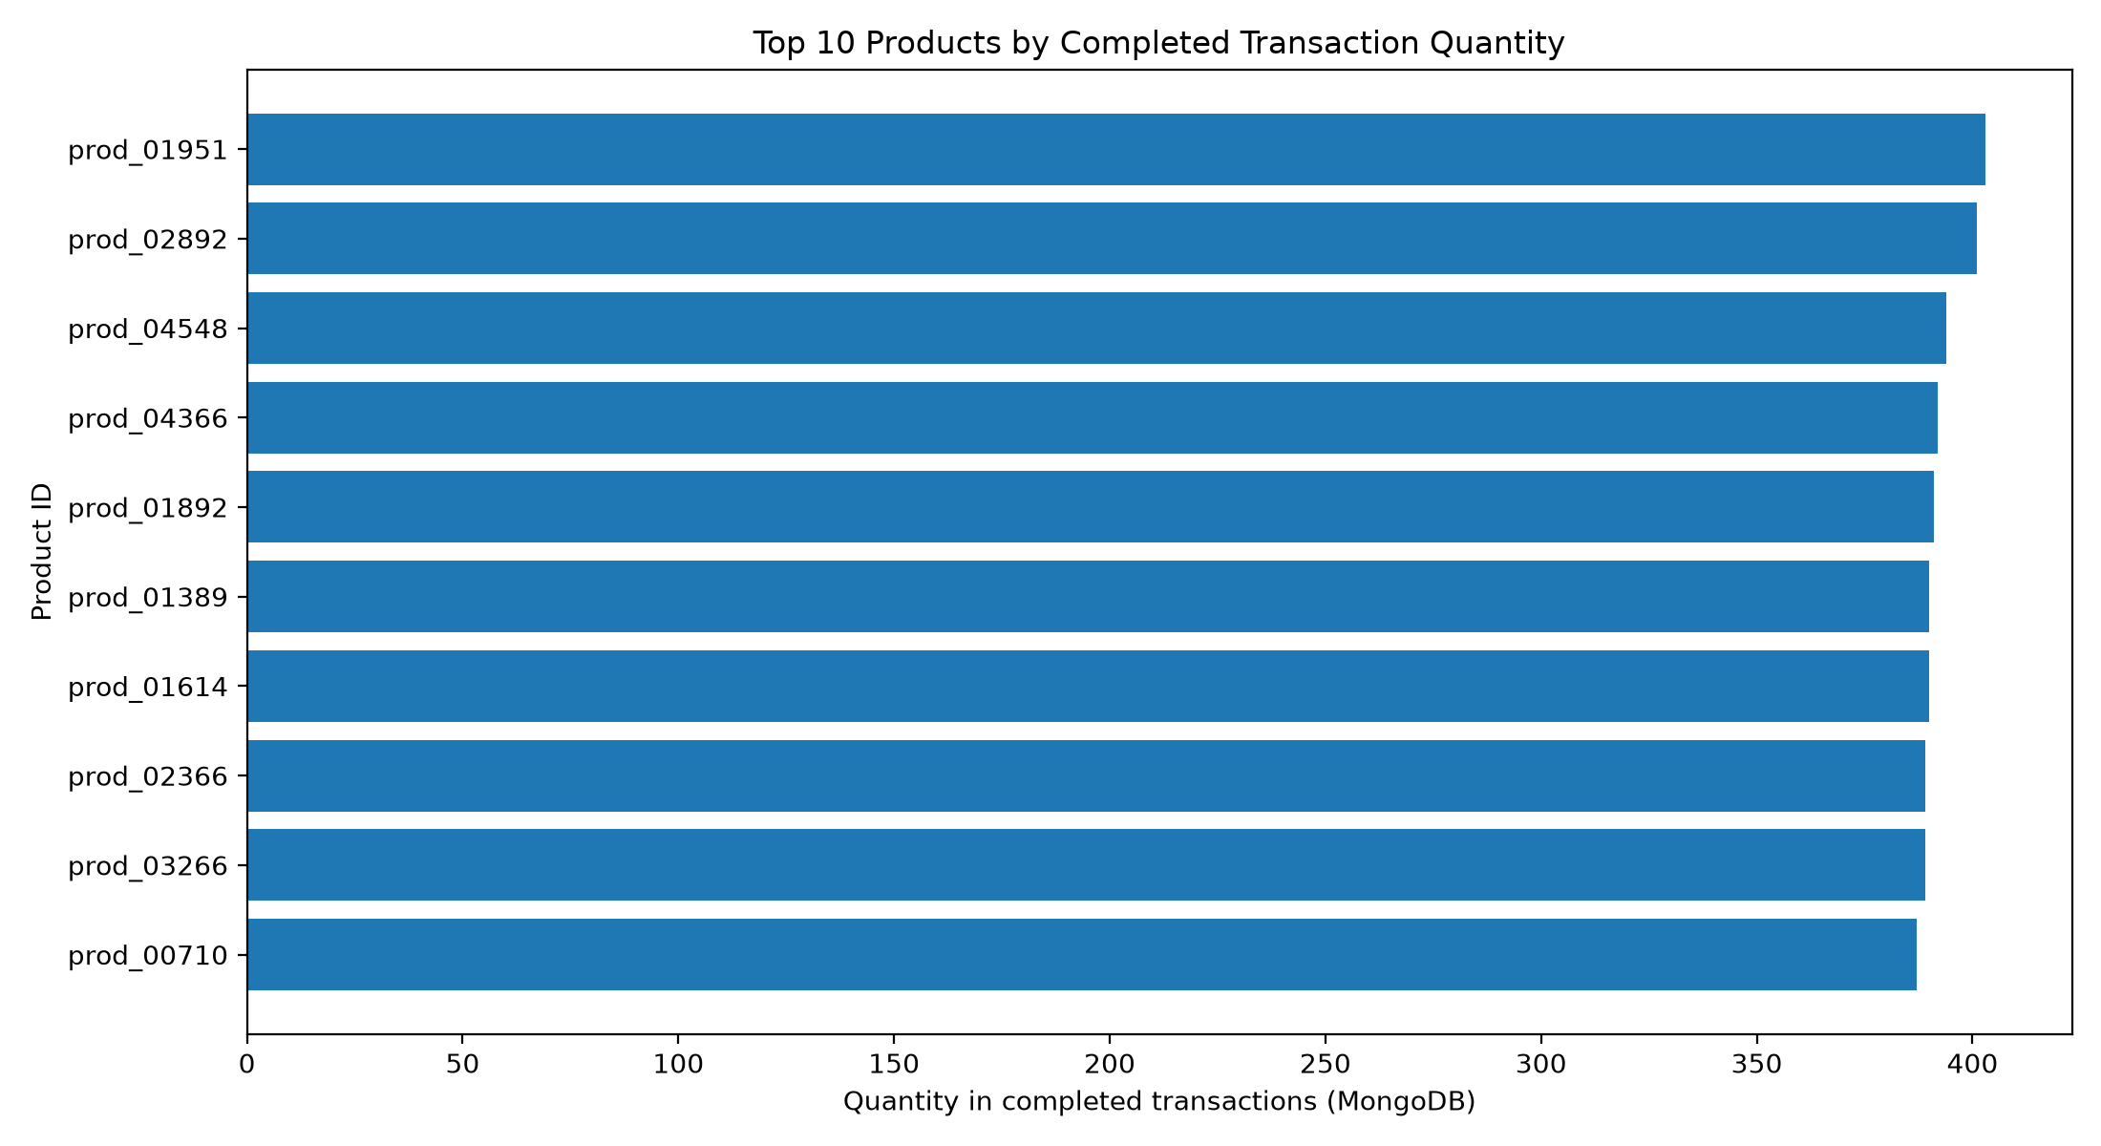
Top Products by Completed Quantity
Product prod_01951 had the highest completed transaction quantity (403 units).

Slide 12
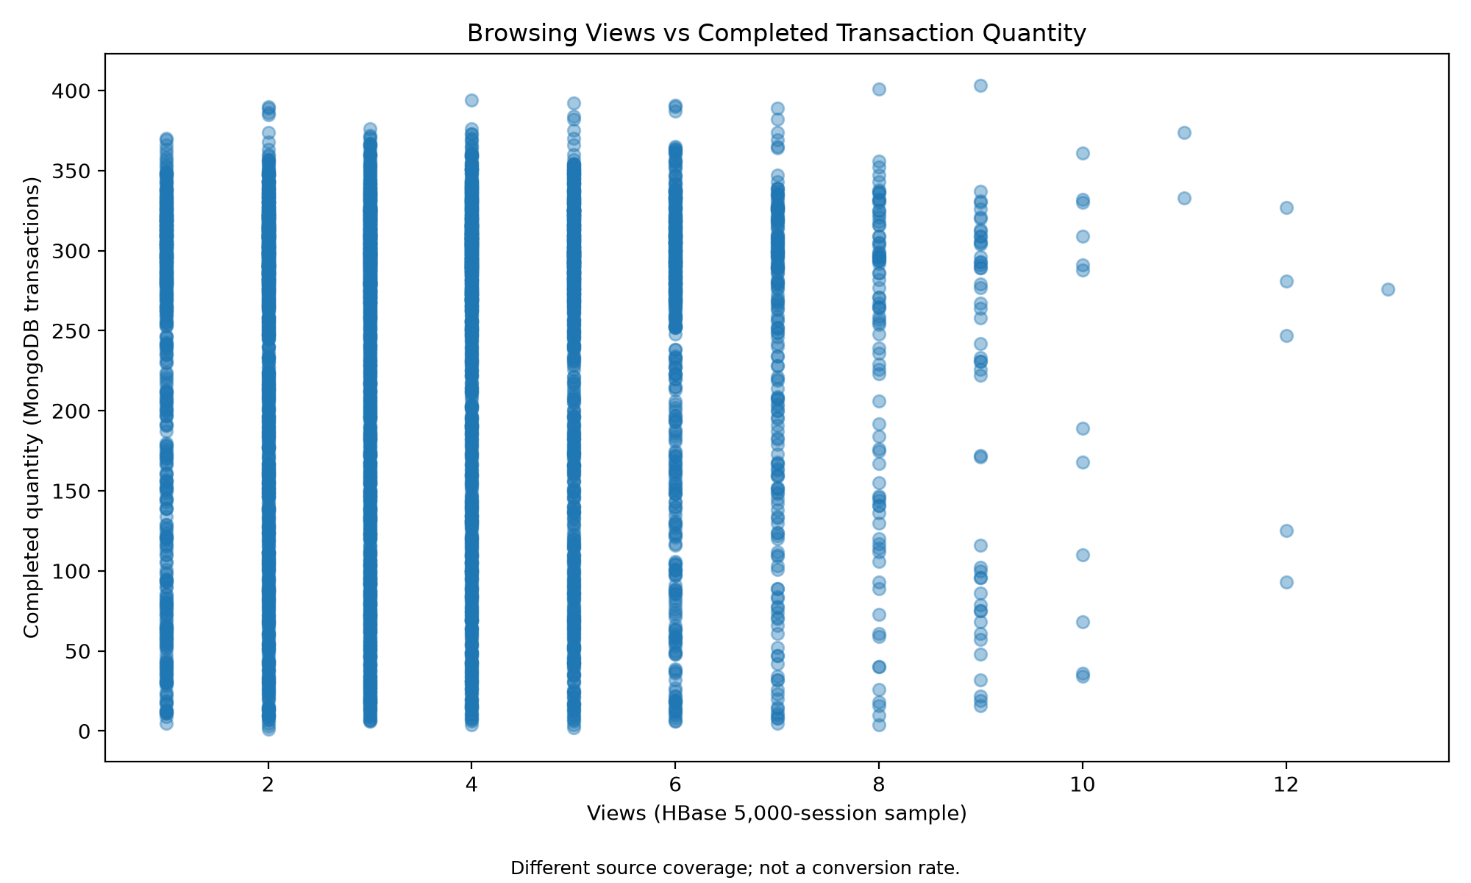
Browsing Views vs Completed Quantity
Browsing uses a 5,000-session subset while transactions use the full data. This is not a conversion rate.

Slide 13
Challenges, Limitations and Conclusion
- HBase startup required troubleshooting and recovery.
- Spark configuration conflicts were resolved.
- HBase sampling limits direct conversion comparisons.
- Synthetic cohort results do not prove real customer retention.
- The project demonstrates integrated multi-model analytics.

