Slide 1
Introduction to data build tool (dbt)
By Mina Sonbol

Slide 2

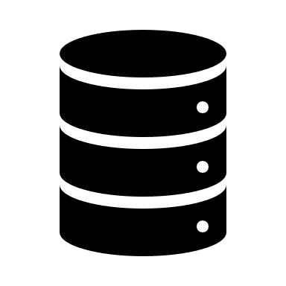










🤔
A typical work scenario for a data analyst
🤨
😎
null

Slide 3

Common shortfalls of standard approach
Reusable code
Version control
Data quality
Documentation
Notes:
Tracking in the work: file is lost in dbeaver, retrieving query from query history can be hard, data lineage not maintained, not well structured / organized way to work
Version control: tied to the first problem, in addition, it is hard to collaborate on a project when it’s version is not maintained. If analysis is to be included in a dashboard, a version controlled project would allow multiple analysts to work on the project simultaneously by using branching and code checks etc…
Data quality: relies on analyst’s knowledge and carefulness
Reusable code: Once the session is closed we can’t use this code again

Slide 4
dbt: What it is and how it addresses these shortfalls?
Transforming large volumes of data efficiently
Modular & reusable code
Automating data quality testing
Version control
Documentation
This makes dbt a transformative tool that can improve efficiency and productivity, enhance data quality and trust, and allow for better collaboration and transparency, providing a framework for a better analytics process.
source
Notes:
Transformation: dbt is a transformation workflow framework developed by dbtlabs in 2016. It is currently being used by 30,000 companies, and it’s open source offering – dbt-core – had more than 8 million downloads over the past.
Testing: We also need to think about specific business requirements and edge cases (ex. Receiving old data file - staleness, getting nulls, outliers, wrong values) and setup processes that can deal with them. dbt allows us to create tests with a few lines of code. Ex. skills, freshness
Version control: can allow for better collaboration & organization. Changes can be validated are tracked, and can be rolled back. BIT BUCKET
Documentation: data documentation is a crucial part of our jobs, and dbt makes it easy to document table descriptions, column data types, and trace the data lineage. And crucially, the documentation will sit where the data is. Documentation can help with Ex. crm data fields, data availability score

Slide 5
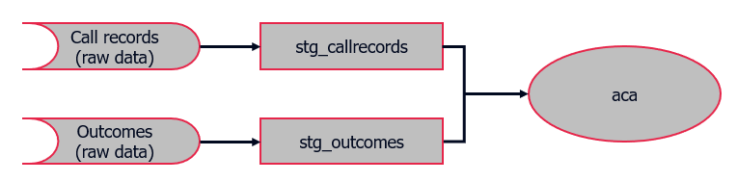
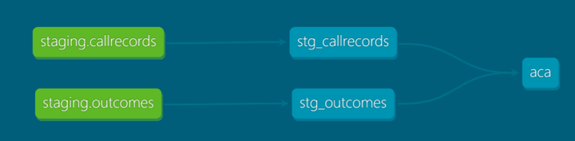
dbt in action 1: Matching query simplified
We will create several models to imitate the matching query. The models will be split into 3 phases:
Staging: This is where we type cast the raw data into appropriate data types
Core: This is where we join the data from the staging phase to create a source of truth table
Reporting: This is where we create data artifacts that can be used for building dashboards
By splitting the processing into phases, each with its own directory, we create a modular simplified matching query that is easier to understand and debug. dbt also allows us to generate data lineage charts like this:
Source, demo link
Notes:
*** VERY IMPORTANT ***
1- activate virtual env: dbt-env\Scripts\activate
2- Remember to setup env variables before presentation
3- Run dbt deps before demo
Demo using dummy data that shows callrecords and outcomes showing sales as 1s no-sales as 0s
Project has 3 phases: staging, core, reporting – each will have its own folder – in this demo I will only show the staging part, but if you’re interested reach out and I can walk you through the setup and the other parts
Lets look at the data first
Look at the data:
- model folder – sub folders represent different phases, easy to arrange and manage
- Easy to use
Staging:
Schema.yml, sources (name, database, schema, tables) + models (name, description)
type cast
Add insert_date
is_test_run variable
Run stg_callrecords only first (dbt build –select stg_callrecords)
Run all with is_test_run as true
Dbt build, dbt docs generate / serve

Slide 6
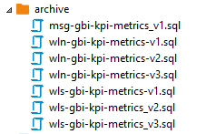
dbt in action 2: Documentation, testing, and version control
Documentation: We add documentation to the schema.yml file, including descriptions and data types. That way our data dictionaries sit where the data is.
Tests: Tests are also defined in the schema.yml file. dbt provides generic and bespoke tests.
Generic tests – Tests that can be performed out-of-the-box. There are 4 types:
Unique
Not null
Accepted values
Relationships
Bespoke tests - These are custom queries created under the test directory. The test succeeds if the query does not return any rows.
Version control: Having the tests and documentation in the same file makes it easy to version control them, along with our sql models, using tools such as git. No need to track changes like this →
source
Notes:
documentation: we keep the data dictionary next to our model, easy to retrieve
Tests: two types, generic / bespoke
Show difference between freshness and data tests, former doesn’t stop the build process, latter does
Freshness: dbt source freshness
Data test:
1- insert into stg_callrecords
2- run dbt test –select test_type:data
3- insert into callrecords
4- run dbt build –select stg_callrecords –vars ‘{is_test_run: false}’
5- clean up
Dbt build in prod: dbt build –target prod –vars ‘{is_test_run: false}’
Version control (easy way to deal with the suffix creep):
1- git init
2- echo “my dbt project” > README.md
3- git add README.md
4- git commit –m “my first commit”

Slide 7
Appendix: dbt configurations and commands
Main Configuration Files
profiles.yml: Contains the profile settings, including database connection settings (host, user, password). Can accept multiple profiles. Is typically stored outside the dbt project directory.
dbt_project.yml: Defines the dbt project configuration, including the project directories and model configurations (ex. materialization settings).
schema.yml: Contains the definitions of the sources, models, and tests that dbt will run when compiling the models.
dbt init → Initiates a project and creates / modifies the profiles.yml configuration file
dbt debug → Tests database connections
dbt build → Builds the dbt models
dbt test → Runs tests defined on the data to ensure its integrity
dbt docs generate/serve → Generates documentation for the project
dbt deps → Downloads and installs package dependencies
dbt commands

Slide 8
Thank you

