Slide 1
Edge-AI Enabled Cooperative Road Hazard
Detection & Dissemination
Group – 7
Project Supervisor – Dr. Anita Mohanty
Dept. of Electronics & Telecommunication Engineering

Slide 2
Group – 7
Project Members
Adarsh swarup maharana – 2421109136
Mihir Kumar panda – 2301109402
A Lakshmi Narayan Dora – 2421109135
Vishal Kumar Prashad – 2301109440
Bhabani Nayak – 2301109376
Muskan Patra – 2301109403
Kamalakant Sahoo - 2301109397

Slide 3
Content
Introduction
Road features associated with accidents
Graphical abstract of the proposed work
Literature survey
Research Gap
Objectives of the project
Reference

Slide 4
Introduction
Fig.-1 India Road Safety Trend

Slide 5
Road Features Associated with Accidents
Fig. 2 Road Features Associated With Accidents

Slide 6
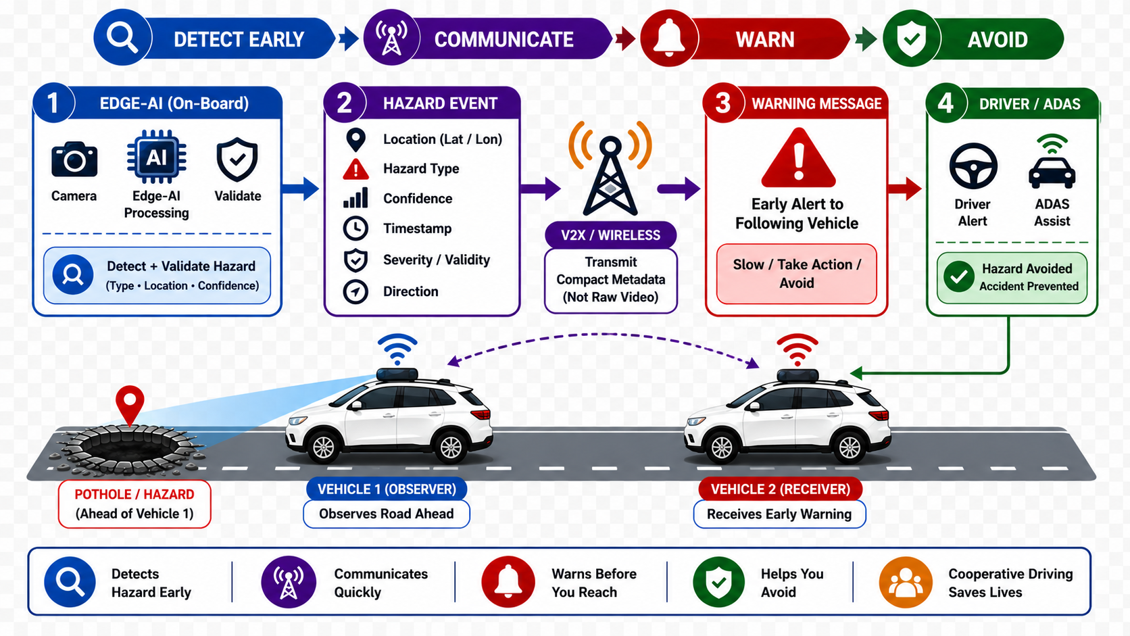
Graphical abstract of the proposed work

Slide 7
Literature survey
Approach | Detection | Edge | Cooperative | Warning | Cost
Manual inspection | Slow | No | No | Delayed | Low
Cloud-centric[1] | High-latency | No | Yes | Delayed | High
Vehicle-only ADAS [2] | Fast | Yes | No | Local only | High
Conventional CCTV[3] | Manual | No | No | No | Medium
High-end ITS [4] | Fast | Yes | Yes | Real-time | Very High
Proposed approach | To be measured | Yes | Proposed | Target | Cost-oriented

Slide 8
Research Gap
Manual inspection → delayed warning
Cloud-centric systems → bandwidth, latency, privacy concerns
Vehicle-only ADAS → limited sensing horizon
Conventional CCTV → passive; no cooperative warning
High-end ITS → effective but costly for dense deployment
RESEARCH GAP
Low-cost Edge AI + cooperative validation + V2X warning

Slide 9
Objectives of the project
1. Develop a low-cost Edge-AI sensing architecture.
2. Detect and classify selected road hazards locally.
3. Validate hazards using temporal, spatial and cooperative evidence.
4. Disseminate compact hazard events to approaching vehicles.
5. Demonstrate and benchmark the two-vehicle pothole-warning chain.
EVALUATION METRICS — TO BE MEASURED
Precision
Recall
F1
False Positives/Hour
Inference Latency
End-to-End Warning Latency
Position Error
Packet Delivery
Power

Slide 10
Reference
[1] S. Bitam, A. Mellouk, and S. Zeadally, “VANET-cloud: A generic cloud computing model for vehicular Ad Hoc networks,” IEEE Wireless Communications, vol. 22, no. 1, pp. 96–102, Feb. 2015, doi: 10.1109/MWC.2015.7054724.
[2] R. Tarun and B. Priya Esther, “Traffic Anomaly Alert Model to Assist ADAS Feature based on Road Sign Detection in Edge Devices,” 2023 International Conference on Emerging Smart Computing and Informatics (ICESC), 2023, pp. 824–828, doi: 10.1109/ICESC57686.2023.10193442.
[3] D. Grabowski and A. Czyżewski, “System for monitoring road slippery based on CCTV cameras and convolutional neural networks,” Journal of Intelligent Information Systems, vol. 55, pp. 521–534, 2020, doi: 10.1007/s10844-020-00618-5.
[4] J. Zhang, F.-Y. Wang, K. Wang, W.-H. Lin, X. Xu, and C. Chen, “Data-driven intelligent transportation systems: A survey,” IEEE Transactions on Intelligent Transportation Systems, vol. 12, no. 4, pp. 1624–1639, Dec. 2011, doi: 10.1109/TITS.2011.2158001.
[5] Ministry of Road Transport and Highways, Government of India, Road Accidents in India 2023, New Delhi, India, 2024.

Slide 11
Thank You

