Slide 1

Optimizing I/O operations for the Linux O.S. by leveraging eBPF technology
Diploma Thesis
of
Symeon N. Porgiotis

Slide 2
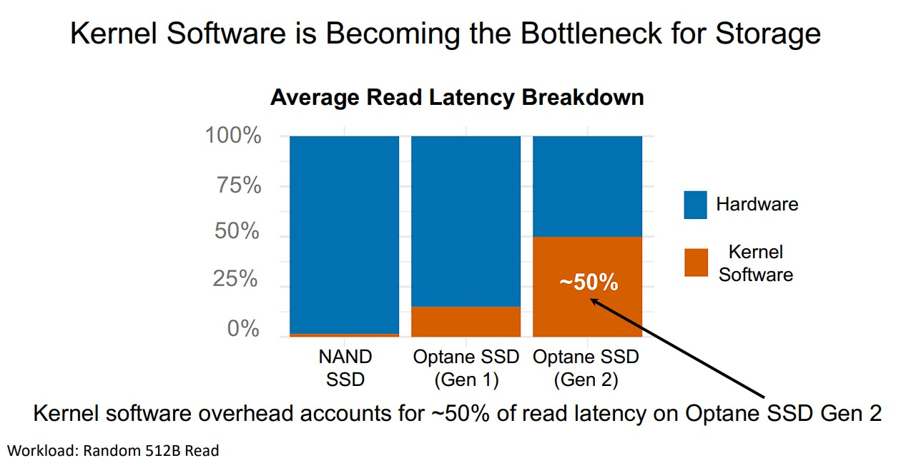
Motivation
Source : https://www.usenix.org/conference/osdi22/presentation/zhong

Slide 3
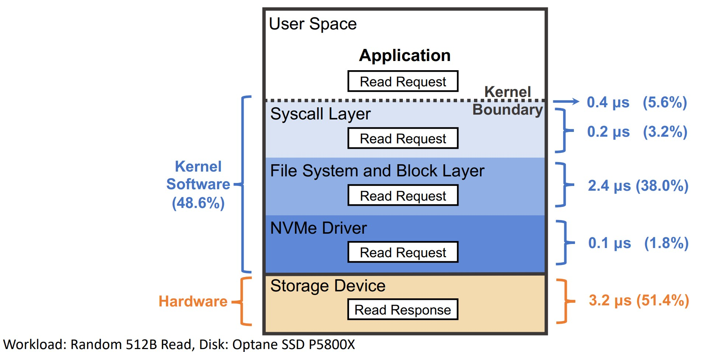
Preview of Kernel Software Layers
Source : https://www.usenix.org/conference/osdi22/presentation/zhong

Slide 4
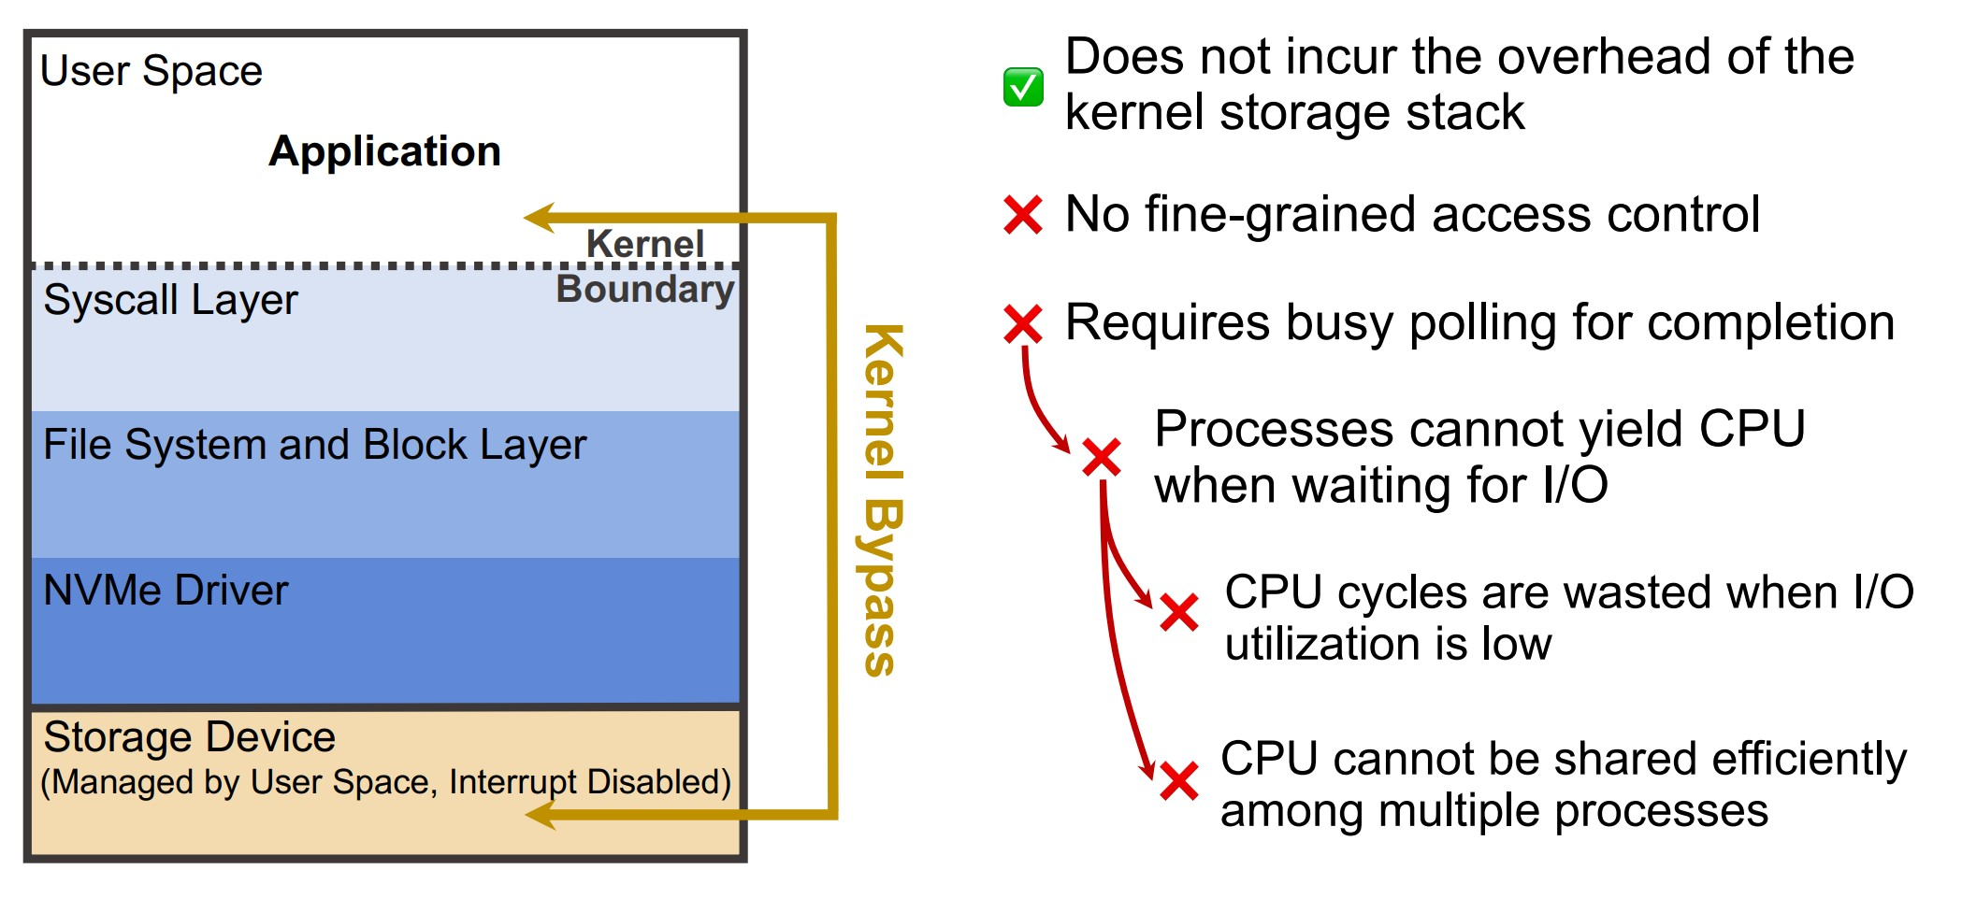
Bypass Kernel to Eliminate Overhead
Source : https://www.usenix.org/conference/osdi22/presentation/zhong

Slide 5
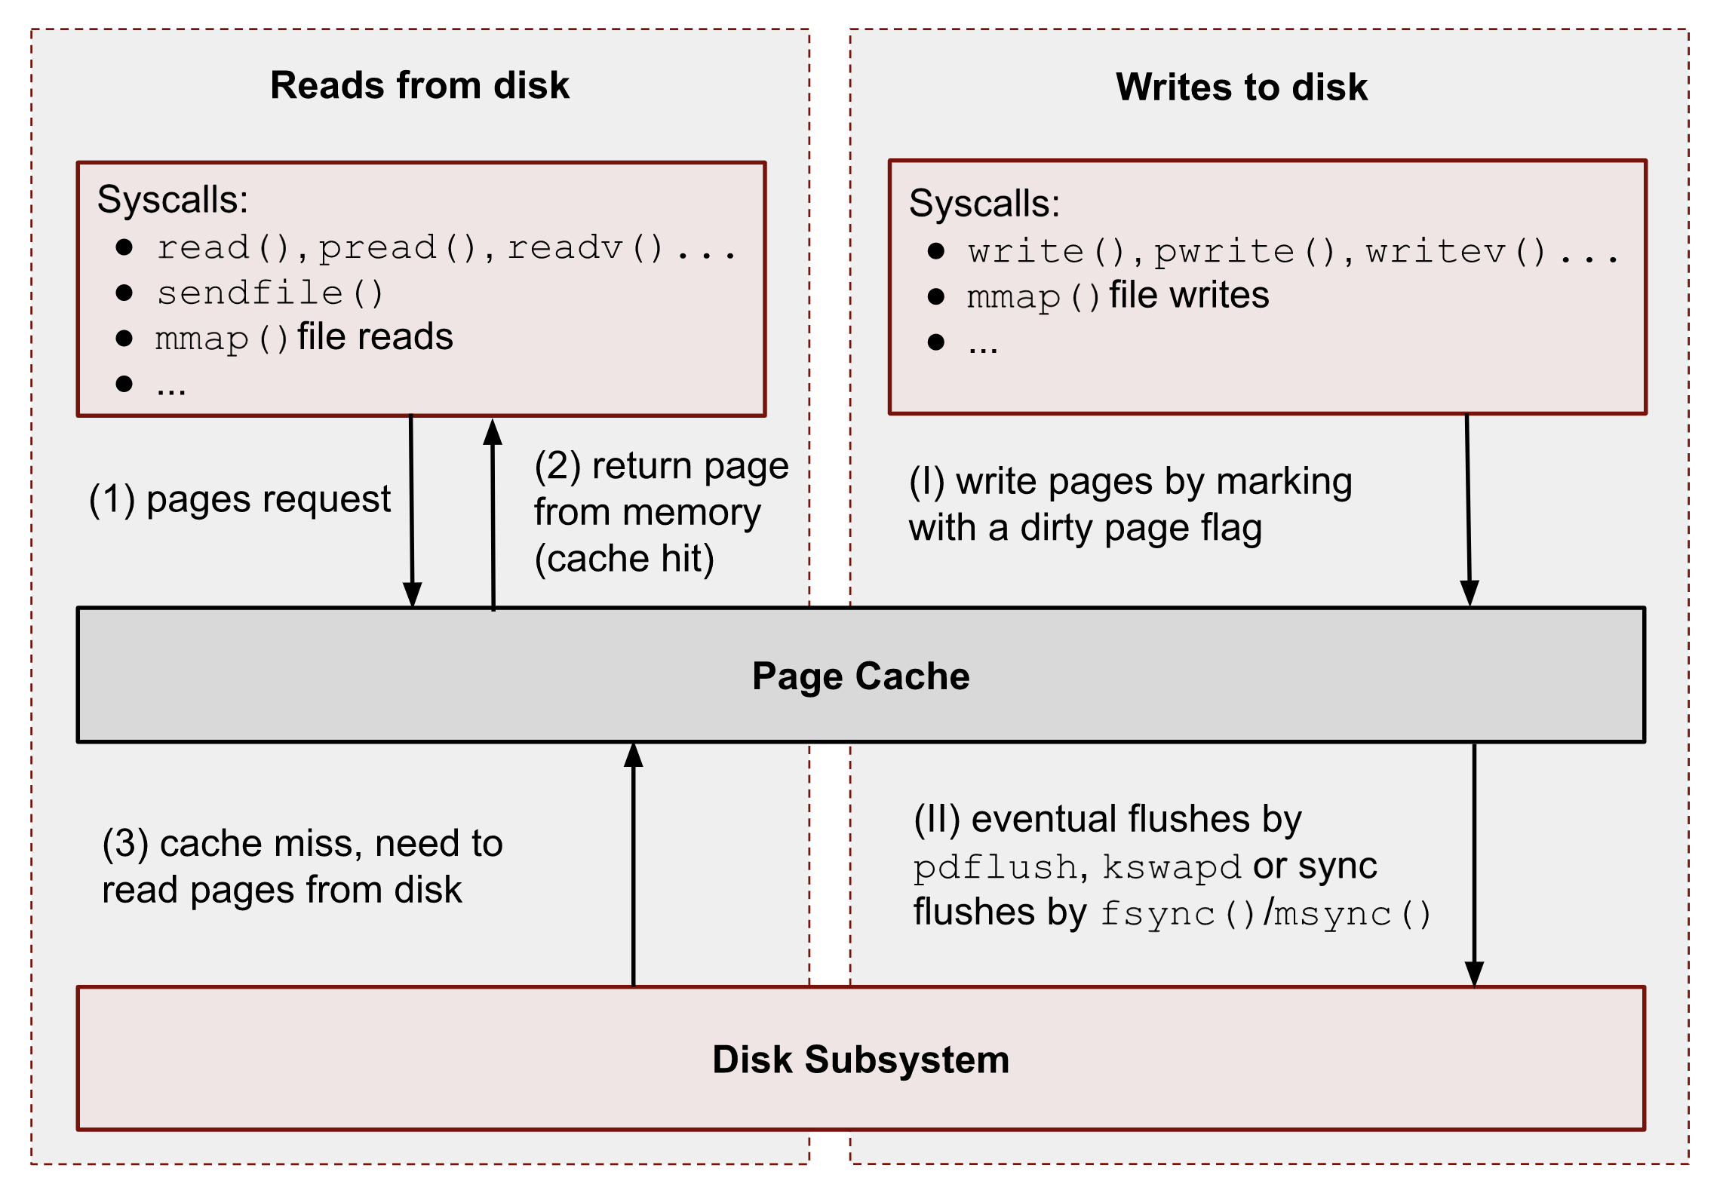
Page Cache

Slide 6
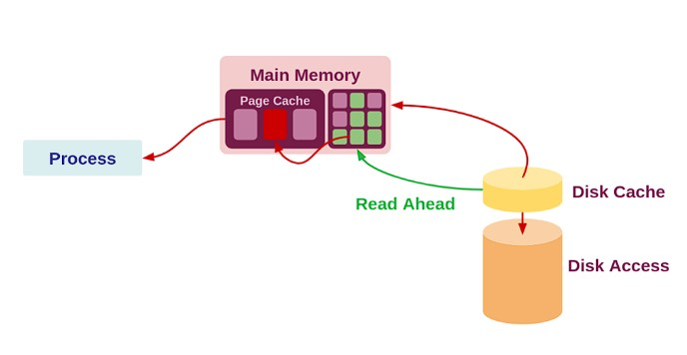
Read Ahead I

Slide 7
Read Ahead II : How it works
First Access \ Sync read
…
Page located on disk
Page requested
Marker
PG_Readahead
…
Page located on Page Cache
PG_Readahead
…
Page accessed

Slide 8
Read Ahead IiI : How it works
Async Read
PG_Readahead
…
Read-Ahead page
New Marker
…
PG_Readahead
Page located on Page Cache
Page accessed
Since new pages are brought before they’re requested, there are no page cache misses.
…

Slide 9
Read Ahead Iv : How to determine Read Ahead Window Size
Marker
…
PG_Readahead
Initial
Window Size : 4
Marker
Every time you hit a marker double it
Window Size : 8
…
PG_Readahead
…
…
…
…
Until an upper limit (usually it’s)
Window Size : 32

Slide 10
Read Ahead v : Random Accesses
First Access \ Sync read
Page located on disk
Page requested
Marker
PG_Readahead
Page located on Page Cache
Page accessed
New Sync Read
PG_Readahead

Slide 11
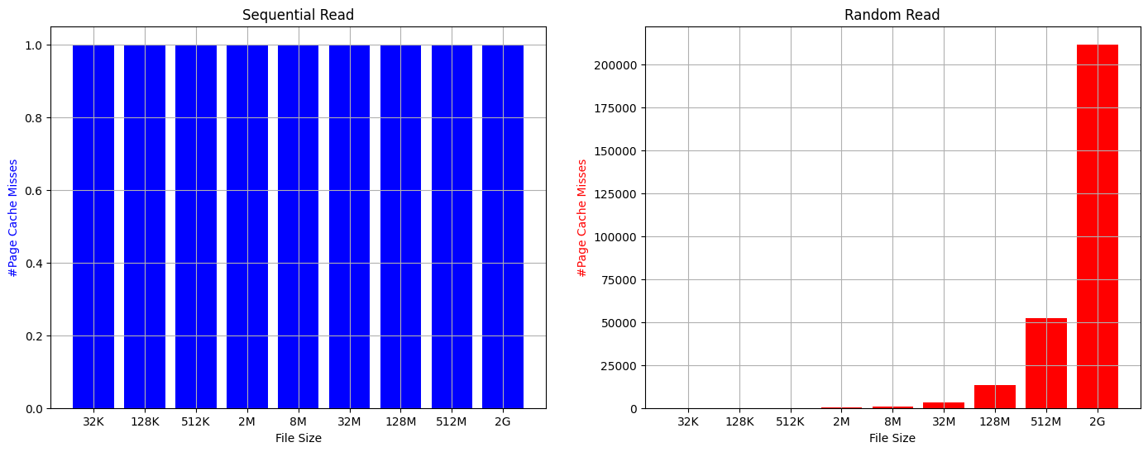
Read Ahead VI : Number of Page Cache Misses
99,9%

Slide 12
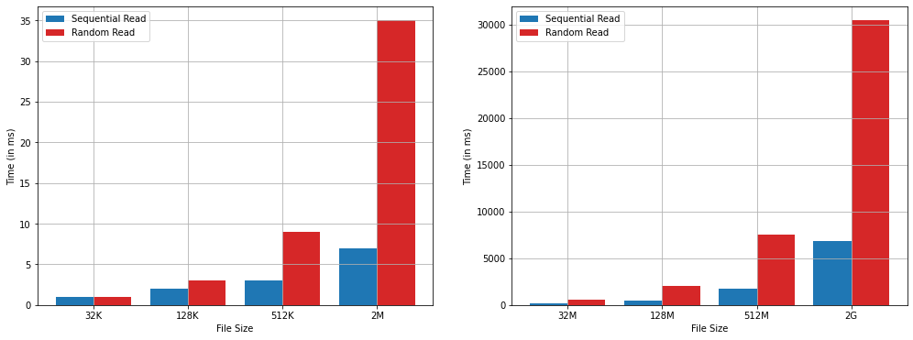
Read Ahead VII : read()
80%

Slide 13
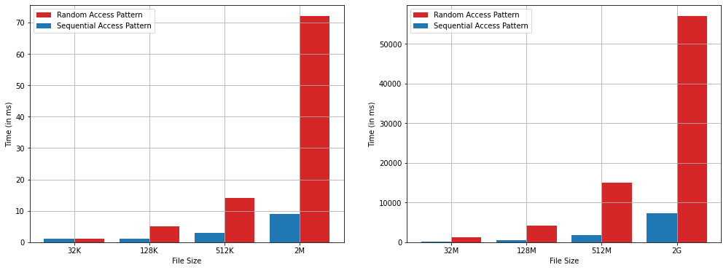
Read Ahead VIII : mmap()
85%

Slide 14

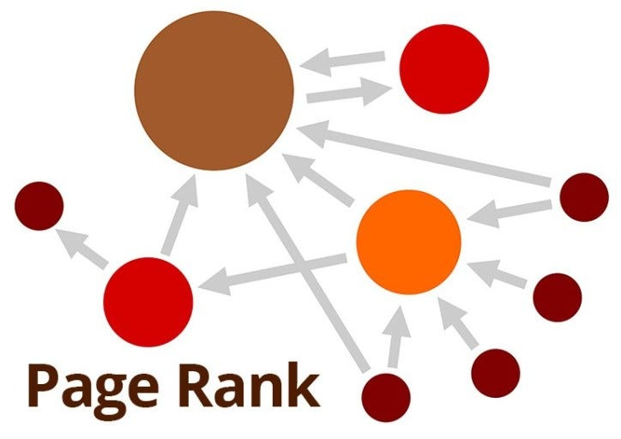

Complex Access Patterns
Firecracker

Slide 15
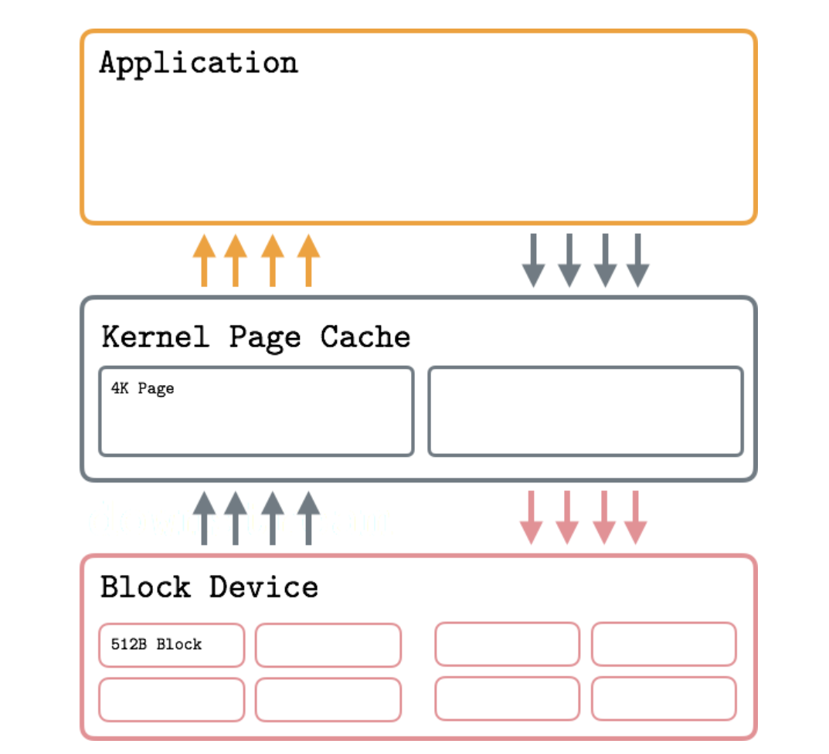
Solution Overview
Page Offsets
User request to Page Cache

Slide 16


Slide 17
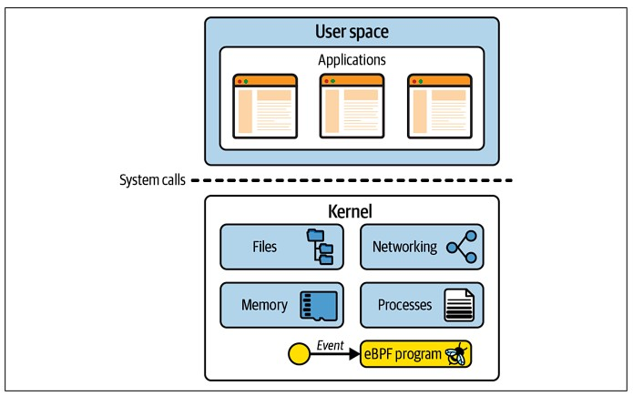
eBPF I : Overview

Slide 18
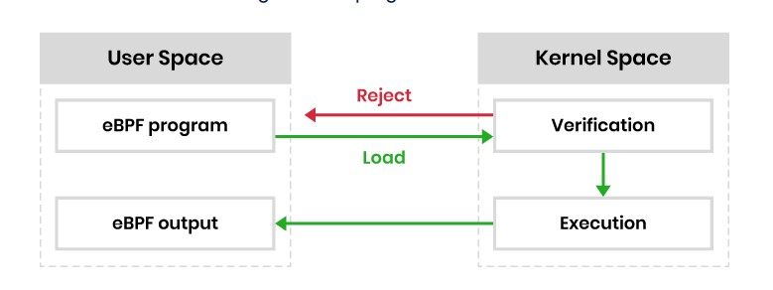
eBPF Ii : How it Works

Slide 19
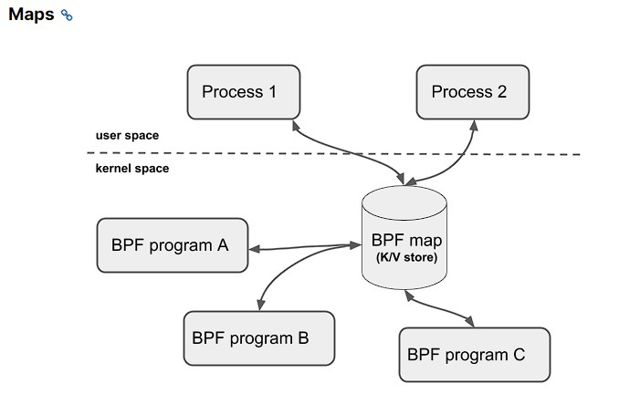
eBPF Iii : Maps

Slide 20
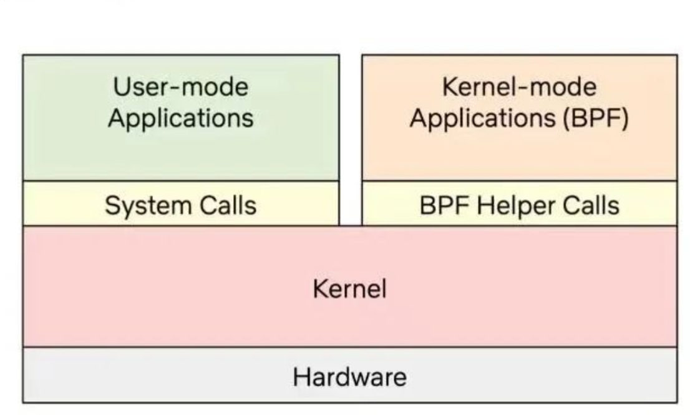
eBPF Iv : Helpers

Slide 21
Solution I
page offsets
eBPF MAP
bpf_force_page2cache()

Slide 22
Solution II
READ SYS CALL
…
PAGE_CACHE_ADD_PAGES()
FILE_GET_PAGES()
…
…
kprobe attached
bpf_force_page2cache()

Slide 23
Solution III
offload_pages2cache()

Slide 24
Solution IV
offload_pages2cache()
Creates batches with consecutive page offsets

Slide 25
Solution V
Page Offsets
bpf_force_page2cache()
eBPF Maps
offload_pages2cache()

Slide 26

Results

Slide 27
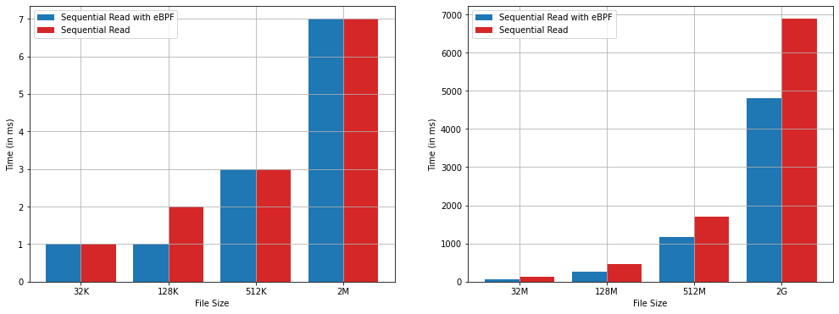
Sequential Read()
30%

Slide 28
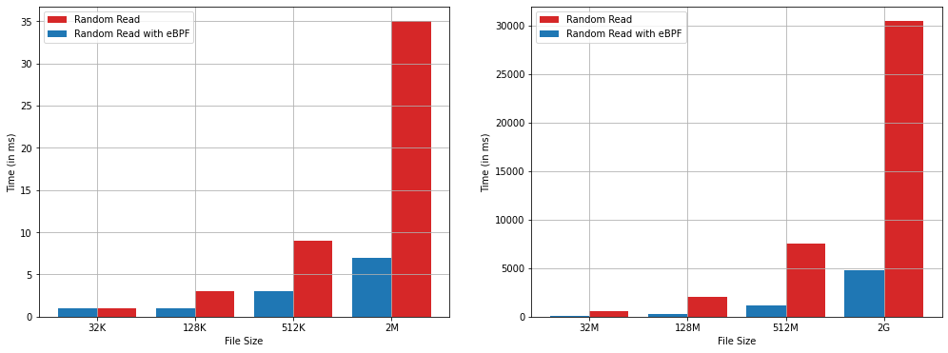
Random Read()
85%

Slide 29
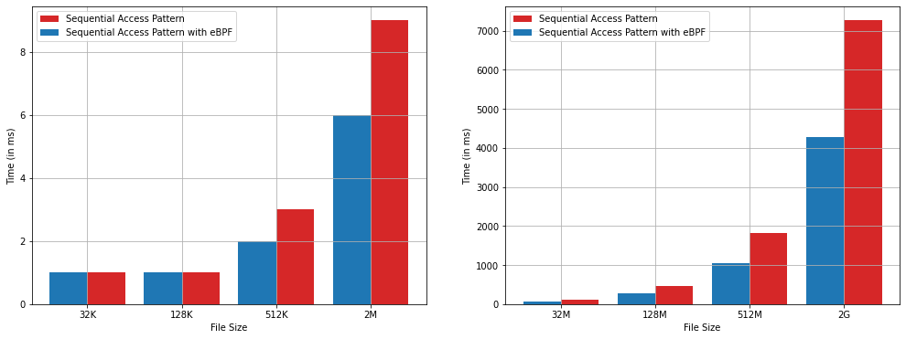
mmap() Sequential Accesses
40%

Slide 30
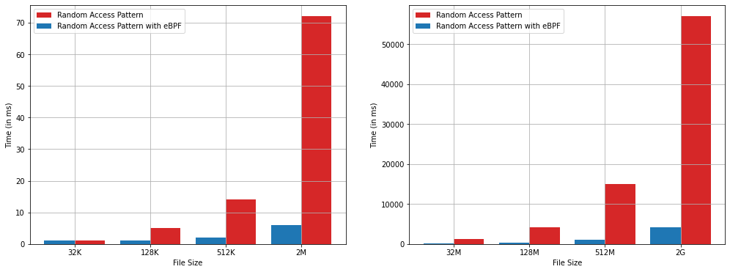
mmap() Random Accesses
90%

Slide 31

USE CASE : FIRECRACKER

Slide 32


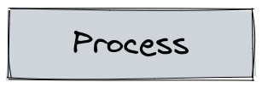
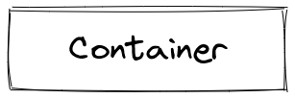
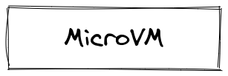
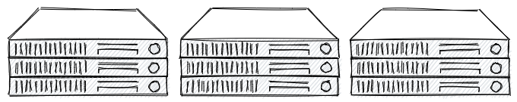

Serverless Stack
Massive colocation
cluster utilization
Isolation/Security
Fast instantiation
Firecracker

Slide 33
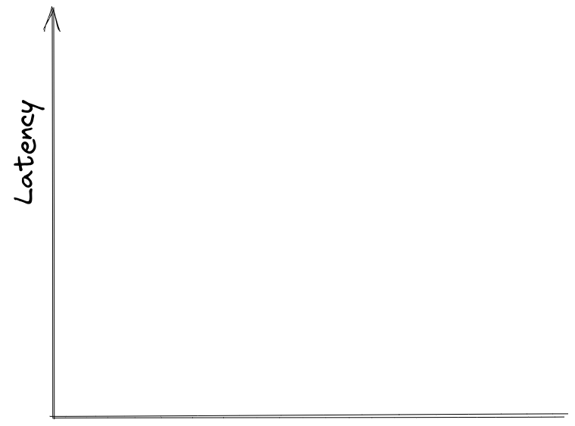
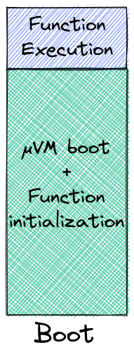
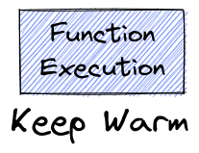
Serverless Cold Start Performance
Boot & initialize a new function instance?
~50% of apps run for <= 670ms on avg ¹
~90% of apps run for <= 10s on avg ¹
Functions are short-lived
Keep them warm?
~81% of apps invoked more rarely than once per minute ¹
~45% of apps invoked more rarely than once per hour ¹
Functions are invoked infrequently
¹ Shahrad et al – ATC 20: Azure Functions trace

Slide 34
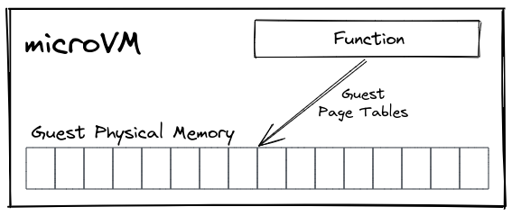
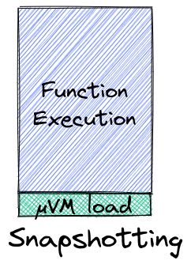
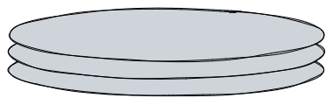

Serverless VM snapshotting
Du et al – ASPLOS'20
Ustiugov et al – ASPLOS’21
Tan et al – arXiv:2109.13319, 2021
Implemented in Firecracker¹
Firecracker dumps guest physical
memory onto a snapshot file
Firecracker mmaps the snapshot file

Slide 35
Serverless VM snapshotting
New bottleneck : IO over the snapshot file (bring pages to DRAM) [ASPLOS 21, EuroSys 22 etc)
Firecracker dumps guest physical
memory onto a snapshot file
pages
DRAM

Slide 36
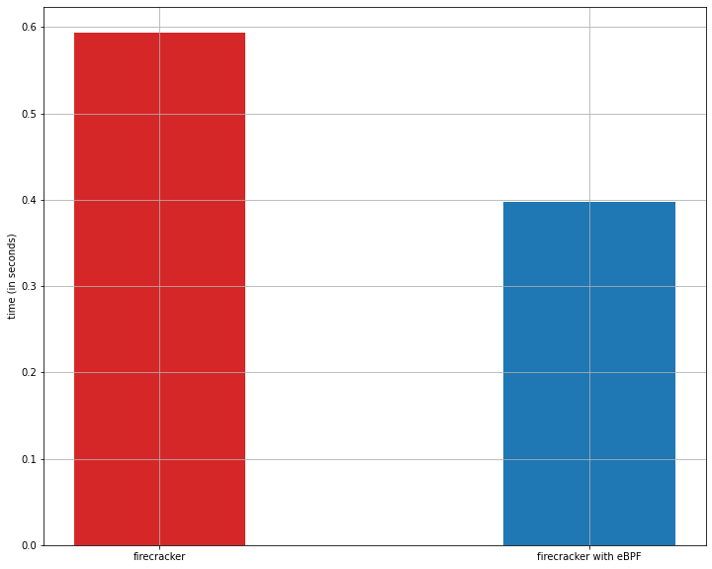
firecracker’s execution time
33%

Slide 37
Conclusions
Page Cache can not provide sufficient performance for processes with complex access patterns.
We’ve leveraged eBPF to develop a new tool that will alter the kernel’s behavior by allowing users to define what pages will be added to the Page Cache.
Our new tool eliminates the performance gap between processes with sequential and random access patterns and can be utilized from processes that execute read() or mmap() file operations such as firecracker micro-VMs.

Slide 38
Future Work
1) Asynchronous read
Add Readahead Marker
Add Readahead Marker
Add Readahead Marker
2) Parallel Computing
Kernel Thread 1
Kernel Thread 2
Kernel Thread 3

Slide 39
Thank you

