Slide 1
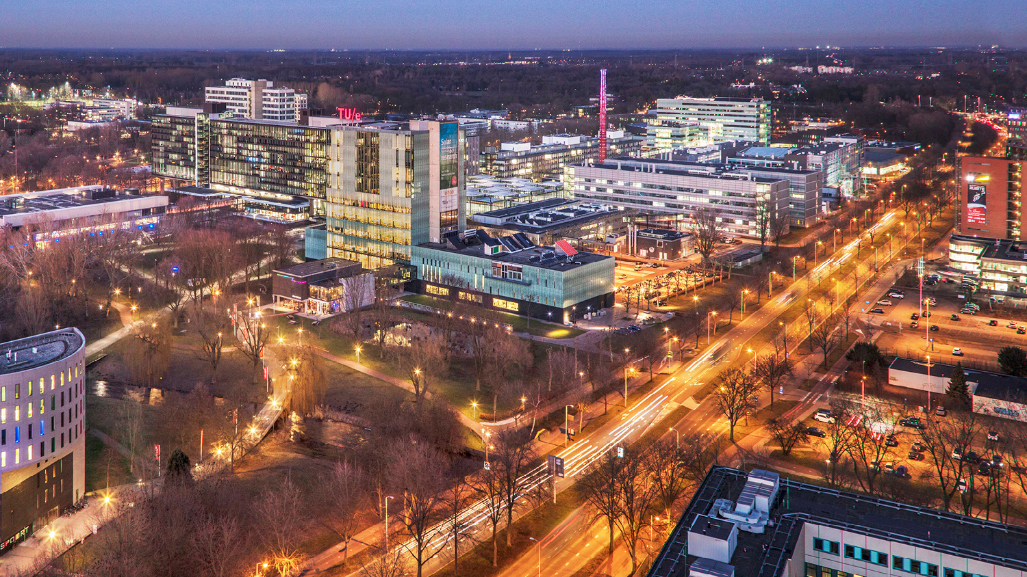
Three Tank System – Group 7
5SC26 – Systems & control integration project
K. Gunti, M. van Haren, E. Verhees, B. Wingelaar
Systems and Control

Slide 2






Table of Contents
1
Modelling:
First-Principle
Experimental
3
Control: LQR
5
Control: NLC
2
Model Validation
4
Control: MPC
6
Conclusions,
recommendations
and questions

Slide 3
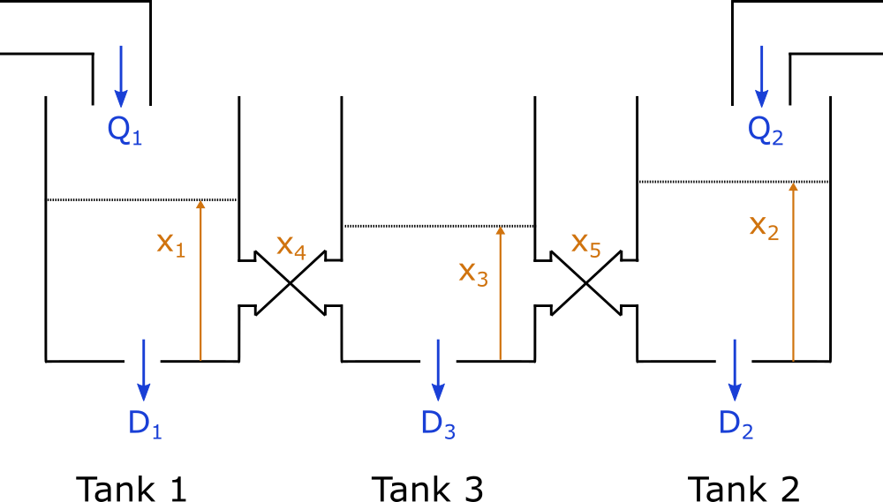
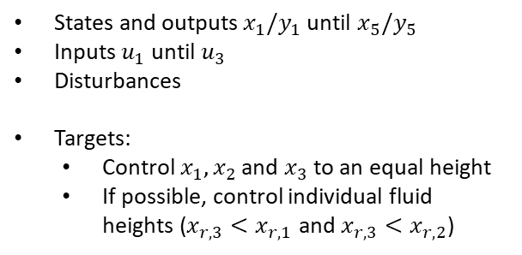
Modelling – System Description
States and outputs $x_{1}/y_{1}$until $x_{5}/y_{5}$
Inputs $u_{1}$ until $u_{3}$
Disturbances
Targets:
Control $x_{1}, x_{2}$ and $x_{3}$ to an equal height
If possible, control individual fluid heights ($x_{r,3}<x_{r,1}$ and $x_{r,3}<x_{r,2}$)

Slide 4





Modelling – First principles
$$\dot{x_{1}}= \frac{Q_{1} −Q_{1→3} −D_{1} }{A_{tank}}$$
Governing Equations
$$\dot{x_{2}}= \frac{Q_{2} −Q_{2→3} −D_{2} }{A_{tank}}$$
$$\dot{x_{3}}= \frac{ Q_{1→3}+Q_{2→3}−D_{3} }{A_{tank}}$$
$Q_{i→j}=S_{n}c_{i→j}\left(x_{k}\right)sign(x_{i}−x_{j})\sqrt{2g\left|x_{i}−x_{j}\right|}$
Bernoulli Flow (Free fall)
→ $\dot{x_{4}},\dot{x_{5}},c_{1→3},c_{2→3},Q_{1}\left(u_{1}\right), Q_{2}(u_{2})$?

Slide 5
Modelling – Experimental Identification - Valve movement

Slide 6
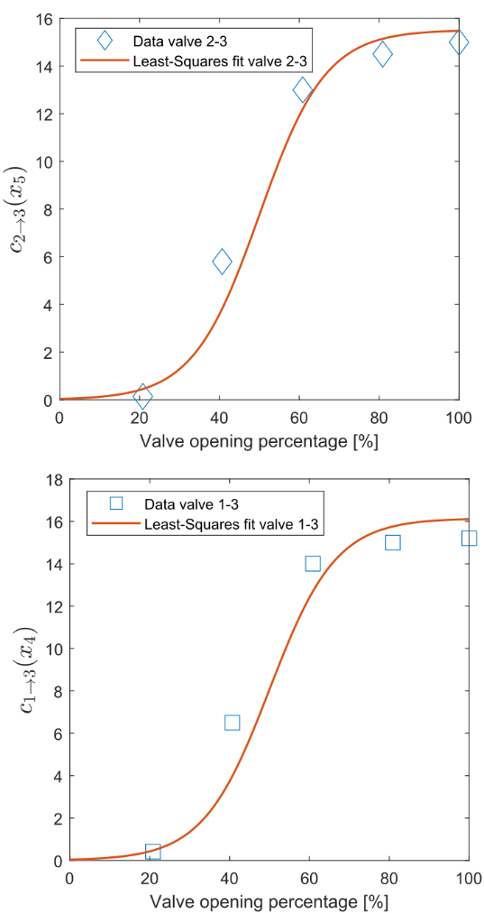



Modelling – Experimental Identification - Connecting tube volume flow
$Q_{i→j}=S_{n}c_{i→j}\left(x_{k}\right)sign(x_{i}−x_{j})\sqrt{2g\left|x_{i}−x_{j}\right|}$
Fill tank with valves closed
Open valve to certain position
Measure fluid height in neighboring tank
Use least squares with Sigmoid basis for fit
$${\hat{c}}_{1→3}\left(x_{4}\right)=16,15 \frac{e^{x_{4}∙12/100}}{e^{x_{4}∙12/100}+1}$$
$${\hat{c}}_{2→3}\left(x_{5}\right)=15,52 \frac{e^{x_{5}∙12/100}}{e^{x_{5}∙12/100}+1}$$

Slide 7
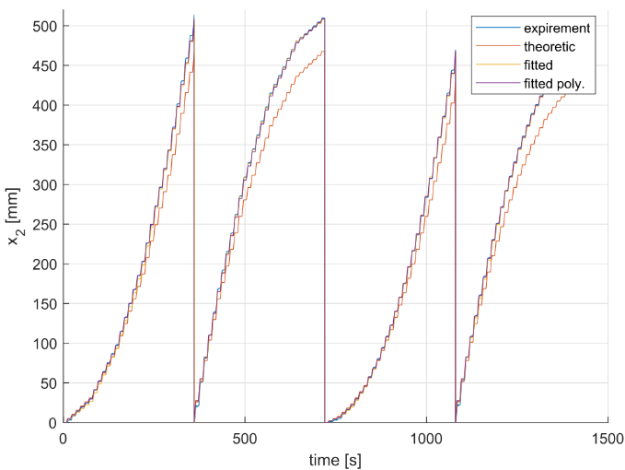
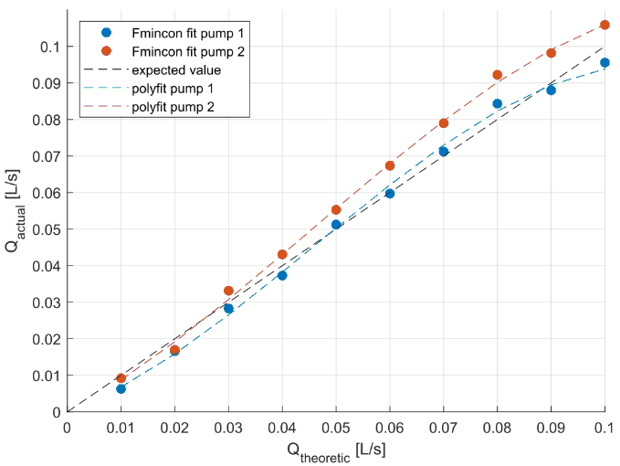



Modelling – Experimental Identification - Pump dynamics
$$Q_{i}=f(u_{i})$$
Close all valves
Send input sequence – Square wave signal
Measure height of respective tank
Fit data
Validate
$$Q_{1}=−106,2u_{1}^{3}+14,6u_{1}^{2}+0,5u_{1}$$
$$Q_{2}=−77,3u_{2}^{3}+10,5u_{2}^{2}+0,8u_{2}$$

Slide 8
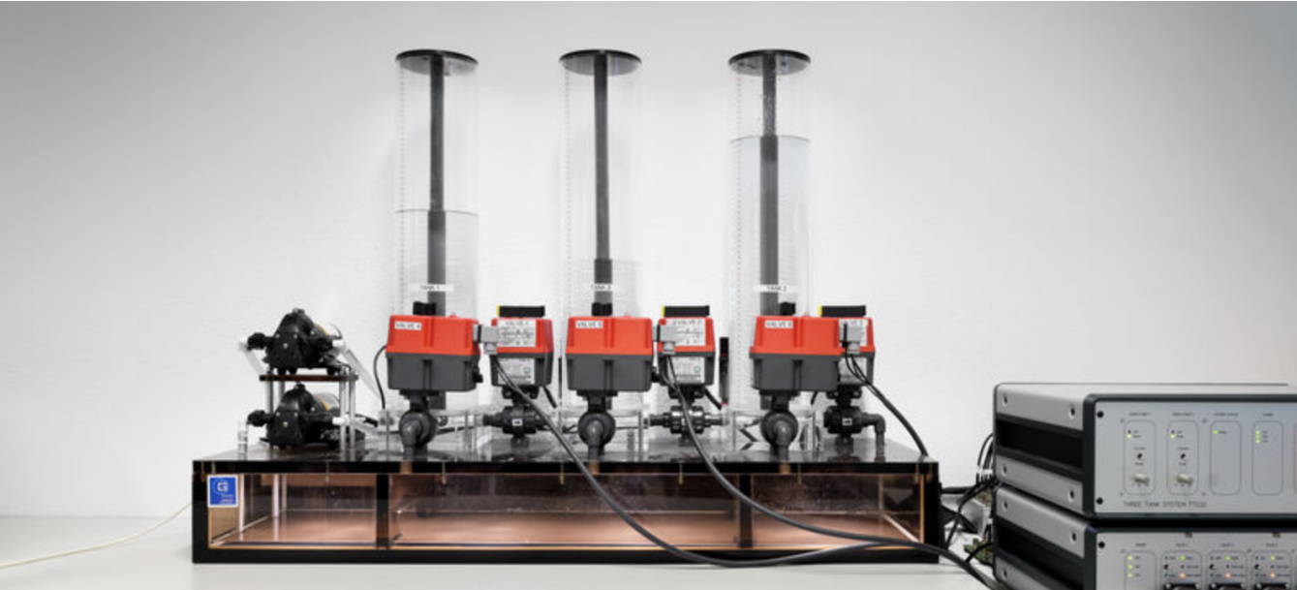
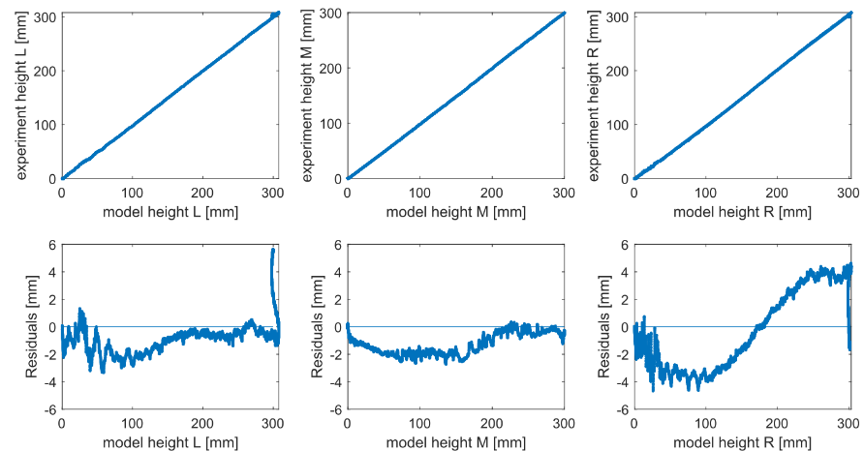
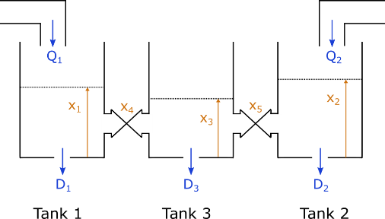



Model Validation
System
$$y_{system}$$
$$u$$
+
-
Model
$$y_{model}$$

