Slide 1


Strings and Patterns

Slide 2

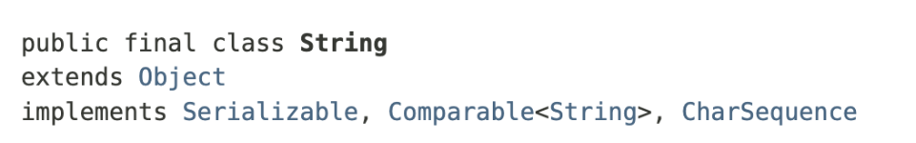
String
The String class represents character strings. All string literals in Java programs, such as "abc", are implemented as instances of this class.

Slide 3
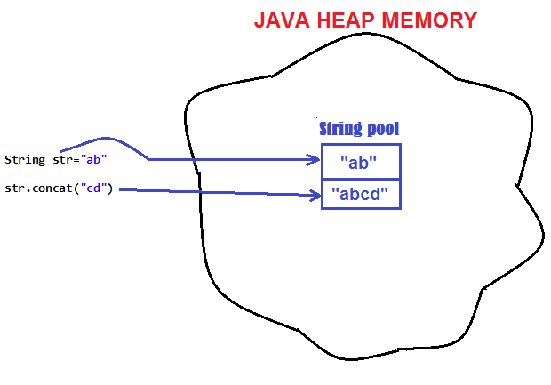
String
Strings are constant; their values cannot be changed after they are created. String buffers support mutable strings. Because String objects are immutable they can be shared.
Notes:
Once a string is created, it cannot be changed. Any operation on a string (e.g., replace(), substring(), toUpperCase()) returns a new string object, leaving the original string unchanged.

Slide 4
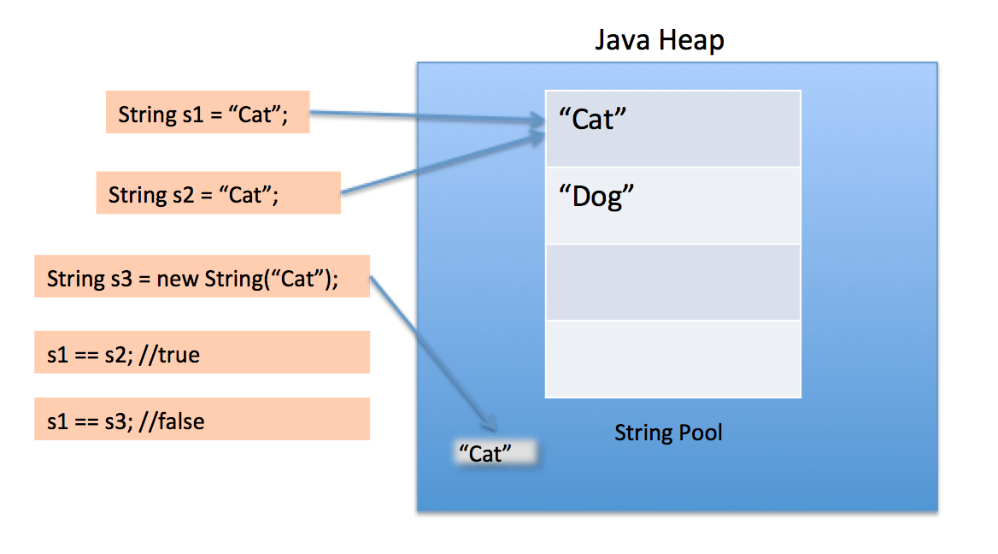
String
Strings in Java are stored in a special memory area called the String Pool for memory efficiency and reuse.

Slide 5
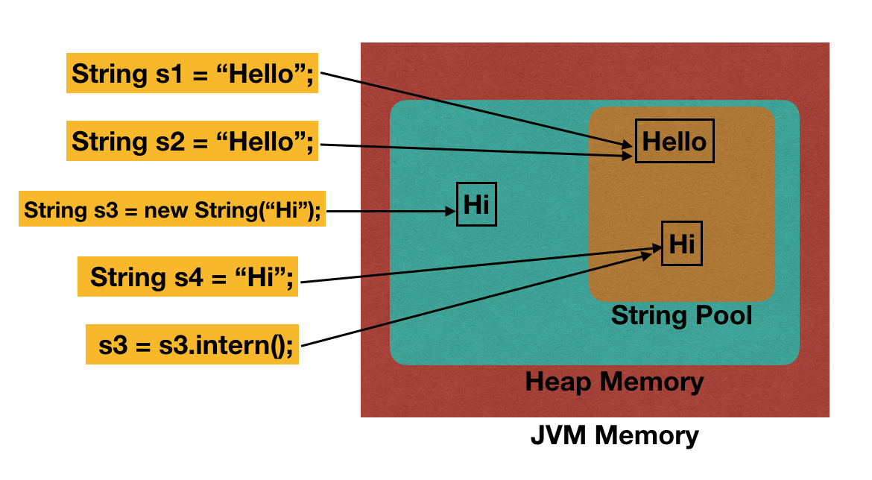
String
When the intern method is invoked, if the pool already contains a string equal to this String object as determined by the equals(Object) method, then the string from the pool is returned. Otherwise, this String object is added to the pool and a reference to this String object is returned.
All literal strings and string-valued constant expressions are interned.

Slide 6
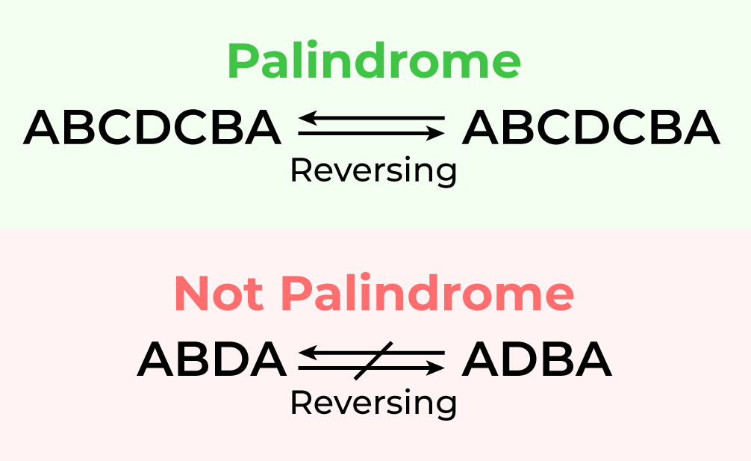

Slide 7
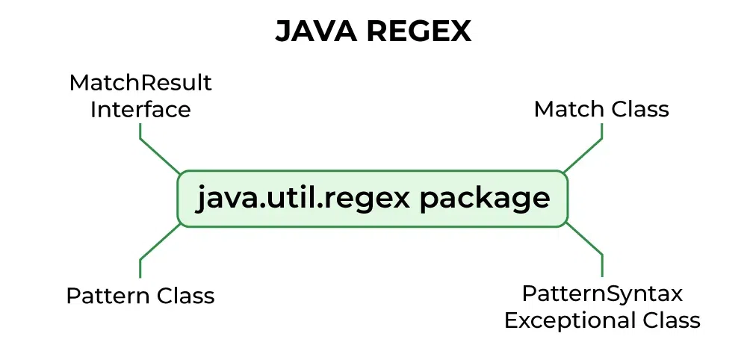
Regex
In Java, Regular Expressions or Regex (in short) in Java is an API for defining String patterns that can be used for searching, manipulating, and editing a string in Java.
Email validation and passwords are a few areas of strings where Regex is widely used to define the constraints.
Regular Expressions in Java are provided under java.util.regex package.
java.util.regex

Slide 8
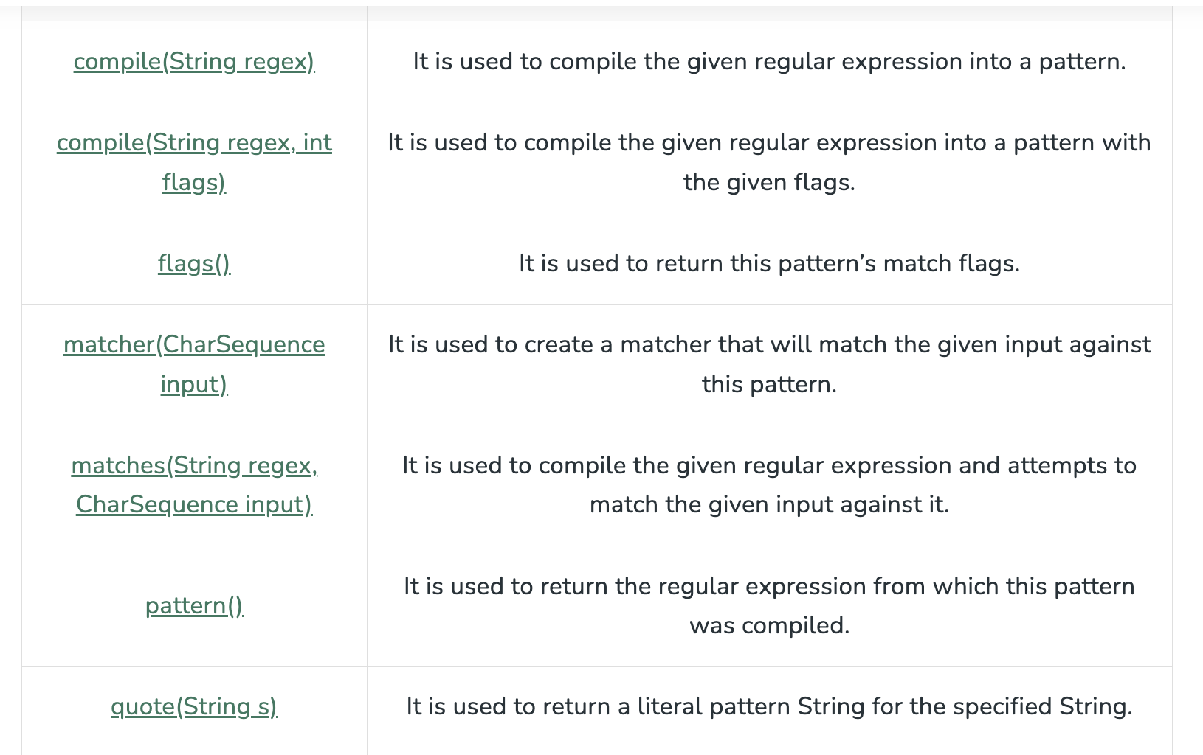
Pattern
Pattern class is a compilation of regular expressions that can be used to define various types of patterns, providing no public constructors.
This can be created by invoking the compile() method which accepts a regular expression as the first argument, thus returning a pattern after execution
java.util.regex
Pattern Class
Notes:
This consists of 3 classes and 1 interface. The java.util.regex package primarily consists of the following three classes as depicted below in tabular format as follows:
Pattern Class - Used for defining patterns
Matcher Class - Used for performing match operations on text using patterns
PatternSyntaxException Class - Used for indicating syntax error in a regular expression pattern
MatchResult Interface - Used for representing the result of a match operation

Slide 9
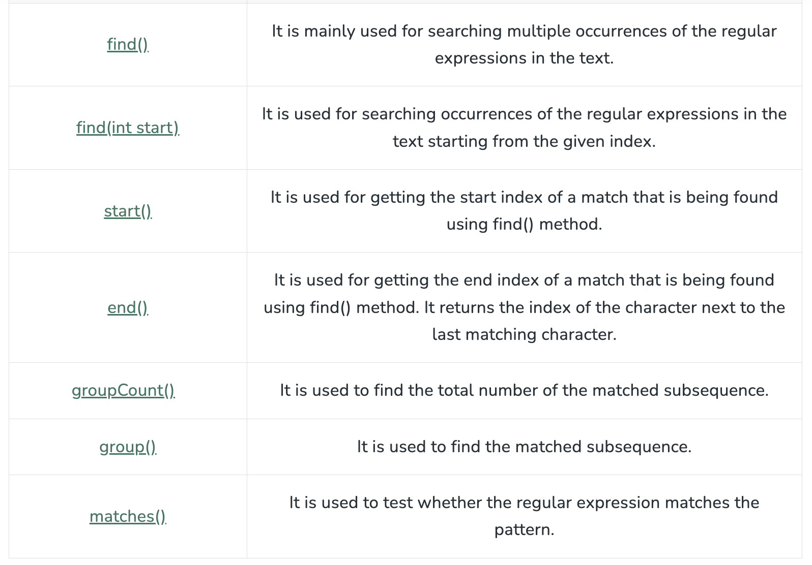
Matcher class
This object is used to perform match operations for an input string in Java, thus interpreting the previously explained patterns. This too defines no public constructors. This can be implemented by invoking a matcher() on any pattern object.
java.util.regex
Step 2
Pattern Class
Matcher Class

Slide 10
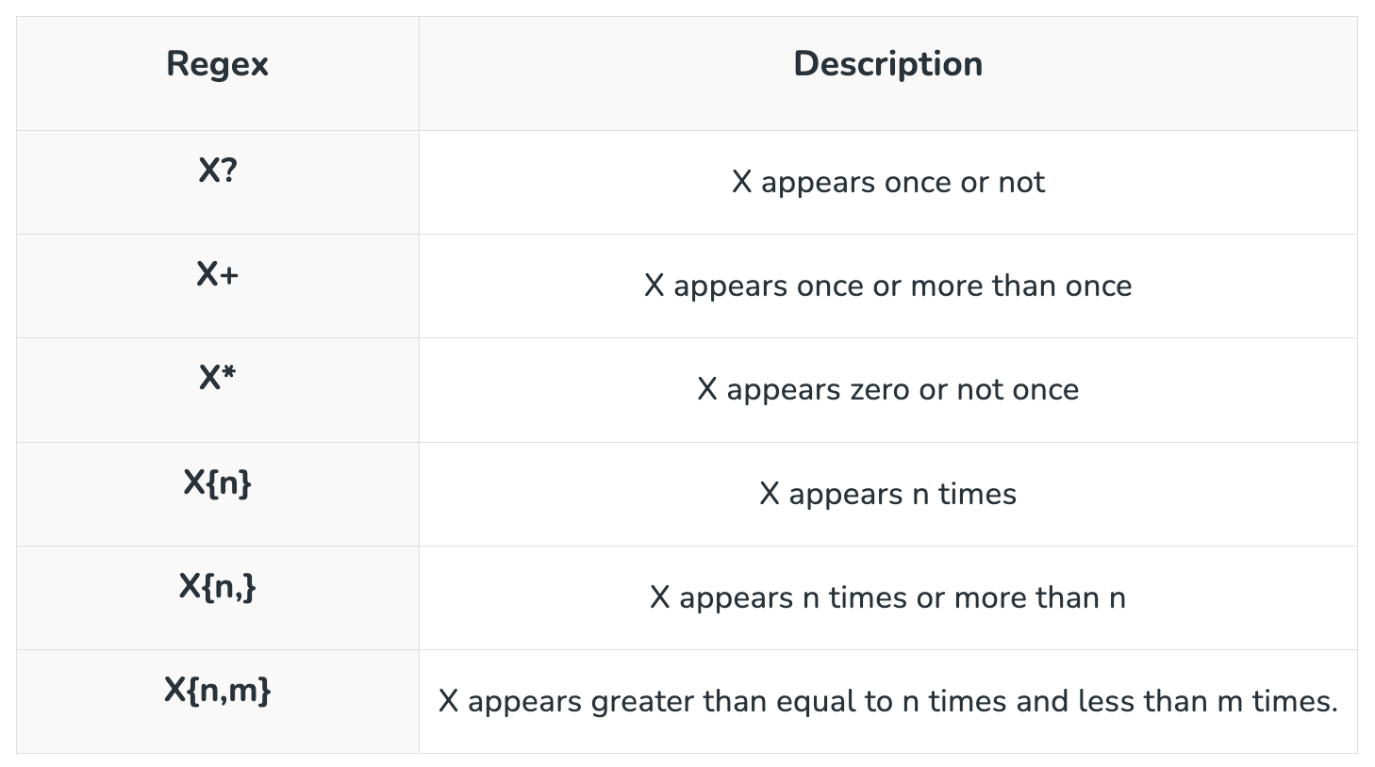
Regex Metacharacters

Slide 11
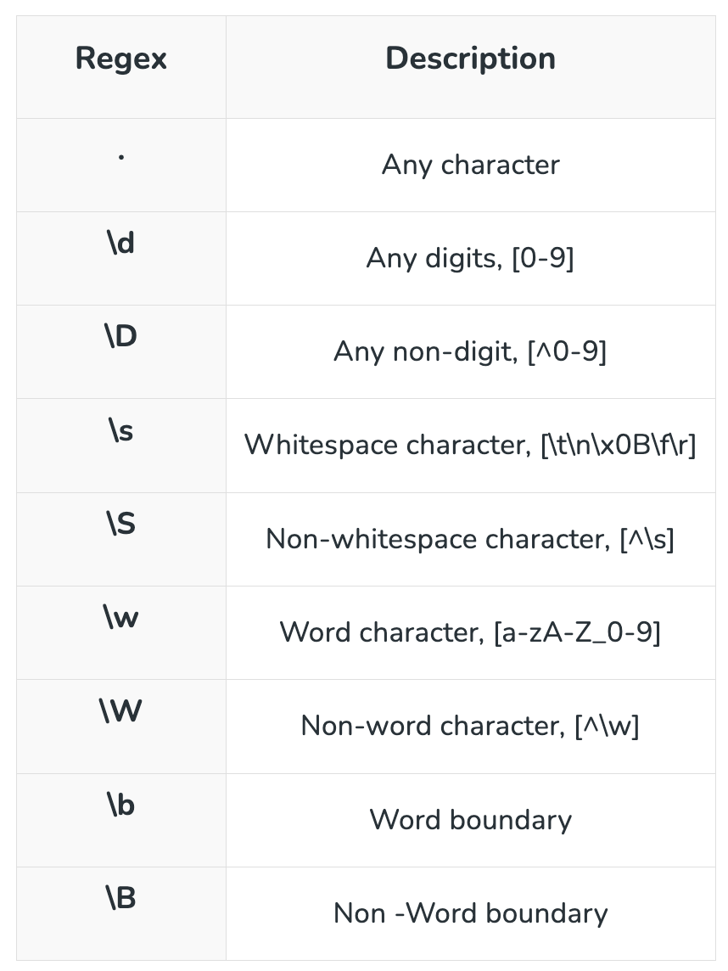
Java Regex Finder Example

Slide 12
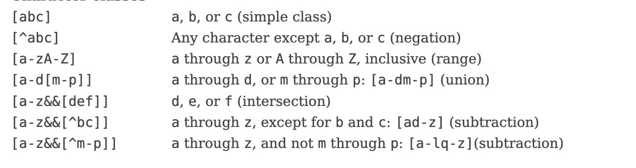
Character classes

Slide 13
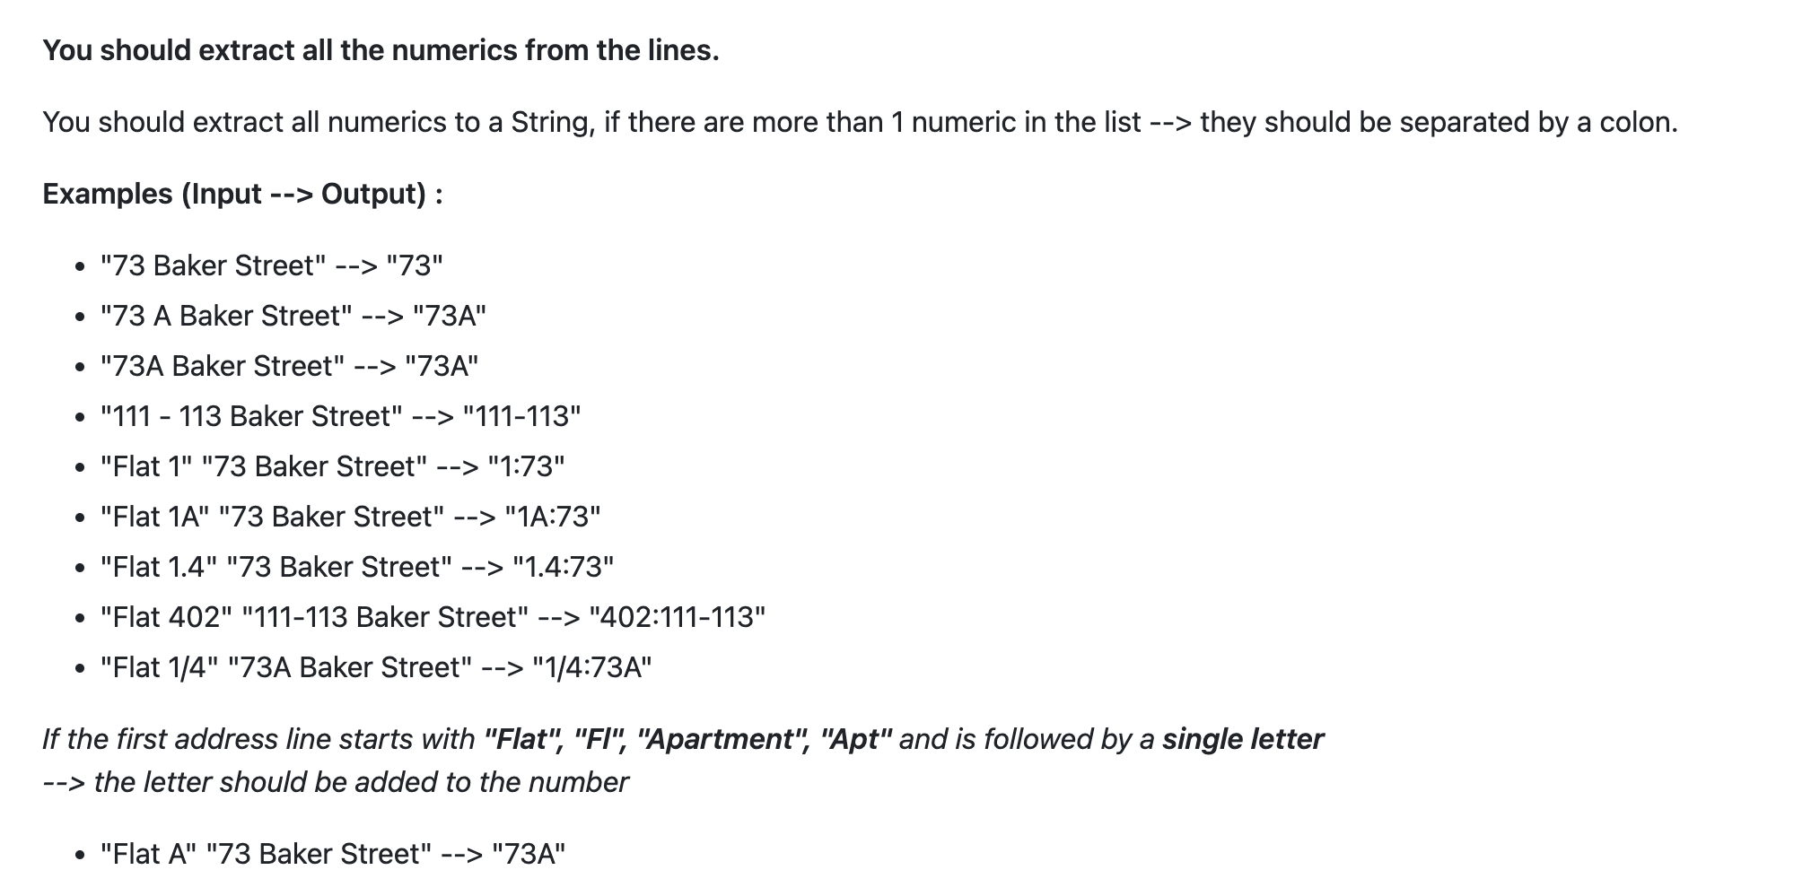
Task

Slide 14
To validate your regex I suggest to use this site
https://regex101.com/

Slide 15

Thank you
Author: Yelyzaveta Lubenets
My LinkedIn: linkedin.com/in/yelyzaveta-lubenets-275312227
Date: December 2024
Join Codeus community in Discord
Join Codeus community in LinkedIn

