Slide 1
Bootstrap Continued
GWDA273 Intermediate Web Design
Week 7
Russell Burt

Slide 2
Today
Homework review
Competencies covered today
Menu systems in BS
Advanced BS features
Reading
In-class work
Homework assignment

Slide 3
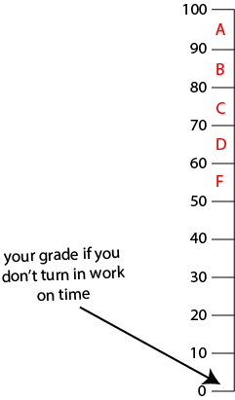
Homework Review
Let’s see what you did
Remember, late = 0
Deliver it NOW, or it earns a zero

Slide 4
Competencies Covered Today (highlighted in red)
Define terms and methods for styling web pages
Articulate the concept for a web page design
Identify issues of accessibility that need to be addressed when styling web pages for various devices
Discuss the benefits of separating structure and presentation during web site production
Apply various methods for styling web pages
Use CSS to visually design the presentation of web page content
Implement various page layout methods such as fixed and liquid layouts
Design a web site that works on different screen resolutions and devices
Solve information architecture and communication problems with effective web site styling
Identify ways to use on-line resources for problem solving
Implement solutions for common information architecture principles through web page styling

Slide 5
Common Problems
Folder/file management
File names
Large image sizes
Missing assets

Slide 6
Menu Systems
LOTS of classes are assigned to individual nav items
Once you understand this class structure, you’ll understand Bootstrap!

Slide 7
Advanced Bootstrap Features
BS grid system explored
Fluid containers, push/pull, and more
See http://developer.telerik.com/featured/leveling-up-your-app-with-advanced-bootstrap-features/

Slide 8
Reading
None

Slide 9
In-Class Work
Bootstrap the bike-more site
Let’s work through problems together
ZIP and upload finished site to the wk07 dropbox on eCompanion
DUE BY END OF CLASS
Late = 0

Slide 10
Homework Assignment
Bootstrap ONE of the given sites—see Faculty Storage, also on eCompanion Doc Sharing
Finish AT LEAST the home page
The menu must work!
Remove sitemap/sources
Remove breadcrumbs
Use dummy emails (if applicable)
Forms do not need to work
DO NOT upload to your web host
ZIP and upload the site to the wk07 homework dropbox on eCompanion
DUE BY BEGINNING OF CLASS NEXT WEEK
Late = 0

