Slide 1
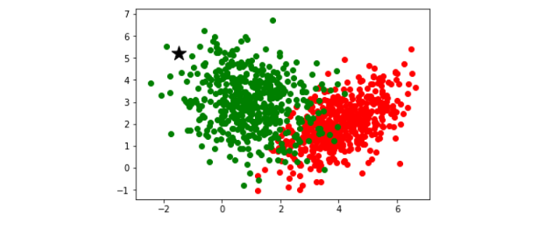
How Does K-nearest Neighbor Works In Machine Learning Classification Problem?

Slide 2
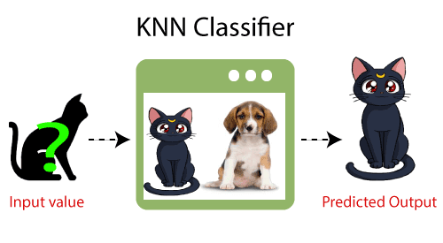
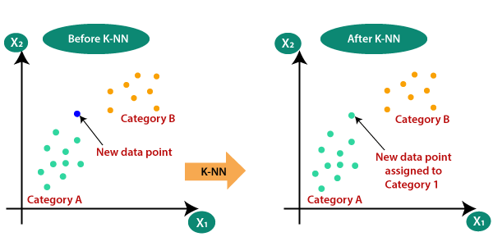

Slide 3
How does K-NN work?
The K-NN working can be explained on the basis of the below algorithm:
Step-1: Select the number K of the neighbors
Step-2: Calculate the Euclidean distance of K number of neighbors
Step-3: Take the K nearest neighbors as per the calculated Euclidean distance.
Step-4: Among these k neighbors, count the number of the data points in each category.
Step-5: Assign the new data points to that category for which the number of the neighbor is maximum.
Step-6: Our model is ready.

Slide 4
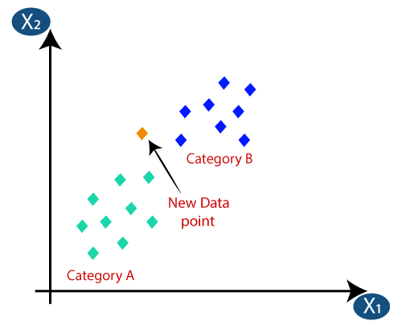
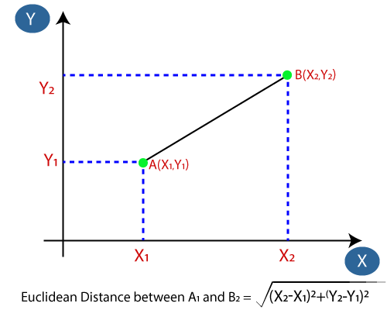

Slide 5
