Slide 1
Building For Production
iOS version

Slide 2

Agenda
1
Develop - Practices
2
Build - Configuration
3
Store - Guidelines

Slide 3
Develop - Practices

Slide 4
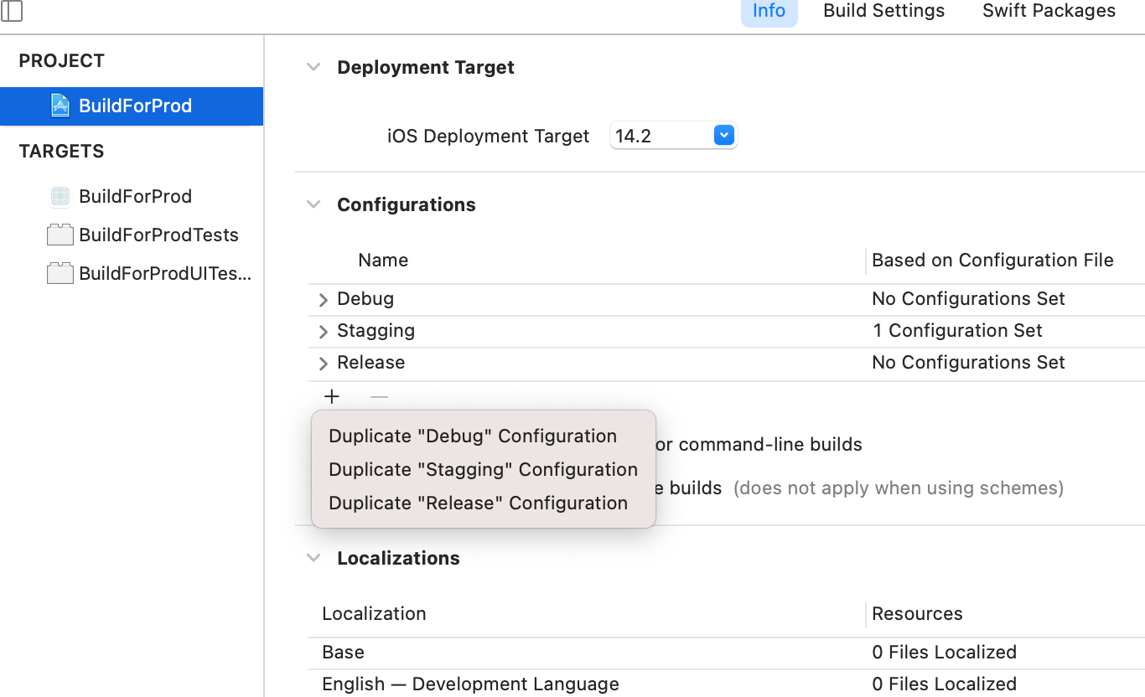
Build configuration
A build configuration is a specific group of builds settings that can be applied to any target.
Default projects come with two build configurations
Every environment you must Duplicate Debug and Release configuration.
Custom build configuration can be created to enable custom settings

Slide 5
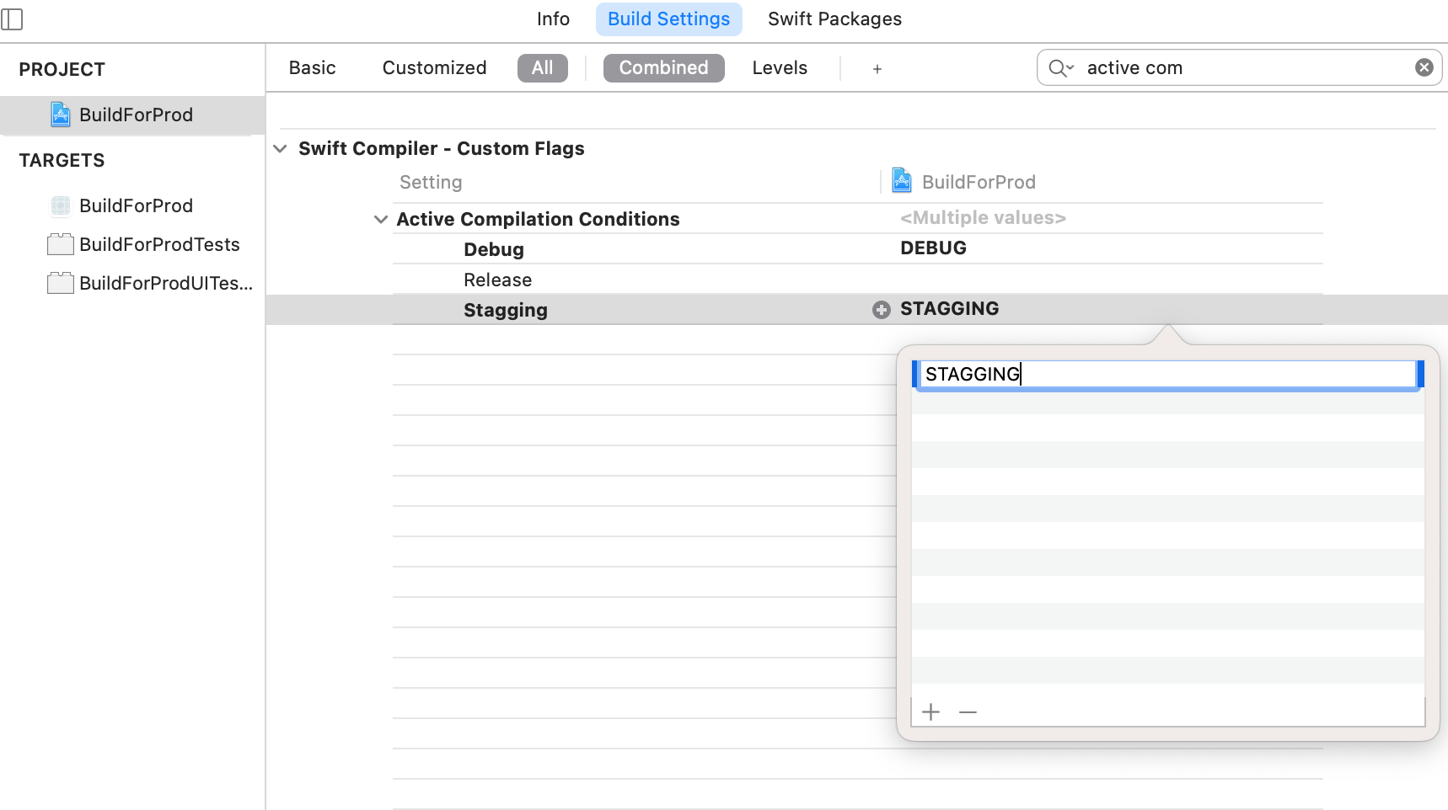
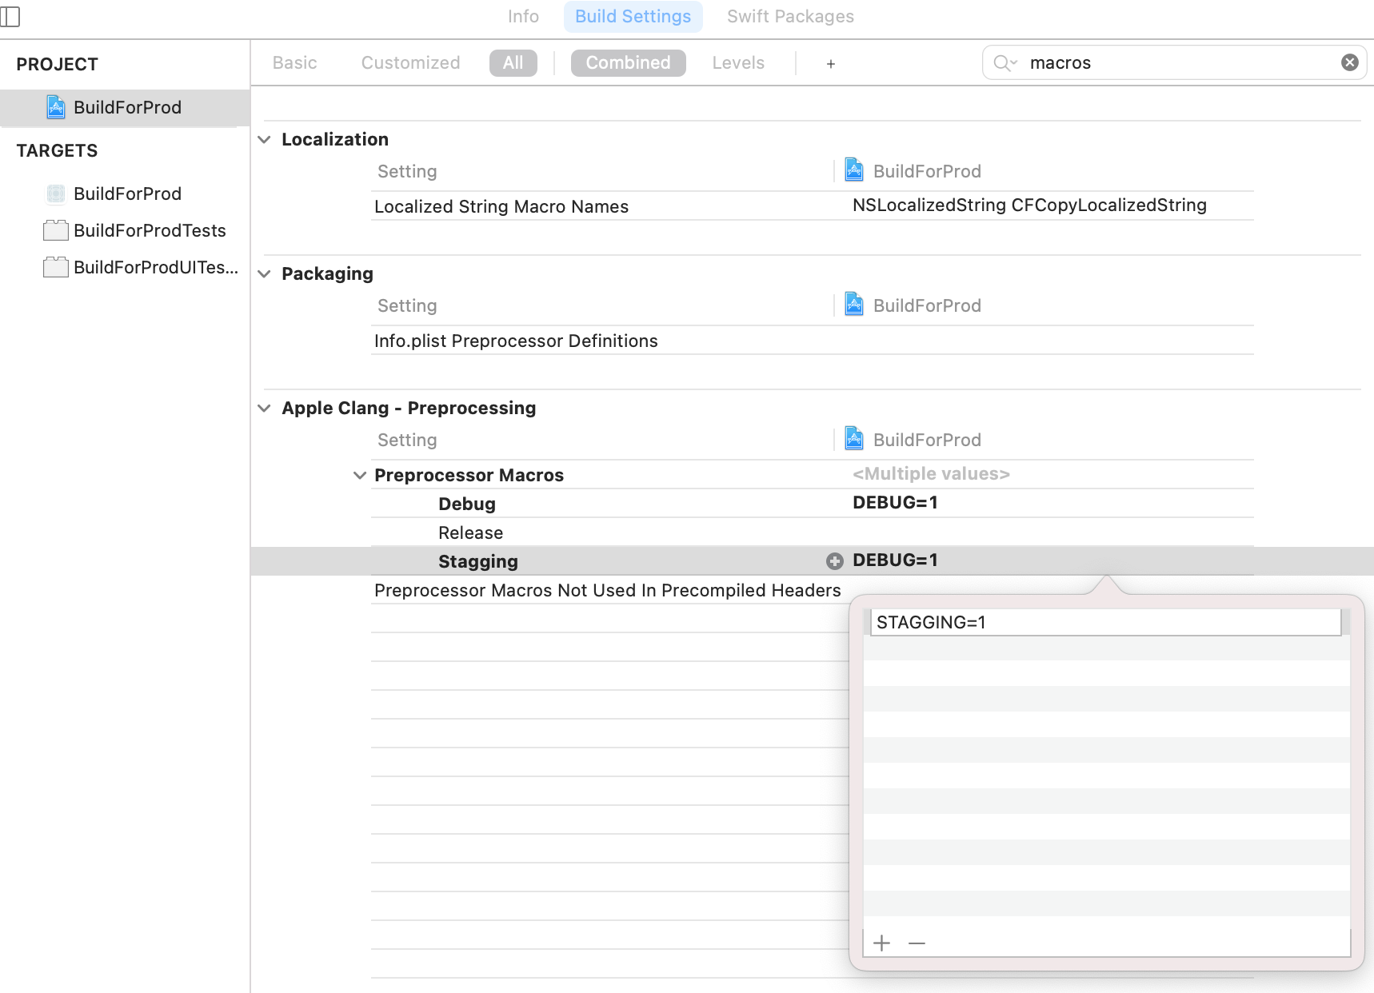
Build configuration – Connect conditional directives
This option allows you to define any number of compiler flags (Compile Time!)
Preprocessor directives, unlike normal Swift code, do not run any logic.
Preprocessor main purpose is to mark specific lines of your Swift code as hidden/visible to the compiler
Swift Objc

Slide 6
Build configuration - Conditional directives code
Swift
ObjC
#if DEBUG
func callApi() -> Request
print("Inside callApi()")
#elseif STAGGING
func callApi() -> MockRequest {
#else
func callApi() -> Request {
#endif
// implementation
...
}
#if defined(DEBUG)
// Do something only in DEBUG
#elif defined(STAGGING)
// Do something only in TEST
#else
// Do something only in RELEASE
#endif

Slide 7
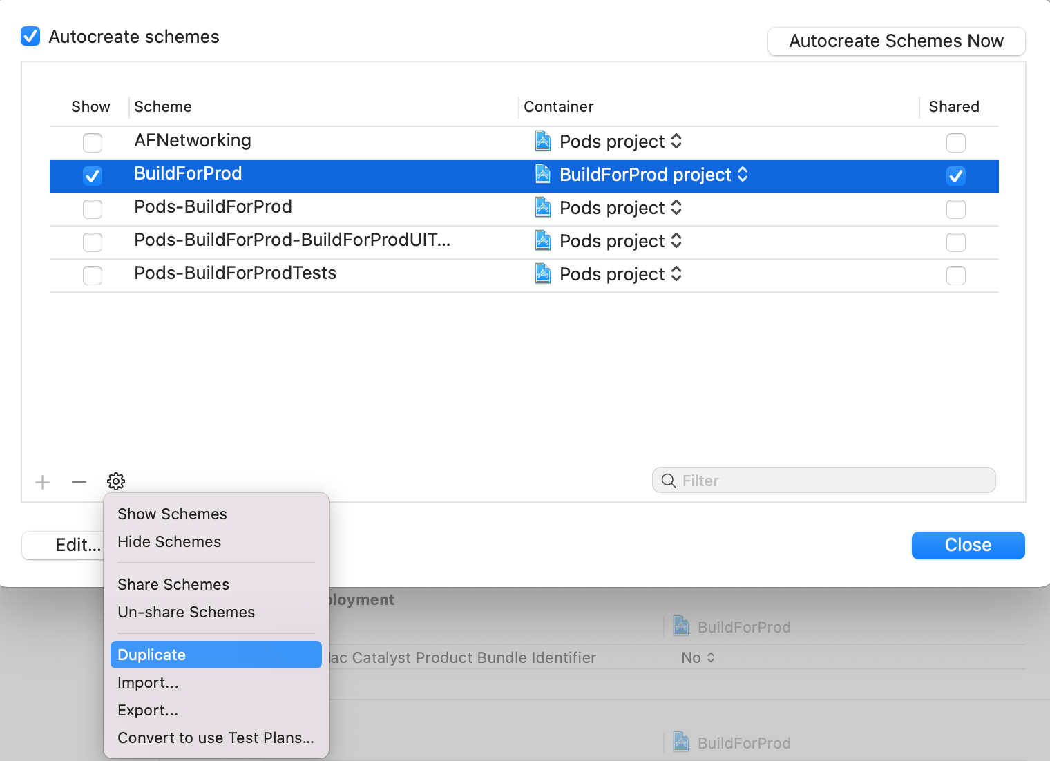
Schemes
A build scheme is a blueprint for an entire build process
A way of telling Xcode what build configurations you want to use to create the development (Build, Run, Test, Profile, Analyze, Archive)
Default projects come with two build configurations and one build scheme
Uses
Free version & in-app purchase
Production server & testing server
Internal app & public app

Slide 8
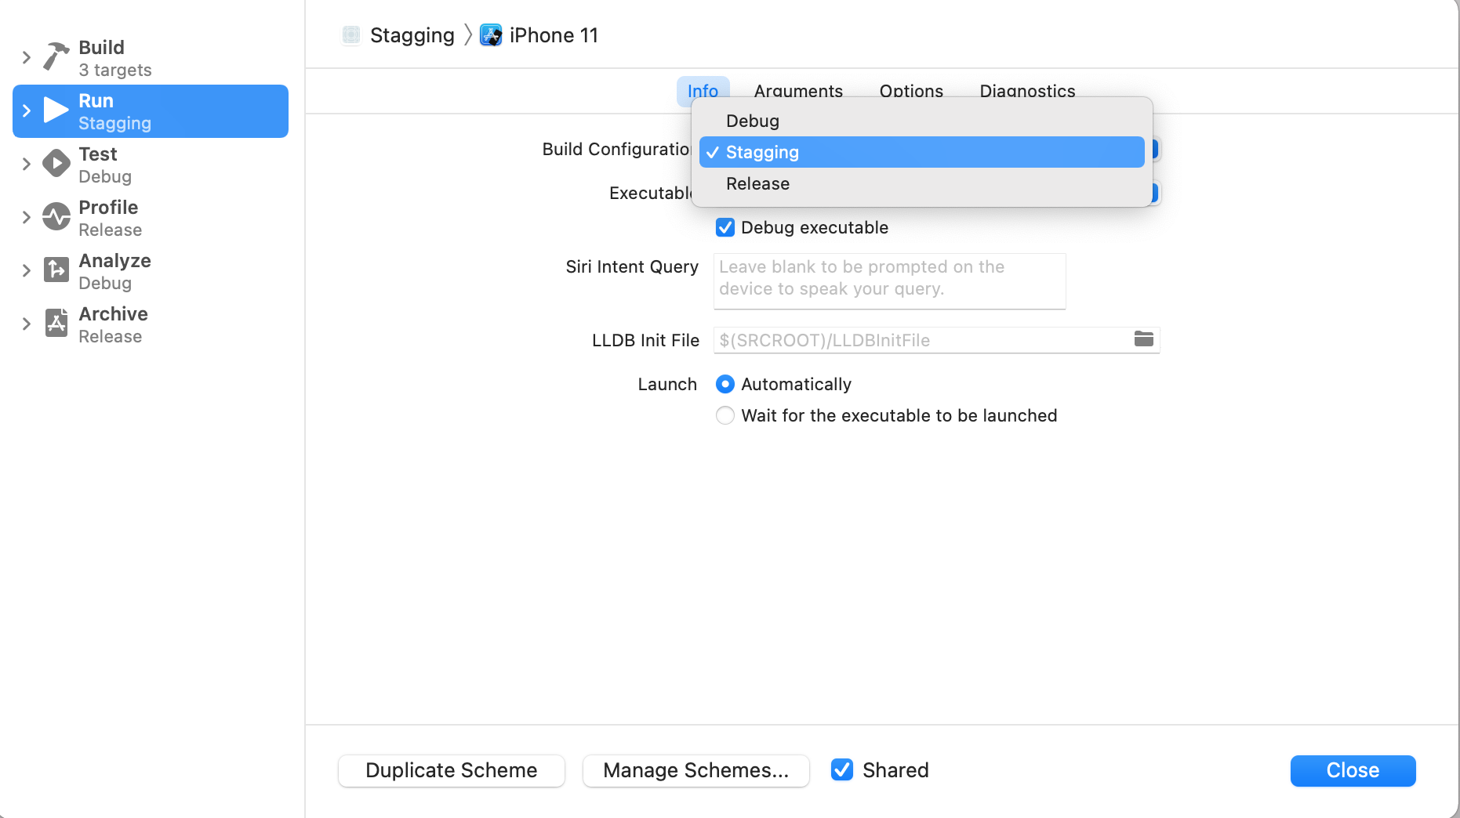
Schemes – connect to build config
Trigger point for build configuration
AppIcon => Edit Scheme
Always configure Build and Run to avoid problems
Shared indicate that they are not strictly local to only your own Xcode environment, but available project-wide

Slide 9
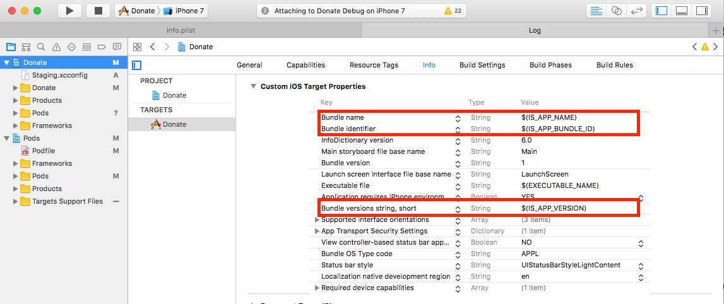
.xcconfig Files
A key/value based file.
Define and override the build settings for a particular build configuration of a project
Used instead of conditional compilation blocks to manage the build settings
You can use your configuration variables in project settings, info.plist and entitlement files
Environment variables have names consisting solely of uppercase letters, digits, and underscore (_)
IS_APP_NAME = BuildForProdApp Stagging
IS_APP_VERSION = 0.3
IS_BUNDLE_ID = com.vois.BuildForProdApp.stagging

Slide 10
.xcconfig Files - Formatting
Append to existing definitions, use the $(inherited) variable
Substitutions can be used to define new variables according to existing values
Conditional Build settings
Build configuration file can include settings from other configuration files
BUILD_SETTING_NAME = $(inherited)additional value
CONFIGURATION_BUILD_DIR = $(BUILD_DIR)/$(CONFIGURATION)
BUILD_SETTING_NAME[arch=architecture] = value for specified architecture
#include "path/to/File.xcconfig"
Notes:
inherited values locations
Platform Defaults
Xcode Project xcconfig File
Xcode Project File Build Settings
Target xcconfig File
Target Build Settings
Speed up build settings by removing architectures

Slide 11
Pods – Configuration
Deployment target and build settings inherited from project
Each pod install step reset Pods.xcodeproj configuration
Add custom build configuration to pod file script
Config name use defined preprocessor directives
post_install do |installer|
installer.pods_project.targets.each do |target|
target.build_configurations.each do |config|
if config.name = 'STAGGING'
config.build_settings['IPHONEOS_DEPLOYMENT_TARGET'] = 13'
config.build_settings['ENABLE_TESTABILITY'] = 'YES'
end
end
end
end

Slide 12
Saved Data Types
Files Saved During App Updates When a user downloads an app update, iTunes installs the update in a new app directory then moves the user’s data files from the old installation over to the new app directory before deleting the old installation.
Data are not wiped between app updates
NSUserDefaults
KeyChain
Core Data
Files
<Application_Home>/Documents
<Application_Home>/Library

Slide 13
Data handling tips
Don’t change saved data structure between multiple releases
Use unique keys when storing a variable
Never reuse same keys to store different types
Change data models in Core Data wisely use renaming identifier
Check data types before before using
Exclude iCloud data backup
Everything in your app’s home directory is backed up, with the exception of the application bundle itself, the caches directory, and temp directory.
Use isExcludedFromBackup to excluding cache and other application support files which are not needed in a backup
Test update scenario
Define a way in app to reset the data

Slide 14
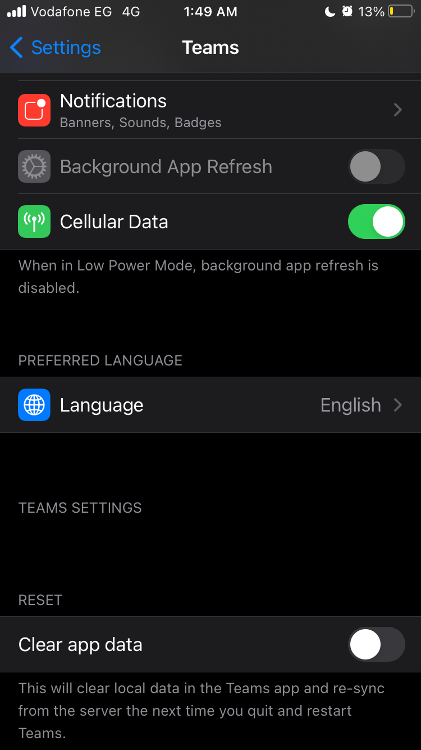
Persistent data – Reset –Settings bundle
Use Android way to clear data!
A way to control the app without opening
Used in cases where the app is unstable or crashing
Defined with settings.bundle
Special kind of bundle provided by Apple to allow developers to add their app preferences into the iOS Settings app.
Types
Text field, Title, Toggle, Slider, Group, Child pane
Use custom flag to determine when to delete data.

Slide 15
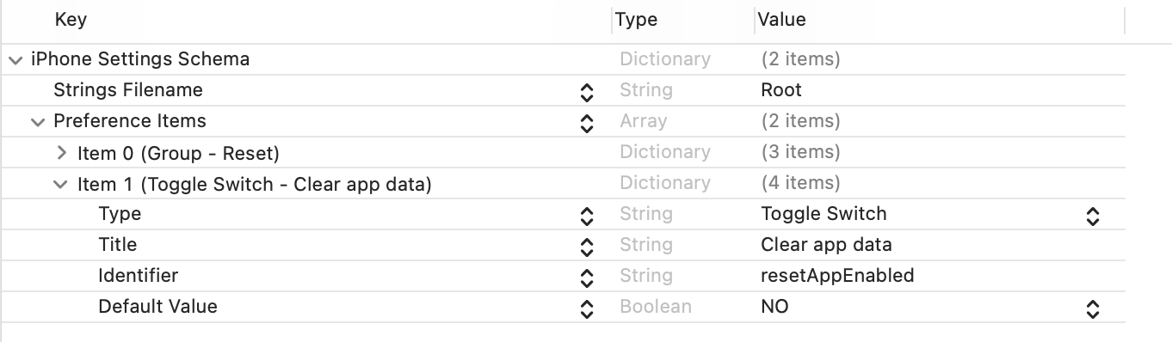
Settings bundle - implantation
AppDelegate class
Settings.bundle
class AppDelegate: NSObject, UIApplicationDelegate {
func application(_ application: UIApplication, didFinishLaunchingWithOptions launchOptions: [UIApplication.LaunchOptionsKey : Any]? = nil) -> Bool {
if UserDefaults.standard.bool(forKey: "resetAppEnabled") {
UserDefaults.standard.removePersistentDomain(forName: "BuildForProd")
UserDefaults.standard.set(false, forKey: "resetAppEnabled")
}
return true
}
}

Slide 16
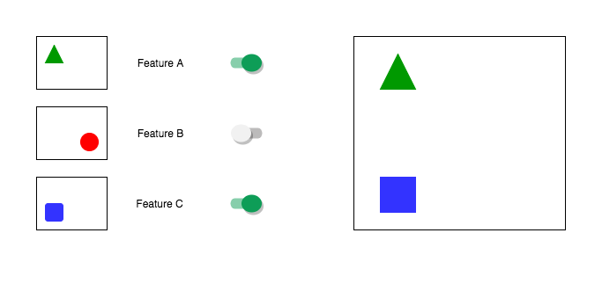
Feature Flags
Software development technique that turns certain functionality on and off during runtime
Build conditional feature branches into code.
Allows Trunk based development preventing merge conflicts.
Allow incomplete and un-tested codepaths to be shipped to production.
Continuous Delivery principle of "separating [feature] release from [code] deployment
Firebase Remote Config and Adobe Target are examples

Slide 17
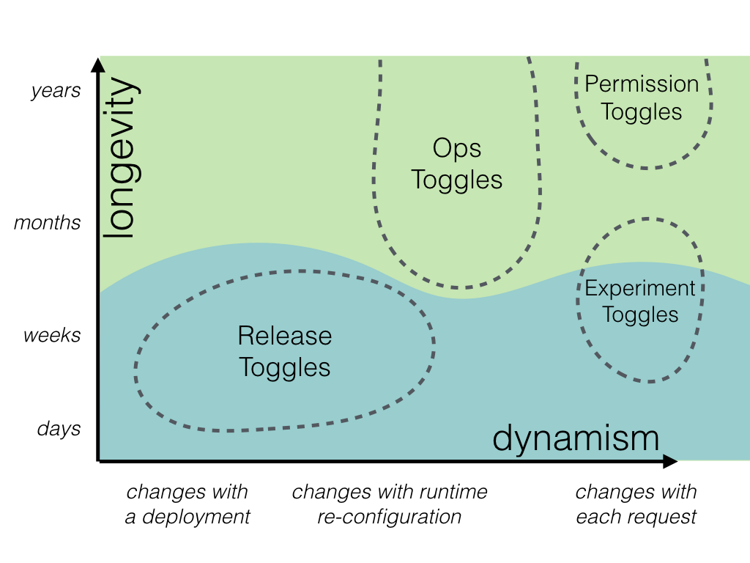
Feature Flags - Types
Release Toggles – in-progress features to be checked into a shared integration branch
Experiment Toggles - perform multivariate or A/B testing (data driven).
Ops Toggles - degrade non-vital system functionality when the system is enduring unusually high load (performance driven).
Permission Toggles – Specific set of identified users, premium vs normal, postpaid vs prepaid (user type driven).

Slide 18
Build - Configuration

Slide 19
Xcode build settings - Architecture
Architectures declared ARCHS_STANDARD list of available architectures for both simulator and device specific build.
x86_64 is the architecture of Intel's 64-bit CPUs (Mac OS)
arm64 is the architecture used by newer Macs built on Apple Silicon (Mac OS)
arm64 is the current 64-bit ARM CPU architecture, as used since the iPhone 5S and later (iOS)
armv7s being used in Apple's A6 and A6X chips on iPhone 5, iPhone 5C and iPad 4 (iOS)
armv7, an older variation of the 32-bit ARM CPU, as used in the A5 and earlier
xcodebuild -showBuildSettings -scheme BuildForProd -sdk iphoneos | grep ARCHSxcodebuild -showBuildSettings -scheme BuildForProd -sdk iphonesimulator | grep ARCHS
xcodebuild -showBuildSettings -scheme BuildForProd -sdk iphoneos | grep ARCHSxcodebuild -showBuildSettings -scheme BuildForProd -sdk iphoneos | grep ARCHS

Slide 20
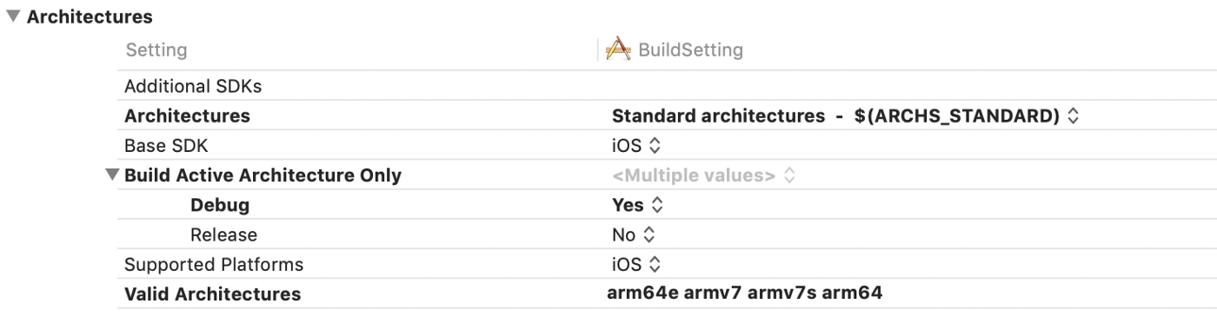
Xcode build settings - Architecture
Build Active Architecture Only
Xcode will detect the device that is connected
Debug mode should be YES to optimize build speed
Release mode should be No to build all valid archs
Architectures the Xcode will build is the list Valid Architectures intersected with Architectures.
32-bit architectures are now deprecated from Apple

Slide 21
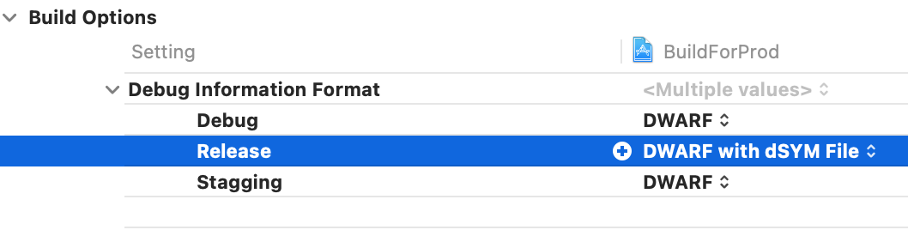
Xcode build settings - DWARF
Debugging with attributed record formats
dSYM is needed because dSYM files are used to de-symbolicate the crashes your app might have
dSYM files will likely change each time your app is compiled
dSYM files should be uploaded to any crash analysis tool ex. Crashlytics

Slide 22
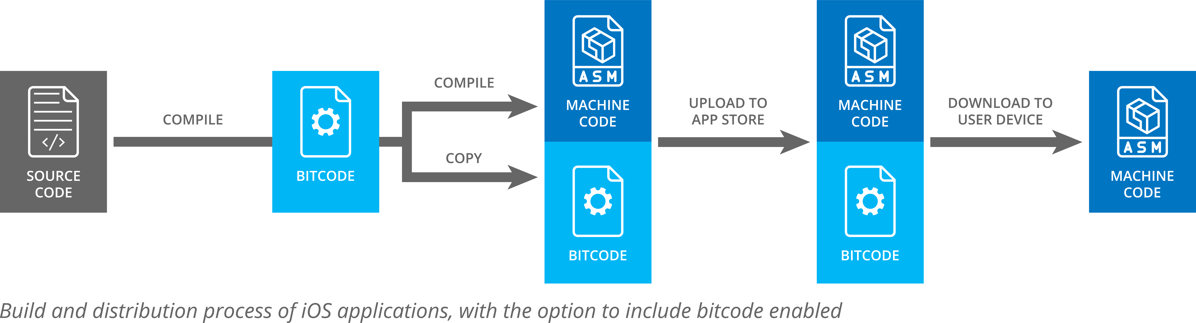
Xcode build settings - Bitcode
Compiler front-end converts the source code into some kind of intermediate representation (IR)
Optimizer performs a sequence of optimizing transformations
Apple is able to recompile applications without interacting with the developer when Bitcode is attached.

Slide 23
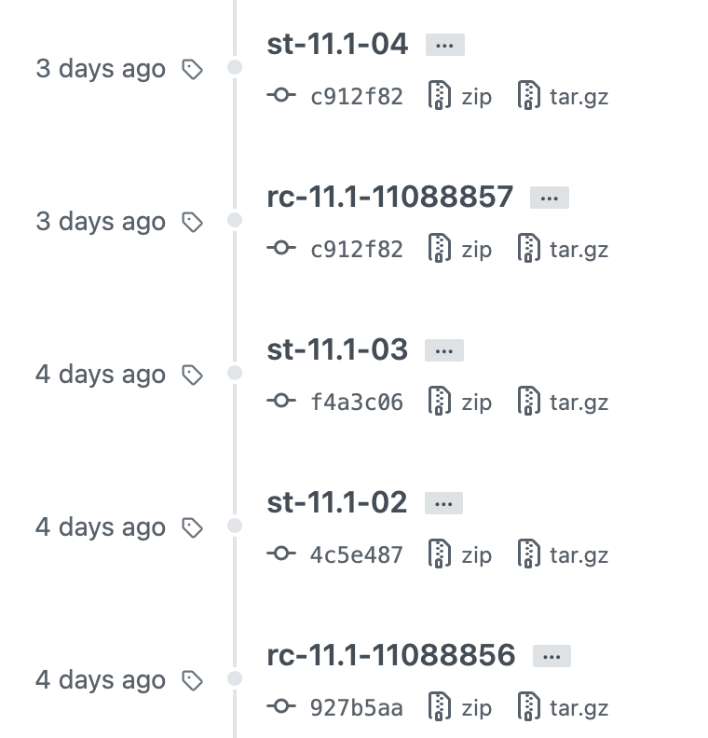
Tagging a release
Each build testing/store should have a tag on source control
It allows you to document the release notes of your project
Easier for the team to roll back changes to the previous release
Allows you to compare changes between two releases.
Allows you to deploy a previous release in your local in case you need to investigate

Slide 24
Provisioning and Certificates
Provisioning profiles are used to authorizes a set of known iOS devices to run and install a given iOS app
Development Used in development phase of the app to run the app on simulator and developer devices. (If a developer device is not in this list the in-development app can not be installed).
Ad Hoc: - Is provided to distribute the app to a known finite set of iOS devices outside the AppStore. These are very commonly used to distribute an app to testers via a third part testing service.
Devices have to be added to developer account
Enterprise:- Enable large enterprises to distribute inhouse applications to enterprise approved devices in a manner which is independent of the AppStore.
Devices are not added to developer account
App Store:- Used for AppStore or for TestFlight
TestFlight requires approval

Slide 25
Store - Guidelines

Slide 26
Firebase vs TestFlight
TestFlight
Firebase
No provisioning profile steps for testers — this means it’s super easy to manage users
Easy bug reporting/screenshot sharing features for testers built in.
Easy to open up to the whole community with the public sharing link.
Need a (Beta) Apple review before new builds can be distributed — this is usually fairly quick but can take up to a week which can be frustrating.
Limited number of testers — although this is fairly large at 10,000 users, larger companies could potentially need a fair few more.
Not cross platform — this is included as Firebase App distribution is cross platform.
Test cross platform — meaning you can upload your Android APK and your iOS build to the same service and distribute them to the appropriate users.
There’s no limit to the number of users that can test the app.
Simpler to compare and manage different beta versions
Not as seamless an experience as TestFlight to report bugs.
Not realistic test environment for final stage
Requires Enterprise certificate for testers more than 100 device per company.

Slide 27
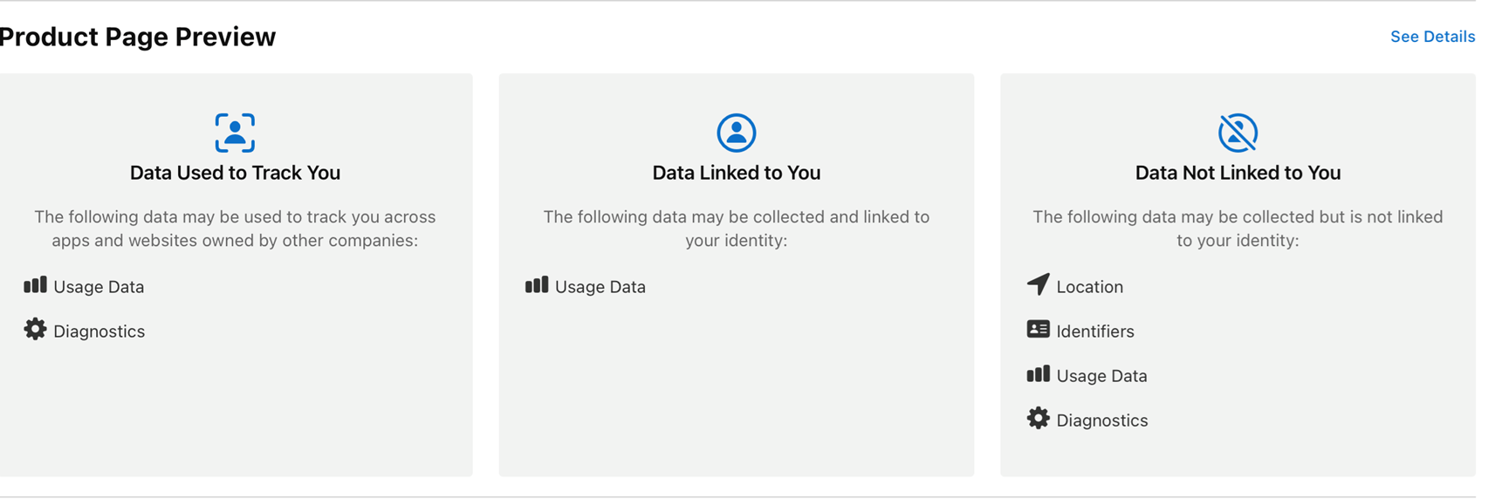
App Store changes - Tracking
AppStore mandating to answer privacy question in App Store for any app submission
Collect and analyze data collected from user and submitted by app to any third party or API.
Classify those data into tracking data like Adobe, Tealium, SMAPi, Firebase,Netperform, …
Classify if data is associated to user identity or not.

Slide 28
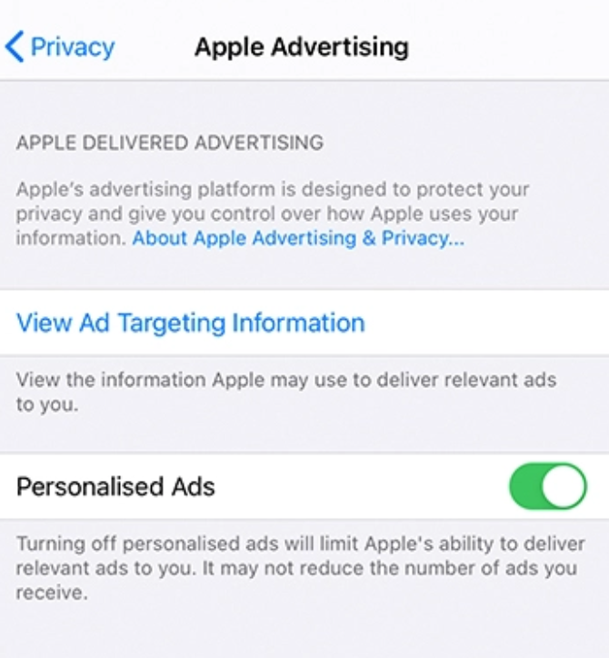
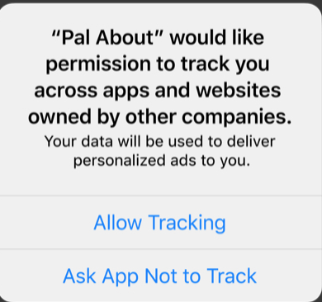
App Store changes – IDFA/IDFV
The Identifier for Advertisers (IDFA)
A random device identifier assigned by Apple to a user’s device.
Advertisers use this to track data so they can deliver customized advertising Collect and analyze data collected from user and submitted by app to any third party or API.
Can’t be used with Limit ad tracking (LAT)
Requires permission to be exposed in app.
The Identifier For Vendors (IDFV)
Random identifier which is assigned to all apps by the one vendor
Doesn’t not persist once all apps from that vendor are uninstalled.
Can be used with Limit ad tracking (LAT)

Slide 29
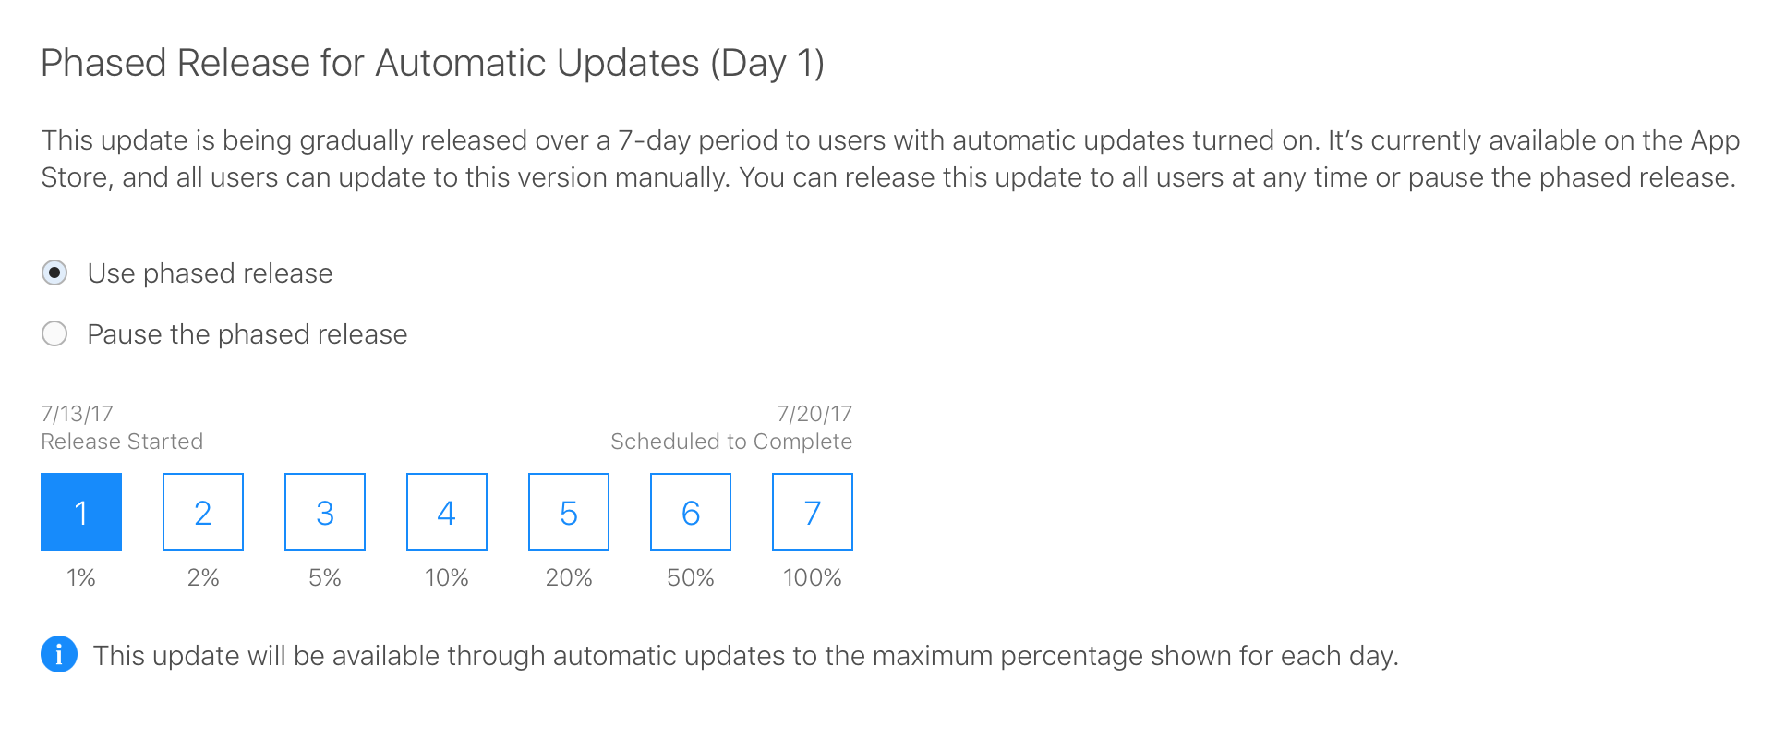
Gradual rollout
A process where an app update is released to customers in stages instead of all at once
Gauge how customers respond to an app update and respond accordingly.
Backend processes or infrastructure can be scaled intelligently as adoption ramps up.
Release can be paused for triage leaving only X% of customers affected instead of everyone.
Release can be pushed to all at any point.

