Slide 1

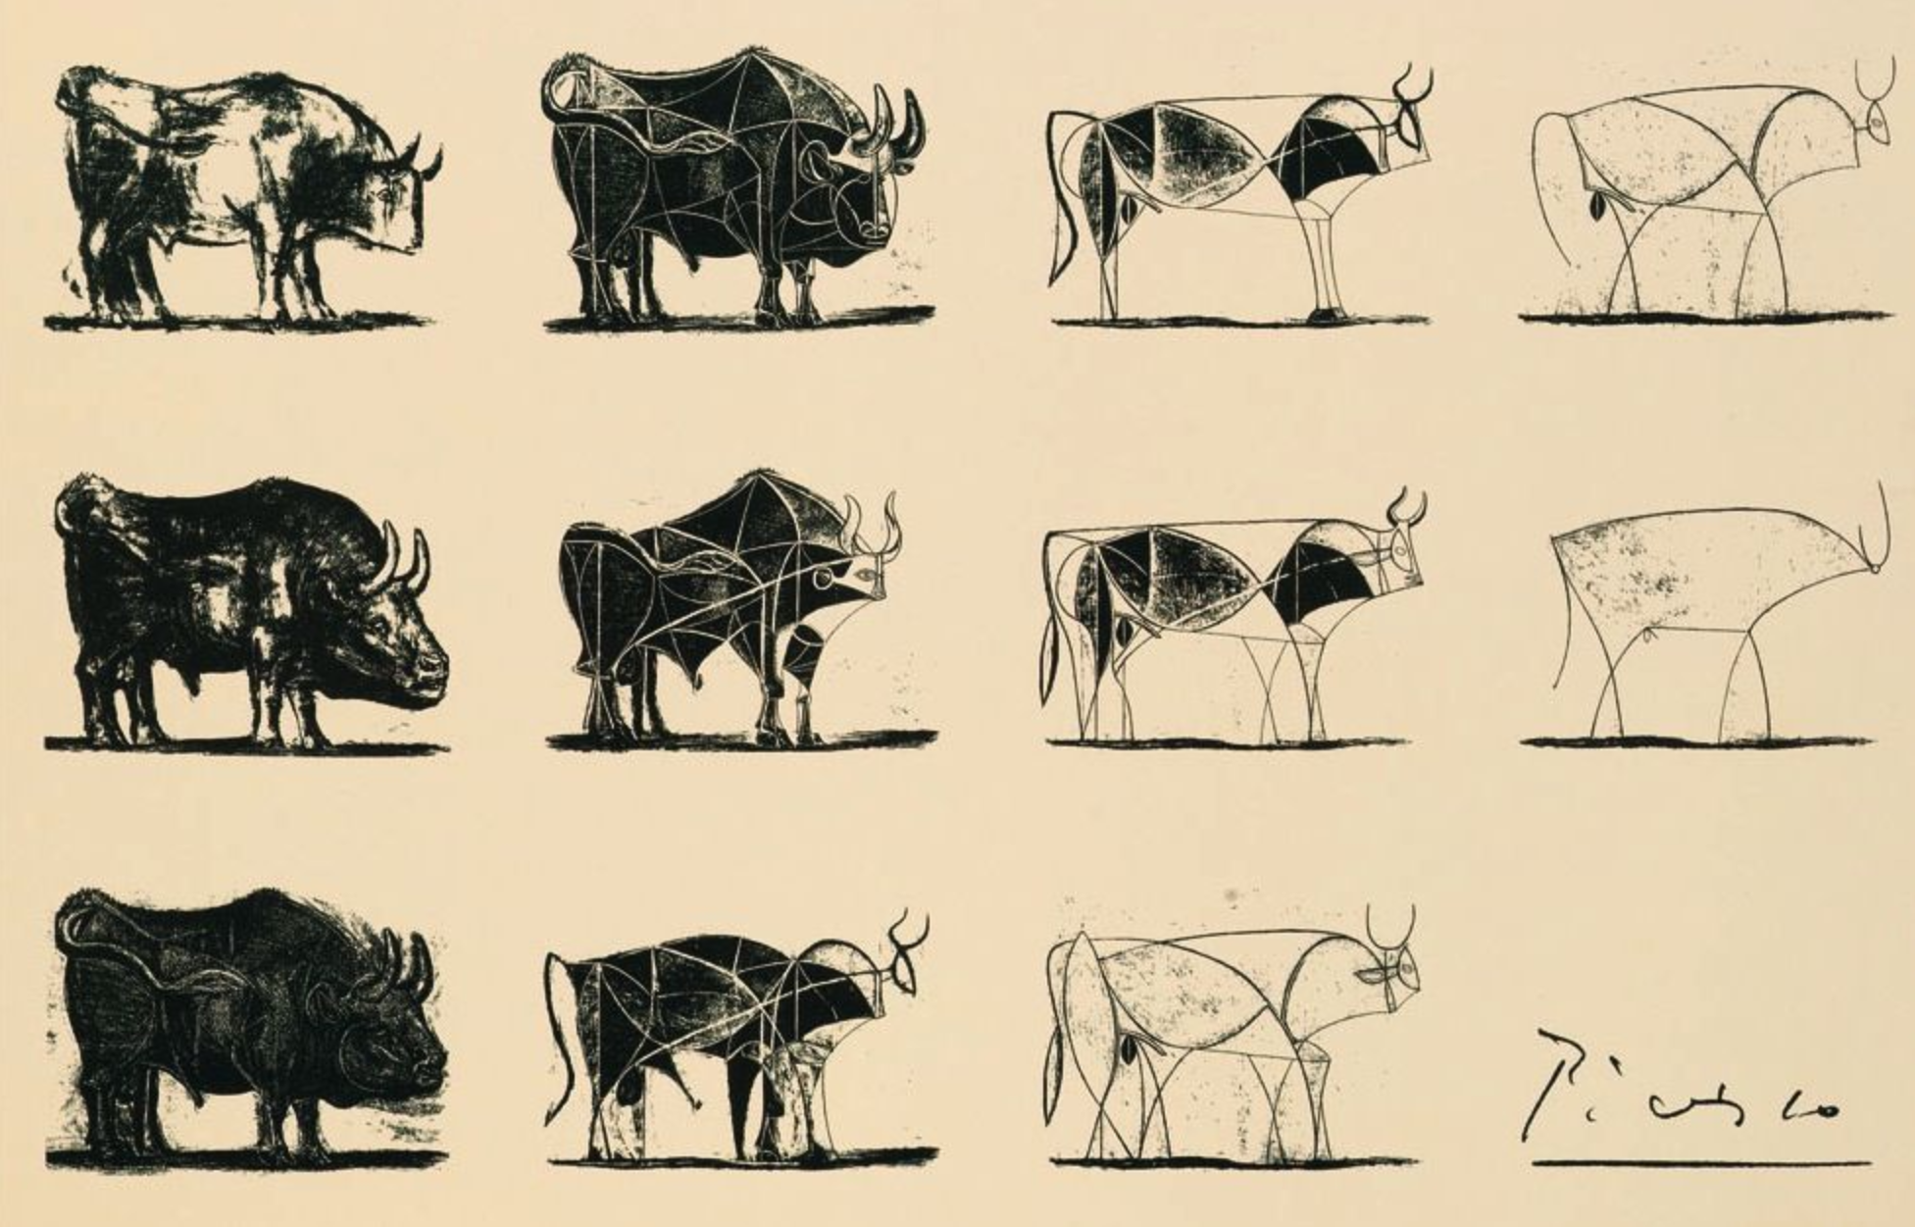
Measure similarity between images
An image is one possible representation of an object
Same Image – different objects
Same Object – different images
Fundamental Problem:
Similarity between images ≠ similarity between underlying objects

Slide 2
What should a good similarity metric do?
The metric should have a high value, if
A human observer extracts the same object from the two images
Find the underlying object of the image first
Need clever algorithms
Not done in this project
The data of the images itself are «similar»
Treat image as «arbitrary pile of data»
Can use simple metrices
Done in this project
AND

Slide 3
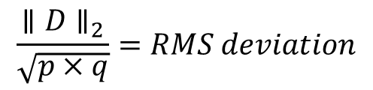



Measuring difference (distance)
Root mean square deviation (RMS)
$$∥D∥_{2} =Euclidean norm$$
$$\frac{∥D∥_{2}}{\sqrt{p×q}}=RMS deviation$$
How much difference you can expect in any pixel on average
p x q ImageMatrix
ImageVector $∈ℝ^{p×q}$
Maximum Norm
$$∥D∥_{∞} =max⁡(\left|d_{1}\right|,…, \left|d_{p×q}\right|)$$
Upper bound of the pixel difference
ImageVector 1
ImageVector 2
«Zero Norm»
DifferenceVector D
$$∥D∥_{0} =Number of nonzero Elements of D$$
Percentage of changed pixels

Slide 4
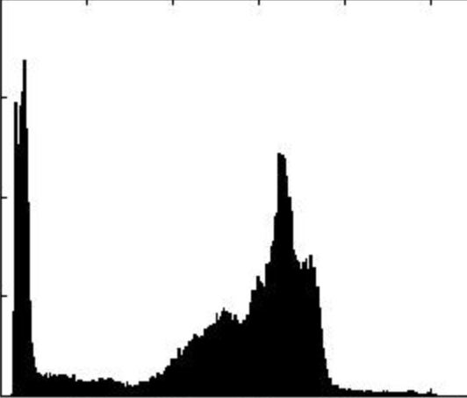
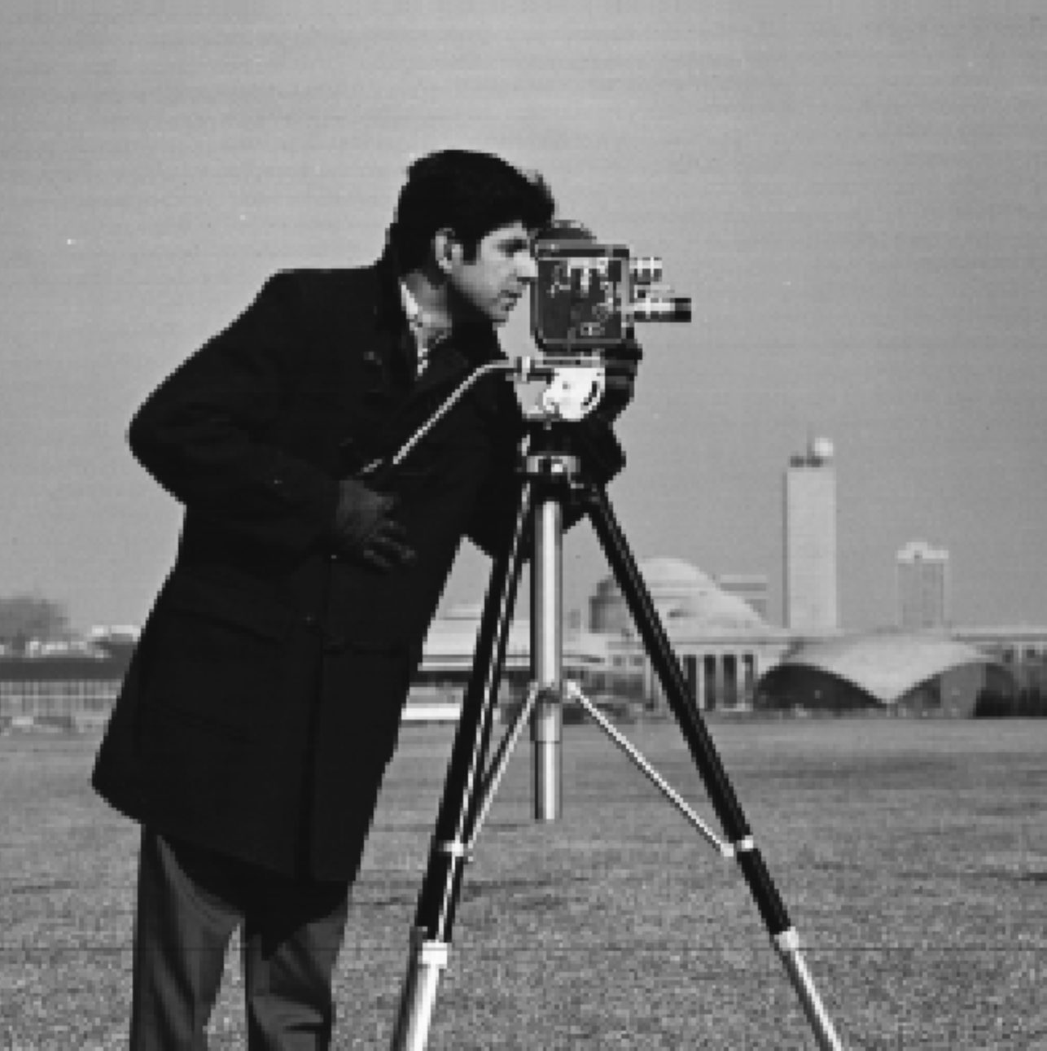
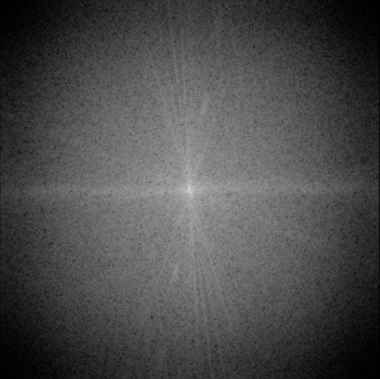
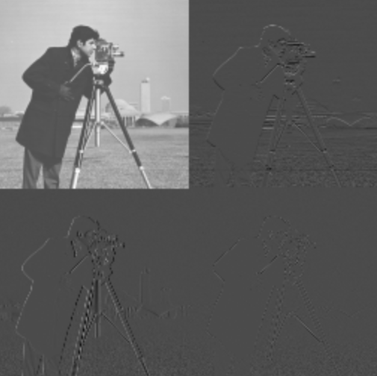
Changing domains before measuring distance
Histograms
Robust to image shifts
Robust to noise
Used in this project
Fourier
Access to low/high image frequencies
Use some prior knowledge
Wavelet
Concentrates information / enforces sparsity

