Slide 1

ERROR
Could not start the game!
The macros seem to be disabled, the game works entirely because of them, to activate them go to the properties of the 'dbxw' file and activate the 'unlock' box at the bottom, after making this option you will have access to the macros and be able to execute the game.
Continue in all ways
Exit
©2024, elJulioQlo - Games in PowerPoint
All rights reserved

Slide 2

elJulioDev

Slide 3
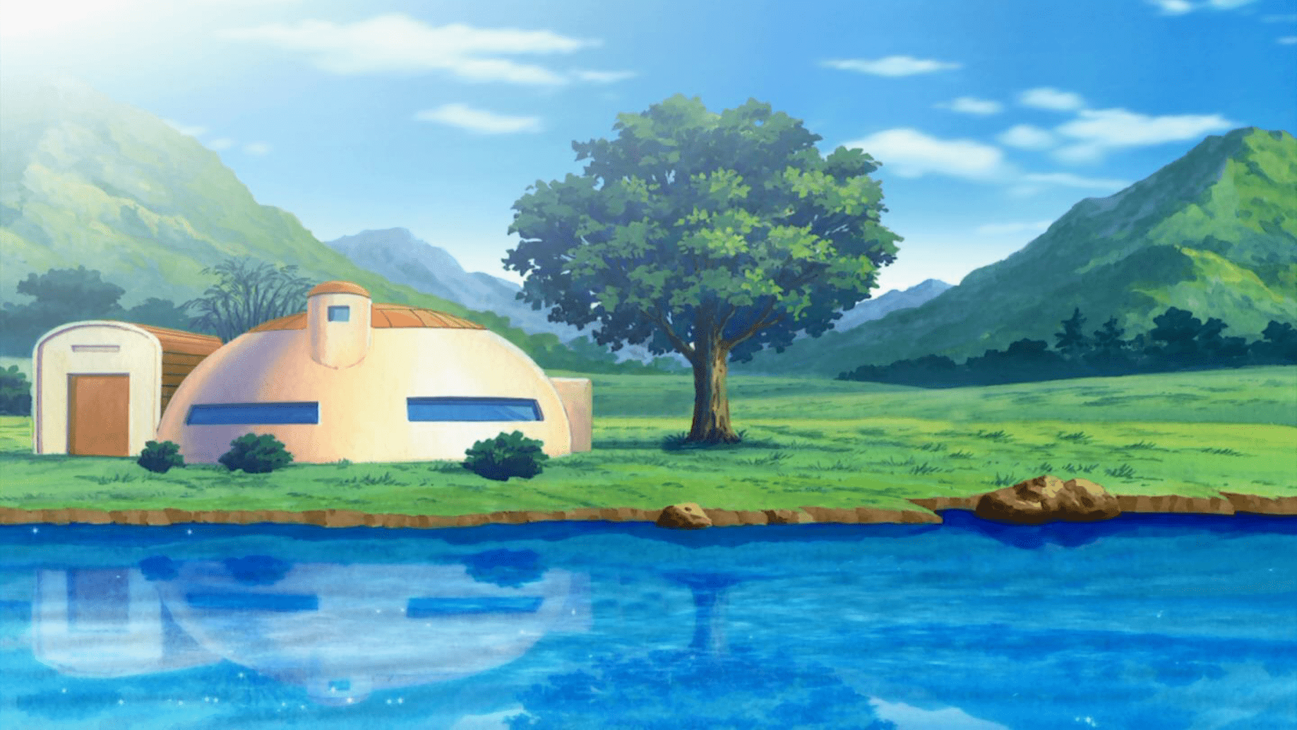



Modo Historia
Local Game
Online
Credits
Settings
Exit game
Version 1.0.1

Slide 4

Performance
Loading effects
Movement in stage
Shadows
Life bar animation
Energy bar animation
Effects on Characters
Explosion effects
Low quality backgrounds
Back

Slide 5

27
Player 1 Controls
Movement
Energy
Jump
Charge
Left
Ki Blast
Right
Cover
Combat
Others
Hit
Emote
Kick
Tackle
Back

Slide 6

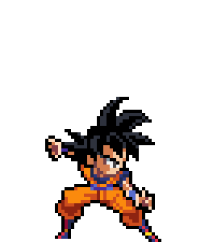
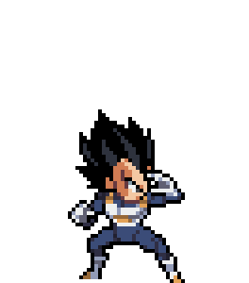



































41492,093
char1
char2
P1
P2
Son Goku
Vegeta
Select two characters to continue
Back
Deselect
Continue
char1
char2
67/64 FPS
Verify

Slide 7
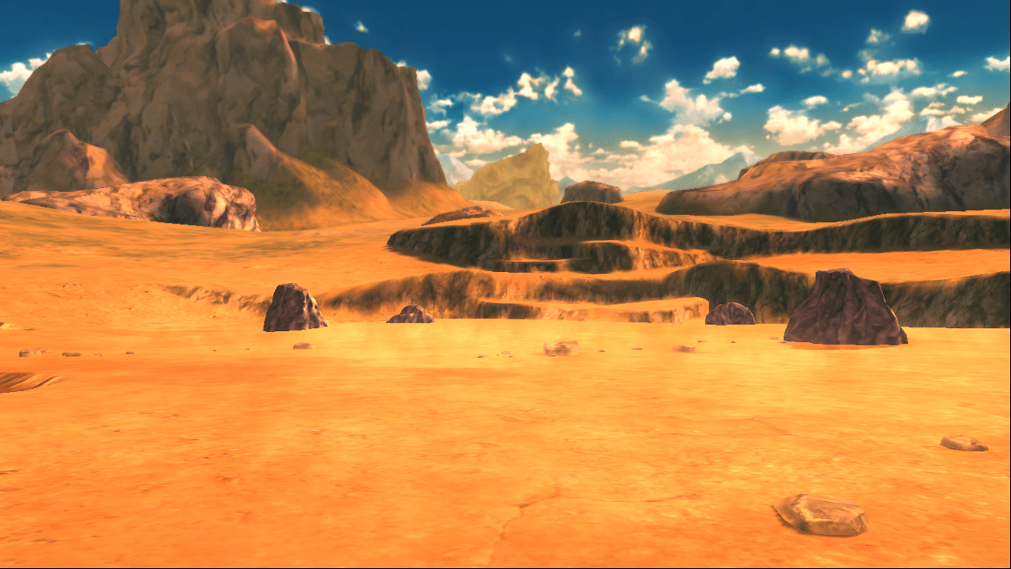

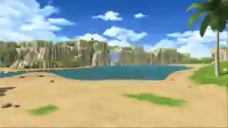
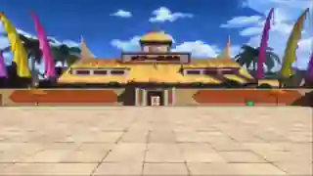
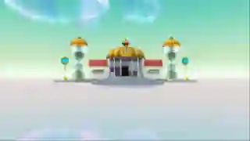
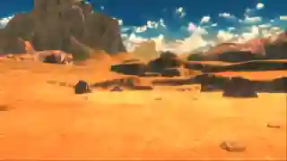
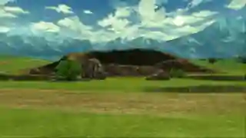
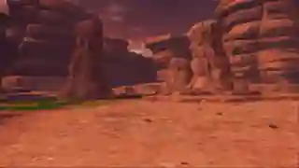
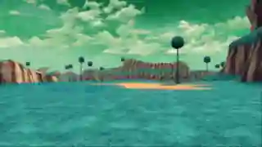
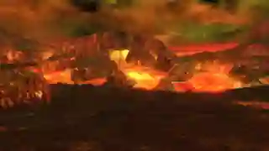
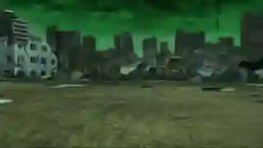
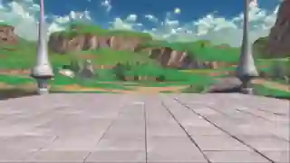
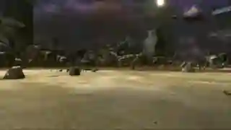
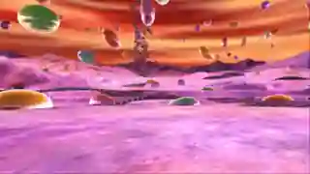
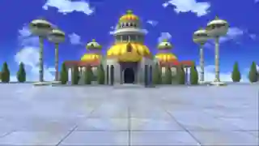
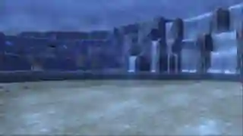
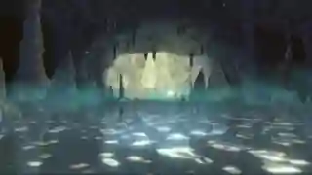
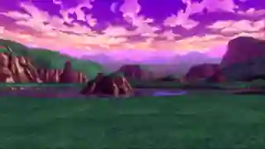
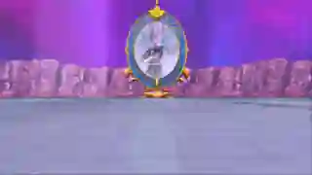
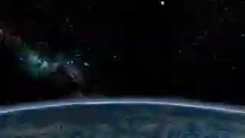
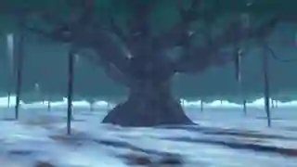
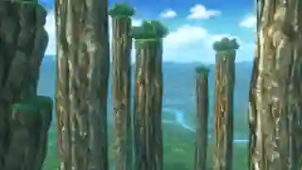
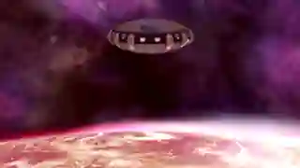
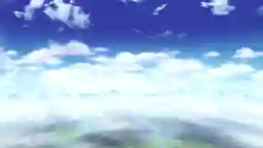
711348,703
Scenery
Westland
Select a scenario to continue
Back
Deselect
Continue
62/64 FPS
Verify

Slide 8
805983,734
Loading...
100%
An error occurred while loading the chars, please choose them again.
Back

Slide 9

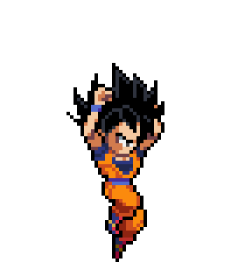
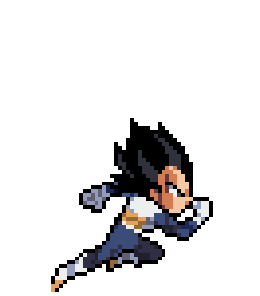
15
1480868,171

Slide 10
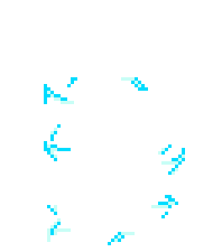

20
60

Slide 11
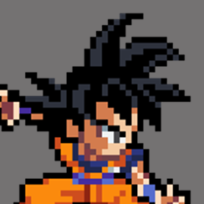

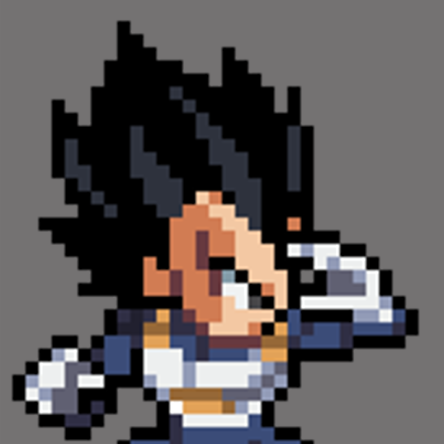








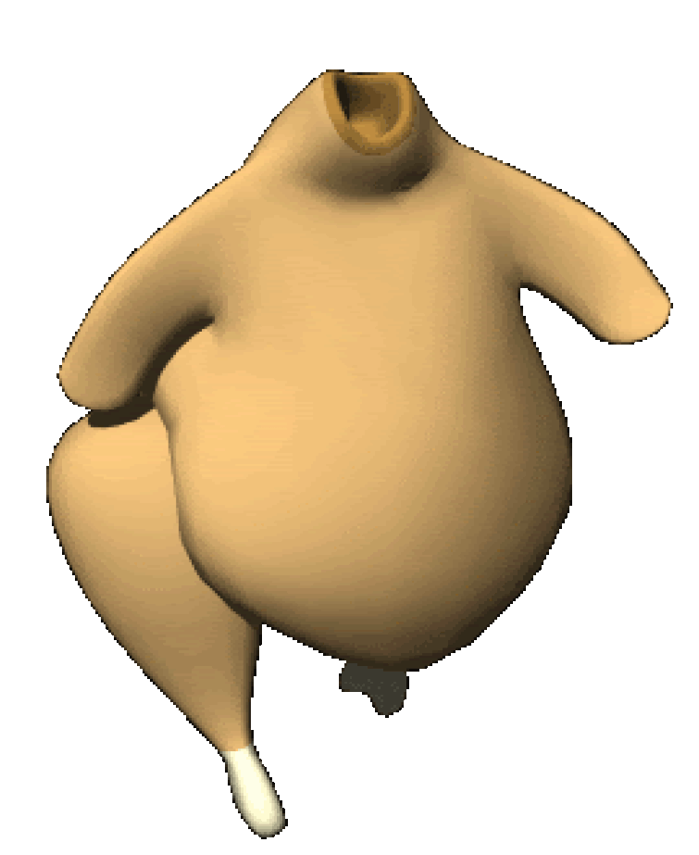
18
Son Goku
Vegeta
60
lv.
0
0
lv.
2
3
1
Go!

Slide 12
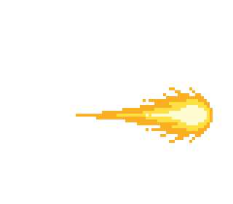
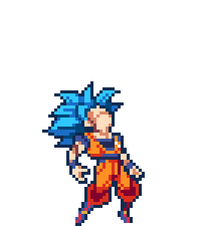

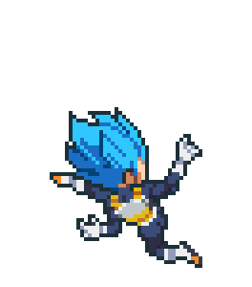








19
711421,171
Son Goku
Vegeta
0
lv.
3
3
lv.
0
Game on Pause
9 Hits
5 Hits
0
4760
Resume
Restart
Select new fighters
Go to main menu
Music
Previous
Random
Incoming
True
62/61 FPS
Notes:
m

Slide 13

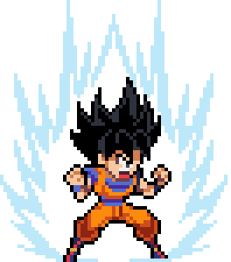
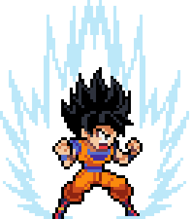
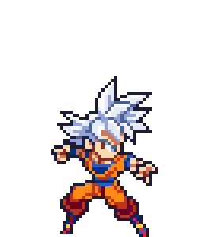
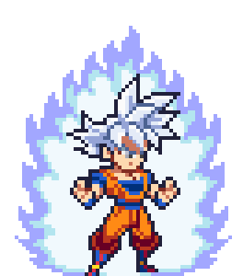
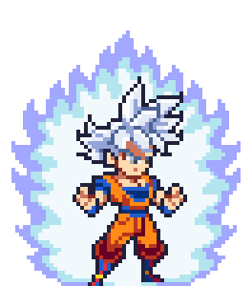
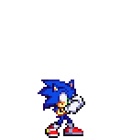



23
378580,765

Slide 14
12

Slide 15
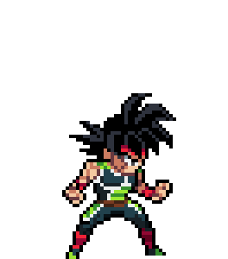
414269,296

Slide 16

25
Sound
Effects on charge
Hit effects
Ki shot effect
Eneable
Eneable
Eneable
Music in gameplay
Kick effects
Ki blast effect
Eneable
Eneable
Eneable
Menu Music
Tackling effect
Teleport effect
Eneable
Eneable
Eneable
Back
Sounds in cinematics

Slide 17
26
Game
Game time
Disable
Instant transformation
Flash effect
Total Rounds
Eneable Bot (Player 2)
See controls
Spanish
English
Back

Slide 18

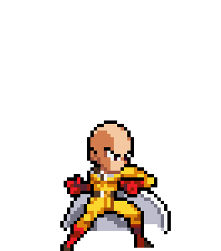
28
Victory
skibidi
-
Rank:
Score: 000.000
Select new fighters
Rematch
Exit to main menu

Slide 20






Credits
Art and Sprites
Artists from the community and free non-commercial use packs.
Open list
Stages
Musics and sound effects
Special Thanks
Back

Slide 21
32
Player 2 Controls
Movement
Energy
Jump
Charge
Left
Ki Blast
Right
Cover
Combat
Others
Hit
Emote
Kick
Tackle
Back

Slide 22
33
Controls
Others
Show FPS
Show Hitboxes
Pause Game
Back

Slide 23





-2075059,671

