Slide 1
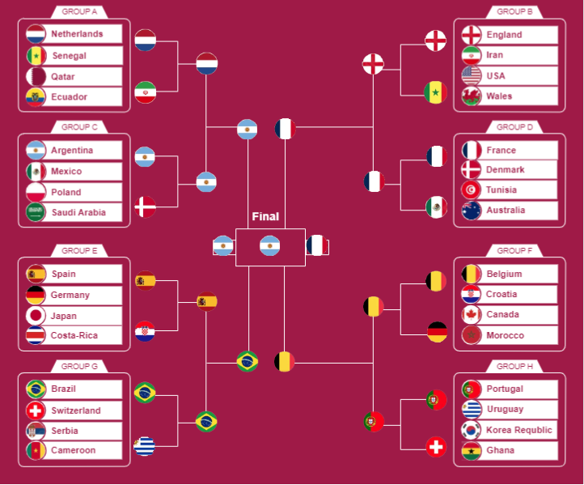
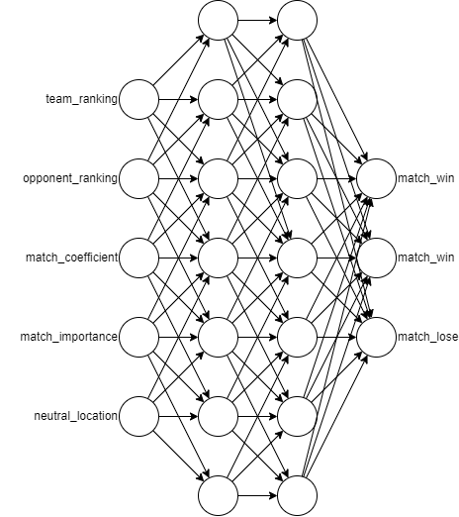
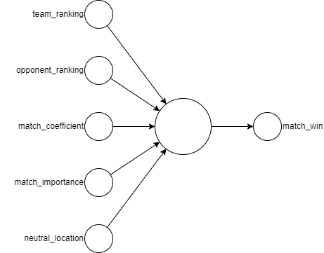
Faculty of Engineering Technology, Campus Group T
World Cup 2022 Predictor
Jad Haddad, Yonathan Irawan
Introduction
During the writing of this paper, the FIFA World Cup 2022 was ongoing.
Interesting to predict the outcome of the whole competition.
To complete the task, we built a machine learning model that used historical matches to predict any international match.
Then we use this model to predict each match of the competition.
The whole competition is simulated 1000 times to show which team has the best chance of winning.
Results/Discussion
The accuracy of logistic regression is 67%.
The accuracy of the neural network is 60%, with an F1 score of 0.6.
Neural network has a lower accuracy as it tries to classify win, draw, or lose.
Dataset and Features
Using 24,000 past international matches dating back to 1993, we have the following dataset:
Feature | Description
team_ranking | The home team FIFA ranking
opponent_ranking | The away team FIFA ranking
match_coefficient | The average of the two teams’ confederation coefficient
match_importance | The importance of the match
neutral_location | True if the match is played in a neutral location
Methods
We first used a single logistic regression node to predict if the home team wins.
Then we used a python library called sklearn to construct a neural network to improve accuracy. This is a classifier model to predict whether the home team will win, draw, or lose
A visualization from one of the iterations.
Issues with the model:
Has a bias towards the home team.
Does not predict draws very often.
The model does not consider that surprises happens all the time in football.
Conclusion/Future Work
More features can be added to improve accuracy. For example, age is a huge factor.
Output predicted goals instead of match winner.
Both models are then used predict each match of the world cup.
All the group stage matches are simulated to find the top two teams in each group.
The top two teams then are fed into the knockout stages according to the official bracket.
The last 16, quarterfinals, semifinals, third place, and finals are all simulated.
The simulation are iterated 1000 times and the winner, runners up, third place, and fourth place are counted.

