Slide 1
project
Software Requirements:
Web Server:
XAMPP (For hosting the application)
Programming Languages:
PHP (For backend development)
JavaScript (For client-side scripting)
jQuery (for easier implementation of AJAX)
Database:
MySQL (For storing user data, Students inventory, attendance history, etc..)
Frontend Framework:
Bootstrap (For responsive and user-friendly web design)
Operating System:
Windows 10 (Supports web server and database setup)
Web Browser:
Google Chrome, Microsoft Edge (For accessing the web application)

Slide 2
MYSQL
MySQL is a very popular and widely used open-source relational database management system.
It organizes data into tables with rows and columns.
Relationships between different tables can be defined, which helps in structuring data efficiently.
It provides tools for storing, retrieving, modifying, and deleting data.
MySQL uses SQL, which is a standard language for interacting with databases.
Open-Source this means that the source code is freely available, and anyone can use, modify, and distribute it.

Slide 3
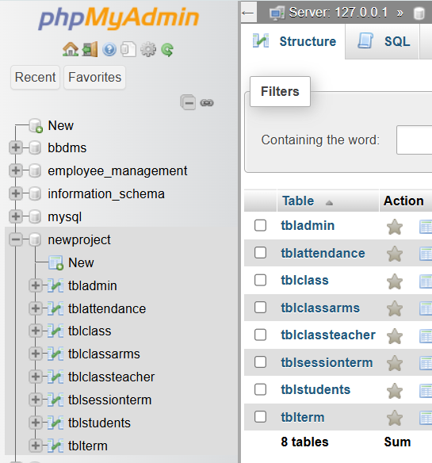
Mysql
tbladmin → Admin users
tblattendance → Student attendance records
tblclass → Class details
tblclassarms → Class sections or arms
tblclassteacher → Teachers assigned to classes
tblsessionterm → Academic sessions/terms
tblstudents → Student details
tblterm → Terms within the academic year

Slide 4
Php code
PHP is a widely-used open-source server-side scripting language primarily designed for web development.
It is embedded into HTML and is used to create dynamic and interactive web pages.
PHP code is executed on the server, and the result is sent to the client’s browser, This makes PHP a powerful tool for creating interactive websites and applications.
Open-Source: PHP is free to use and widely supported by a large community of developers.
Cross-Platform: PHP can run on various operating systems such as Windows, Linux, and macOS.
PHP code is typically written in files with a .php extension.

Slide 5
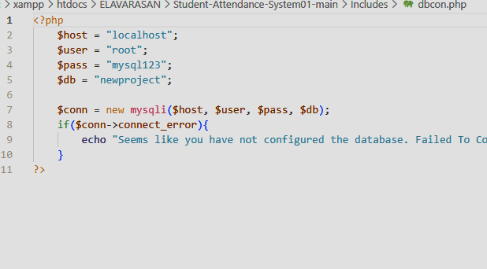
PHP CODE
PHP Code is used to retrieve the data in the database dbladmin.
To retrieve information about Student information.
To retrieve information about lists available in Address and 3rd-sem mark.
To retrieve information about Requests for Admin from Teacher.
To retrieve information about Holds contact information for the Admin.

Slide 6
XAMPP
XAMPP creates a local server environment on your own computer.
test websites and web applications without needing a live, internet-connected server.
XAMPP is a tool for beginners who are learning web development. It provides a safe and easy way to experiment with different technologies.
XAMPP is a free and open-source cross-platform web server solution stack.
Cross-platform: XAMPP can run on various operating systems such as Windows, Linux, and macOS.
XAMPP lets you turn your computer into a mini web server, so you can build and test websites

Slide 7
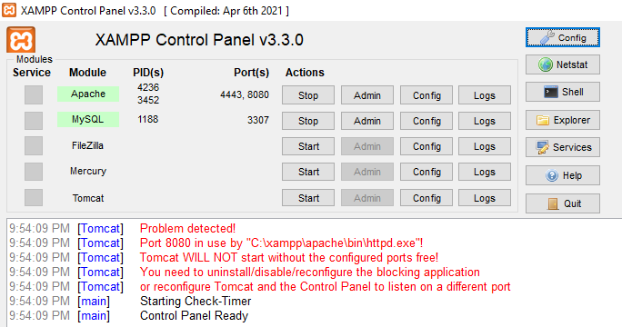
XAMPP
Apache : The web server that processes PHP files and serves web pages.
MySQL : The database management system for storing and managing data.
Start : Starts the selected module (e.g., Apache, MySQL).
Admin: Opens the module's admin page (e.g., phpMyAdmin for MySQL).
Config : Allows you to edit settings for each module.
Click Admin next to MySQL or open http://Localhost /phpmyadmin/
Create/import your database for the student management system.

Slide 8
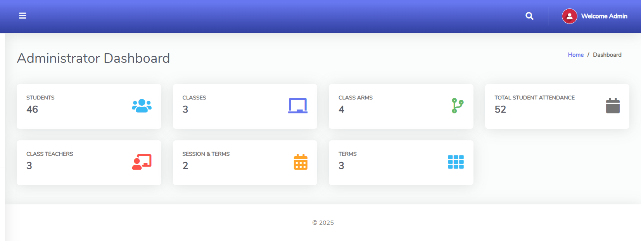
ADMIN-DASHBOARD
The image shows an Administrator Dashboard for a Student Attendance System.
Quick access to student, teacher, class, and attendance data.

Slide 9
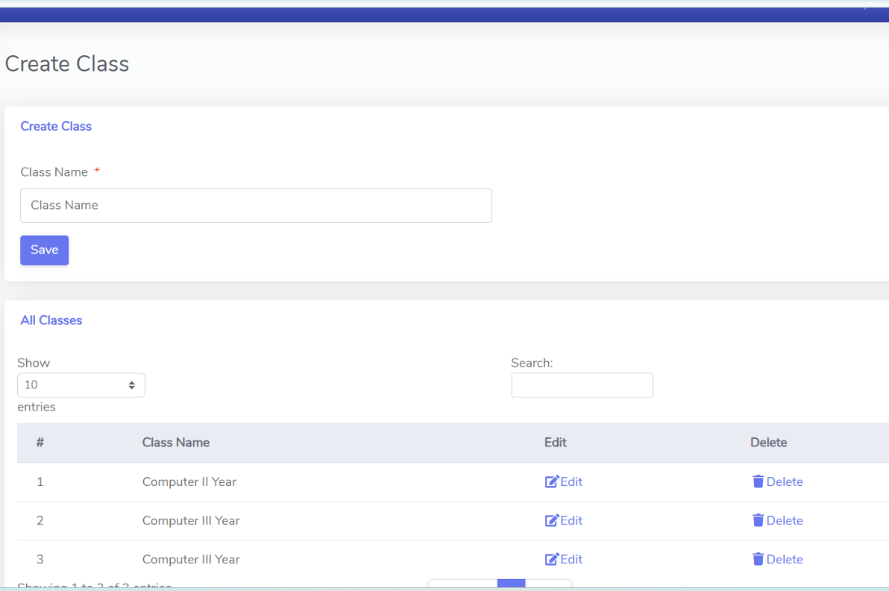
ADMIN-DASHBOARD
The Create Class section in your student management system allows administrators to add new department year.
A text field where the admin enters the Department year.
Saves the new class entry into the database.
Displays all available classes in a table.

Slide 10
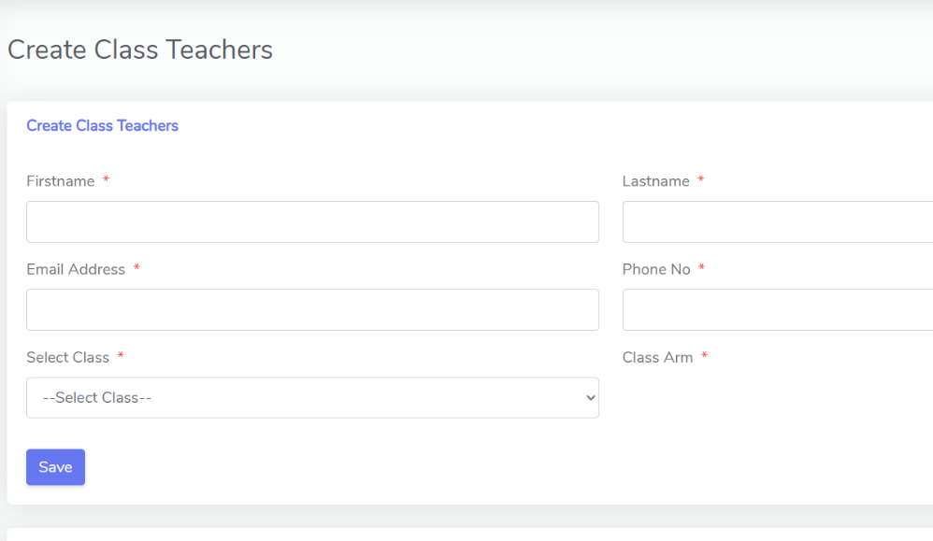
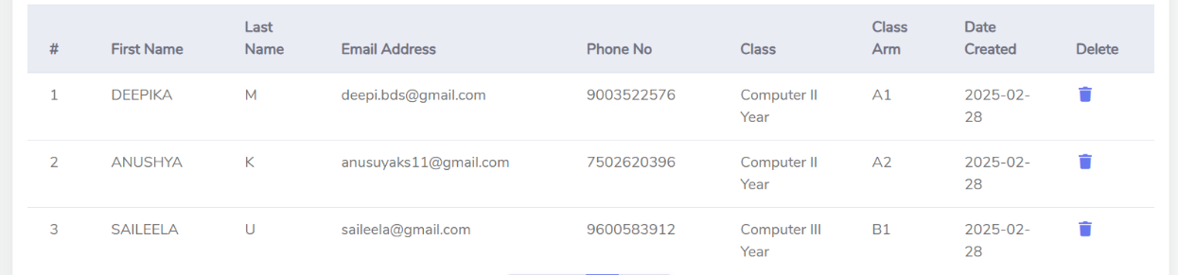
ADMIN-DASHBOARD
The Create Class Teachers page allows administrators to assign teachers to specific classes.

Slide 11
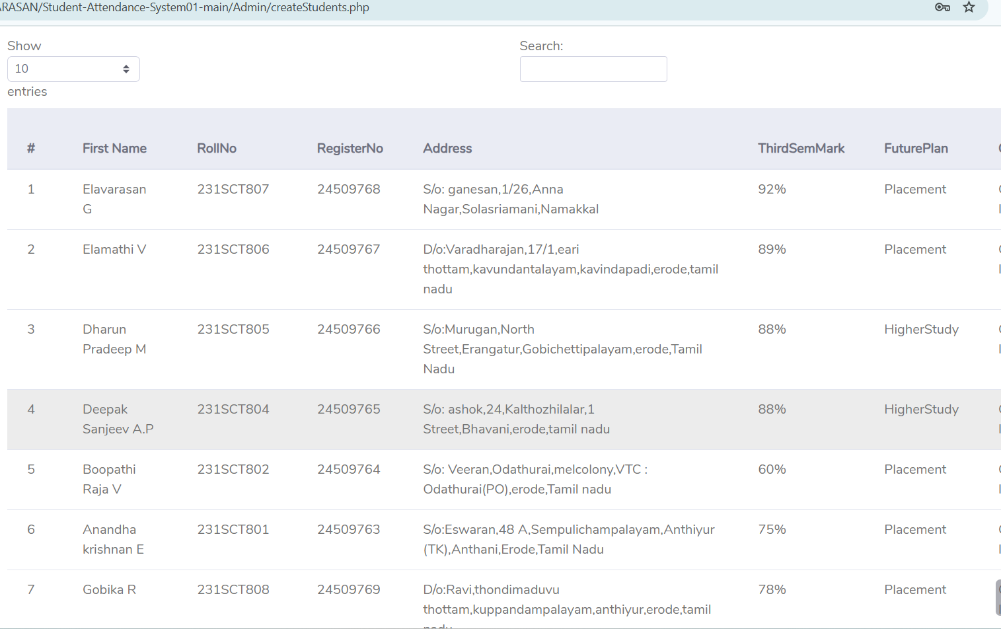
ADMIN-DASHBOARD
The Create Students page allows administrators to add student details to the system.
Stores academic details like 3-rd semester marks and future aspirations for better tracking

