Slide 1
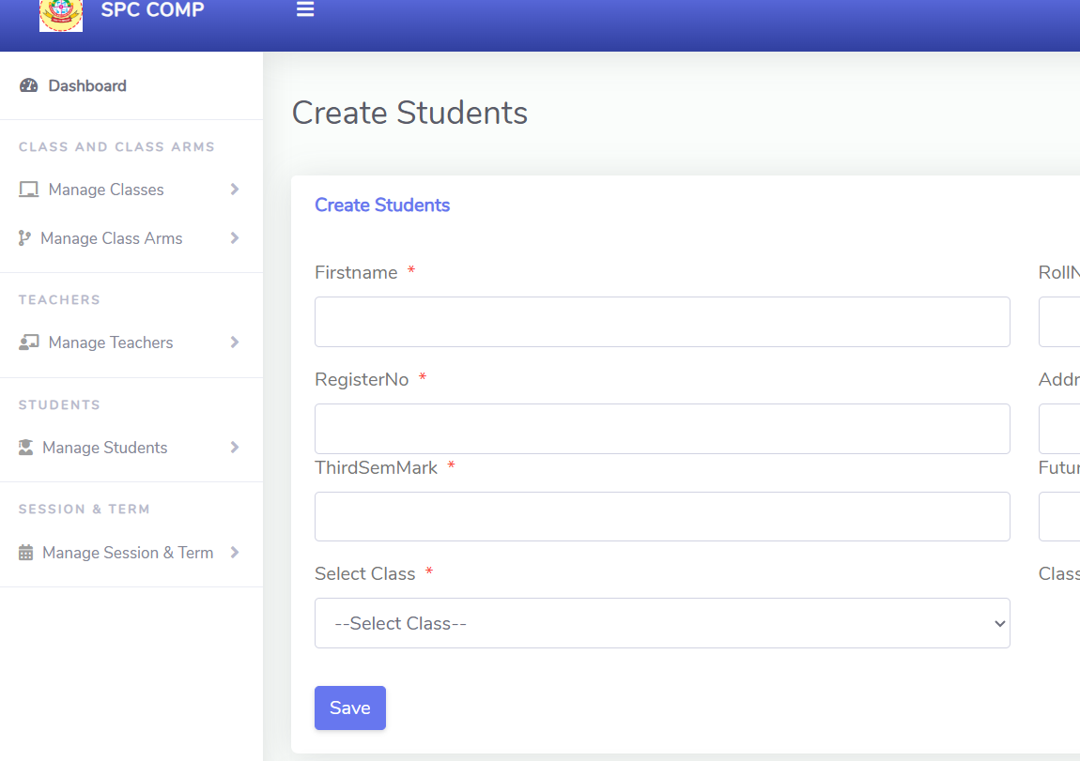
INSERT
Create a Students Name,Rollno,Registerno,Address,Thirdsem mark,Futureplan.
The insert operation is used to store the data of the students.
The inserted data is used to display the user as a Student on the webpage and for requesting for the student attendance another user, as well as user authentication.

Slide 2
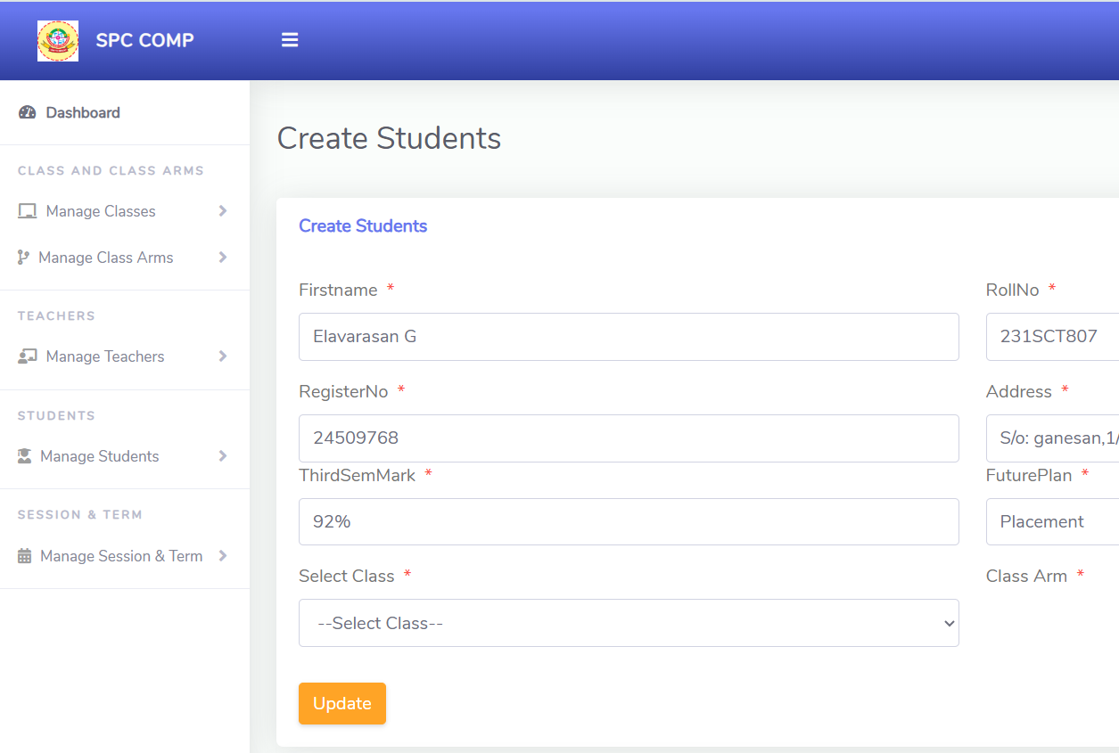
UPDATE
The Student profile is used to update (change) the user's data that is already available in the database.
The update operation is used to modify the user's data.
Here, the user's name, Rollno, Registerno, Address, Thirdsemmark, Futureplan.
The modify operation is used to correct any incorrectly entered details.

Slide 3
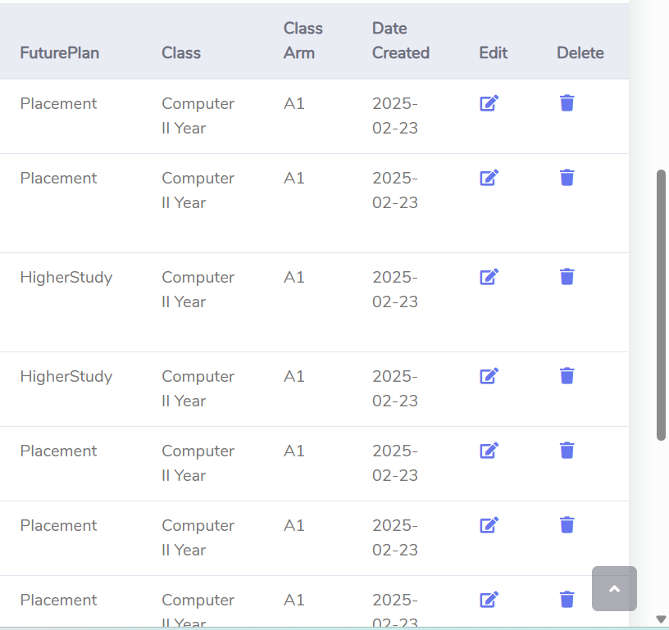
DELETE
The delete operation is used to remove the user's data.
Here, the admin can delete the entire user's details.
The delete operation is used to remove any unwanted users.

Slide 4
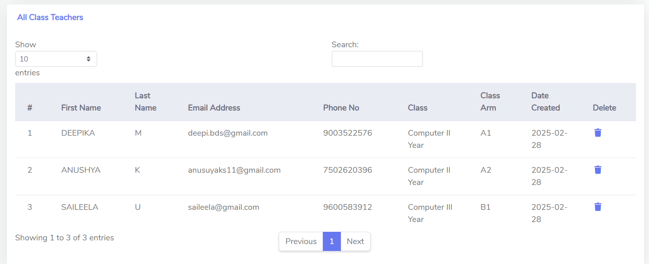
CLASS TEACHER
Create a Class Teacher in Admin panel
Display the Class Teacher on the Admin Panel

Slide 5
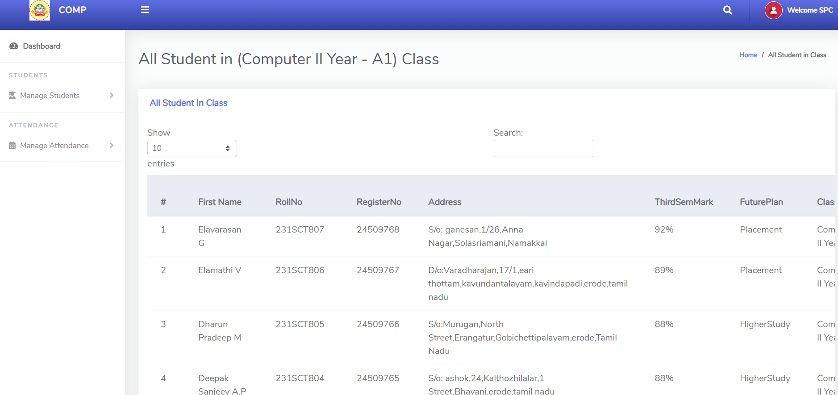
ALL STUDENTS
All Students Information Display on the Table.
Here ,Insert,Update,Delete on the table

Slide 6
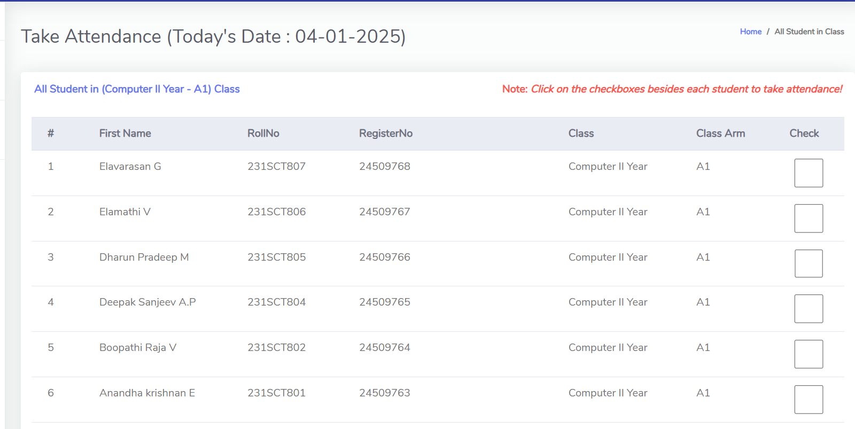
TAKE ATTENDANCE
The checkbox-based digital attendance system in the image allows a teacher to mark students present or absent by selecting the checkboxes.
The system is likely connected to a database where attendance records are stored for future reference.

Slide 7
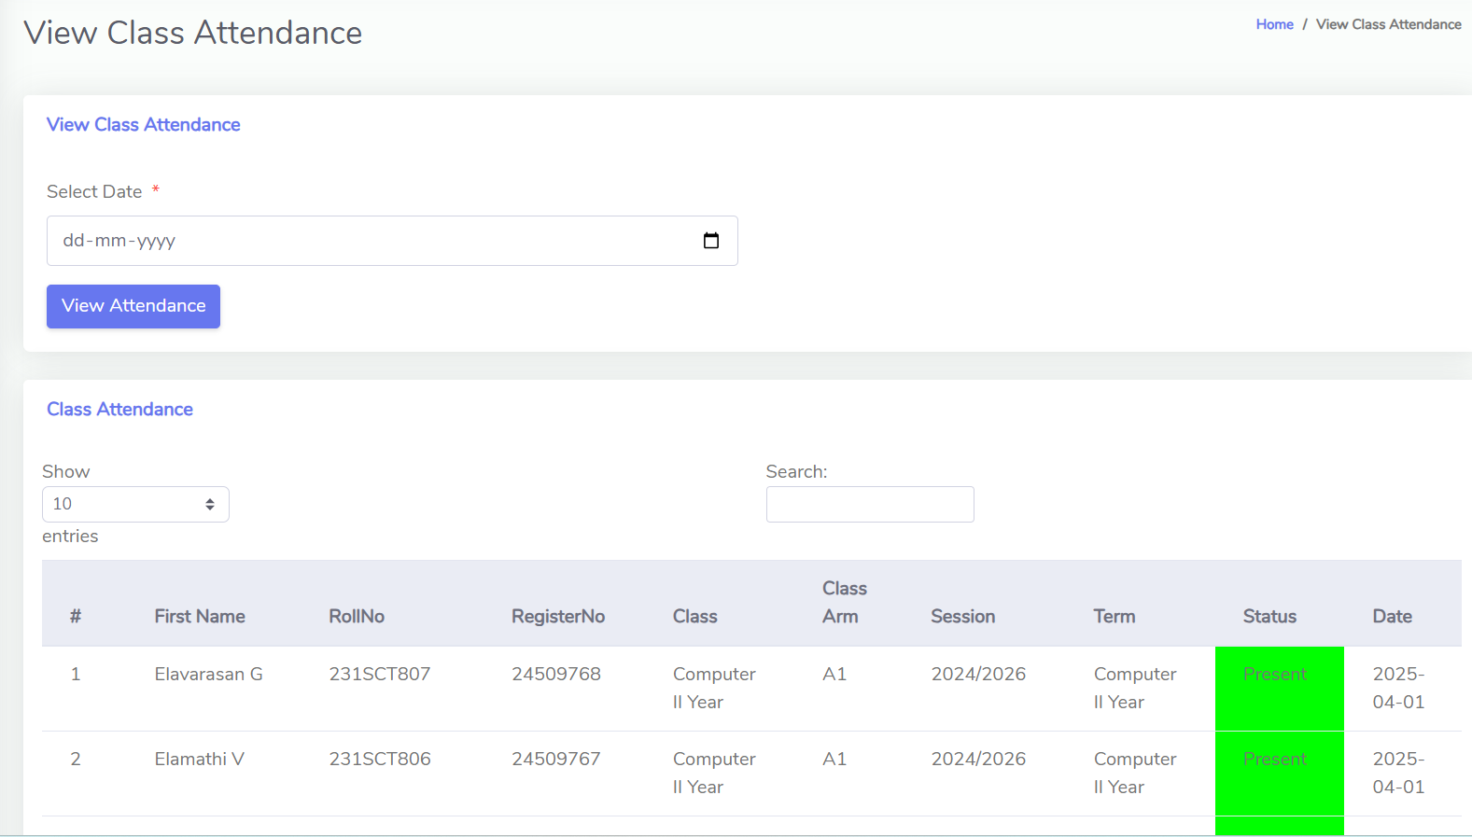
VIEW CLASS ATTENDANCE
This image shows a Class Attendance Viewing Page from a student attendance management system.
View student details, including roll number, session, and class. ✔ Check if a student was present or absent on a specific date.

Slide 8
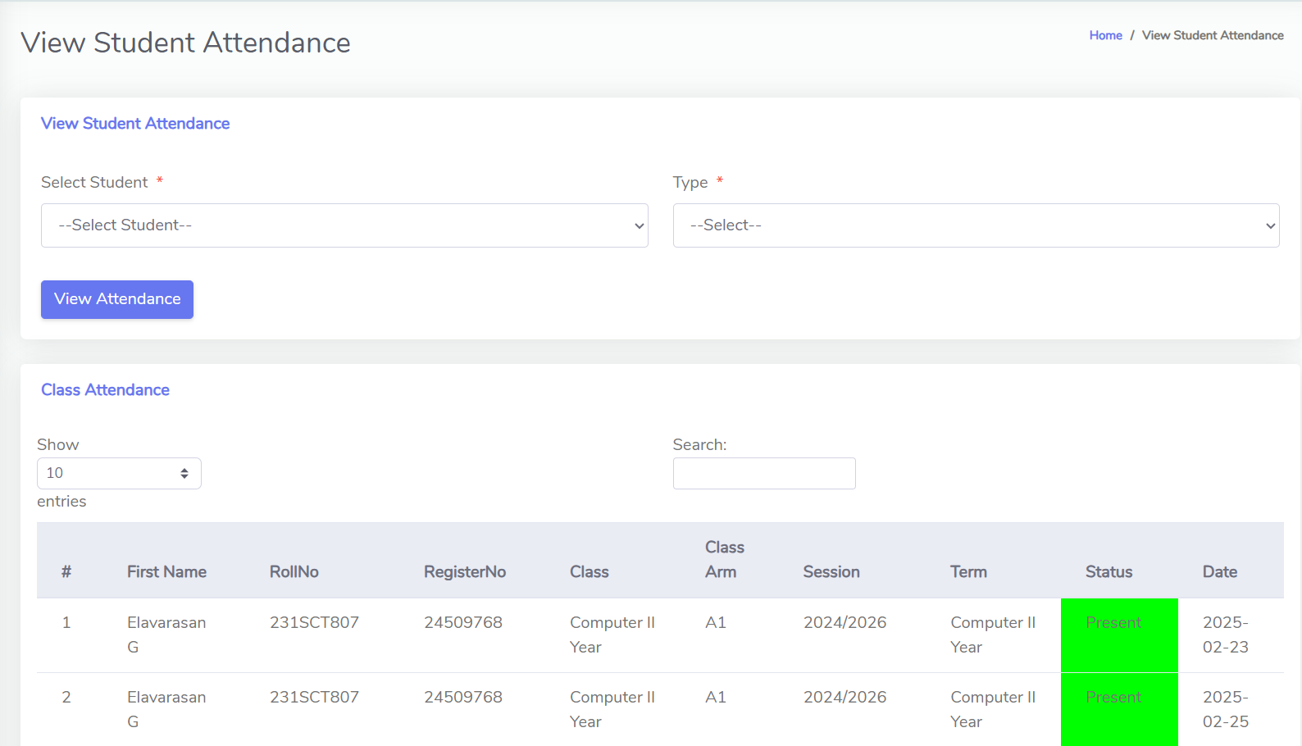
VIEW STUDENT ATTENDANCE
View Student Attendance on the Class teacher Panel.
Specific Student Select on the View Student Attendnace on the Teacher.

Slide 9
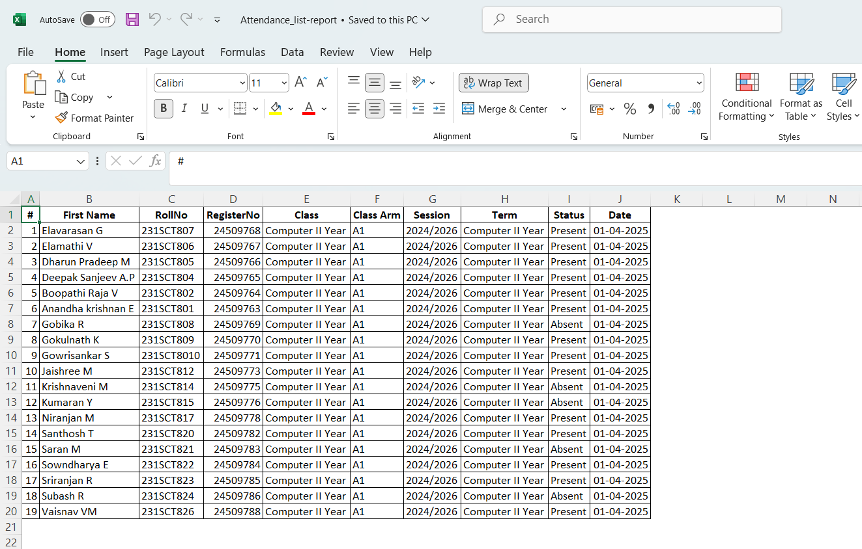
REPORT IN (EXCEL FORMAT)
Finally Completed The Attendance into convert the Repot to Excel Format.
Print the Student Attendance.

