Slide 1


me: Write. Understand. Evolve.
An intelligent reflection companion that turns your words into self-knowledge.

Slide 2


The problem: self-reflection without feedback
Systematic abandonment
Incomplete apps
Existing solutions analyze mood or generate text rarely both over the long term.
Most users drop off after a few weeks, for lack of seeing any concrete progress.

Slide 3
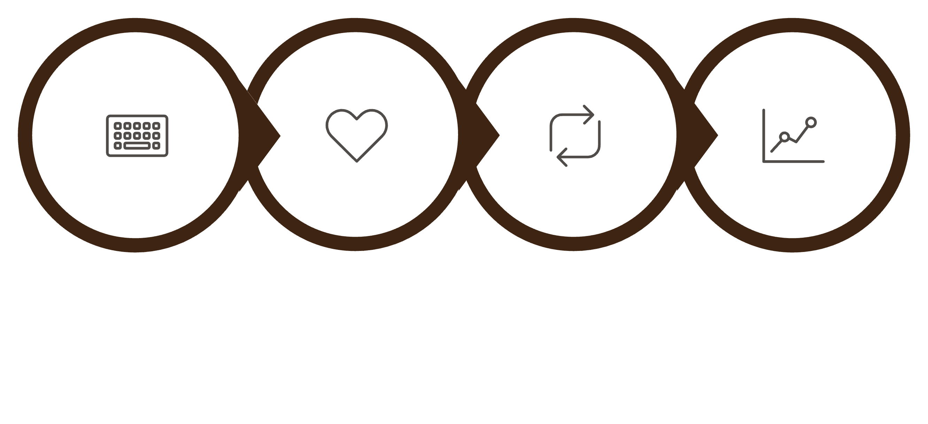
The solution: a journal that connects
Free entry
Emotions
Patterns
Trends
A conversational reflection companion not a substitute for a professional. A memory built with you, never imposed: you control what is retained.

Slide 4
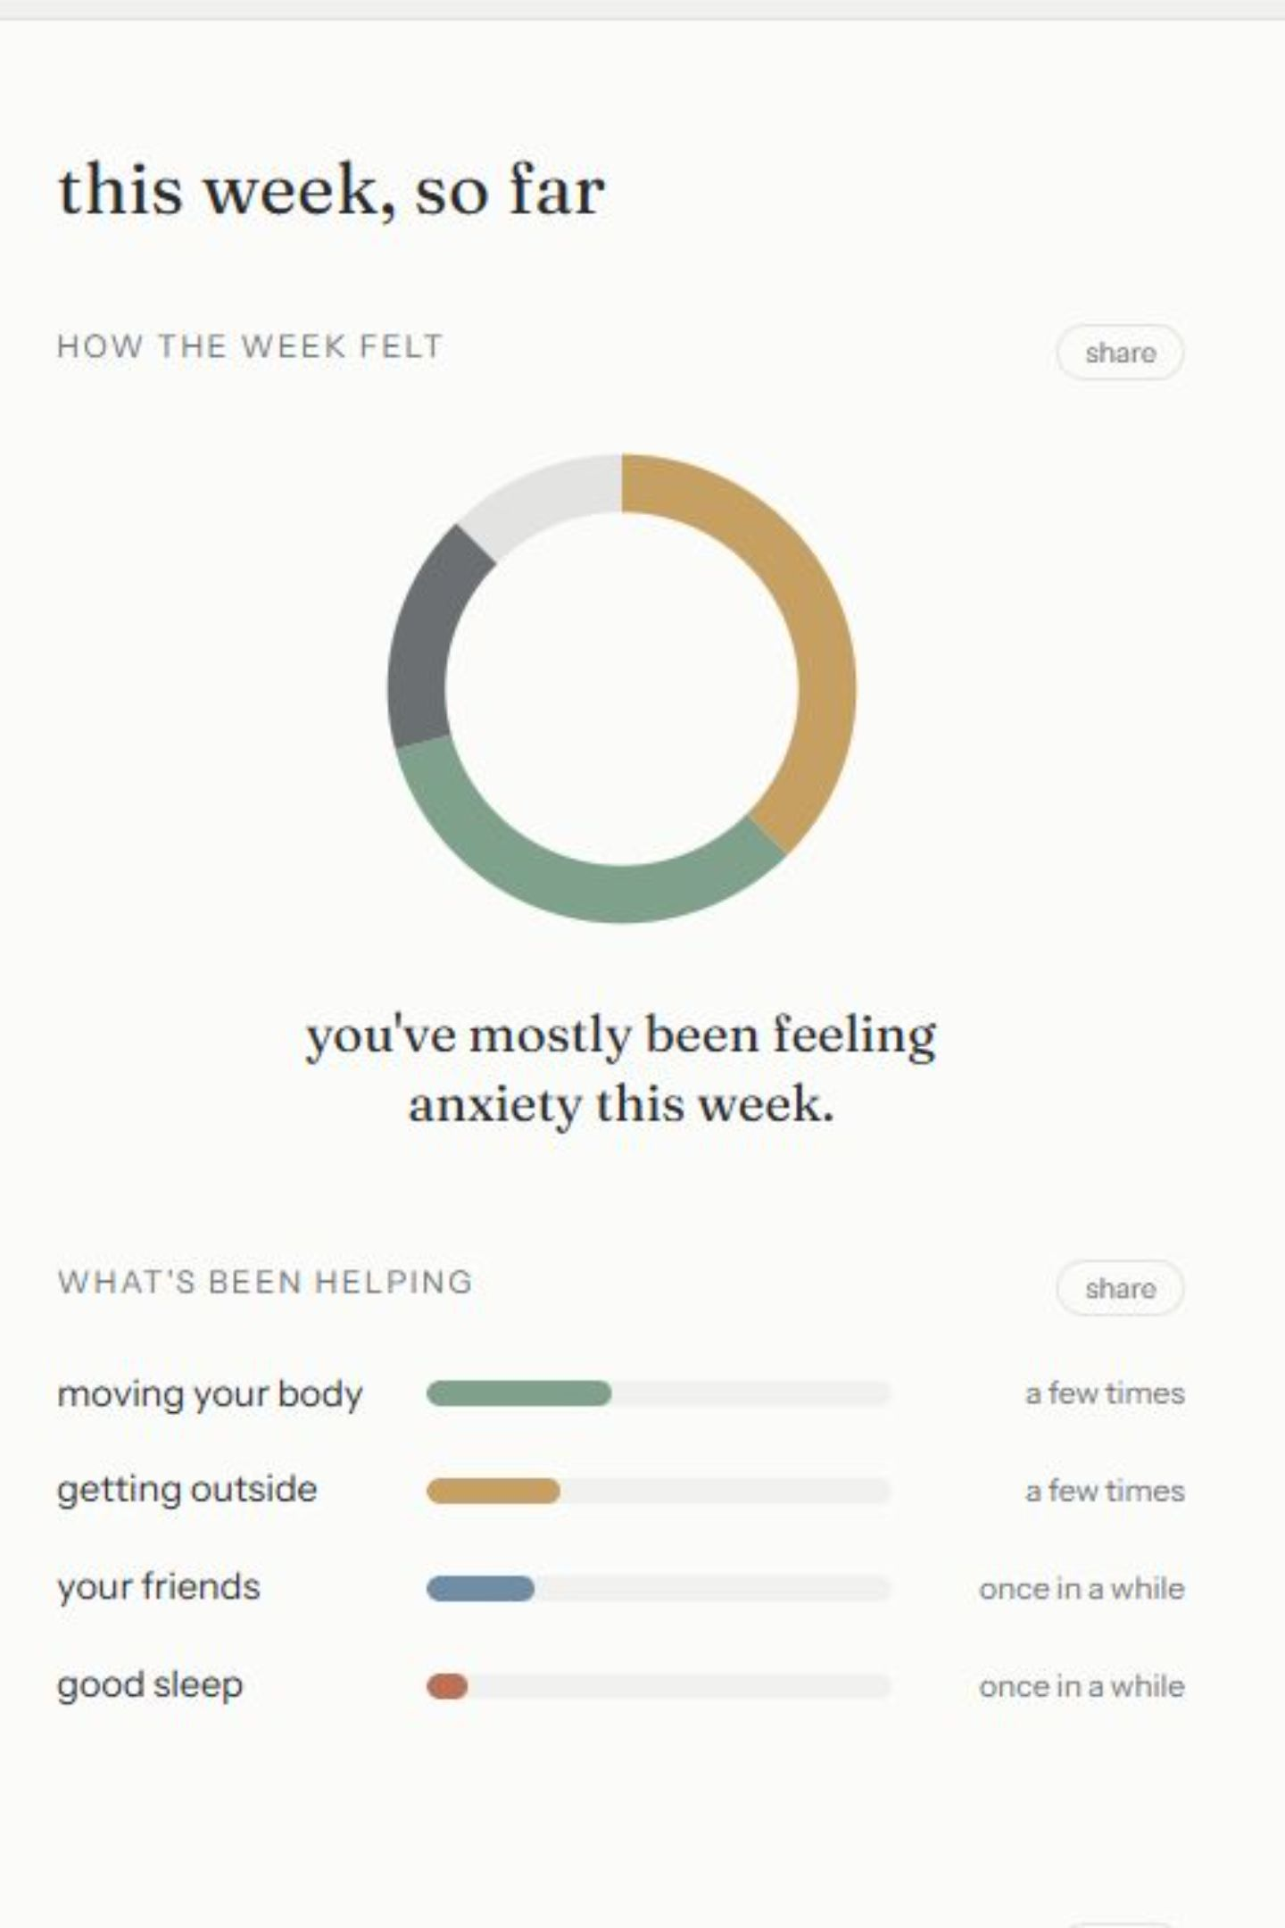



Demo: what me detects
The input
"Another argument with my colleague. I thought it didn't affect me, but I came home completely drained."
me analyzes
Frustration 7/10 — Trigger: work conflict — Identified need: recognition
me responds
"I notice that conflicts at work keep coming up several times. Would you like us to look at what keeps repeating?"

Slide 5
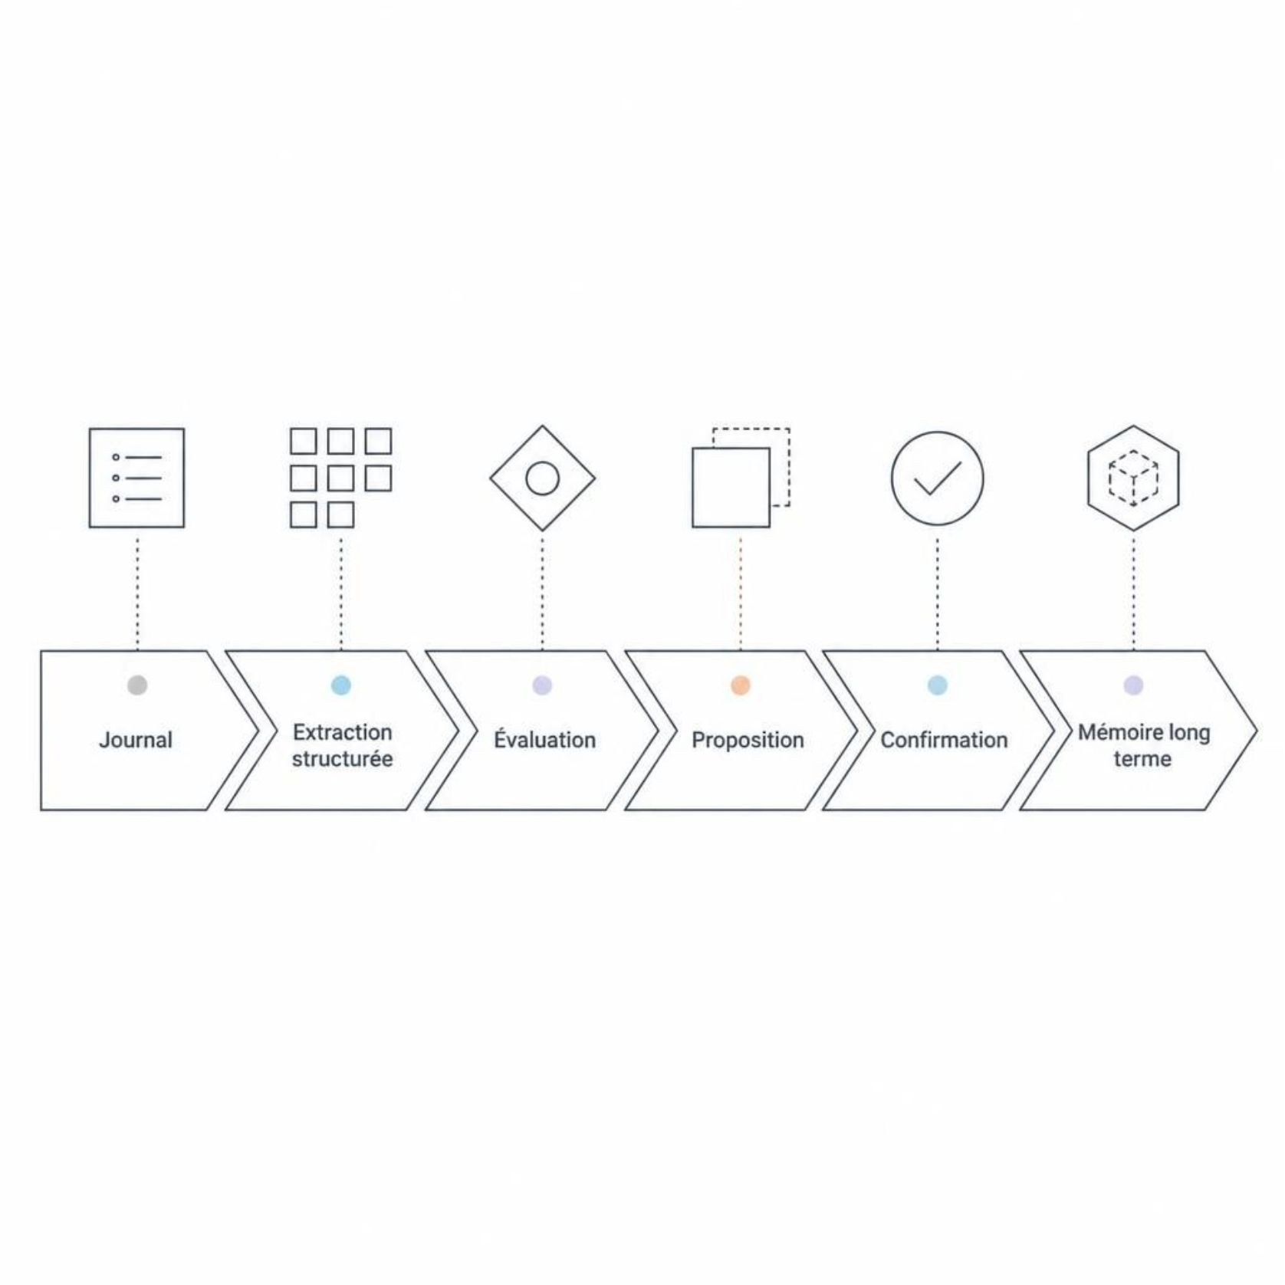
Memory: consented, not automatic
You stay in control
The user can review, correct, or delete anything that has been retained at any time
The AI does not decide on its own what defines the person
A trust model built on transparency, not automation

Slide 6




The dashboard: seeing the patterns
Emotions over time
Recurring triggers
See the intensity and evolution of your emotions week after week.
Identify the stress categories that come up most often in your daily life.
Pattern chains
What helps
Trigger → emotion → thought → behavior: the loop made visible.
Observed directly in your own entries — your resources, not generic advice.

Slide 7

The bridge to human support
me prepares the ground between sessions .
Optional sharing: summaries of trends chosen by the user, never the full journal by default
For the therapist: a structured summary of what happened between appointments
A discreet, controlled bridge focused on continuity of care

Slide 8
Differentiation: the complete combination
Solution | Dashboard | Long-term memory | Therapist bridge | Integrated individual
Daylio / Reflectly | ✅ | ❌ | ❌ | ❌
Rosebud | ✅ | ✅ (paid) | ❌ | ❌
Wysa | ✅ | Partial | ✅ (separate B2B) | ❌
me | ✅ | ✅ | ✅ | ✅
me is the only solution that integrates all four building blocks at the individual user level.

Slide 9
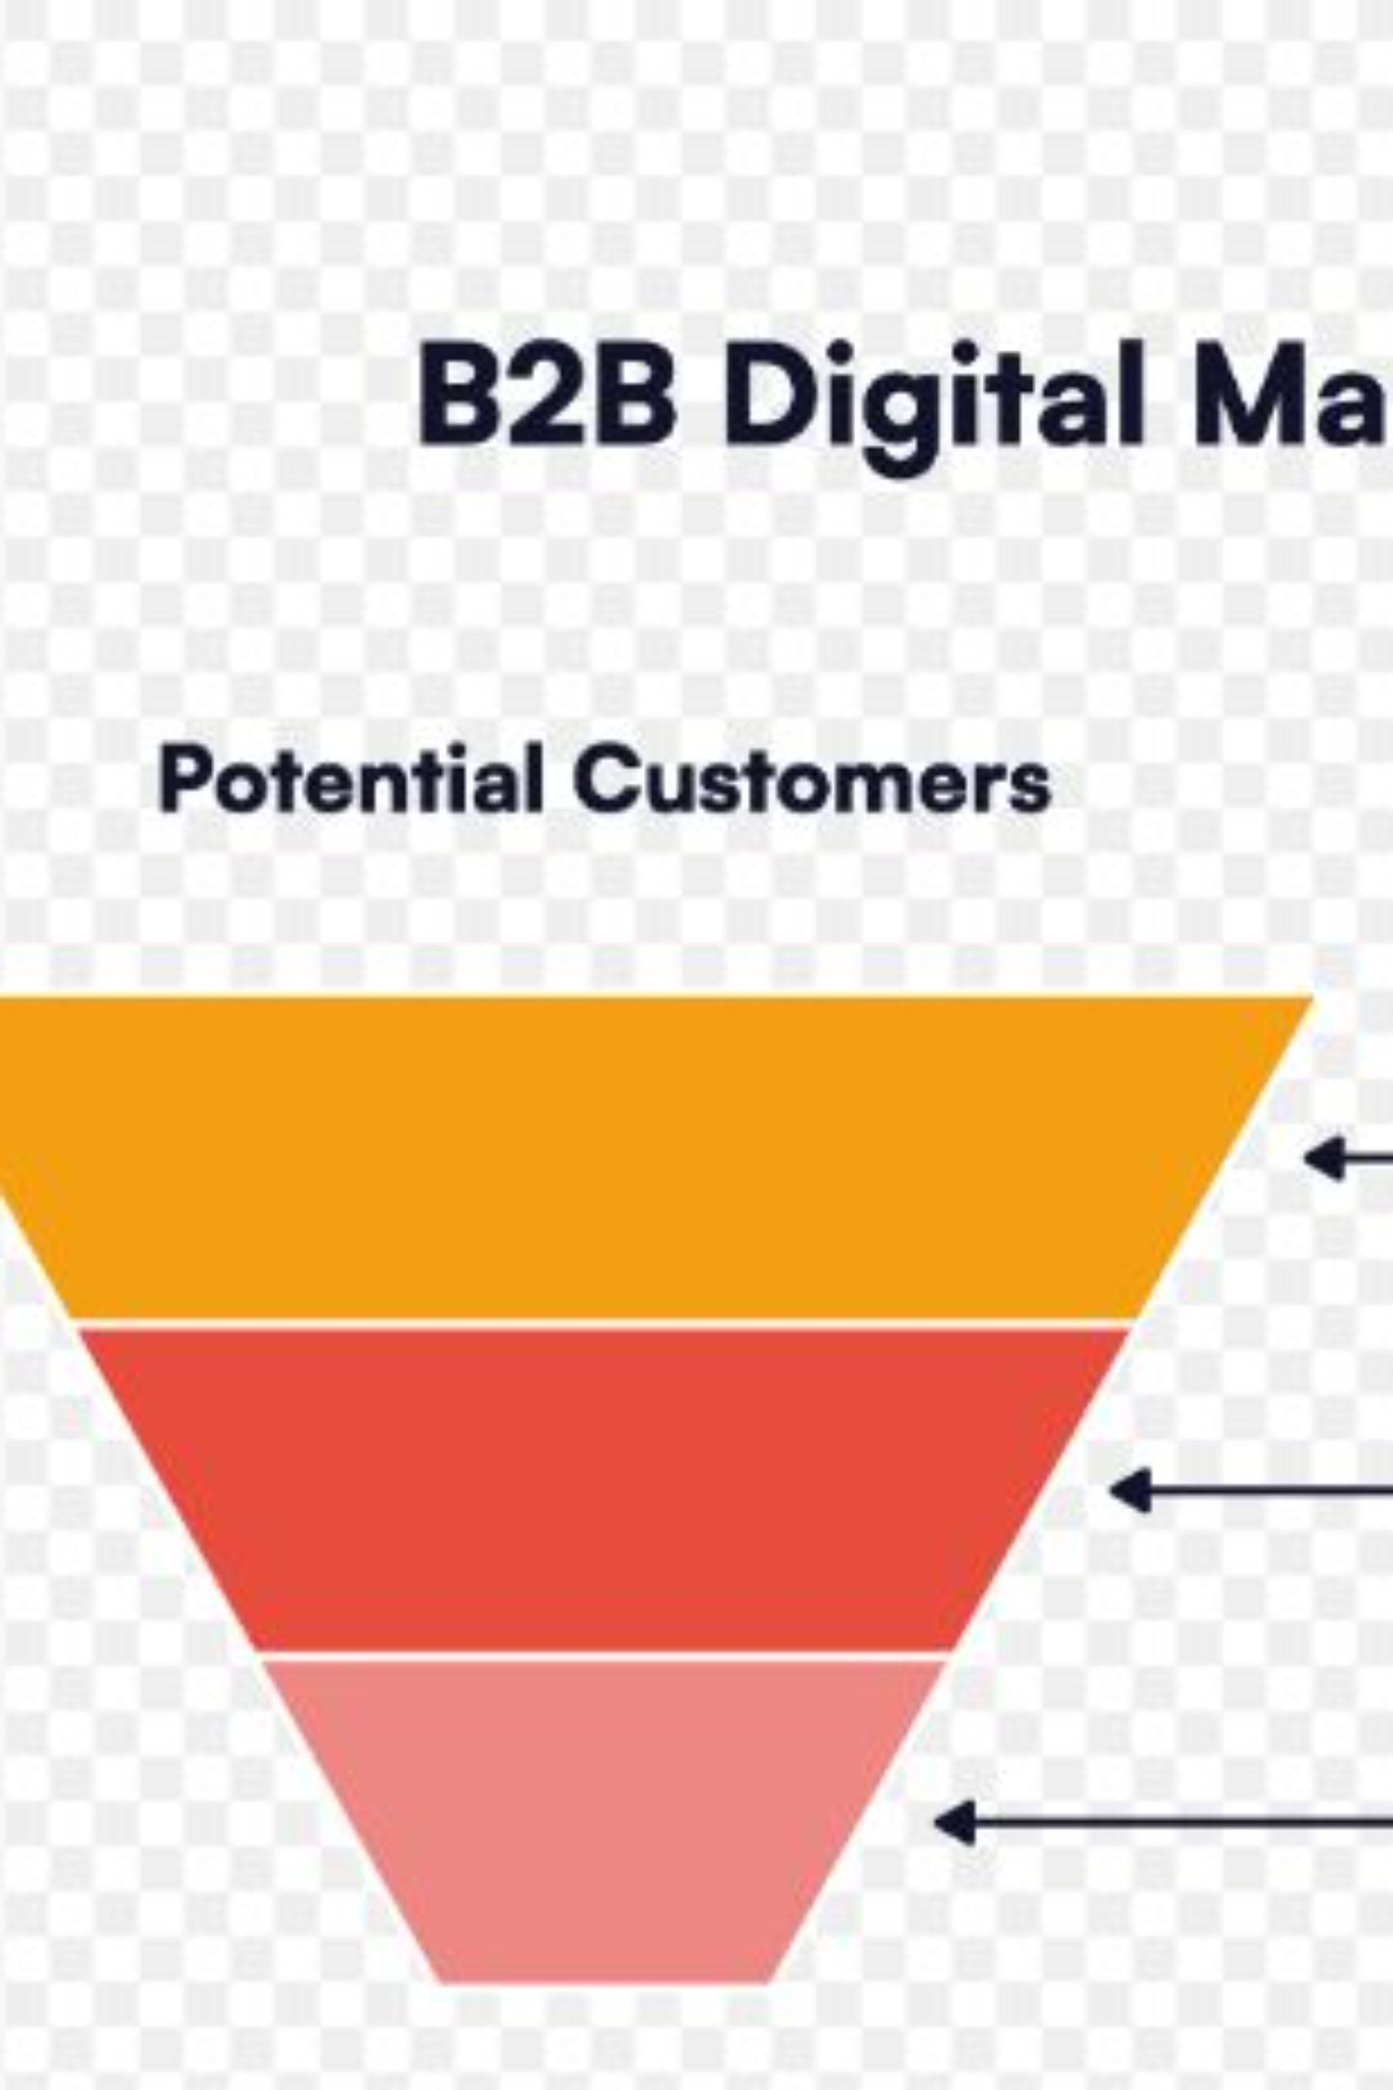
Business Model: Two Engines
B2C :Freemium
Free to start, Premium for depth. Users pay to access advanced patterns, long-term memory, and shareable summaries.
B2B2C :Professional Platform
Platform access for therapists and coaches via a fixed monthly payment. Each client keeps their own subscription, already funding their AI usage.

Slide 10
Pricing
Free
Premium
Pro Therapist
Daily journal, basic extraction, simplified weekly summary
15dt/month or 100dt/year: unlimited companion, long-term memory, monthly summaries
40dt/month (independent) or 150dt/month (practice up to 15 practitioners)

Slide 11
Roadmap: From Prototype to Market
Already built
1
Journal, AI extraction, consented memory, dashboards, functional therapist bridge
2
Next step
Real user testing on both sides
Then
3
Native mobile app, marketplace of partner therapists

Slide 12
THANK YOU

