Slide 1
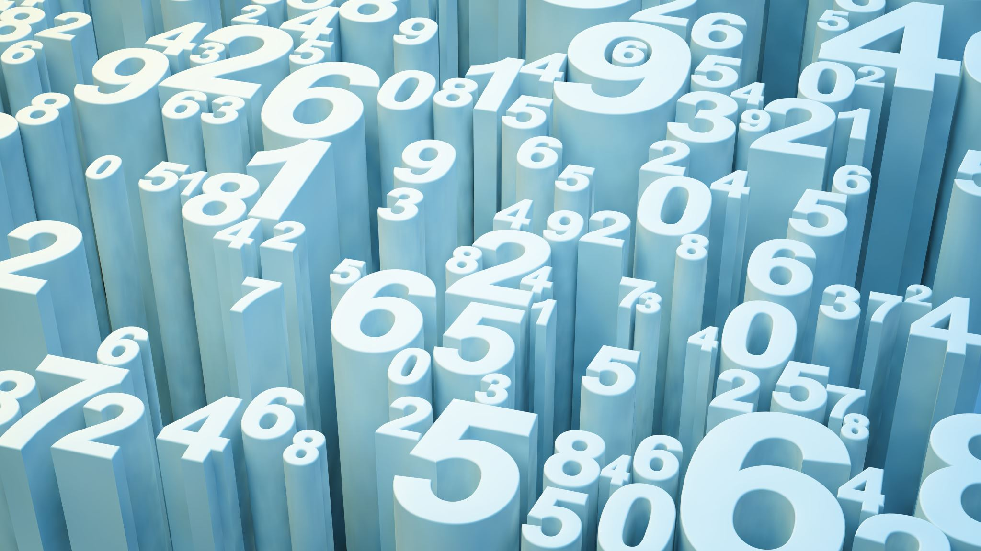
Eniac: Discounts
Are discounts beneficial for Eniacs sales?

Slide 2
Agenda
New product categories
Distribution of prices across different categories
Discounts in each category
Discounts & Sales
Conclusion
How could data collection be improved?

Slide 3
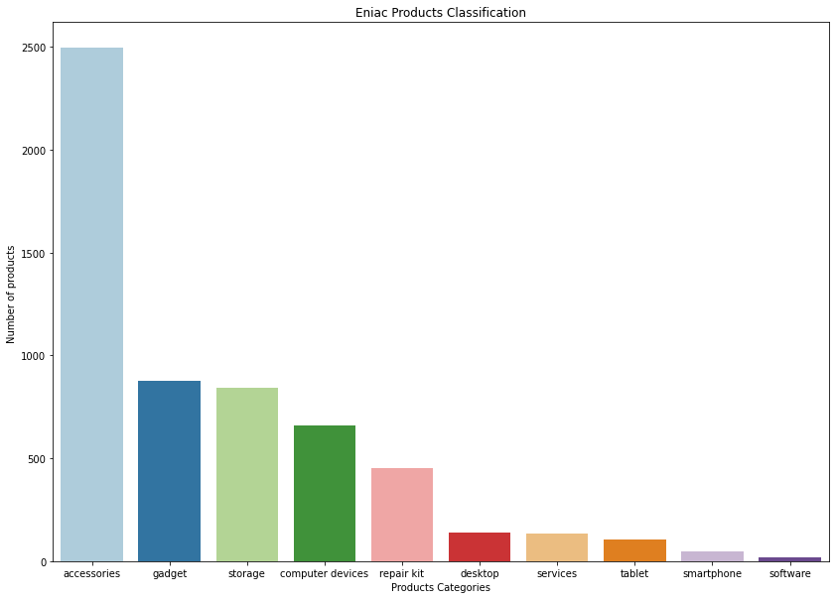
Eniacs new product categories
Accessories
= Cases, Bags, Stands, etc.
= Smartwatches, healthcare devices, cameras, iPods, etc.
= keyboard, mouse, charger, cable, battery, etc.
Gadget
Number of products
Computer devices
Product categories

Slide 4
Agenda
New product categories
Distribution of prices across different categories
Discounts in each category
Discounts & Sales
Conclusion
How could data collection be improved?

Slide 5
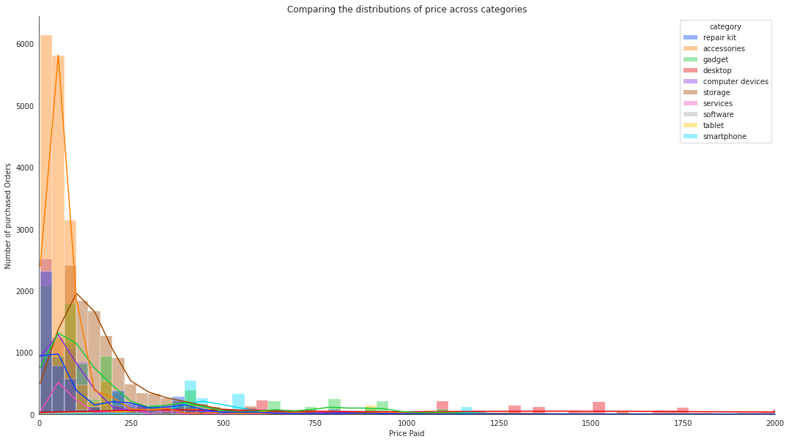

Distribution of prices across different categories
Accessories
Number of purchased orders
Services
Computer devices
Repair kit
Storage
Smartphones
Desktop
Gadget
Paid price

Slide 6
Agenda
New product categories
Distribution of prices across different categories
Discounts in each category
Discounts & Sales
Conclusion
How could data collection be improved?

Slide 7
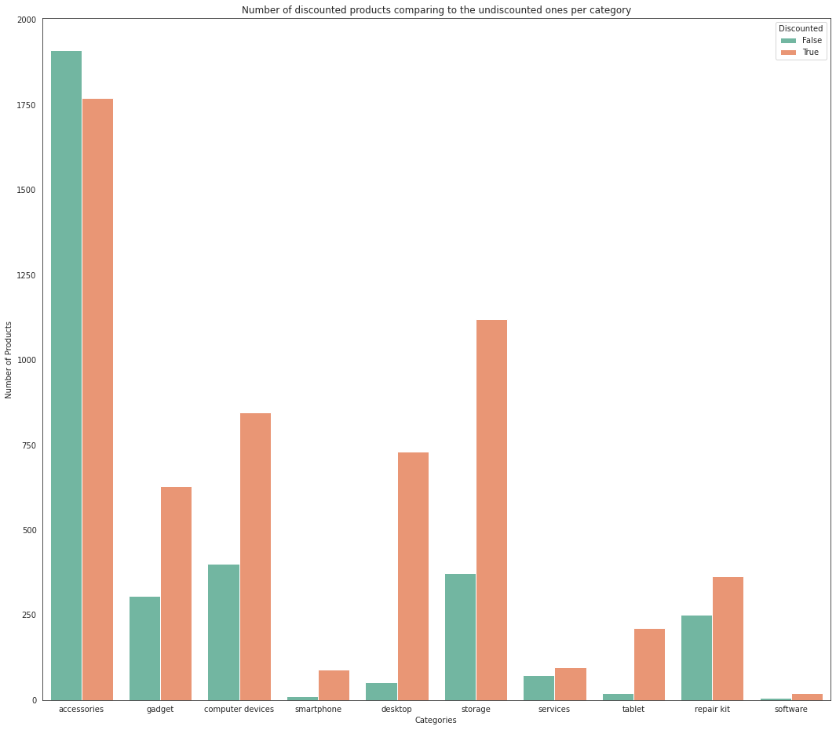
How many products are being discounted?
Number of products
Categories

Slide 8
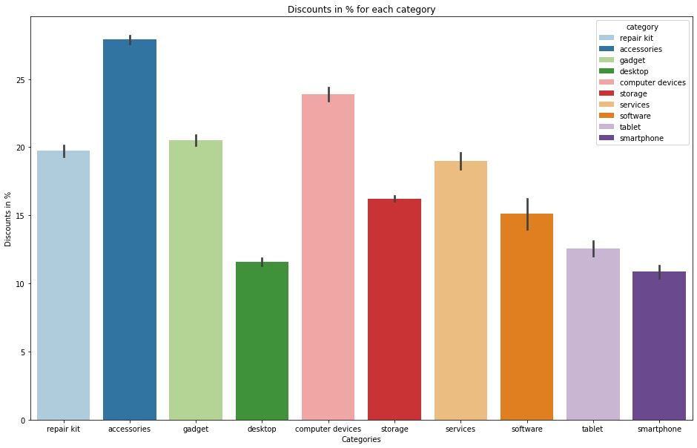
Discounts in each Category
Discounts in %
Categories

Slide 9
Agenda
New product categories
Distribution of prices across different categories
Discounts in each category
Discounts & Sales
Conclusion
How could data collection be improved?

Slide 10
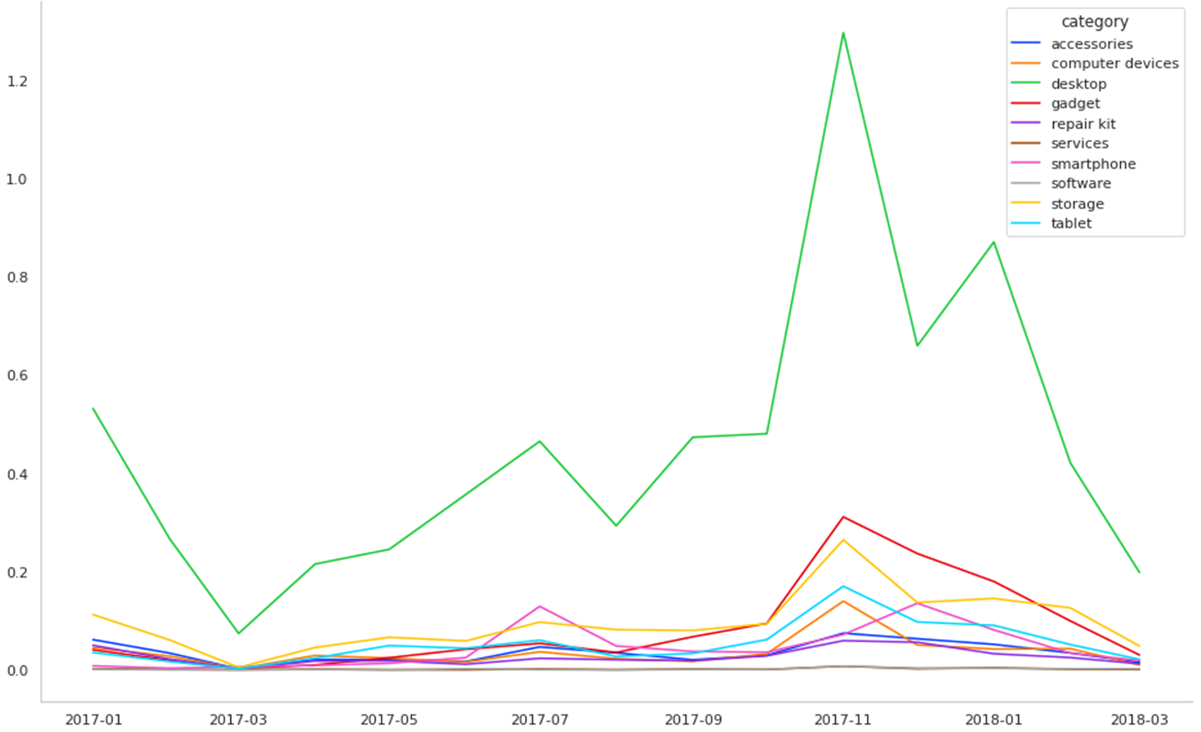
Discounts during the year
Winter sales
Black Friday
Discounts
Summer sales
Months

Slide 11
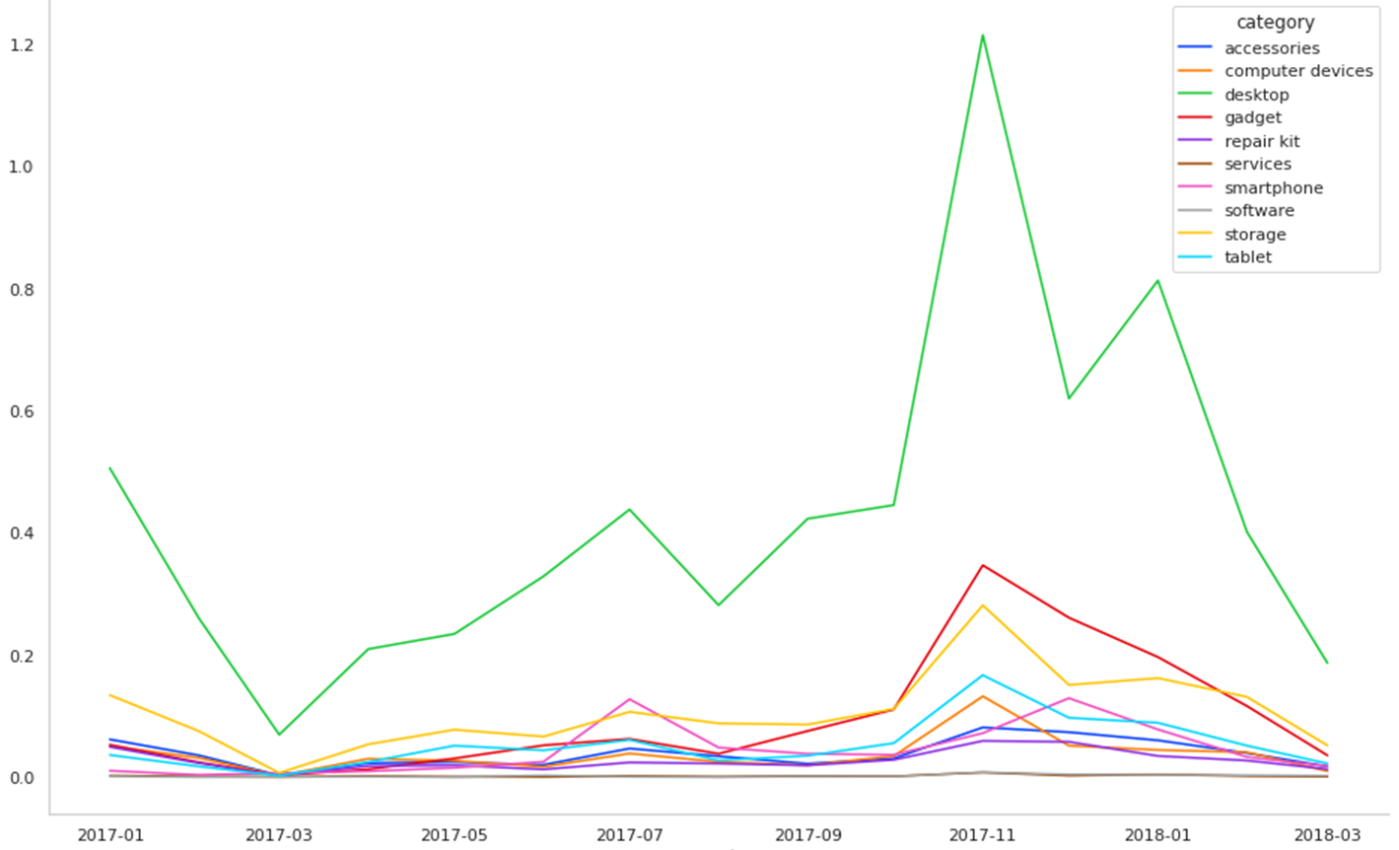
Sales during the year
Sales
Months

Slide 12
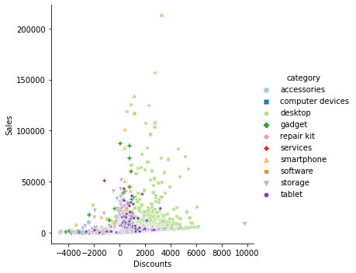
Relationship between sales and discounts
Sales
Discounts

Slide 13
Agenda
New product categories
Distribution of prices across different categories
Discounts in each category
Discounts & Sales
Conclusion
How could data collection be improved?

Slide 14
Conclusion: Are discounts beneficial?
As the sales volume increases due to price reduction, promotional pricing is likely to drive better revenue at least for the short-term. ​
In order not to abuse discounts which could cheapen the brand in the long-term, further strategies could be discussed with the marketing department.

Slide 15
Agenda
New product categories
Distribution of prices across different categories
Discounts in each category
Discounts & Sales
Conclusion
How could data collection be improved?

Slide 16

How could data collection be improved?
Set an elaborate system for product categorizing
Set a frequency for data capture and analysis
Automated data management
Customer behavior analysis (by collecting the customer info & what they buy etc., customer satisfaction survey)

