Slide 1


by Deltablot

Slide 2

Chapter 00
THE SOFTWARE: eLabFTW

Slide 3
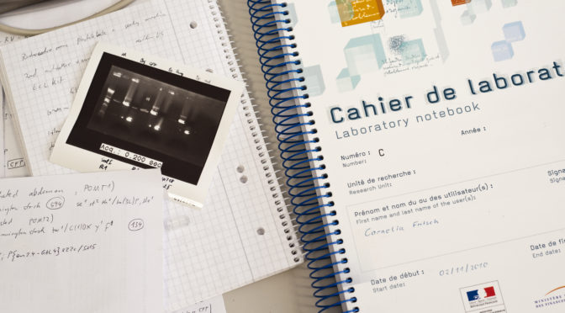
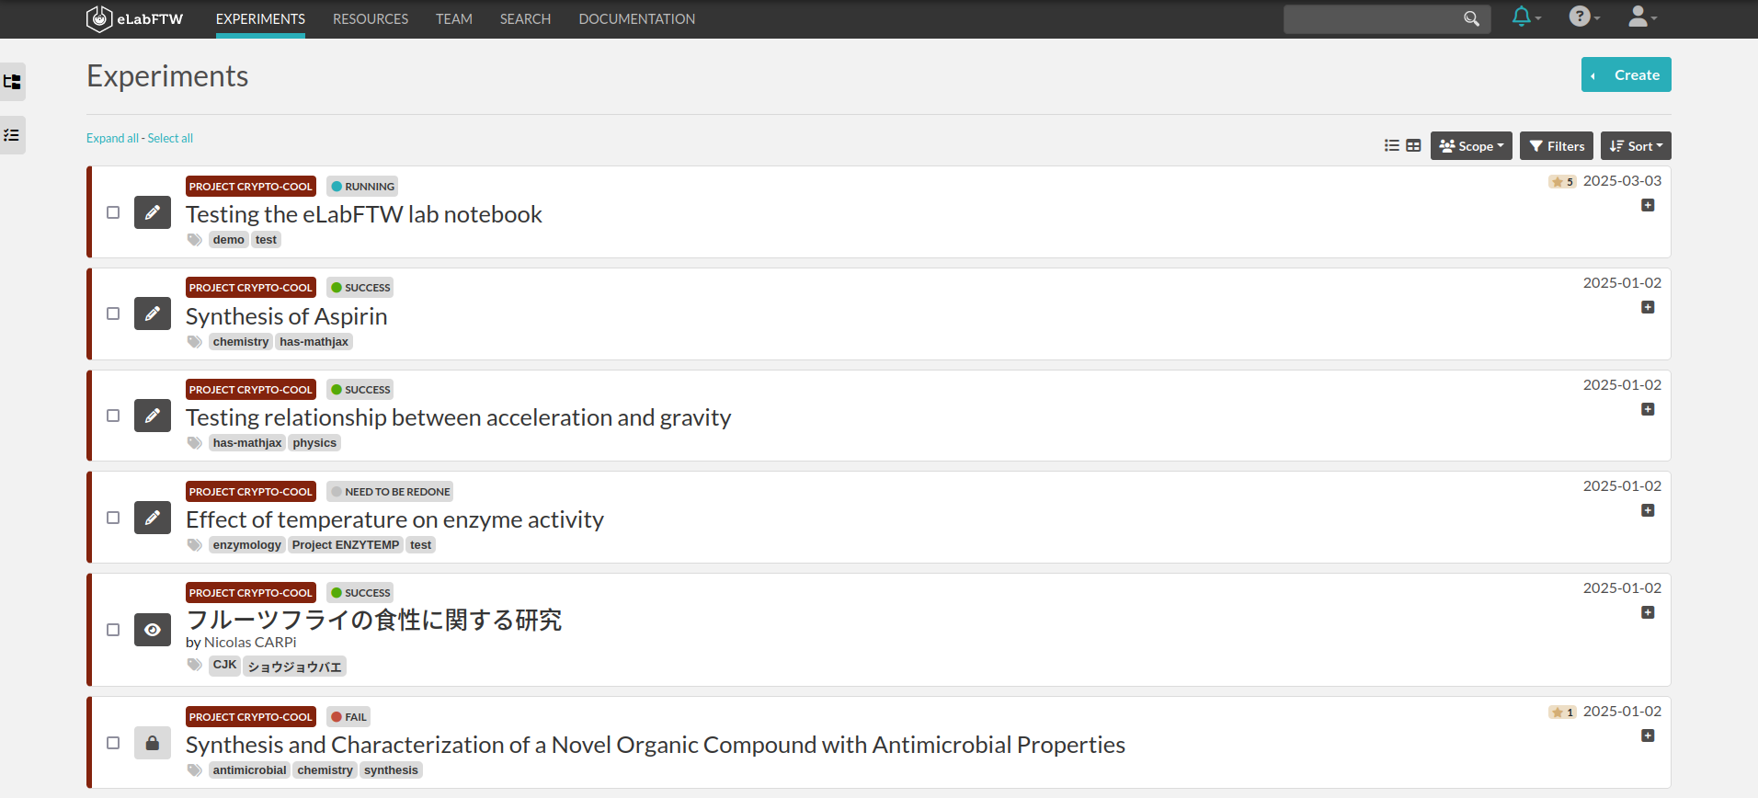
The software: eLabFTW
eLabFTW is an electronic laboratory notebook for
research groups
Modernity

Slide 4
The software: eLabFTW

Slide 5
The software: eLabFTW
… allows you to:
Store digital results in a digital notebook
Share procedures and protocols through templates
Collaborate on scientific results
Improve probity, traceability and integrity of results
Use tablets or phone to access it
Step into the XXIst century

Slide 6
ELN + Laboratory stock management (LIMS)
Highly customizable database to store:
  Antibodies
  Plasmids
  Cell lines
  Chemical products
  Equipment (and booking system)
  Basically any kind of resource → every team can configure it

Slide 7
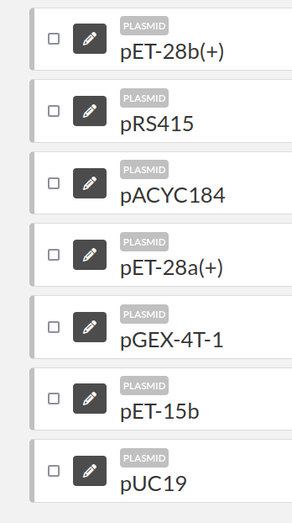
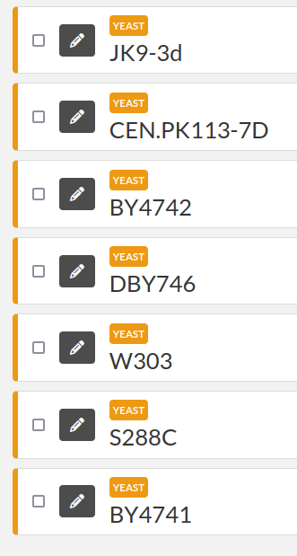

Slide 8
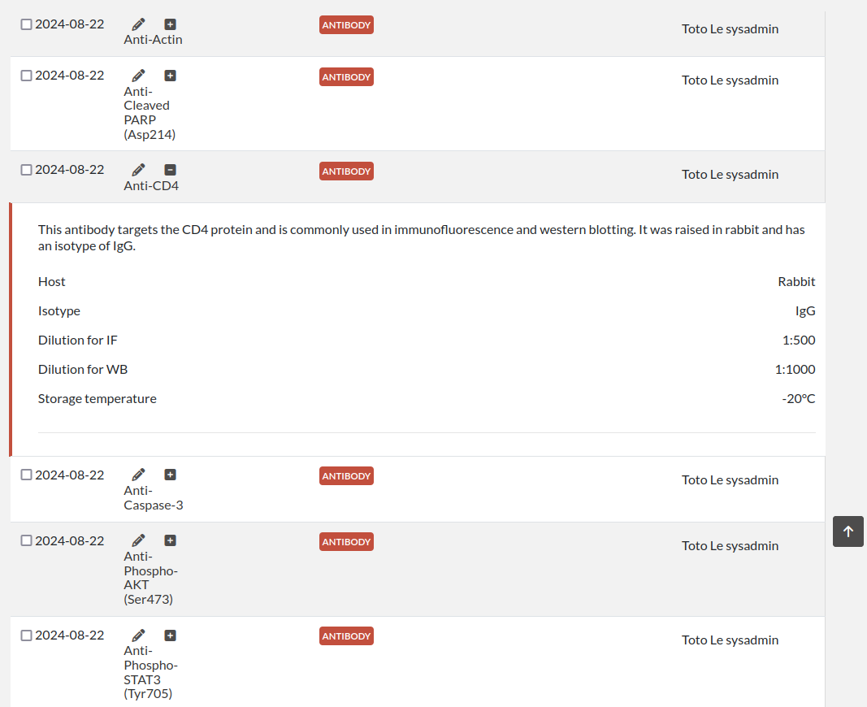

Slide 9
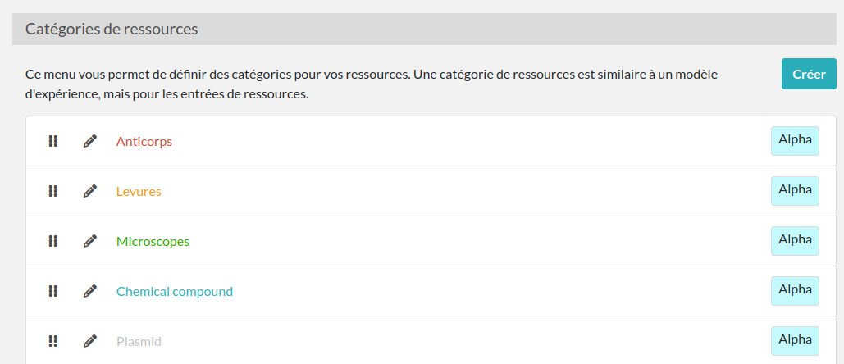
Every team can configure their resources categories

Slide 10
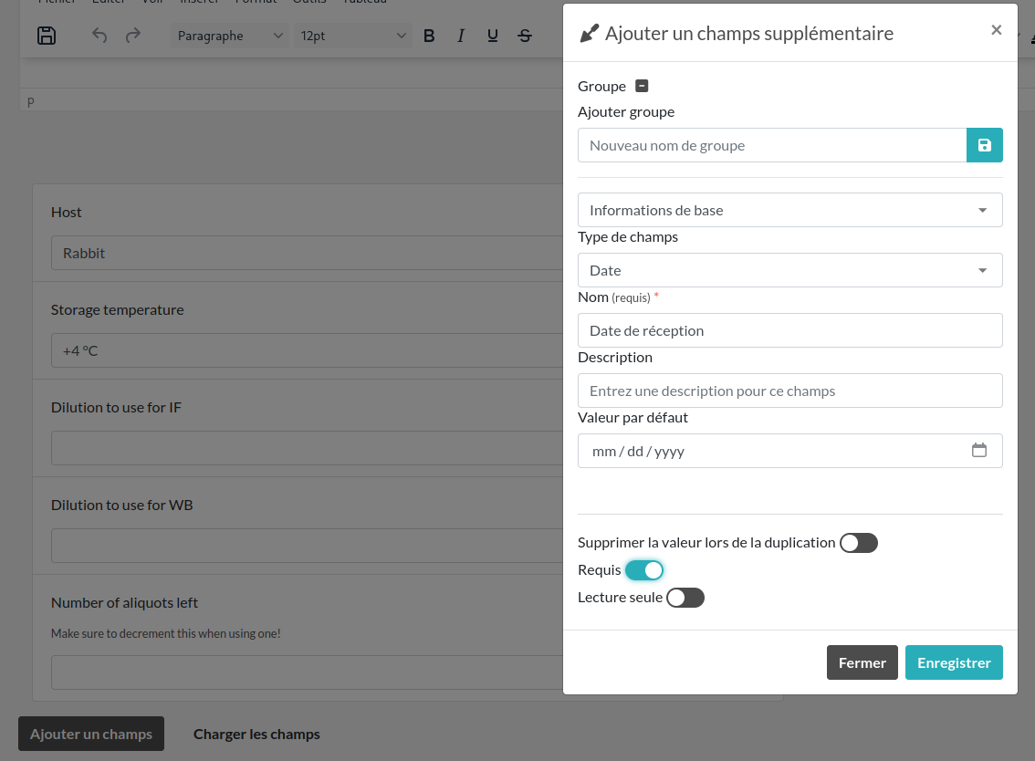
Custom fields can be added to templates and experiments

Slide 11


Features of eLabFTW
Freedom: published under an OSI approved license (AGPL3.0)
Security: code audits, bug bounty program, good practices
Utility: saves time
Popular: greatly appreciated by users
Flexibility: adaptable to all kinds of research
Accessibility: follows WCAG 2.1 specifications
Internationalisation : available in 21 languages
Community: large user base from various domains

Slide 12


Integrity, probity, timestamping
eIDAS qualified timestamping (910/EU/2014 - RFC 3161)
Blockchain timestamping (Consortium Bloxberg)
Immutable audit logs
Immutable files with integrity cryptographic sum
Cryptographic signatures (ed25519 elliptic curves)
Soft delete mechanism to prevent destructive actions

Slide 13
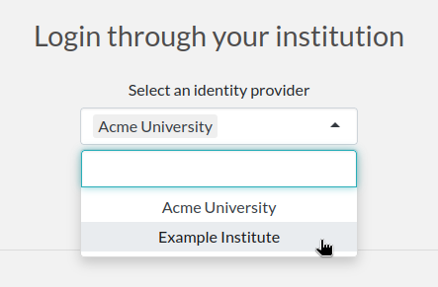
Centralised authentication
  Use your institutional authentication service
  Support for federated services
  SAML or LDAP protocols

Slide 14

Accessibility
Compliant with WCAG2.1 guidelines
Level AA et AAA when possible
Included in Continuous Integration pipeline
Download our accessibility report:
https://www.deltablot.com/files/deltablot-accessibility-report-WCAG.pdf

Slide 15
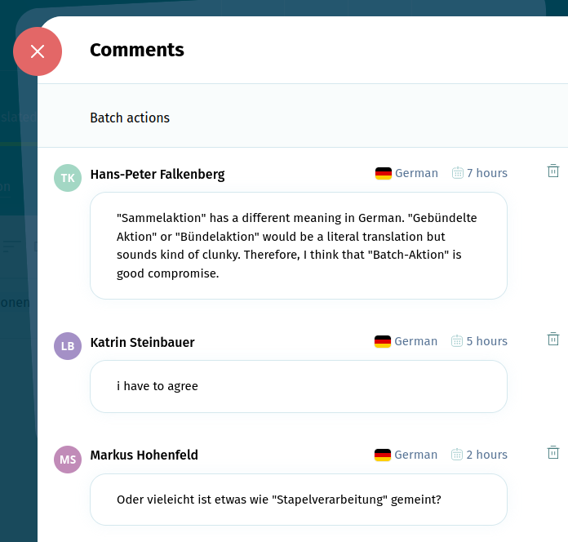
Internationalization
Translated into 21 languages ​​by the user community (160+ contributors)
Each user is free to display the interface in the language of their choice

Slide 16
Chapter 02
SOFTWARE SECURITY

Slide 17

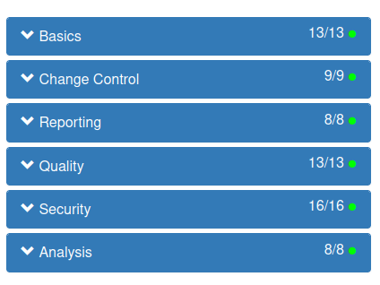
Quality and security
Quality and security aspects
Code audits by external security companies
Bug bounty program for security researchers
Responsible disclosure through CVE publication
Advanced configuration options: centralized authentication, password policy, multi factor, protection against brute-force attacks, etc...
Good practices of project management (OpenSSF referential)

Slide 18
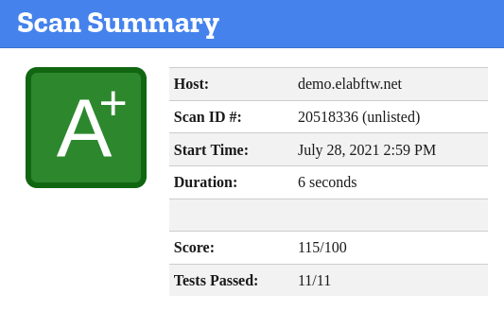
eLabFTW: quality and security
More security aspects
Perfect score on Mozilla’s Obervatory
Services hardening
Services containerization
Automated vulnerabilities scanning
Scan result from observatory.mozilla.org

Slide 19
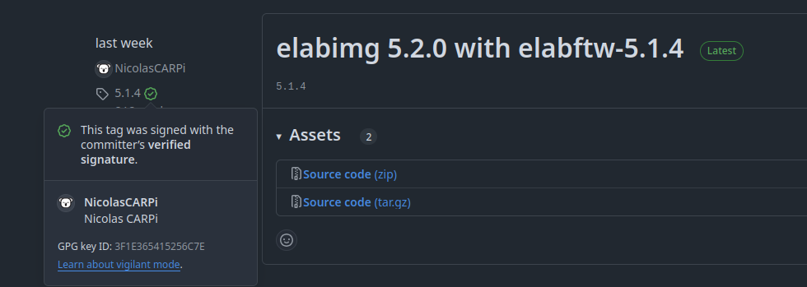
eLabFTW: quality and security
Tagged releases are signed with a GPG key and have a public build log

Slide 20
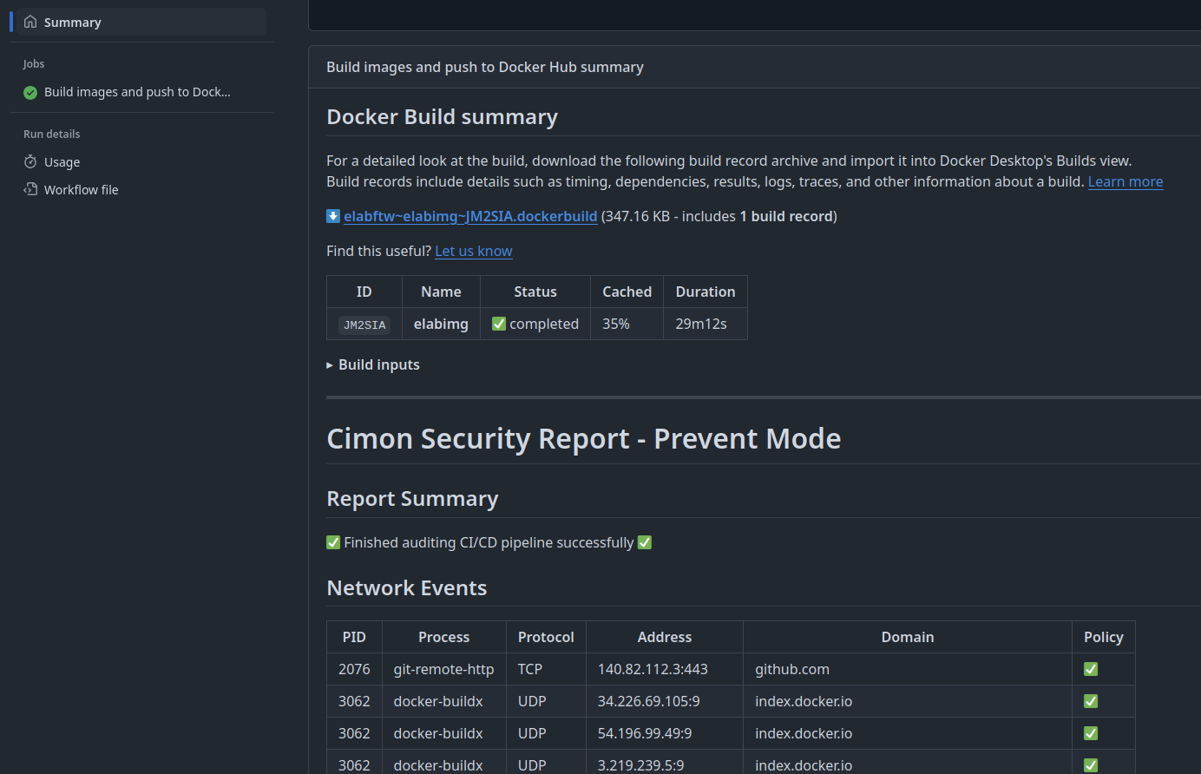
eLabFTW: quality and security
Auditable build logs with kernel level protection against supply chain attacks

Slide 21
Chapter 03
OPEN SCIENCE COMMUNITY

Slide 22

eLabFTW: a major actor in open science and FAIR data
Founding member of The ELN Consortium
15+ members including other ELN editors
Created a standardized exchange file format (.eln)
Based on RO-Crate and JSON-LD
Recognized as an official media type by IANA
Increases interoperability of data (FAIR)

Slide 23
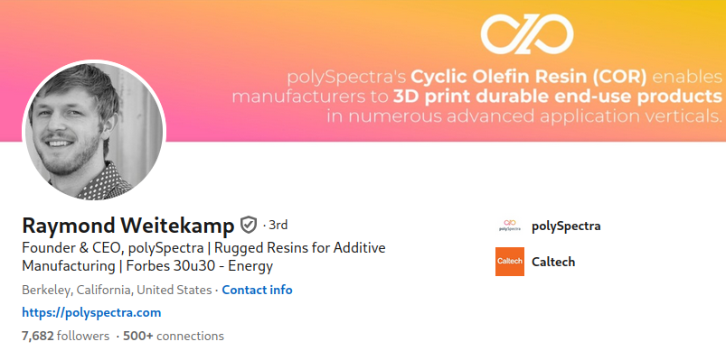
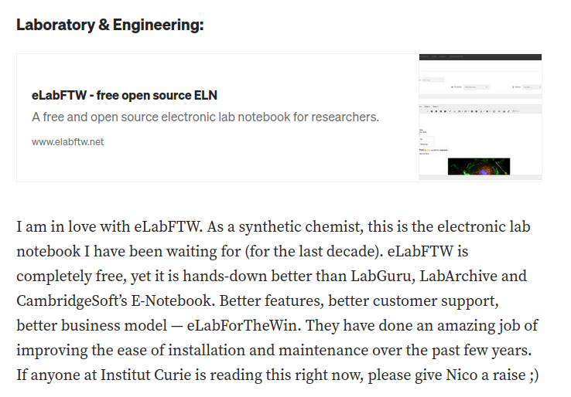
User reviews
Source : https://medium.com/phd-to-ceo/an-open-source-stack-for-physical-science-startups-c83266852efc

Slide 24

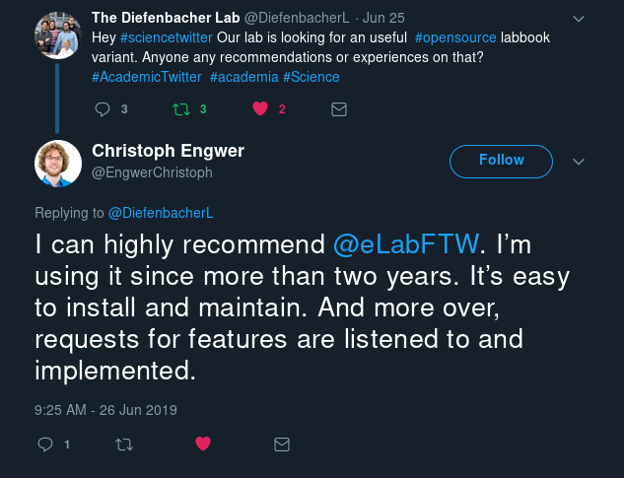



User reviews

Slide 25
User reviews
The most adapted ELN software for academic research groups.
A true alternative to paper notebooks, that is simple and intuitive to use.
Garrett Curley – École Polytechnique – Laboratoire Physique des Plasmas
As an open-source tool, eLabFTW allows full customization without expensive licenses. It’s great for labs that need flexibility and control over their data
Hüseyin Uzun – RDM Universität Frankfürt
A user-friendly and flexible open source tool with great support and a helpful community
Nikki Parks – Universität Aachen
Easy and simple to setup and use.
Rohit Karthikeyan

Slide 26
Chapter 04
THE DELTABLOT COMPANY

Slide 27



Founded in 2019
Located in Paris, France
Operating on 4 continents
Dedicated to helping research teams
Nicolas Carpi
President
Sydney Koke
Customer Success Manager
Moustapha Camara
Full Stack Developer

Slide 28


Our partners
Paris, France
Easter Eggs
GNU/Linux specialists
Paris, France
Universign
eIDAS qualified timestamping
Marseille, France
Keeex
Document integrity, traceability, and probity

Slide 29





Our team of experts
Marcel Bolten: Fullstack developer
Hüseyin Uzun: Video editor, german language trainer
Simon Bekemeier: German language trainer
Manon Stripes: UI/UX design
Anders Märak Leffler: Cybersecurity specialist

Slide 30
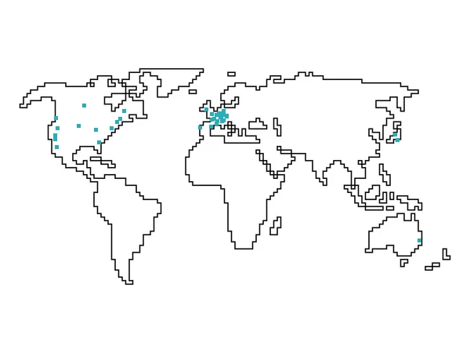
Our customers

Slide 31
Make Open Source Great Again
We maintain open source projects
We contribute to open source projects
We donate to open source projects
We are member of APRIL association for the promotion of free and libre software
Learn more: https://www.deltablot.com/opensource/

Slide 32
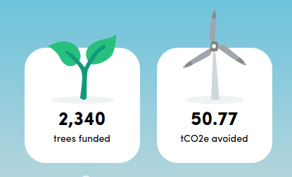
Make Our Planet Great Again
Deltablot has a carbon reduction plan through ecologi.com
Visit our forest: https://ecologi.com/deltablot

Slide 33
Chapter 05
CHOOSE YOUR PLAN

Slide 34
Hosted by us in the cloud or by you on your network
1
PRO HOSTING
We take care of everything (SaaS)
PRO SUPPORT
We help you deploy eLabFTW on your network and provide support (On-Premise)
2

Slide 35
1. PRO Hosting
Hosted close to you:
  Europe → Paris, France, optionally in the SecNumCloud environment
  North America → Toronto, New York, or San Francisco
  Japan, Australia → Tokyo
Dedicated eLabFTW instance
Custom domain name
eIDAS qualified timestamping tokens included
Fully managed backups and updates
Ransomware protection
Infinite updates
Includes PRO Support

Slide 36





1. We take care of everything
PRO Hosting
Instance size | Active users max | Yearly cost | SecNumCloud
S | 32 | 2 985 € | 4 985 €
M | 128 | 3 985 € | 6 985 €
L | 128+ | 4 985 € | 7 985 €

Slide 37

2. Support for self-hosting
PRO Support
We help you implement eLabFTW within your IT system
User training (webinars) in French, English or German
Access to sandbox instance
20% discount on custom development requests
1000 eIDAS qualified timestamping token
1 789 € / year

Slide 38
Contact us
contact@deltablot.email

