Slide 1

a free and open source electronic lab notebook
Why you should choose eLabFTW
www.elabftw.net

Slide 2



eLabFTW costs nothing to deploy
Free as in beer
Free as in speech (AGPLv3 licence)
Unlimited users
Unlimited experiments
Unlimited storage
Unlimited everything basically
Forever

Slide 3
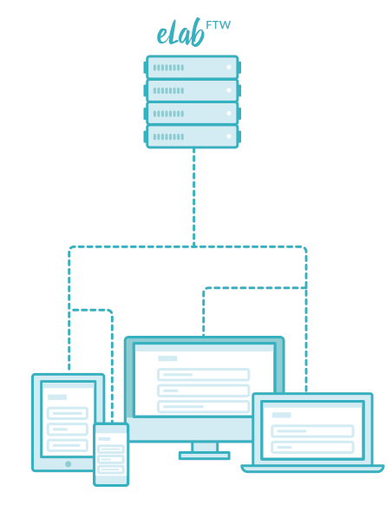

eLabFTW works everywhere for everyone
Installed on a server and accessed through a browser:
  Works from Windows, Mac and GNU/Linux
  Works on iPad, iPhone, Android, tablets, ...
No need to install anything on users' computers

Slide 4



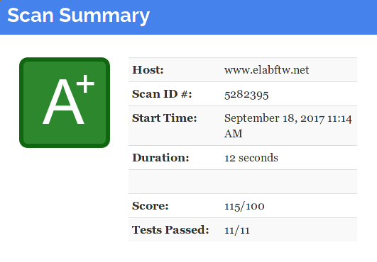
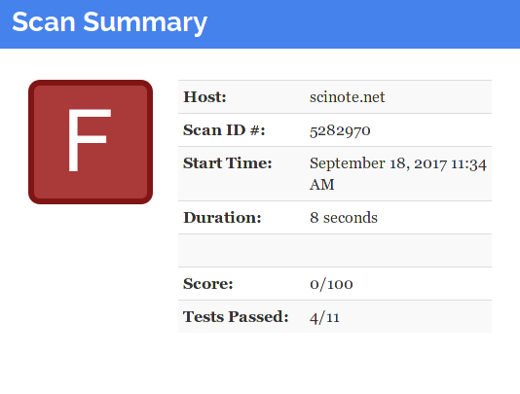
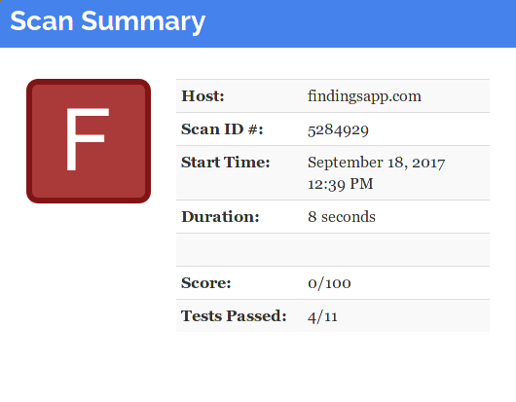
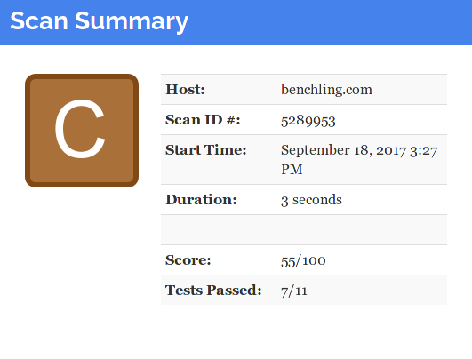




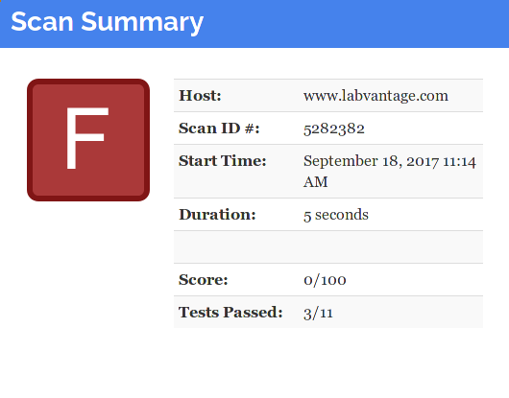
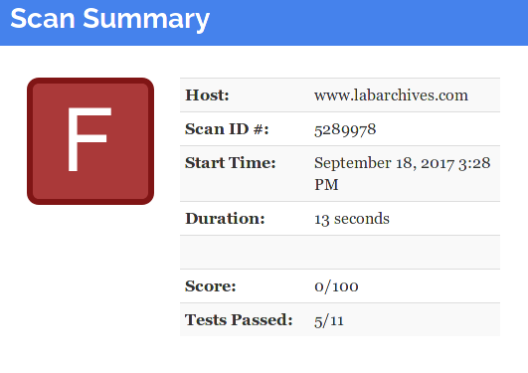
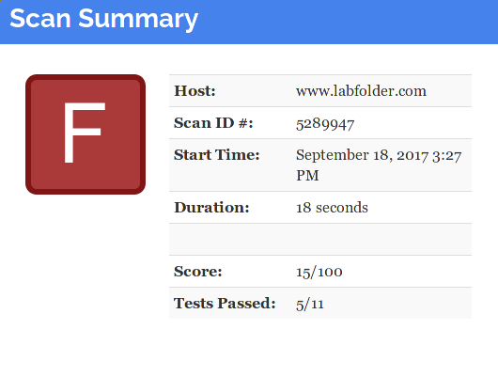

eLabFTW is secure
Test results from Mozilla's observatory (testing good practices in web security)
Which one of these would you trust with your data?

Slide 5
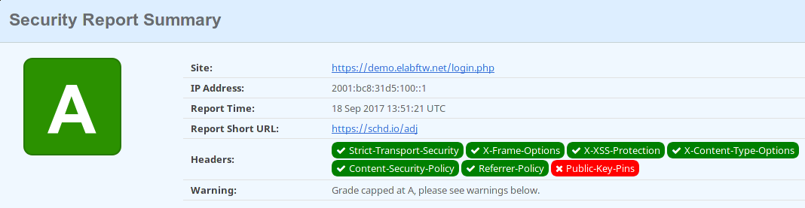
eLabFTW is secure (part 2)
Docker containerization technology using Alpine linux as base image
HTTPS by default with modern protocols and modern cipher suite
2048 bits Diffie-Hellman parameters for perfect forward secrecy
Installed on your server inside your network: no data leakage
Secure headers (see scan below)
From https://securityheaders.io

Slide 6

eLabFTW is translated in several languages
Because not everyone is a native english speaker, each user can choose which language they prefer
Users can also easily contribute to translations (see the contributing page)

Slide 7

eLabFTW can timestamp your experiments
Never worry anymore about patents. With experiments timestaming you'll be able to prove the experiment was done at the specified time!

Slide 8































eLabFTW is used all over the globe
Here are some places known to run an eLabFTW instance (list is definitely not comprehensive)

Slide 9
eLabFTW works with centralized authentification for users
Have an Identity Provider on your network for authentification on applications? eLabFTW can use that (SAMLv2)
Or you can have local users (or both)

Slide 10
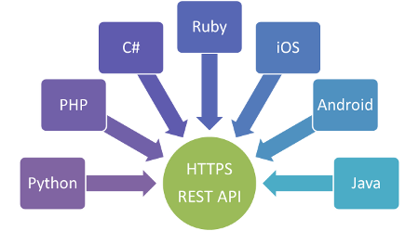
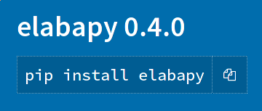
eLabFTW features a public API
Users can interact with eLabFTW through a REST API:
  automatic experiments update at the end of the experiment
  json export
  allows use of external tools to interact with database
  a python library exists to facilitate such tasks

Slide 11
eLabFTW is packed with features
WYSIWYG editor or Markdown
File uploads
3D Mol support for 3D molecules
Chemical editor for 2D molecules
Steps for experiments
Protocols
Template system
Scheduler to book rooms or microscopes or whatever you want
Links between entities
Tagging system
ZIP, CSV and PDF export/import
Great flexibility: can fit any kind of lab
…

Slide 12
Still have questions?
Drop me an email: nicolas.carpi@curie.fr
Website: https://www.elabftw.net
Live demo: https://demo.elabftw.net
Documentation: https://doc.elabftw.net

