Slide 1
Research data management and ELNs
ACS Fall 2023 – August 14th 2023

Slide 2
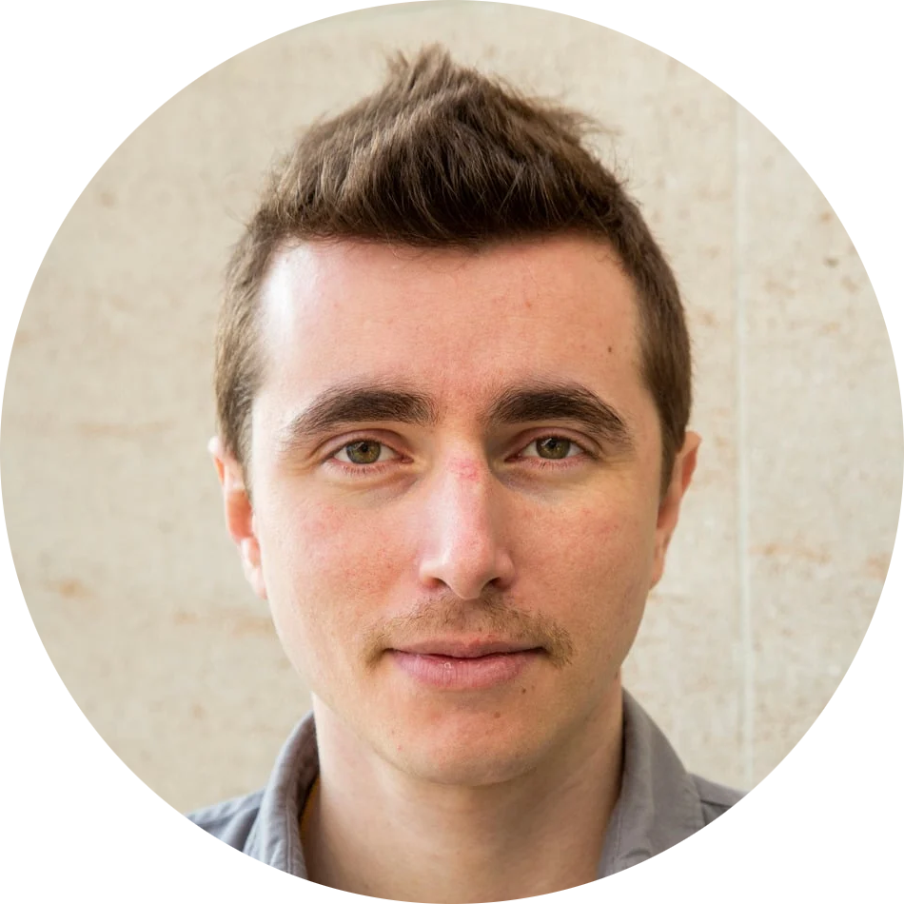

Who am I
Nicolas CARPI
Worked for 15 years in a cell biology research lab
Creator of eLabFTW electronic lab notebook
Founder and President of Deltablot company
ACS Fall 2023 – August 14th 2023

Slide 3
What’s an ELN?
ELN = Electronic Laboratory Notebook
Vastly superior to paper notebooks
First place where research data is referenced (close to the bench)
Daily tool of any researcher in any branch of Science
ACS Fall 2023 – August 14th 2023

Slide 4
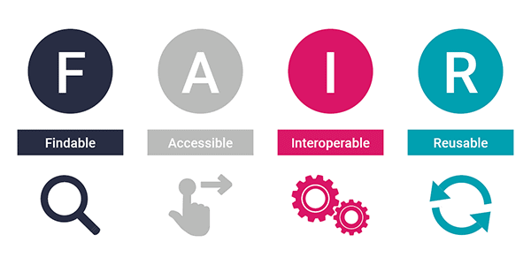
What’s FAIR
ACS Fall 2023 – August 14th 2023

Slide 5
100% FAIR is utopia
Research is messy by design
Labs are highly dynamics, people come and go all the time
Improving the FAIRness MUST NOT be a hassle and should be as automatic/transparent as possible
=> Using a progressive enhancement approach is the most likely to be successful
ACS Fall 2023 – August 14th 2023

Slide 6
First step is to get the data in the ELN
Make it easy to input data
It’s okay if the data doesn’t have 184 ontology defined fields
It’s okay if it’s incomplete, at least we have something
Now we can search for it : that’s the F
ACS Fall 2023 – August 14th 2023

Slide 7
Making it Accessible
That’s the job of a data repository, and should happen after publication
eLabFTW’s approach to research data is private by default
ACS Fall 2023 – August 14th 2023

Slide 8

Making it interoperable
https://xkcd.com/927
ACS Fall 2023 – August 14th 2023

Slide 9

Making it interoperable
We need to describe research data in a way that any program can understand.
The ELN Consortium: we’ll use RO-Crates and ZIP archives. => re-use existing technology!
RO-Crate contains ro-crate-metadata.json using specific terminology to describe the content of the archive.
The ELN file format is officially recognized by IANA (application/vnd.eln+zip).
https://the.elnconsortium.org
ACS Fall 2023 – August 14th 2023

Slide 10
Making it interoperable
How it works:
- eLabFTW: I use date
- Kadi4Mat: I use start_date
- PASTA: I use experiment_date
- SampleDB: I use main_datetime
Problem: we all have our vocabulary/format for different aspects of the data
Solution: common vocabulary that we can agree upon
ACS Fall 2023 – August 14th 2023

Slide 11
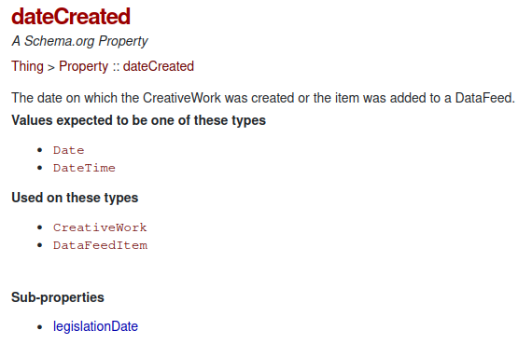
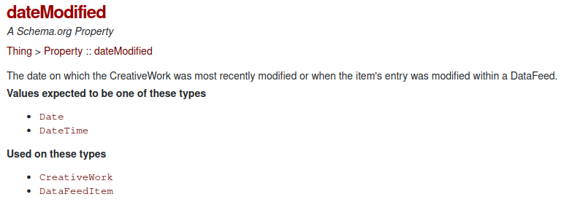
Making it interoperable
Use common vocabulary
ACS Fall 2023 – August 14th 2023

Slide 12
Making it interoperable
Now everyone uses DateTime in ISO8601 format.
We can import/export from different software.
Want to share a sample? Share also the .eln so the history of its creation is not lost!
Want to publish a project along with your scientific article? Export all the related entries in a .eln and push that to the data repository which can interpret all the metadata correctly.
ACS Fall 2023 – August 14th 2023

Slide 13
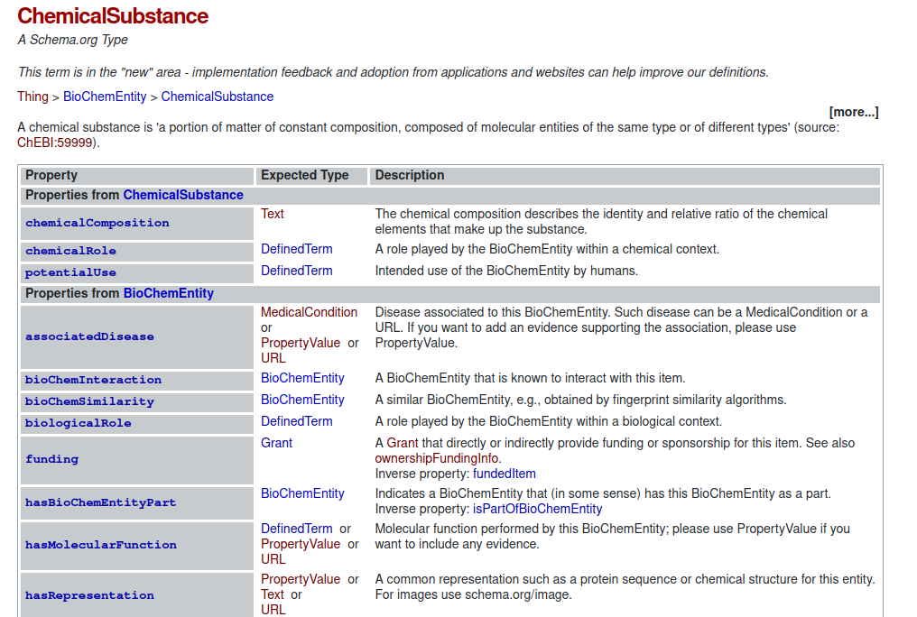
ChemicalSubstance example

Slide 14
Making it interoperable
Result:
export from one ELN to another
export from an ELN to a data repository
export from anything to anything that can open a zip and read JSON
https://the.elnconsortium.org
ACS Fall 2023 – August 14th 2023

Slide 15
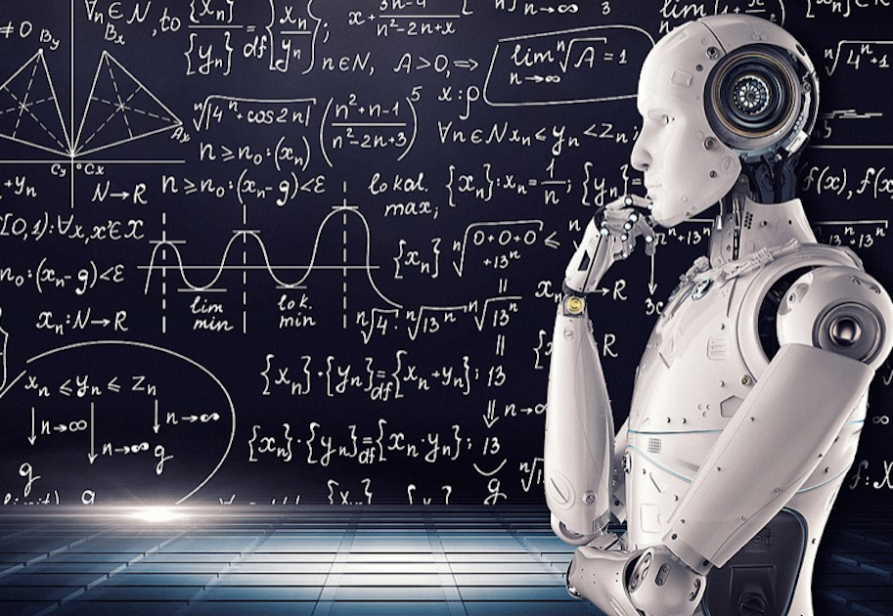
Making it reusable
The research data is now convenably annotated
More importantly: the experiment that produced that data is available with all the conditions and information needed to reproduce it
We can do some machine learning AI magic on it!
ACS Fall 2023 – August 14th 2023

Slide 16
Next steps
Improve automatic metadata extraction from raw data
Improve ELN file format comprehension from Dataverse
Increase ELN file format support across the research software space
Use more precise ontologies
ACS Fall 2023 – August 14th 2023

Slide 17
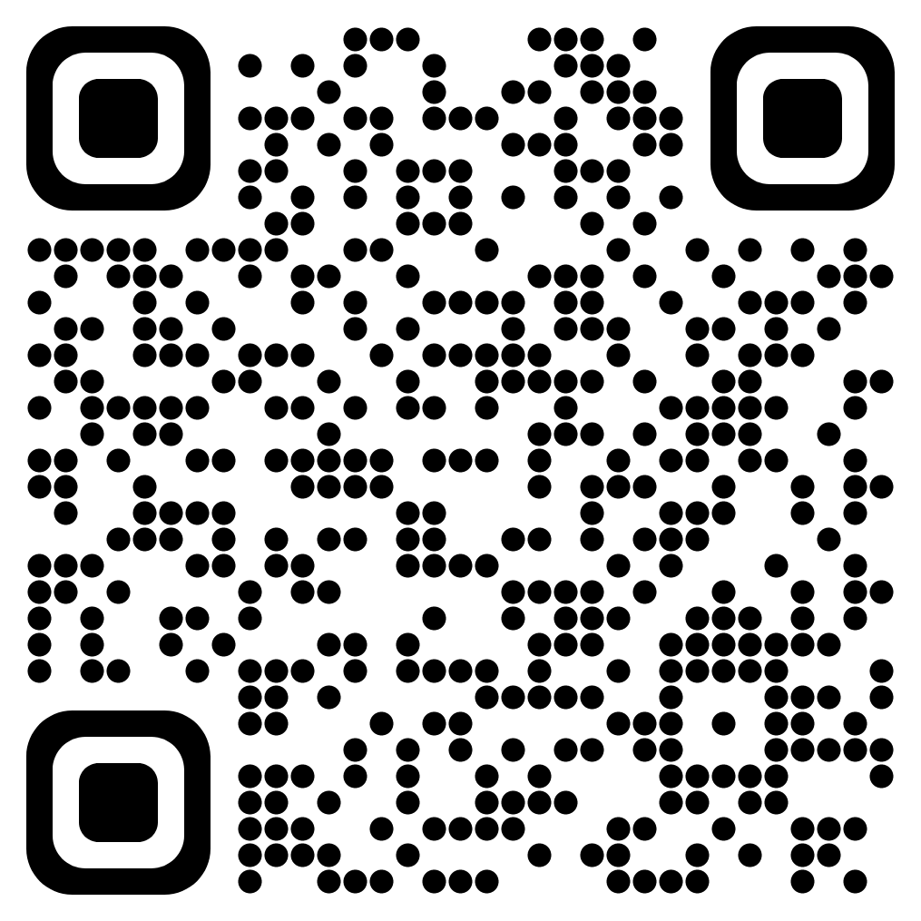
Links
eLabFTW ELN: https://www.elabftw.net
The ELN Consortium: https://the.elnconsortium.org
This presentation:
https://github.com/elabftw/elabpdf/blob/master/talks/2023-08-14-ACS/acs.pdf
Scan for link to this presentation:

