Slide 1
SPLINES
2D Splines
- Bézier curves
- Spline curves

Slide 2
2D Splines
Smooth curves generated from an input set of user-specified control points (knots)

Slide 4
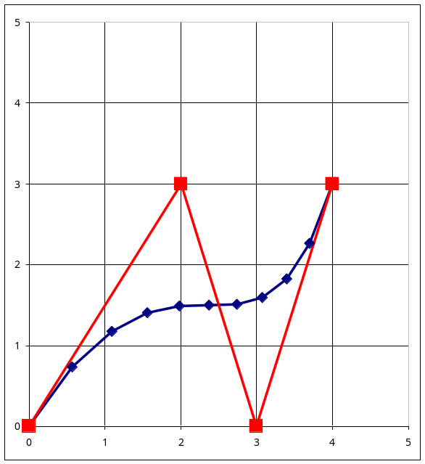
Raster conversion problem
Given a set of control points, plot the spline
A spline curve is usually approximated by a set of short line segments
Control points
Computed points on the spline, inked with short line segments into a smooth curve

Slide 5
Spline defined by parametric equations
P(u) = ( x(u), y(u) )
u is the parameter
x(u) and y(u) are functions of the parameter u which generate x and y coordinates of the curve P

Slide 6
Spline curves can
interpolate control points
(the curve does not have to pass through them)
or
approximate control points
(the curve passes through the points).

Slide 7
Bézier curves
Bézier curve is generated by forming a set of polynomial functions formed from the coordinates of the control points

Slide 8
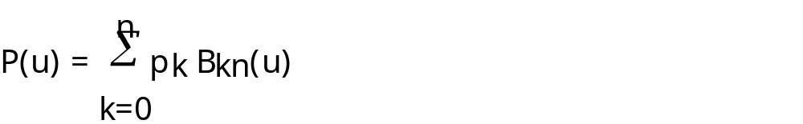
Bézier curves: equations
Input
a set of n+1 control points
p_{k} = ( x_{k}, y_{k} ), k = 0, n
Bézier function P(u) in parametric form:
k
kn
n
P(u) =
∑
p
B
(
u
)
= p
B
(u) + p
B
(u) + ... + p
B
(u)
k
kn
0
0n
1
1n
n
nn
k=0

Slide 9
k
kn
p_{k} – a control point, p_{k} = (x_{k}, y_{k})
B_{kn}(u) is a blending function (a polynomial):
B_{kn}(u) = C( n, k ) · u^{k} · ( 1 - u )^{n - k}
function C( n, k ) provides values for coefficients:

Slide 10
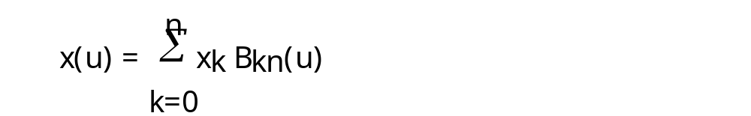

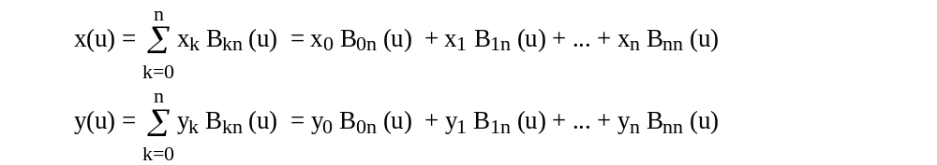
k
kn
P(u) in a form showing explicit equations for the individual curve coordinates:
k
kn
k
kn

Slide 11
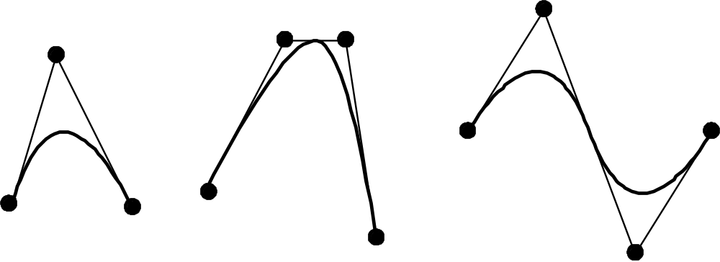
k
kn
The function P(u) is a polynomial of degree n (one less than the number of the control points used)
For example, 3 points generate parabola, 4 points generate a cubic curve etc.

Slide 12
Bézier curves: example
See a worked-out example of generating a Bézier spline at
http://www.cs.bham.ac.uk/~exc/Teaching/Graphics/ComputingSpline.pdf

Slide 13
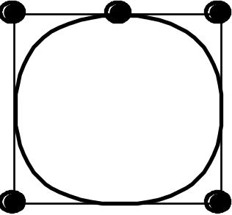
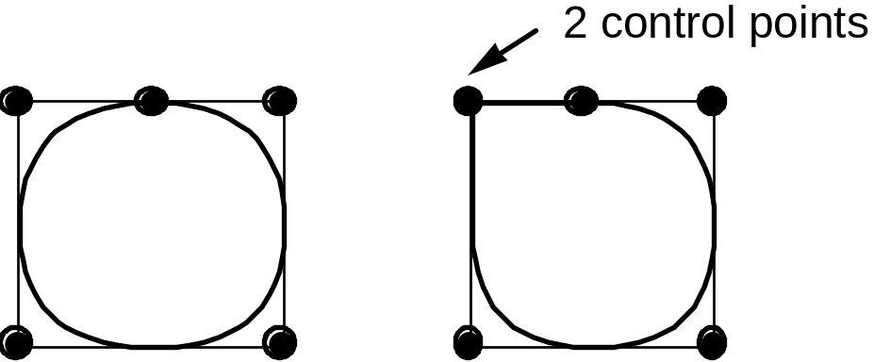
Multiple control points
Condition for closed curves: p₀ = p_{n}
Multiple control points at a same position the curve is "pulled" more towards that position

Slide 14
In theory Bézier curves can be constructed for any number of points.
This would lead to polynomials of a very high order which are inefficient to calculate.

Slide 15
Solution
A set of points is divided into smaller subsets
Bézier curve specified for each small set
A very useful property of Bézier curves is that the curve fragments are always smoothly joined

Slide 16
Spline curves
B-splines are similar to Bézier curves, they differ in the choice of blending functions.
In a Bézier curve the shape of the curve is influenced by all the control points.
In B-splines only up to four nearest control points are taken into consideration (i.e. the highest degree of a polynomial is 3, a cubic spline).

Slide 17
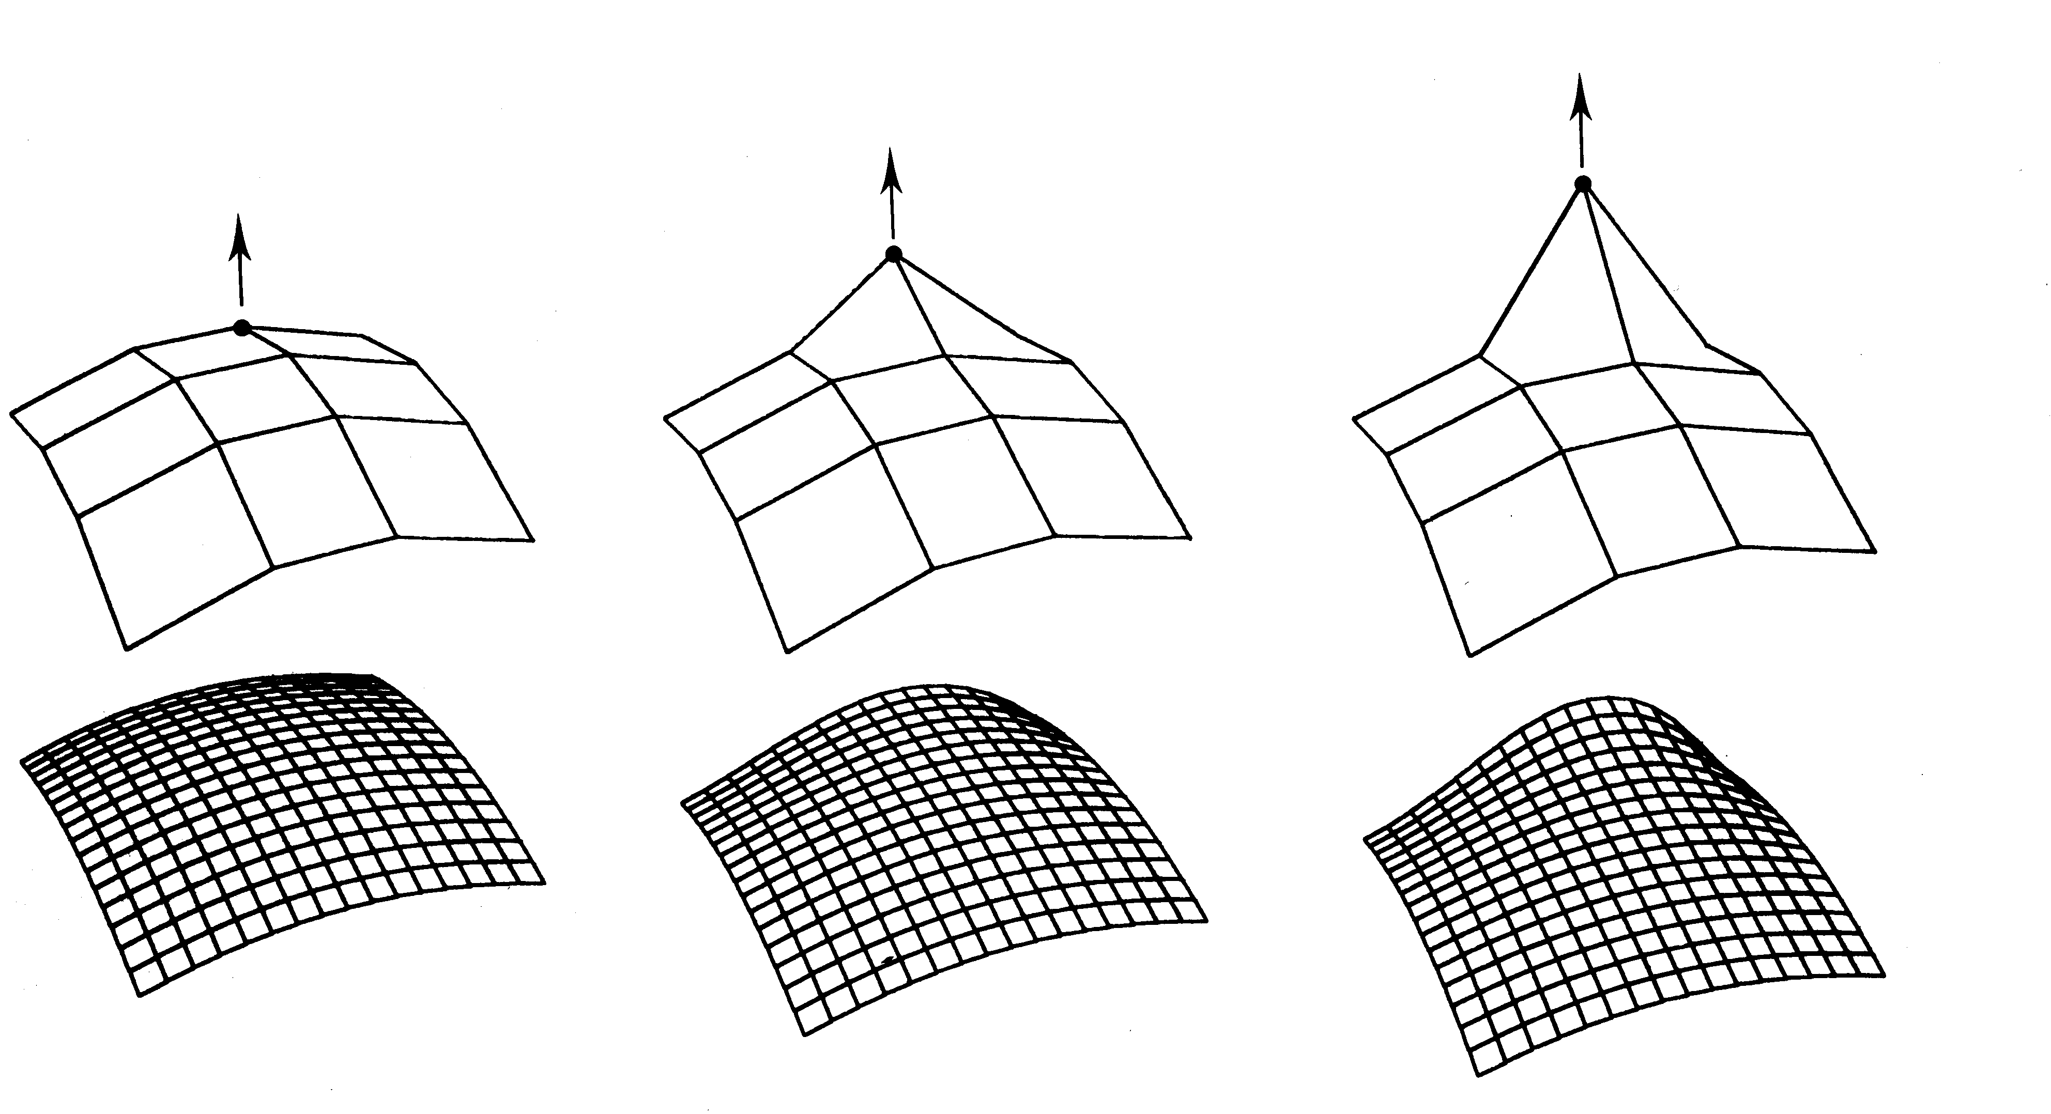
3D Bezier patches defined on a regular grid

Slide 18
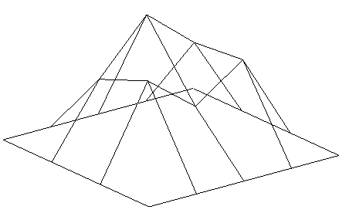
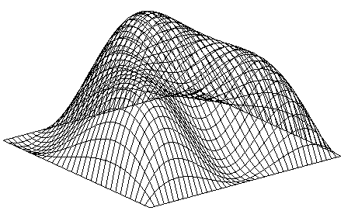
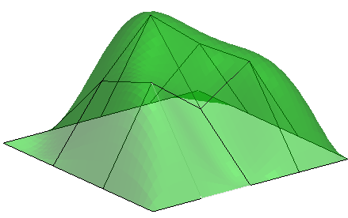
3D Bezier patches
random height map on 5x6 grid
Bezier interpolation (50x60 grid)
Bezier interpolation (50x60 grid), surface, flat shading

Slide 19
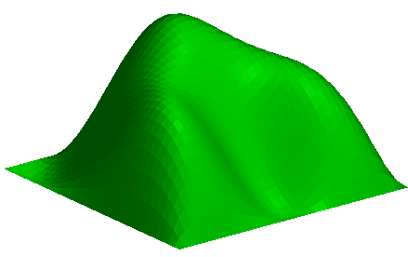

3D Bezier patches
Bezier interpolation
surface, flat shading
Bezier interpolation
surface, Phong shading

Slide 20
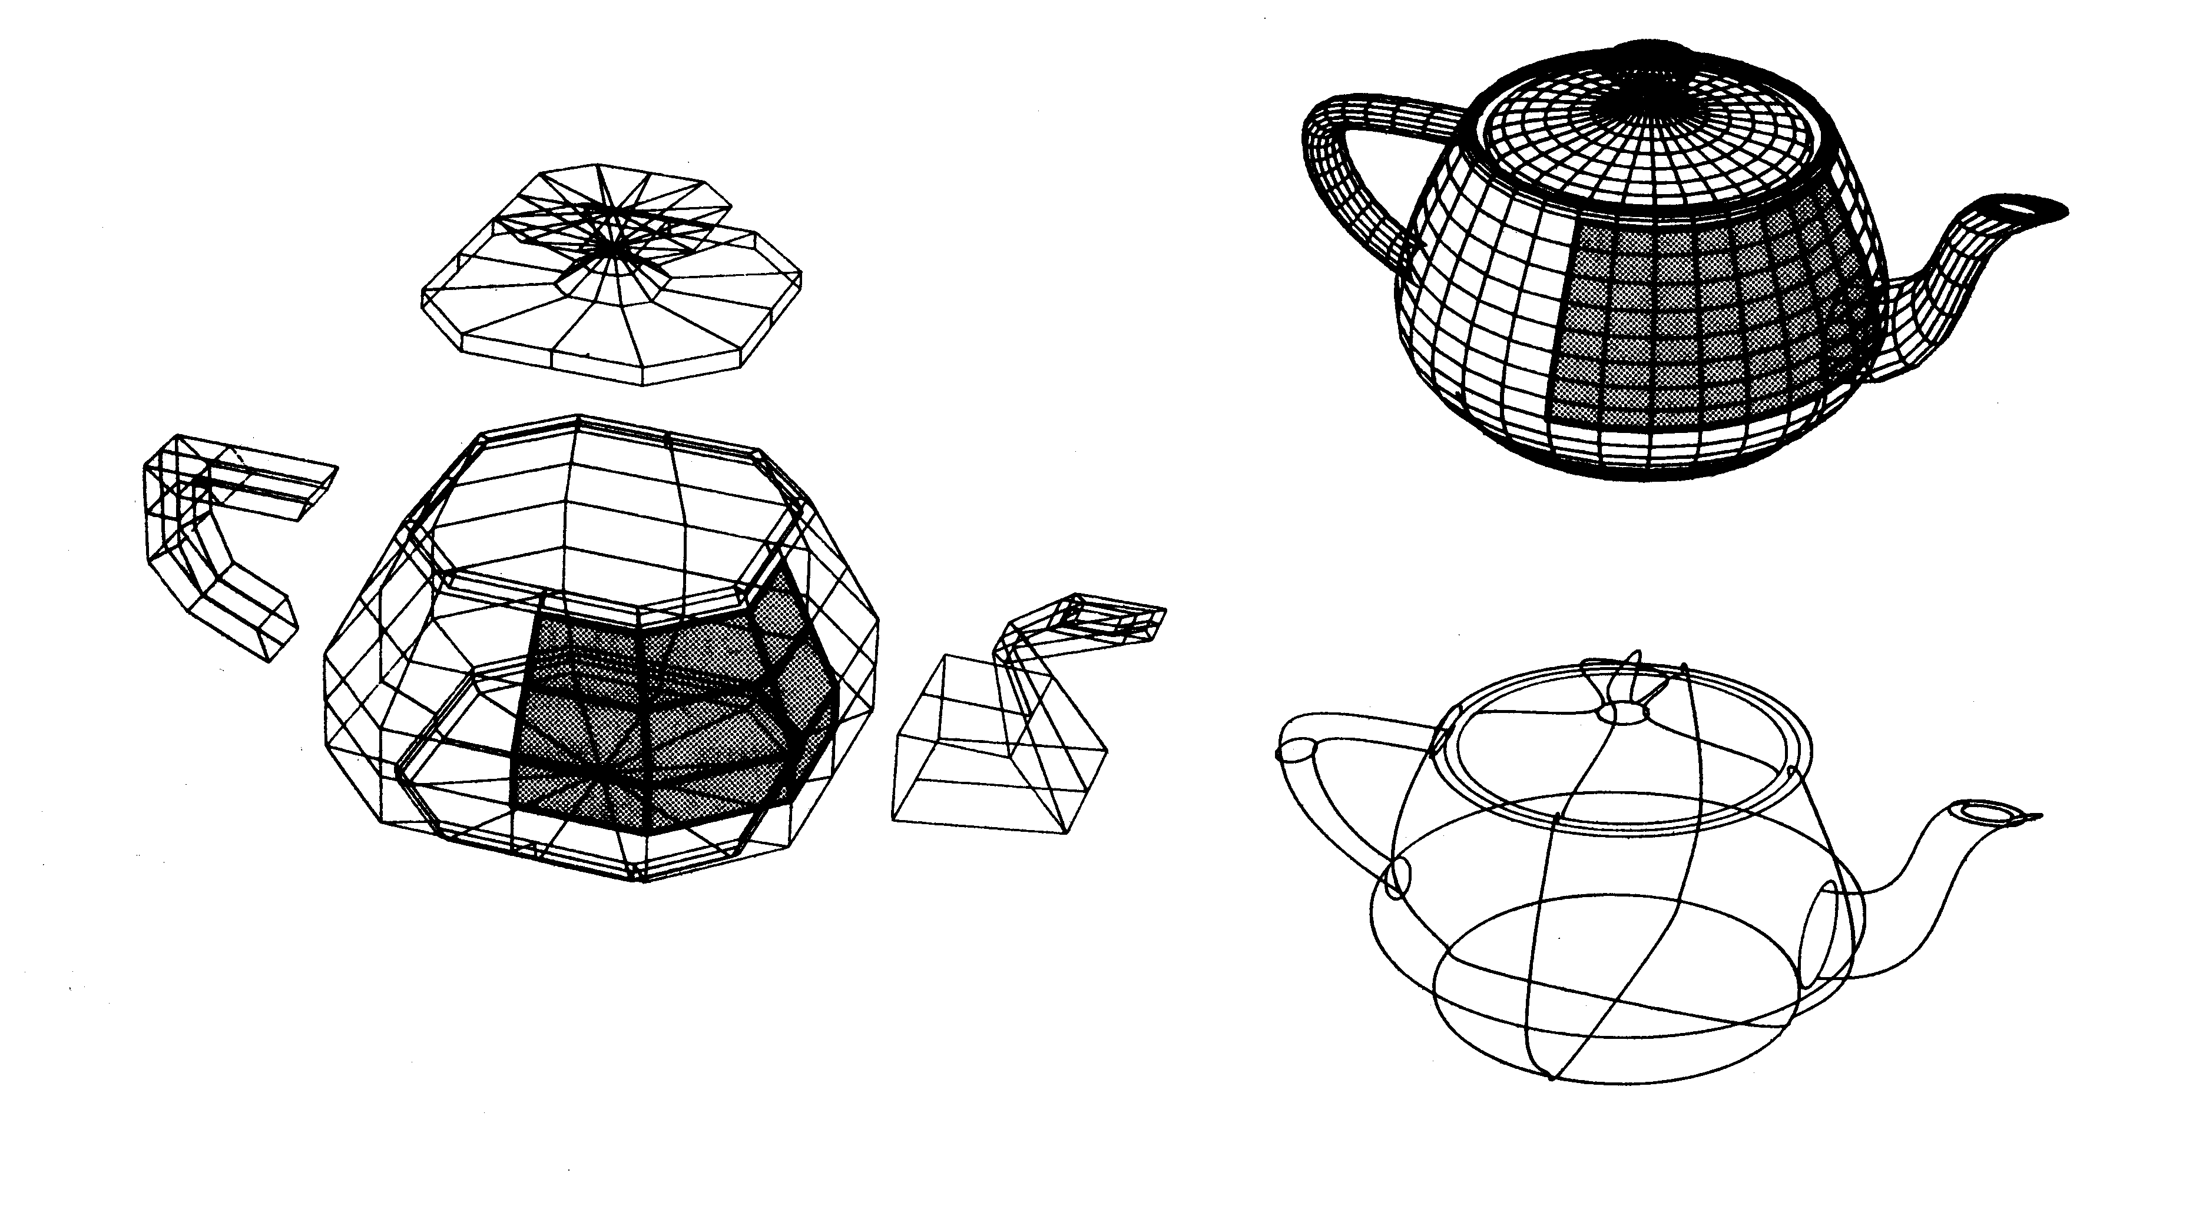
3D Bezier patches – Utah teapot defined at arbitrary positions

Slide 21
3D Bezier patches
Interactive animation at
http://www.nbb.cornell.edu/neurobio/land/OldStudentProjects/cs490-96to97/anson/BezierPatchApplet/

Slide 22

Homework
Given a set of control points
  (0, 6) , (2, -2), (6, 2), (8, 6)
compute Bezier curve with parameter u changing in steps of 0.2.
[For adventurous students]
Given a set of control points
  (0, 6, 3) , (2, -2, -1), (6, 2, 2), (8, 6, -3)
compute 3D Bezier curve with parameters u and v changing in steps of 0.2.

Slide 23
Next lecture
Raster conversion algorithms
Line and circle

Slide 24
Next lecture
Hidden surface removal

