Slide 1
Rendering: Scan-line area fill
The algorithm
Applications

Slide 2
Scan-line algorithms
Purpose: given a set of (2D) vertex coordinates for a polygon, fill the area surrounded by the polygon
Polygons can be filled with a uniform colour or texture

Slide 3
Scan-line algorithms
Essential in rendering, i.e. conversion of geometric entities into image pixels
Used, for example, in
  Display of polygons
  Hidden surface removal
  Texture mapping

Slide 4
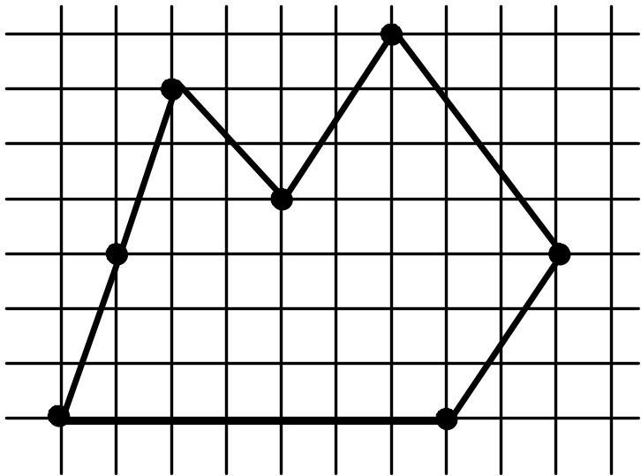
Scan-line algorithm - outline
For each scan line (each y-coordinate)
Compute x coordinates of the intersections of the current scan line with all edges
Sort these edge intersections by increasing x value
Group the edge intersections by pairs (vertex intersections require special processing)
Fill in the pixels on the scan line between pairs of values

Slide 5
Vertex considerations
Do not include edges with zero slope
An extremum vertex - no additional processing
Non-extremum vertex - shorten a second edge by 1 unit in y direction

Slide 6
Parity Check
Draw a horizontal half-line from P to the right.
Count the number of times the half-line crosses an edge.
1 in
4 out
7 in
7 in

Slide 7
Computational structures
Edge table
  One table entry for each scan line which contains at least one “lower” vertex of a polygon edge
  Properties of each edge are stored in a “bucket”
  Table entry consists of an array of buckets
Each bucket contains edges whose minimum y coordinate (ymin) starts at the bucket's line
Each entry is a record containing:
ymax xmin increment
The array of buckets sorted according to ymin
Records in a bucket sorted according to xmin
ymax
1/m
xmin

Slide 8
Polygon Data Structure
Edge record
xmin
ymax
1/m
•
(9, 6)
1
6
8/4
•
xmin = x value at lowest y
ymax = highest y
Why 1/m?
(1, 2)
If y = mx + b, x = (y-b)/m.
x at y+1 = (y+1-b)/m = (y-b)/m + 1/m.

Slide 9
Polygon
Data Structure
13
12
11
10 → e6
9
8
7 → e4 → e5
6 → e3 → e7 → e8
5
4
3
2
1 → e2 → e1 → e11
0 → e10 → e9
Edge Table (ET) has a list of edges for each scan line.
13
e6
10
e5
e3
e7
e4
e8
5
e9
e2
e11
e10
0
e1

Slide 10
Preprocessing the edges
For a closed polygon, there should be an even number of crossings at each scan line.
We fill between each successive pair.
chop lowest pixel to only count once
count twice, once for each edge
delete horizontal edges

Slide 11
Polygon
Data Structure after preprocessing
13
12
11
10 → e6
9
8
7 → e4 → e5
6 → e3 → e7 → e8
5
4
3
2
1 → e2 → e1 → e11
0 → e10 → e9
11 → e6
10
Edge Table (ET) has a list of edges for each scan line.
7 → e3 → e4 → e5
6 → e7 → e8
13
e6
10
e5
e3
e7
e4
e8
5
e9
e2
e11
e11
e10
0
e1

Slide 12
The Algorithm
Start with smallest nonempty y value in ET.
Initialize SLB (Scan Line Bucket) to nil.
While current y ≤ top y value:
  Merge y bucket from ET into SLB; sort on xmin.
  Fill pixels between rounded pairs of x values in SLB.
  Remove edges from SLB whose ytop = current y.
  Increment xmin by 1/m for edges in SLB.
  Increment y by 1.

Slide 13
Algorithm
1 Build edge table
Initialise scan-line list
2 Find first non-empty bucket (ymin) in the edge table
3 While the current ymin not greater than topmost y coordinate of the polygon
3.1 merge the edge table for the current ymin with scan-line list, sort on increasing xmin
3.2 fill pixels between pairs of rounded xmin-s
3.3 Remove from the scan-line list the edges whose ymax = current scanline
3.4 increment xmin by the increment (1/m) for remaining edges in the scan list
3.5 re-sort scan line list on increasing xmin
3.6 increment current scanline ymin to give next scanline

Slide 14
Running the Algorithm
ET
13
12
11 → e6
10
9
8
7 → e3 → e4 → e5
6 → e7 → e8
5
4
3
2
1 → e2 → e11
0 → e10 → e9
xmin ymax 1/m
e2 2 6 -2/5
e3 1/3 12 1/3
e4 4 12 -2/5
e5 4 13 0
e6 6 2/3 13 -4/3
e7 10 10 -1/2
e8 10 8 2
e9 11 8 3/8
e10 11 4 -3/4
e11 6 4 2/3
13
e6
10
e5
e3
e7
e4
e8
5
e9
e2
e11
e10
0
0
5
10
15

Slide 15
Running the Algorithm
y=0
SCB→
e10
13
e6
10 1/4
11
4
-3/4
•
10
e5
e3
e7
e9
e4
e8
11
8
3/8
•
11 3/8
5
e9
e2
e11
e10
0
0
5
10
15

Slide 16
Running the Algorithm
y=1
SLB→
e2
13
e6
1 3/5
2
6
-2/5
•
10
e5
e3
e7
e11
e4
e8
6
6 2/3
4
2/3
•
5
e9
e10
e2
e11
9 1/2
10 1/4
4
-3/4
•
e10
0
e9
0
5
10
15
11 6/8
8
3/8
•
11 3/8

Slide 17
Running the Algorithm
y=2
SLB→
e2
13
e6
1 1/5
1 3/5
6
-2/5
•
10
e5
e3
e7
e11
e4
e8
6 2/3
7 1/3
4
2/3
•
5
e9
e10
e2
e11
8 3/4
9 1/2
4
-3/4
•
e10
0
e9
0
5
10
15
12 1/8
11 6/8
8
3/8
•

Slide 18
Running the Algorithm
y=3
SLB→
e2
13
e6
1 1/5
4/5
6
-2/5
•
10
e5
e3
e7
e11
e4
e8
7 1/3
4
2/3
•
8
5
e9
e10
e2
e11
8
8 3/4
4
-3/4
•
e10
0
e9
0
5
10
15
12 1/8
8
3/8
•
12 4/8

Slide 19
Running the Algorithm
y=4
SLB→
e2
13
e6
4/5
6
-2/5
•
10
e5
e3
e7
e11
e4
e8
8
4
2/3
•
5
e9
e10
e2
e11
8
4
-3/4
•
e10
0
e9
0
5
10
15
12 4/8
8
3/8
•
Remove these edges.

Slide 20
Running the Algorithm
y=4
SLB→
e2
13
e6
4/5
6
-2/5
•
2/5
10
e5
e3
e7
e9
e4
e8
12 7/8
12 4/8
8
3/8
•
5
e9
e11 and e10 are removed.
e2
e11
e10
0
0
5
10
15

Slide 21
Running the Algorithm
y=5
SLB→
e2
13
e6
2/5
6
-2/5
•
0
10
e5
e3
e7
e9
e4
e8
12 7/8
8
3/8
•
13 2/8
5
e9
e2
e11
e10
0
0
5
10
15

Slide 22
Running the Algorithm
Remove this edge.
y=6
SLB→
e2
13
e6
0
6
-2/5
•
10
e5
e3
e7
e7
e4
e8
9 1/2
10
10
-1/2
•
5
e9
e8
e2
e11
12
10
8
2
•
e10
0
e9
0
5
10
15
13 2/8
8
3/8
•
13 5/8

Slide 23
Running the Algorithm
Add these edges.
e3
1/3
12
1/3
•
e4
4
12
-2/5
•
13
e6
e5
10
e3
e5
e7
4
13
0
•
e4
e8
y=7
SLB→
e7
5
9 1/2
10
-1/2
•
e9
e2
e11
e8
e10
0
12
8
2
•
0
5
10
15
e9
13 5/8
8
3/8
•

Slide 24
Scan line algorithm
The algorithm provides a method for computing locations of individual pixels in a 2D display
  E.g. hidden surface removal methods
The pixel colours are computed using other algorithms, e.g.
  Shading (flat, Gouraud, Phong)
  Texturing
The algorithm is efficient because it incorporates some coherence properties of the polygons (i.e. direction and slope of each edge)

Slide 25
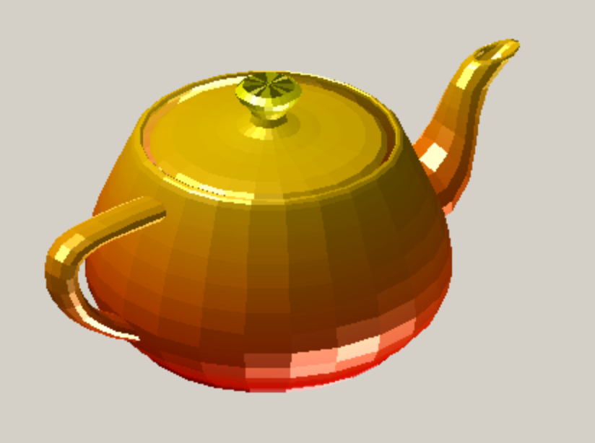

Polygon display
Flat shading
Phong shading

Slide 26
Hidden surface removal
  Z-buffer algorithm
  for x increments, along each
  scan line x+1, y):
  z' = z - A/C
  for y increments,
  for each new scan line (x, y+1):
  z" = z + B/C
Z
Y
X
Projection plane
Scan-line method
Each scan line is processed
list of edges (of ALL polygons) crossing a current line sorted in order of increasing x
...
Y
B
E
F
A
H
C
D
G
X

Slide 27
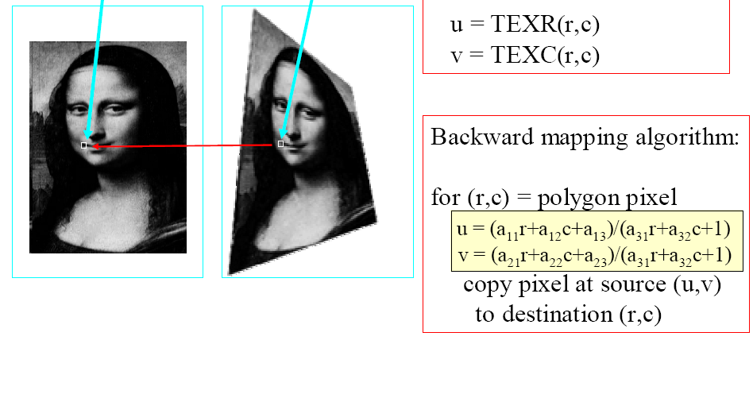
Texture mapping

Slide 28
Credits
The animations copied from Prof. Harriet Fell’s lecture slides, College of Computer and Information Science, Northeastern University

Slide 29
Next lecture
Hidden surface removal

