Slide 1
Hidden surface removal
Object-space approach
Image-space approach
Depth-sorting methods
Scan-line methods
Depth buffer methods

Slide 2
Visible surface determination
An opaque cube has at most 3 sides visible
Problems to solve:
Which sides are visible from a given viewpoint? Which are hidden?
How to make the rendering efficient?

Slide 3
Visible surface determination
An opaque cube has at most 3 sides visible
Problems to solve:
Which sides are visible from a given viewpoint? Which are hidden?
How to make the rendering efficient?

Slide 4
Cases for hidden surface removal
Occluded surfaces (partially or fully)
Back faces

Slide 5
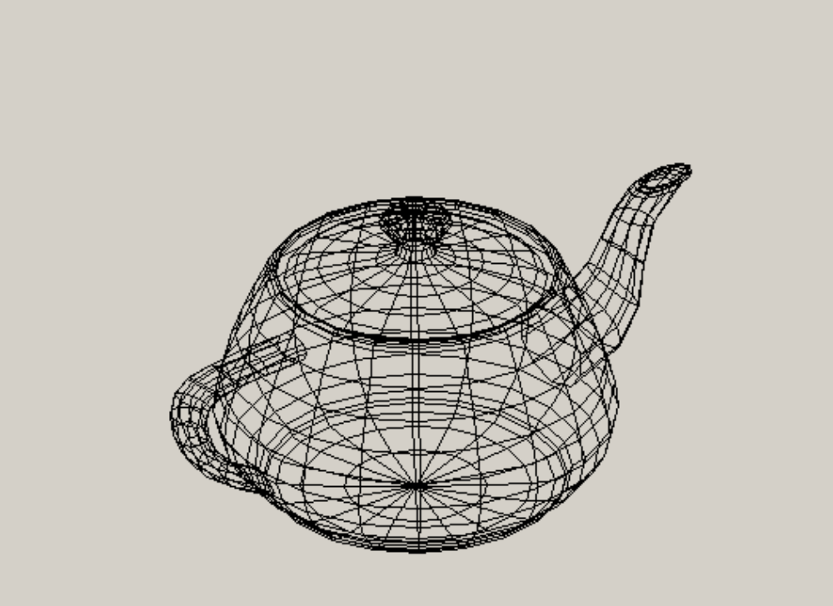
Utah Teapot - wireframe

Slide 6
Utah Teapot - wireframe

Slide 7
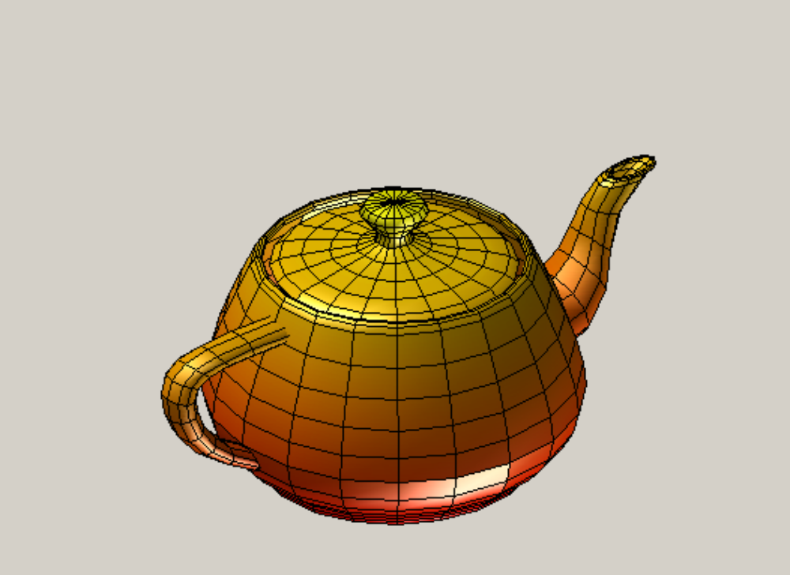
Utah Teapot – surface rendering - outside

Slide 8
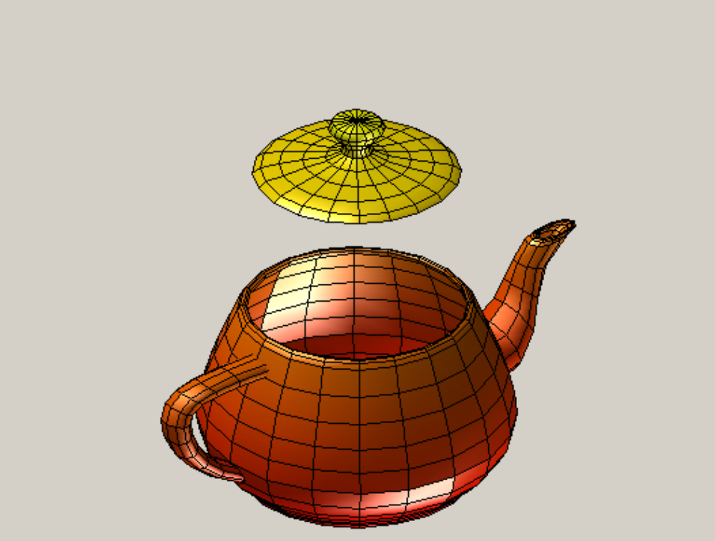
Utah Teapot – surface rendering – inside and outside

Slide 9
Two classes of algorithms
Object-space (OS)
  Operates on 3D object entities (vertices, edges, surfaces)
Image space (IS)
  Operates on 2D images (pixels)
Operations normally applied to polygonal representations of objects (e.g. triangulated surfaces)

Slide 10
Back face removal (Polygon culling): OS
Principles
  Remove all surfaces pointing away from the viewer
  Eliminate the surface if it is completely obscured by other surfaces in front of it
  Render only the visible surfaces facing the viewer

Slide 11
How to determine which surfaces face away from the viewer?
Compute vector N normal to a surface patch (e.g. a triangle)
In the right-handed coordinate system a surface facing away from the viewer (i.e. not visible) will have negative value of z-coordinate of the normal vector: N_{Z}<0
  Details were discussed in lecture “Object rendering”

Slide 12
How to determine which surfaces face away from the viewer?
Compute vector N normal to the face (normally a triangle)
Surface facing away from the viewer will have negative value of z-coordinate of the normal vector: N_{Z}<0
IMPORTANT: In the left-handed coordinate system vertices must be traversed counter-clockwise

Slide 13
How to determine which surfaces face away from the viewer?
Based on the equation of a plane
Ax + By + Cz + D = 0
Vector normal to the plane: N = [ A B C ]
C > 0 : surface facing towards the viewer
C < 0 : surface facing away from the viewer

Slide 14
How to determine which surfaces face away from the viewer?
Derivation: based on the equation of the plane passing through three points:
P1=(x₁, y₁, z₁) P2= (x₂, y₂, z₂) P3=(x₃, y₃, z₃)
x – x₁ y₁ – y₁ z – z₁
x₂ – x₁ y₂ – y₁ z₂ – x₁ = 0
x₃ – x₁ y₃ – y₁ z₃ – x₁
Equivalent to: Ax + By + Cz +D = 0
where
C = (x2 – x1)*(y3 – y1) – (x3 – x1)*(y2 – y1)

Slide 15
How to determine which surfaces face away from the viewer?
Derivation
C = (x₂ – x₁)*(y₃ – y₁) – (x₃ – x₁)*(y₂ – y₁)
= V1 ^{x} V2 (cross-product)
P3
V2 WRONG!
V2
Geometric interpretation
P1
P2
V1

Slide 16
Back face removal (Polygon culling)
Algorithm
  Compute 3D coordinates of the object in the camera coordinate system
  For each surface patch compute the normal vector N
  If the z-coordinate of the normal vector N_{z} < 0 the surface patch does not need to be displayed
Advantages / problems
  Speeds up rendering
  Works only for convex objects

Slide 17
Back face removal (Polygon culling)
N<0
Nz<0

Slide 18
Back face removal (Polygon culling)
Nz<0

Slide 19
Painter's algorithm (depth sorting method): OS/IS
Surfaces sorted in order of increasing depth in 3D
Surfaces drawn starting with the surface of greatest depth (largest Z-coordinate)
Surfaces with smaller depth are "painted over" surfaces that are already scan-converted.

Slide 20
Painter's algorithm
Example for a cube

Slide 21
Painter's algorithm
Example for a cube

Slide 22
Painter's algorithm
X
Steps of the algorithm
Order surfaces according to the largest z value
Select surface with the greatest depth
Select next greatest-depth surface
If no depth overlap occurs - paint the surfaces
Z
No depth overlap

Slide 23
Painter's algorithm
X
If depth overlap then carry out a number of tests to establish whether surface projections (X and Y) overlap
  For detail see Hearn & Baker
Z
Depth overlap
No X projection overlap

Slide 24
Painter's algorithm
X
If depth overlap then carry out a number of tests to establish whether surface projections (X and Y) overlap
  For detail see Hearn & Baker
If all tests fail, swap the order in which surfaces are painted
Z
Depth overlap
X projection overlap

Slide 25
Painter's algorithm
Advantages:
  Very good if a valid order is easy to establish; not so good for more complex surface topolgies (e.g. presence of holes)
  For simple cases very easy to implement
  Fits well with the rendering pipeline
Problems
  Not very efficient – all polygons are rendered, even when they become invisible
  Complex processing (sorting + tests) for complex objects
  There could be no solution for sorting order
  Possibility of an infinite loop as surface order is swapped

Slide 26
Painter's algorithm
A
B
D
E
G
F
C
No solution for sorting order

Slide 27
Z-buffer algorithm (IS)
Test visibility of surfaces one point at a time
The surface with the z-coordinate closest to VRP is visible (largest z in RH coordinate sytem; smallest z in LH coordinate system)
Two storage areas required:
  depth buffer - z value for each pixel at (x,y)
  display buffer – pixel value (colour) for each pixel at (x,y)

Slide 28
Z-buffer algorithm
Z
Y
Projection plane
X

Slide 29
Z-buffer algorithm
fill z_buffer with
“infinite” distance (in LH coordinate system)
for each polygon
compute 2D projections (rasterize)
for each pixel (x,y) inside the rasterized polygon
calculate z-value (see next slide)
if z(x,y) is closer than z_buffer(x,y)
set display_buffer(x,y)=polygon colour at (x,y)
set z_buffer(x,y)=polygon z(x,y)
end
end
end

Slide 30
Z-buffer algorithm – computing depth
Depth values can be evaluated iteratively using the plane equation (Ax + By + Cz + D = 0 see next slide)
  for x increments, along each scan line
(x+1, y):
z' = z - A/C
  for y increments, for each new scan line
(x, y+1):
z" = z – (A/m+B)/C

Slide 31
Compute A, B and C from the plane equation
Construct the equation of the plane passing through three points:
P1=(x₁, y₁, z₁) P2= (x₂, y₂, z₂) P3=(x₃, y₃, z₃)
x – x₁ y – y₁ z – z₁
x₂ – x₁ y₂ – y₁ z₂ – z₁ = 0
x₃ – x₁ y₃ – y₁ z₃ – z₁
Equivalent to: Ax + By + Cz +D = 0
e.g.
C = (x2 – x1)*(y3 – y1) – (x3 – x1)*(y2 – y1)

Slide 32
Z-buffer algorithm
Advantages
  Easy to implement
  Fits well with the rendering pipeline
  Can be implemented in hardware
  Always correct results
Problems
  Some inefficiency as pixels in polygons nearer the viewer will be drawn over polygons at greater depth
It is a standard in many graphics packages (e.g. Open GL)

Slide 33
Other methods
Scan-line method (IS)
Each scan line is processed
list of edges (of ALL polygons) crossing a current line sorted in order of increasing x
on/off flag for each surface
depth sorting is necessary if multiple flags are on
uses coherence along the scan lines to prevent unnecessary sorting
Necessary to divide surfaces with multiple visibility

Slide 34
Other methods
Scan-line method (IS)
Y
B
E
F
A
H
C
D
G
X

Slide 35
Other methods
Scan-line method (IS)
Y
B
E
F
A
H
C
D
G
X

Slide 36
Other methods
Area subdivision method (used also in ray tracing)
Locate view areas (normally squares or rectangles) which represent a part of a single surface
This is done by successively dividing the total view area into smaller rectangles
Stop dividing a given rectangle when it contains a single surface or visibility precedence can be easily determined

Slide 37
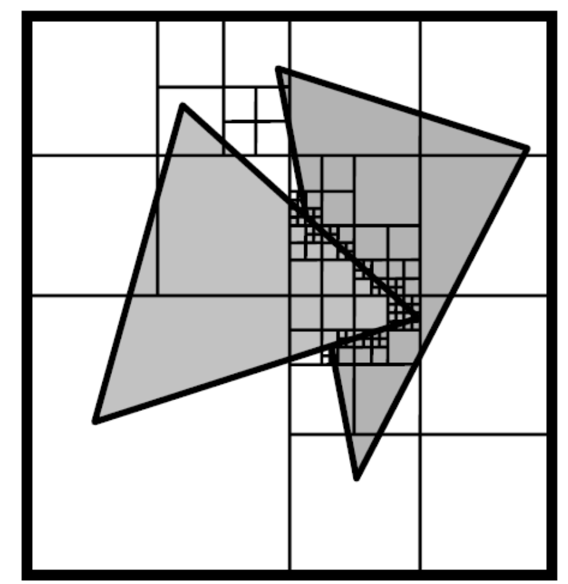
Other methods
Area subdivision method

Slide 38
Recommendations for hidden surface methods
Surfaces are distributed in z | Depth sorting
Surfaces are well separated in y | Scan-line or area-subdivision
Only a few surfaces present | Depth sorting or scan-line
Scene with at least a few thousand surfaces | Depth-buffer method or area-subdivision

Slide 39

Homework
Implement a z-buffer algorithm for a cube with vertices as shown below, viewed from VRP=(30,20,-30) and viewing distance D=15 <TARGET POINT NEEDED>
Vertices:
(0,0,10)
(10,0,10)
(10,0,20)
(0,10,20)
(0,10,10)
(10,10,10)
(10,10,20)
(0,10,20)

Slide 40
Next lecture
Texture mapping

