Slide 1
Adding realism
Overview of further methods
Warping and free-form deformation
Ray tracing
Particle systems

Slide 2
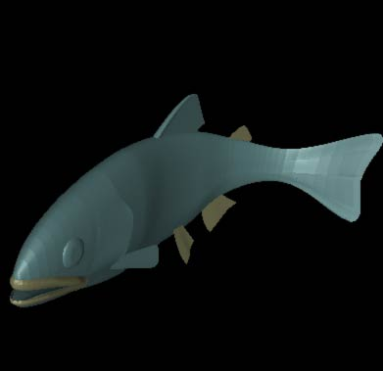
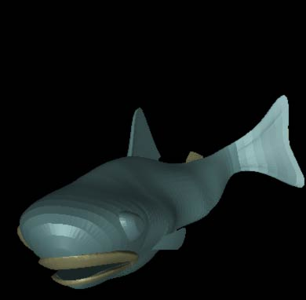
Warping and free-form deformation
http://lgm.fri.uni-lj.si/RG/KRIVLJENJE_3D/3D_krivljenje.ppt

Slide 3
Warping and free-form deformation
Free-Form Deformation (FFD) is a technique for modelling 3D deformable objects
FFDs are defined by a mesh of control points with uniform spacing
An underlying object is deformed by manipulating a mesh of control points
  control point can be displaced from their original location
  control points provide a parameterization of the transformation

Slide 4
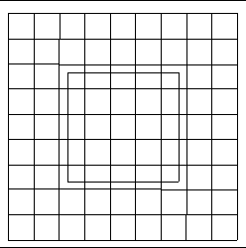
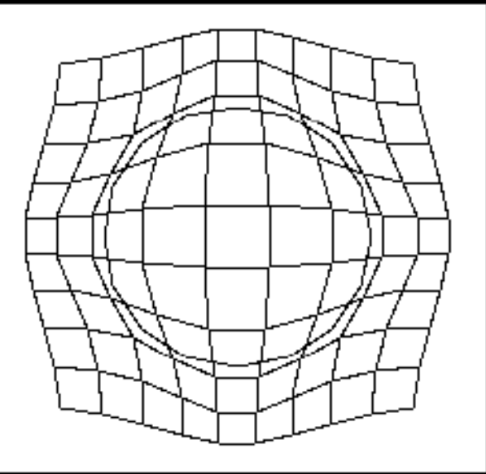
Warping and free-form deformation
Define a mesh around an object
Deform the mesh at all the nodes as required.
Then interpolate the deformation for all the object vertices and pixels

Slide 5
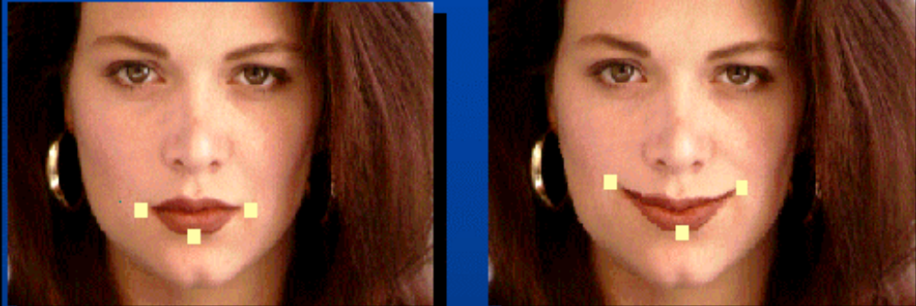
Warping and free-form deformation
2D

Slide 6
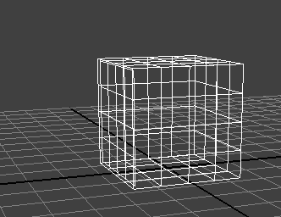
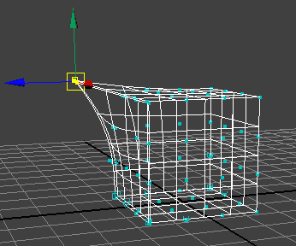
Warping and free-form deformation
3D
Define a mesh around an object
Deform the mesh at all the nodes as required.
Then interpolate the deformation for all the object vertices and pixels
(c.f. Gouraud or Phong method)

Slide 7
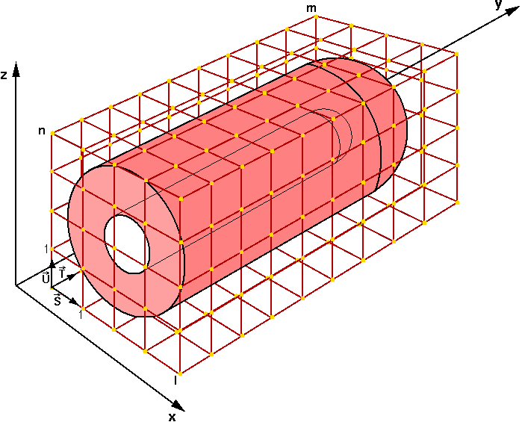
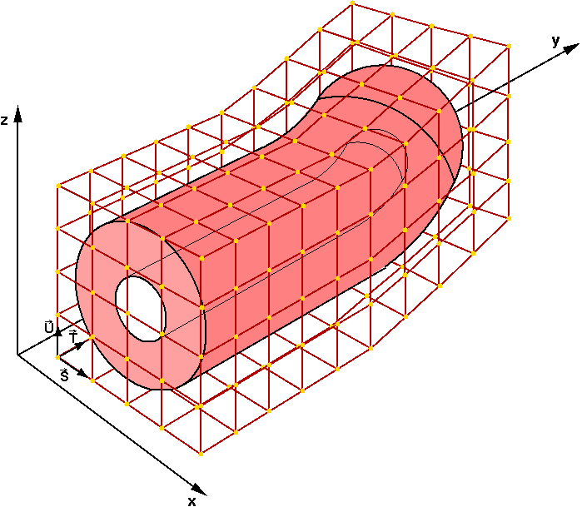
Warping and free-form deformation
3D

Slide 8
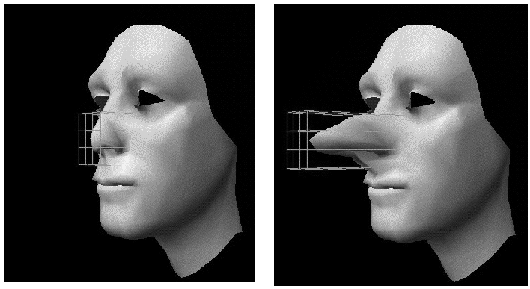
Warping and free-form deformation
3D

Slide 9
Ray tracing
Ray tracing is one of the most popular methods used in 3D computer graphics to render an image
It works by tracing the path taken by a ray of light through the scene, and calculating reflection, refraction, or absorption of the ray whenever it intersects an object in the world
Adds more realism to the rendered scene by allowing effects such as
  shadows
  transparency
  reflections and self-reflections

Slide 10
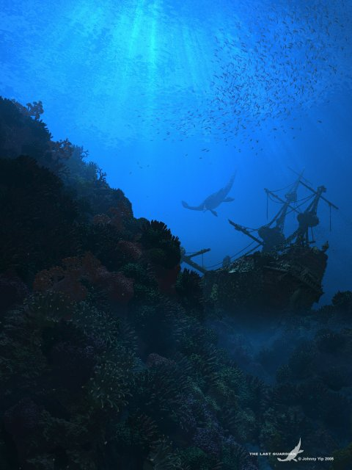

Slide 11
Ray tracing
General scheme
For each pixel on the screen, a ray is defined by the line joining the viewpoint and the pixel of the viewing plane (perspective projection) or by a line orthogonal to the viewing place
Each ray is cast through the viewing volume and checked for intersections with the objects inside the viewing volume

Slide 12
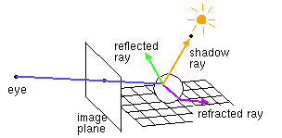
Ray tracing

Slide 13
Ray tracing
In practice a ray of light is traced in a backwards direction
We start from the eye or camera and trace the ray through a pixel in the image plane into the scene and determine what it hits
The pixel is then set to the colour values returned by the ray
Each ray that hits an object can spawn other rays (reflected ray & refracted ray)

Slide 14
Ray tracing
Backward ray tracing
Follow light rays backward from the camera.
Only one ray for each pixel.
When (if) the backward ray hits an object, determine the intensity of light and colour coming from the object at the intersection point.

Slide 15
Ray tracing
Backward ray tracing (cont)
If the object is a light source, this is straightforward.
Otherwise:
  Recursively trace a new backward ray reflected by the surface.
  Recursively trace a new backward ray from the intersection point to each light source on the ”strike side” of the surface. That light source will contribute to the illumination of the intersection point.
  The amount of light reaching the pixel depends on the angle of the ray to the surface, as well as absorption and refraction properties of the surface.
    The light colour will be affected by the surface colour.

Slide 16
Ray tracing
Primary rays
Primary rays are rays from the viewpoint to the nearest intersection point
For each ray we need to test which objects are intersecting the ray:
  If the object has an intersection with the ray we calculate the distance between viewpoint and intersection
  If the ray has more than one intersection, the smallest distance identifies the visible surface
We compute the colour as discussed in an earlier lecture:
I = K_{a} I_{a} + K_{d} I_{d} cos θ_{d} + K_{s} I_{s} (cos θ_{s})^{n}

Slide 17
Ray tracing
Secondary rays
Secondary rays are rays originating at the intersection points
Secondary rays are caused by
  rays reflected off the intersection point in the direction of reflection
  rays transmitted through transparent materials in the direction of refraction

Slide 18
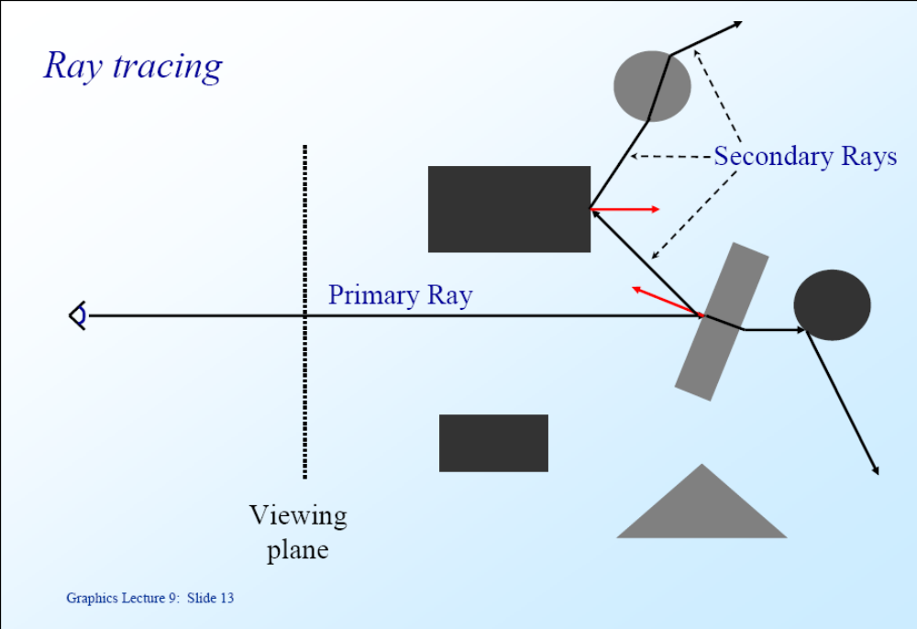

Slide 19
Ray tracing - calculations
For each ray we must
  Calculate all possible intersections with each object inside the viewing volume
  Find the nearest intersection point
The scene can be defined using
  Solid models, e.g.
    Sphere
    Cylinder
  Surface models, e.g.
    planes
    triangles
    polygons
    Bézier patches

Slide 20
Ray tracing - calculations
Rays
Rays are parametric lines
Can be defined by
  origin p₀
  direction d
Equation of ray:
p = p₀ + μd
d
p₀

Slide 21
Ray tracing - calculations
Calculating Intersection
The viewing ray can be parameterized by μ:
  μ > 0 denotes the part of the ray behind the viewing plane
  μ < 0 denotes the part of the ray in front of the viewing plane
For any visible intersection point μ > 0
d
μ < 0
μ > 0
p₀

Slide 22
Ray tracing - calculations
We now have to calculate the point of intersection of each ray with each surface on its path
Different surface representations require different solutions. See the website below for equations for sphere, cylinder, plane and triangle
http://www.doc.ic.ac.uk/~dfg/graphics/graphics2009/GraphicsLecture10.pdf
http://www.doc.ic.ac.uk/~dfg/graphics/graphics2009/GraphicsLecture11.pdf

Slide 23
Ray tracing – speeding up the calculations
Ray tracing is computationally very demanding
Various methods exist to speed up the calculations
The most common are
  Finding bounding boxes (2D)
  Finding bounding volumes (3D)
  Limiting the number of interactions that any ray has with objects in the scene
We first determine “chunks” of image or space which contains object projections (2D) or objects (3D)
We only “fire” rays at the non-empty chunks

Slide 24
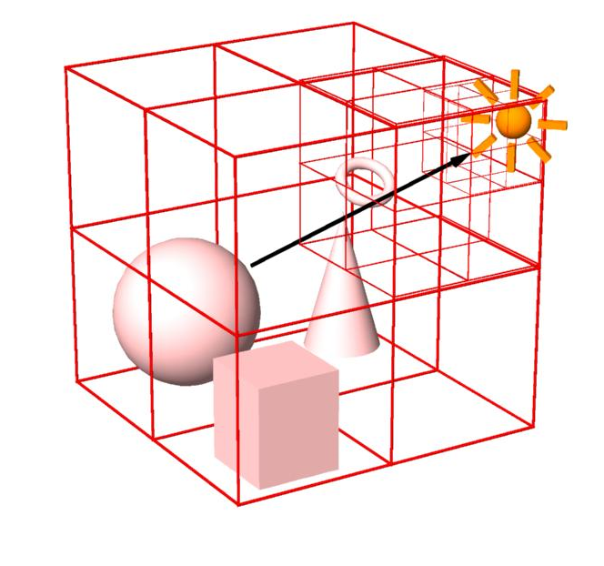
Ray tracing – speeding up the calculations
Bounding Volumes
  Enclose groups of objects in sets of hierarchical bounding volumes (Octree)
  First test for intersection with the bounding volume
  Then only if there is an intersection, against the objects enclosed by the volume.

Slide 25


Slide 26
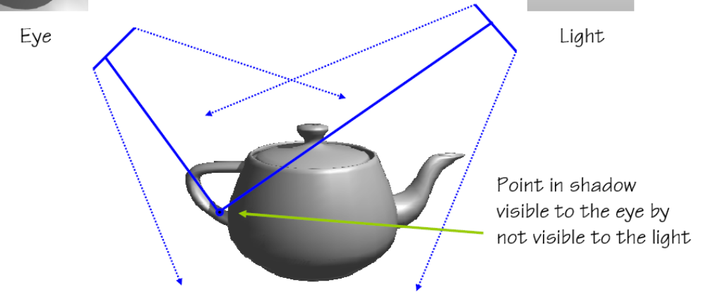
Shadow maps

Slide 27
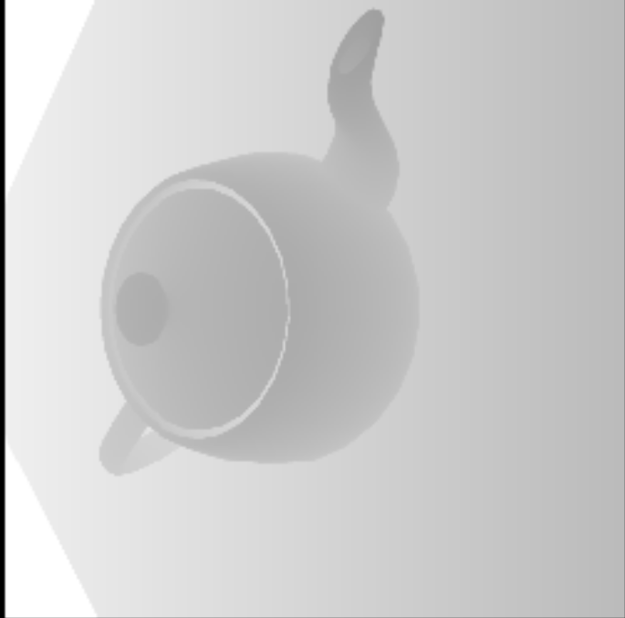
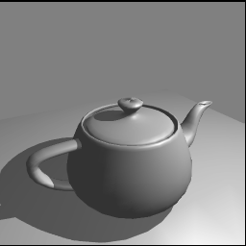
Shadow maps
http://www.cs.unc.edu/~blloyd/comp770/Lecture12.pdf

Slide 28
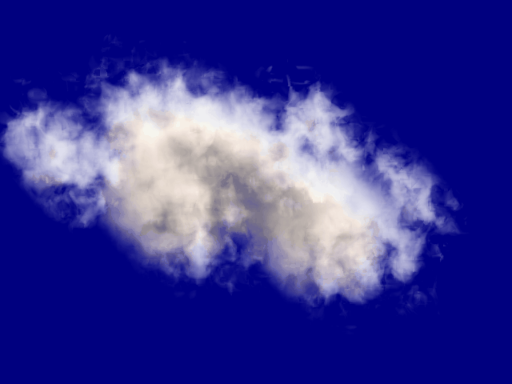
Particle systems
Used to simulate amorphous (shapeless) objects, e.g.
  Fire,
  Smoke
  Water
  Clouds
http://cobweb.ecn.purdue.edu/~ebertd/635/Sp99/notes/Images/cloud_big.gif

Slide 29
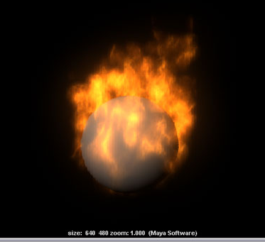
Particle systems
Amorphous objects are simulated by a discrete set of small particles
Particles can have:
  Mass
  Position
  Velocity
  Temperature
  Shape (a sprite)
  Lifetime
http://media.wiley.com/assets/430/48/0-07645-8789-7_1502.jpg

Slide 30
Particle systems
Particles can be created according to a probability distribution
They can be given an initial velocity and a lifetime
Depending on the simulation their movement can be determined by dynamics

Slide 31
Particle system dynamics
Newtonian particles:
  f = m a (f and a are vectors)
  a = dv/dt = d²x/dt²
Given f we need to find the change in position x
Since we are working in frame intervals we can use a simple approximation
  v_{t+1} = a_{t} Δt + v_{t}
  x_{t+1} = v_{t} Δt + x_{t}

Slide 32
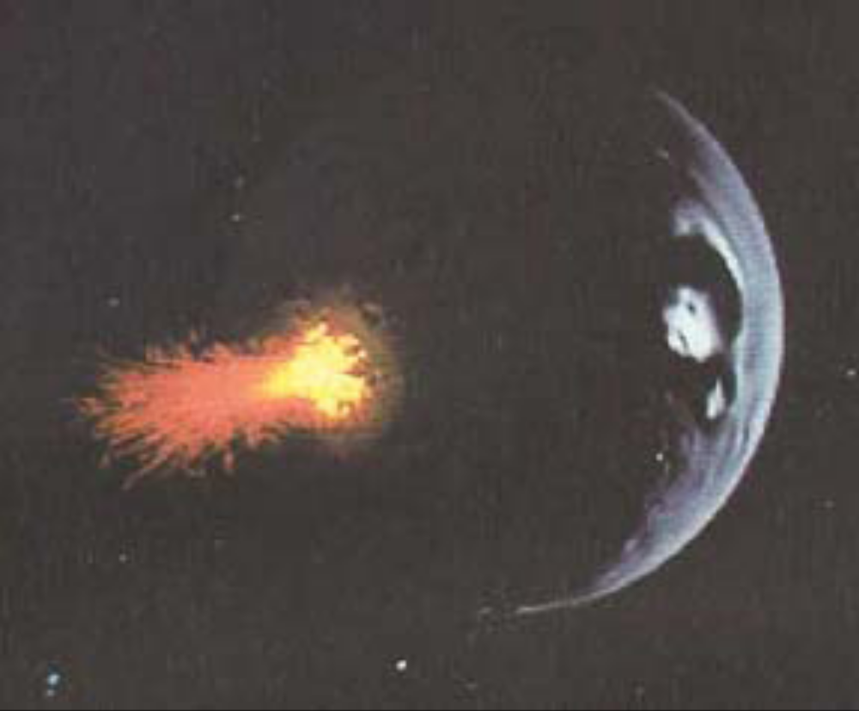
Particle systems

Slide 33
Credits
This presentation has used slides from various web sources, including:
  http://lgm.fri.uni-lj.si/RG/KRIVLJENJE_3D/3D_krivljenje.ppt
  http://www.doc.ic.ac.uk/~dfg/graphics/
  http://www.utm.utoronto.ca/~arnold/320/04s/lectures/16/lecture-16.pdf
  http://www.cs.drexel.edu/~david/Classes/CS431/Lectures/CGII_Pres7.pdf
  http://www.cs.unc.edu/~blloyd/comp770/Lecture12.pdf
  http://hof.povray.org/
  http://www.cs.otago.ac.nz/cosc342/2004-342/Textures2.pp4.pdf
  http://www.avl.iu.edu/~ewernert/b581/lectures/15.1/bumpmap1.jpg
  http://cobweb.ecn.purdue.edu/~ebertd/635/Sp99/notes/Images/cloud_big.gif

Slide 34

Merry Christmas
http://hof.povray.org/

Slide 35
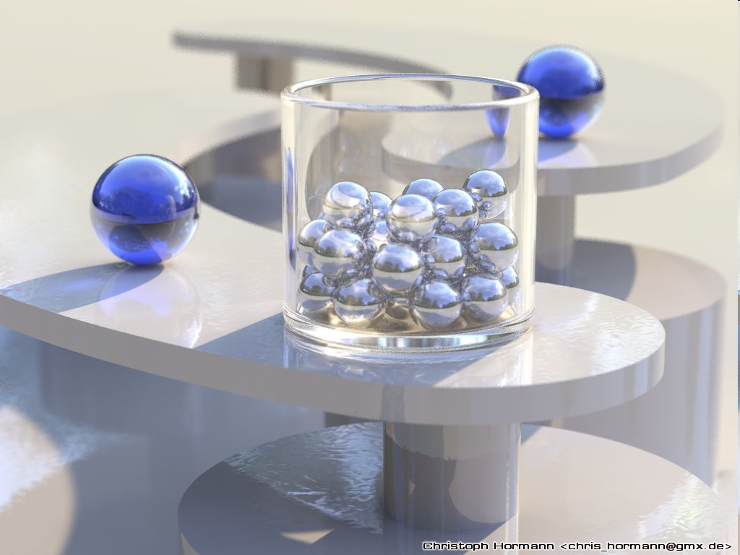
http://hof.povray.org/

Slide 36
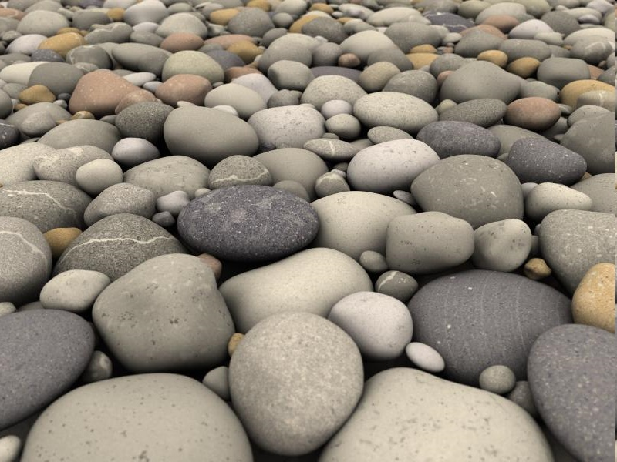
http://hof.povray.org/

Slide 37
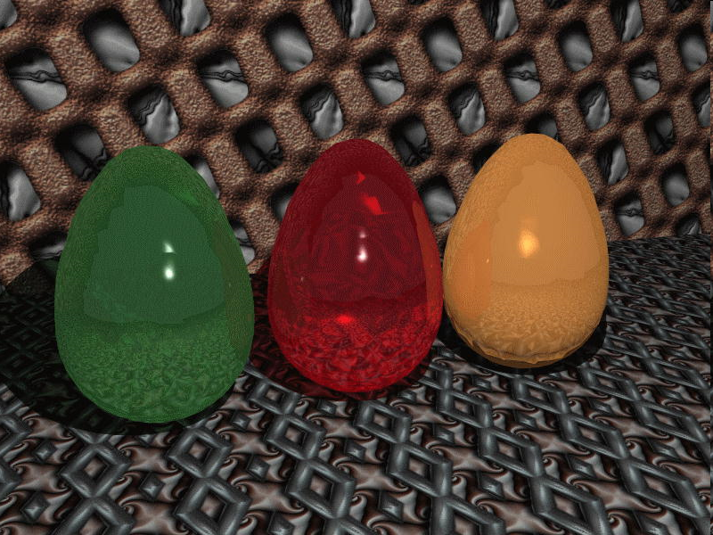
http://hof.povray.org/

