Slide 1
Illumination and shading
(1)
Adding “reality” to images
Light sources and lighting models
Surface properties

Slide 2
Illumination and shading
Adding “reality” to images
Light sources and lighting models
Surface properties
Shading algorithms
Flat
Gouraud
Phong

Slide 3

Rendering: setting up the scene
Given
  Object surfaces
  Light sources
  Camera
Compute
  Colour of each pixel on the screen
  This is colour that bounces off the surface point and goes in the direction of the camera (viewer)

Slide 4
Light
Sources
  Ambient
  Directional: diffuse
  Directional: point source
  Divergence
Location
  w.r.t object
  w.r.t. camera
Colour

Slide 5
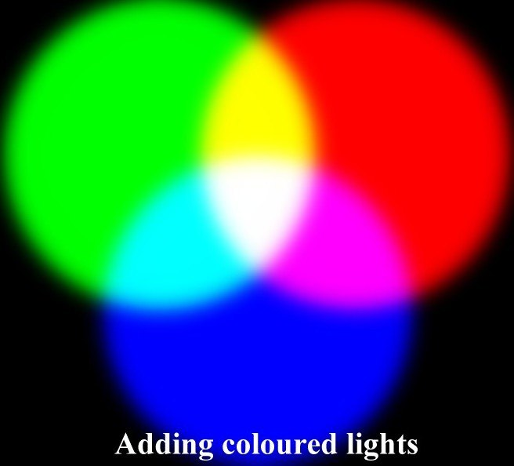
Colour: the basics
Colour can be represented by a three-dimensional vector [R G B] of three primary colours (“primaries”):
  Red (R)
  Green (G)
  Blue (B)
Other colours can be represented by a mixture of the three primaries

Slide 6
RGB – an additive system
K=[0 0 0]
Y=R+G=[1 1 0]
G=[0 1 0]
R=[1 0 0]
C=G+B=[0 1 1]
M=R+B=[1 0 1]
W=[1 1 1]
B=[0 0 1]

Slide 7
Inputs to computation
Light sources (emitters)
  Colour (emission spectrum)
  Geometry (position and direction)
  Directional attenuation
Surfaces (reflectors)
  Colour (reflectance and absorption spectrum of the material)
  Geometry (position, orientation of each surface patch)
  Micro-structure

Slide 8
Light sources
Ambient light
  Global, background light
  No spatial of directional characteristics - seems to come from all directions
  Makes objects visible
  Does not depend on the orientation or position of a surface
  Does not depend on the orientation or position of a camera
  Does not have diffuse or specular reflection components

Slide 9

Light sources
Diffuse Light – parallel
  Has parallel light rays that travel in one direction along the specified vector (e.g. sunlight)
  Contributes to diffuse and specular reflections, which depend on the orientation of an object's surface (with respect to light direction vector) but not its position

Slide 10

Light sources
Diffuse Light – point source
  Light source located at a fixed point in space (e.g. light bulb)
  Radiates light equally in all directions away from the light source
  Light is attenuated as a function of distance, i.e. its brightness decreases as distance from the light source increases
  The rate of decrease is defined by an attenuation factor
  Contributes to diffuse and specular reflections, which depend on the orientation and position of a surface

Slide 11

Light sources
Spot Light
  Light source located at a fixed point in space (e.g. light bulb)
  Light radiating from the source forms a cone defined by a vector in a particular direction and by the angle determining its spread
  Light is attenuated as a function of distance, i.e. its brightness decreases as distance from the light source increases (defined by an attenuation factor)
  Contributes to diffuse and specular reflections, which depend on the orientation and position of a surface

Slide 12
Surfaces
Reminder
Properties
  Geometry (position, orientation of each surface patch)
  Colour (reflectance and absorption spectrum of the material)
  Micro-structure

Slide 13
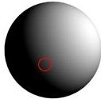
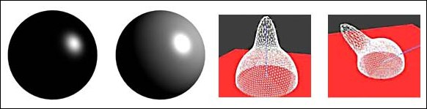
Surfaces
Reminder
Micro-structure
  Defines reflectance properties
Reflectance
  Diffuse: Matte surfaces
  Specular: Shiny surfaces
+

Slide 14
Computing reflectance: shading model
Requires
  Surface geometry, microstructure and colour
  Positions and type of light sources
  Position of the viewer (camera)
Combines the three contributions:
  Ambient light
  Diffuse reflectance
  Specular reflectance
Pixel colour: Ambient + Diffuse + Specular

Slide 15
Shading model
Ambient term: colour
Colour / intensity of ambient light: I_{a}
  Colour is normally assumed white, i.e. I_{a} =[1.0, 1.0, 1.0];
Object colour: ambient coefficient K_{a}
  Represents the reflectivity of ambient light
  0 < K_{a} < 1; 0: no reflectivity; 1: full reflectivity
Complete ambient term: A = K_{a} I_{a}

Slide 16

Shading model
Ambient term: reflectance
  No physical interpretation
  Does not depend on light position
  Looks the same seen from anywhere
Increasing K_{a}

Slide 17
Shading model
Diffuse term: Reflectance
Object surface: Lambertian (matte)
  Light reflected equally in every direction
  The amount of light reflected depends on the angle between the direction of light and a surface normal at each point
  Defined by the “Cosine Law”
N
L
θ
I_{d}
I
K_{d}
I = I_{d} cos(θ)
− π/2 < θ < π/2

Slide 18
Shading model
Diffuse term: colour and reflectance
Colour / intensity of diffuse light: I_{d}
  Colour must be defined, I_{d} =[r_{d}, g_{d}, b_{d}];
Object colour: material diffuse reflectivity coefficient K_{d}
Complete diffuse term: D = K_{d} I_{d} cos θ_{d}

Slide 19
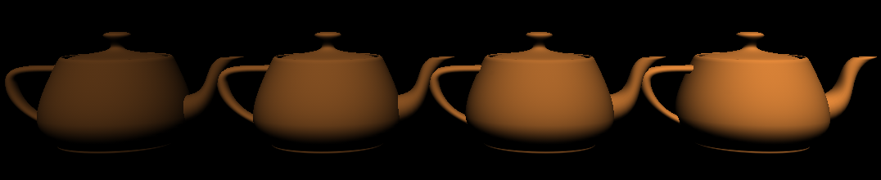
Shading model
Diffuse term
Shading varies along surface
A given point looks the same irrespective of the position of the viewer
Increasing K_{d}

Slide 20
Shading model
Specular term: Reflectance
Object surface: Mirror (ideal case)
  Light reflected in accordance with the Snell’s Law:
  The angle of reflection equals to the angle of incidence (with respect to the surface normal)
  The amount of light reflected towards the viewer / camera varies, depending on the relative position of the light source, position of the viewer and surface orientation
N
L
θ
θ
I_{s}
I
K_{s}

Slide 21
Shading model
Specular term: Reflectance
Object surface: glossy
  Extends the ideal (mirror) case
  The reflected light forms a “cone” around the ideal (Snell-law) reflectance vector
N
I
L
θ
θ
I_{s}
K_{s}

Slide 22
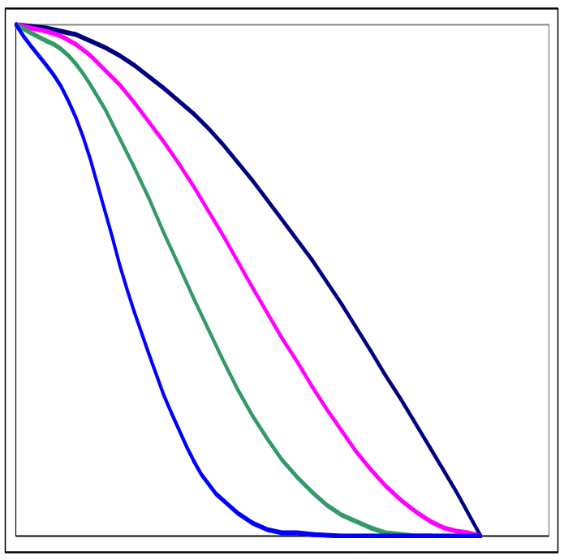
Shading model
Specular term: Reflectance
  The amount of light reflected within the cone decreases from the centre outwards (as a function of exponential decay)
  The rate of decay n is a “shininess factor”
  Object colour: material specular reflectivity coefficient K_{s}
  Colour / intensity of specular light: I_{s}
    Colour must be defined, I_{s} = [r_{s}, g_{s}, b_{s}];
    Common assumption: I_{s} = I_{d}
Width of the “cone”
Shininess factor n
Complete specular term: S = K_{s} I_{s} (cos θ_{s})^{n}

Slide 23
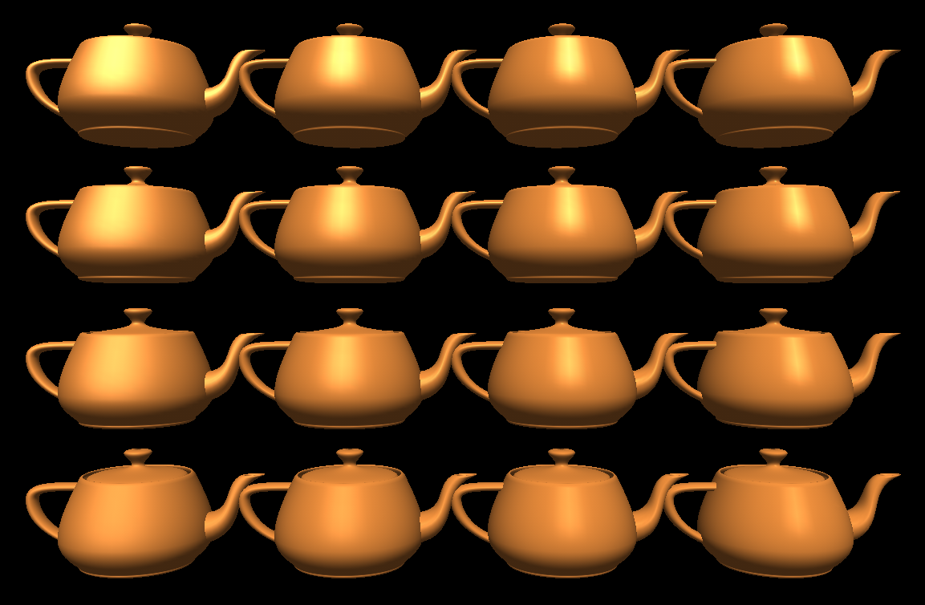
Shading model
Specular term
Increasing K_{s}
Increasing n

Slide 24
A complete shading model
Combines all the terms:
Pixel colour: Ambient + Diffuse + Specular
I = A + D + S
I = K_{a} I_{a} + K_{d} I_{d} cos θ_{d} + K_{s} I_{s} (cos θ_{s})^{n}
where cos θ_{s} = N ⋅ L_{s} and cos θ_{d} = N ⋅ L_{d}
dot product
(N and L normalised)

Slide 25
Next lecture
Shading algorithms

Slide 26
Illumination and shading
(2)
Adding “reality” to images
Shading algorithms
Flat
Gouraud
Phong

Slide 27
Algorithms for shading of surfaces
Shading model so far showed how to compute reflectance for individual points on a surface
Shading varies across surfaces
Point-by-point computation very expensive
Three approaches for computing shading for polygonal surfaces
  Flat shading
  Gouraud shading
  Phong shading

Slide 28
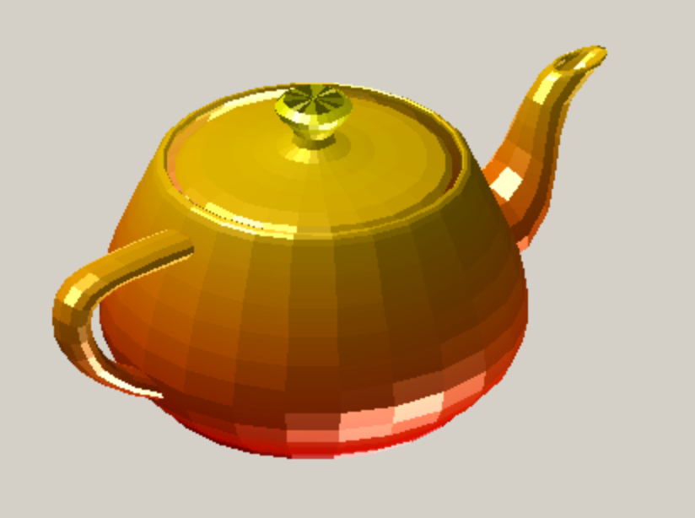
Flat shading
One reflectance value per polygon surface
Advantages
  Computationally simple
Drawbacks
  Not very realistic for curved surfaces
  Polygon structure visibly obvious

Slide 29

Gouraud shading
Interpolates the reflectances (colour vectors) across the surface of each polygon from a subset of points for which reflectance has been computed from the model
Advantages
  Visually more realistic than flat shading
Drawbacks
  Some artifacts may still be visible
  Computationally more expensive than flat shading

Slide 30
Gouraud shading
Input
  Surface normals
Algorithm
  For each surface calculate vertex normals by interpolating surface normals
N3
NV1
N2
N4
NV3
N1
NV2

Slide 31
Gouraud shading
Algorithm
  Compute reflectance at all the vertices
N3
NV1
N2
N4
NV3
N1
NV2
NV1
R1
I = K_{a} I_{a} + K_{d} I_{d} cos θ_{d}
+ K_{s} I_{s} (cos θ_{s})^{n}
NV3
R3
NV2
R2

Slide 32
Gouraud shading
NV1
R1
Algorithm
  Compute reflectance for points on the edges for every scan-line by interpolating vertex colour vectors
  Compute reflectances for every point within the patch of surface by interpolating along each scan-line between edge reflectances
NV3
R3
R2
R1
NV3
R3
NV2
R2

Slide 33
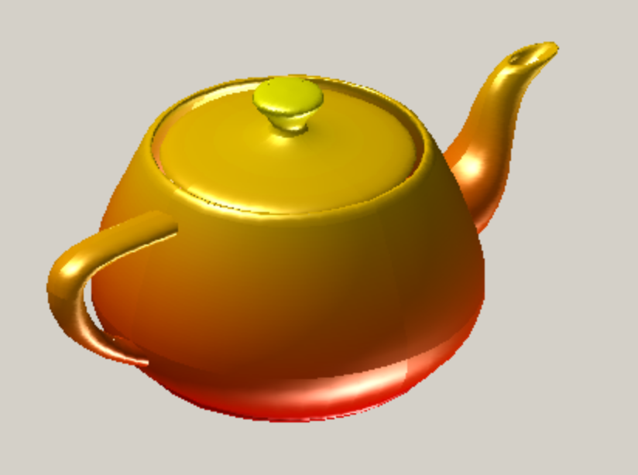
Phong shading
Interpolates the surface normals across the surface of each polygon from a subset of points for which the normal has been computed from the model
Advantages
  Visually more realistic than Gouraud shading
Drawbacks
  Computationally more expensive than Gouraud shading

Slide 34
Phong shading
Input
  Surface normals
Algorithm
  For each surface calculate vertex normals by interpolating surface normals
N3
NV1
N2
N4
NV3
N1
NV2

Slide 35
Phong shading
Algorithm
  For each surface calculate vertex normals by interpolating surface normals
N3
NV1
N2
N4
NV3
N1
NV2
NV1
NV3
NV2

Slide 36
Phong shading
NV1
Algorithm
  Compute normal vectors for points on the edges for every scan-line by interpolating vertex normals
  Compute normal vectors for every point within the patch of surface by interpolating along each scan-line between edge normal vectors
NV3
NV2

Slide 37
Phong shading
Algorithm
  Compute surface reflectance directly from normal vectors for every point within the patch of surface
I = K_{a} I_{a} + K_{d} I_{d} cos θ_{d}
+ K_{s} I_{s} (cos θ_{s})^{n}

Slide 38


Slide 39
Technical issues
Normal vectors must be normalised (i.e. length always set to 1) (WHY?)
After interpolation vectors must be re-normalised
Transforming normal vectors (e.g. after change of the view or after changing position of an object) is not straighforward
see e.g. http://groups.csail.mit.edu/graphics/classes/6.837/F01/Lecture15/lecture15.ppt

Slide 40
Credits
This presentation has used slides from various web sources, including:
  www.classes.cec.wustl.edu/~cse452/lectures/lect11_Illumination_2pp.pdf
  http://www1.cs.columbia.edu/~cs4160/slides/lecture15.ppt#767,2,Rendering: 1960s (visibility)
  groups.csail.mit.edu/graphics/classes/6.837/F01/Lecture15/lecture15.ppt
  http://artis.imag.fr/~Nicolas.Holzschuch/cours/class9.pdf

Slide 41
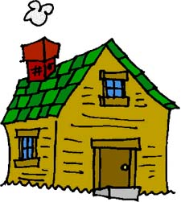
Homework
A surface is of a uniform red colour.
Given two vertices at
  V1 = [ -80 00 58 ]
  V2 = [ -65 -47 58 ]
their vertex normals
  N1 = [ -0.80 -0.04 0.60 ]
  N2 = [ -0.65 -0.50 0.60 ]
a vector specifying the direction of light
  [ -0.30 -2.20 2.80 ]
and light colour vector
  [ 1 0.5 0.5 ]
compute the colours (RGB vectors) of the 10 points lying on the line joining the two vertices V1 and V2

Slide 42
Next lecture
Colour

