Slide 1
Colour (1)
Colours and their origin
- spectral characteristics
- human visual perception
Colour spaces
Raster data
- colour models
- image representations
- single and multi-band (multi-channel) images
- colour lookup tables

Slide 2

Rendering: Colour
Given
  Object surfaces
  Light sources
  Camera
Compute
  Colour of each pixel on the screen
  This is colour that bounces off the surface point and goes in the direction of the camera (viewer)
√
√
√
√
√

Slide 3
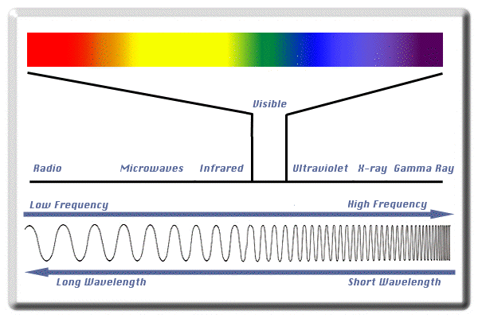
What is colour
Light – a part of electromagnetic spectrum

Slide 4
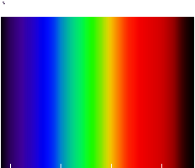
What is colour
Colour spectrum – visible light
Ultraviolet
Infrared
400 nm
700 nm

Slide 5
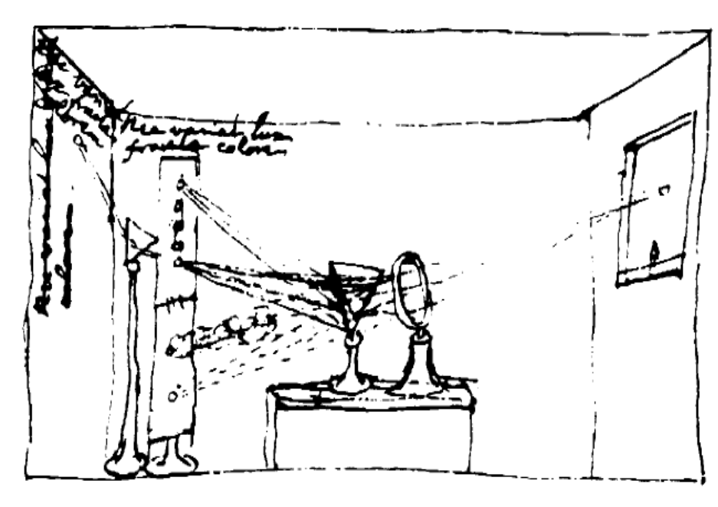
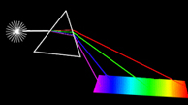
What is colour
Newton’s experiment
Conclusion:
“White” light is a combinations of many different light wavelengths

Slide 6
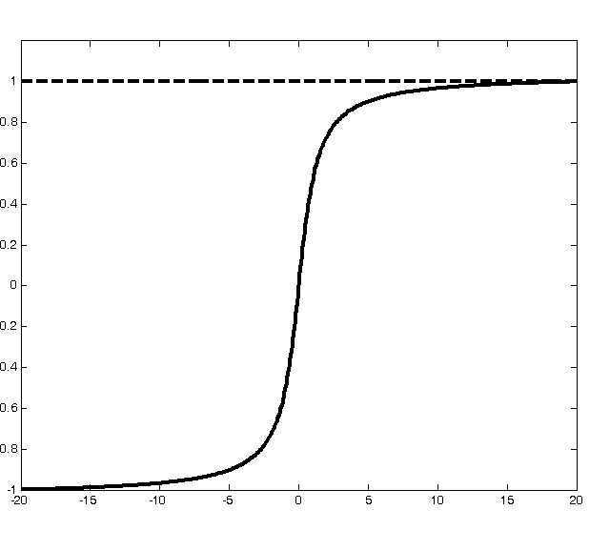
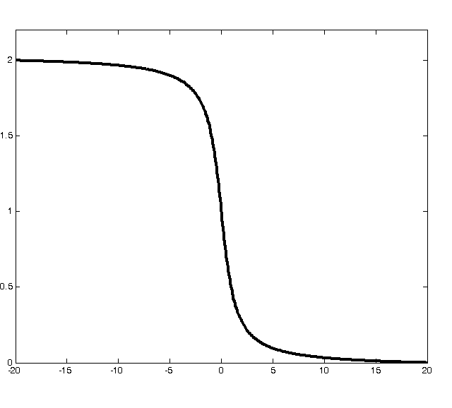
What is colour
Spectrum of white light
Surface absorption
spectrum
Surface reflectance spectrum

Slide 7
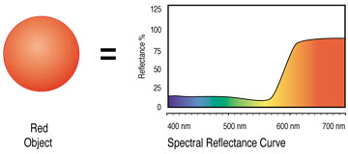

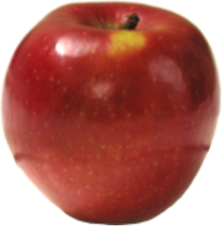
What is colour
Absorption curve
Red object
Spectral reflectance

Slide 8
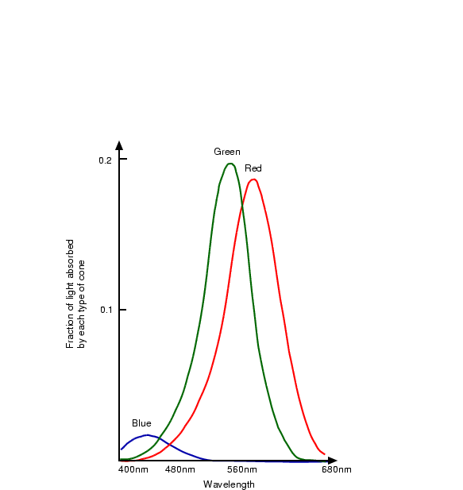
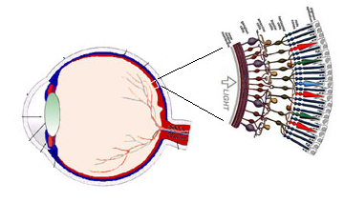
What is colour
Human colour perception

Slide 9
What is colour
Colour is a percept
  White is a colour, the perception which is evoked by light that stimulates all three types of colour sensitive cone cells in the human eye in nearly equal amounts and with high brightness. [Wikipedia]
  Red is a colour, the perception of which is evoked by light that stimulates “red” sensitive cones in the human eye, and no other cones (“green” or “blue”)

Slide 10
Deciphering colour
Object + Light
COOL
HOT

Slide 11
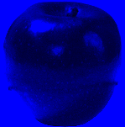
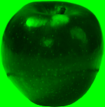
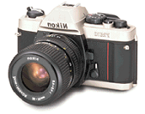
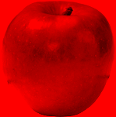
Colour images
Acquisition

Slide 12
Colour images
Colour images have two components:
  raster data - an array of pixels;
  colour model - a description of how pixels are mapped to colours.
A pixel is defined in terms of its components in a particular colour space

Slide 13
Colour spaces
A colour space represents a system for measuring colours
Most colours can be represented using three colour components
They are called the primary colours (or the primaries)

Slide 14
Colour spaces
There are many colour spaces.
The choice of a particular space depends on the context in which we want to describe colours. The four most common colour spaces are:
  RGB
  HSV
  CMY (K)
  XYZ

Slide 15
RGB
Primaries: Red - Green - Blue
Similar to colours detected by colour receptors in the eye
Used in display technology
Blue
Cyan
Magenta
White
Black
Green
Red
Yellow

Slide 16
RGB
(0,0,1)
Blue
Cyan
Magenta
(1,1,1)
White
(0,1,0)
(0,0,0)
Green
Black
(1,0,0)
Red
Yellow

Slide 17
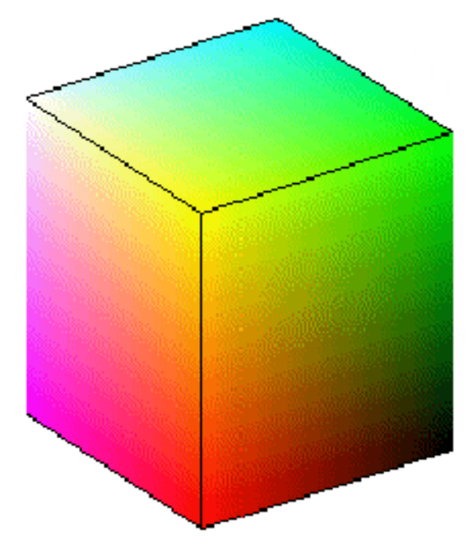
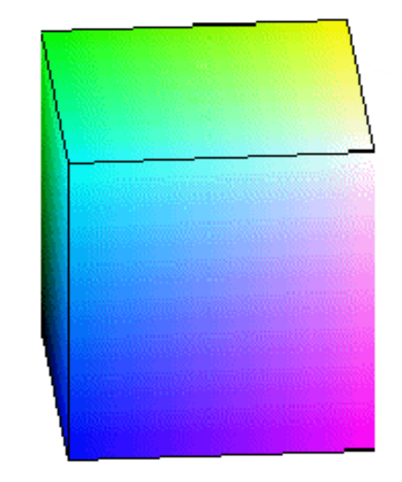
RGB

Slide 18
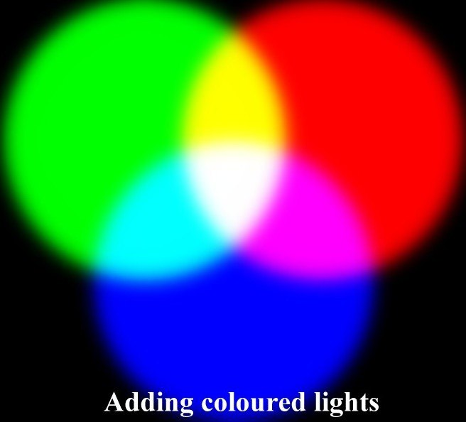
RGB – an additive system

Slide 19
Vector notation for colours (1)
[ Primary1 Primary2 Primary 3 ]
[ R G B ]
red = [ 1 0 0 ]
green = [ 0 1 0 ]
blue = [ 0 0 1 ]
yellow = red + green = [ 1 1 0 ]
magenta = [ 1 0 1 ]
cyan = [ 0 1 1 ]
orange = [ 1 0.5 0 ]

Slide 20
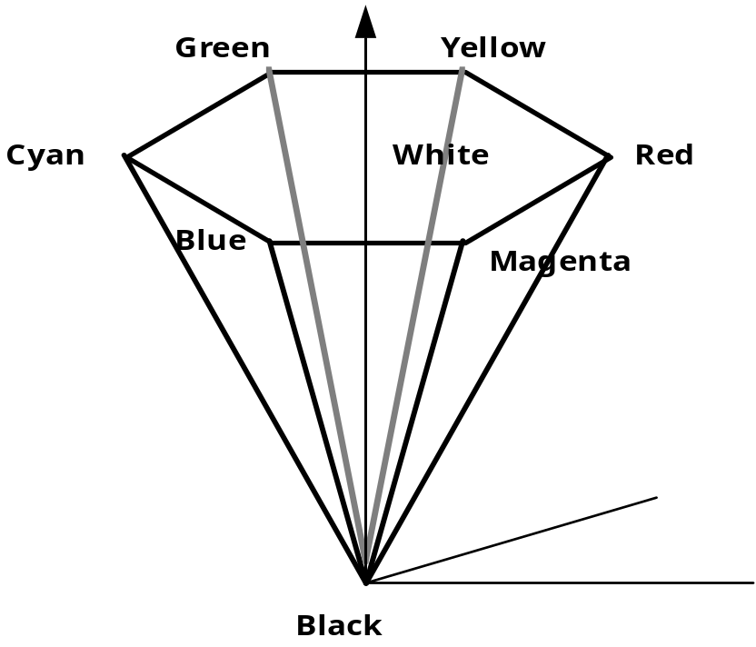
HSV / HSL
Primaries: Hue - Saturation – Value
Or: Hue – Saturation – Lightness
Colour space related to subjective description of colours
HSV

Slide 21
HSV
Value
Green
Yellow
White
Red
Cyan
(*,0,1)
(1,1,1)
Blue
Magenta
Hue
Saturation
Black (*,0,0)

Slide 22
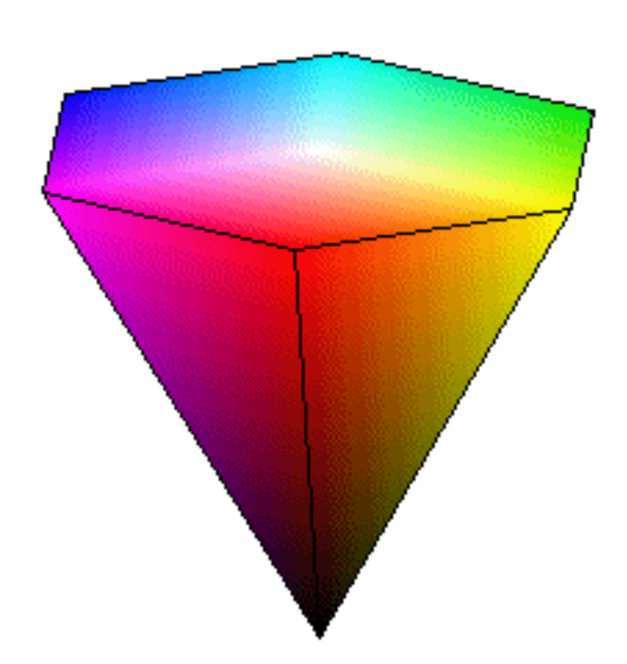
HSV

Slide 23
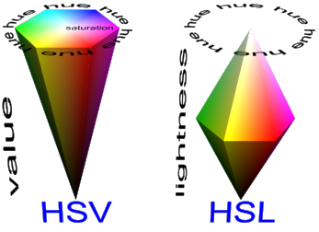
HSV and HSL
Source: http://www.bersoft.com/bimagem/help/hsv_hsl.png

Slide 24
CMY
Primaries: Cyan - Magenta – Yellow
Used in printing technology
Complement of RGB
Mixing is subtractive

Slide 25
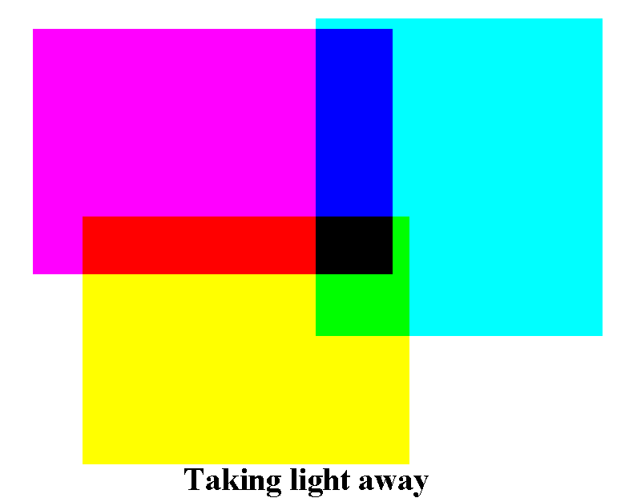
CMY – subtractive system

Slide 26
CMY – subtractive system
[ C M Y ]
cyan = [ 1 0 0 ] _{CMY}
magenta = [ 0 1 0 ] _{CMY}
yellow = [ 0 0 1 ] _{CMY}
Example:
A surface appears yellow because, given white light
[1 1 1] _{RGB}
yellow pigment absorbs blue component of the spectrum
[1 1 1] _{RGB} – [0 0 1] _{RGB} = [1 1 0] _{RGB}
so a mixture of red and green (i.e. yellow) is reflected
[1 1 0] _{RGB}

Slide 27
CIE XYZ
CIE: Commission Internationale de l'Eclairage
Primaries: X, Y, Z
Based on colour perception by humans
Device independent
The most common representation of the CIE XYZ space is the CIE chromacity diagram

Slide 28
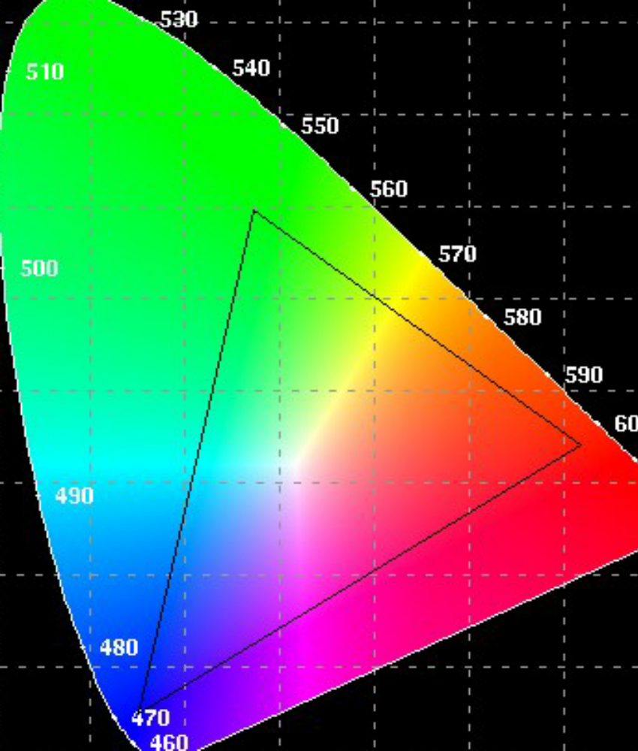
CIE XYZ
Chromacity diagram
Gamut

Slide 29
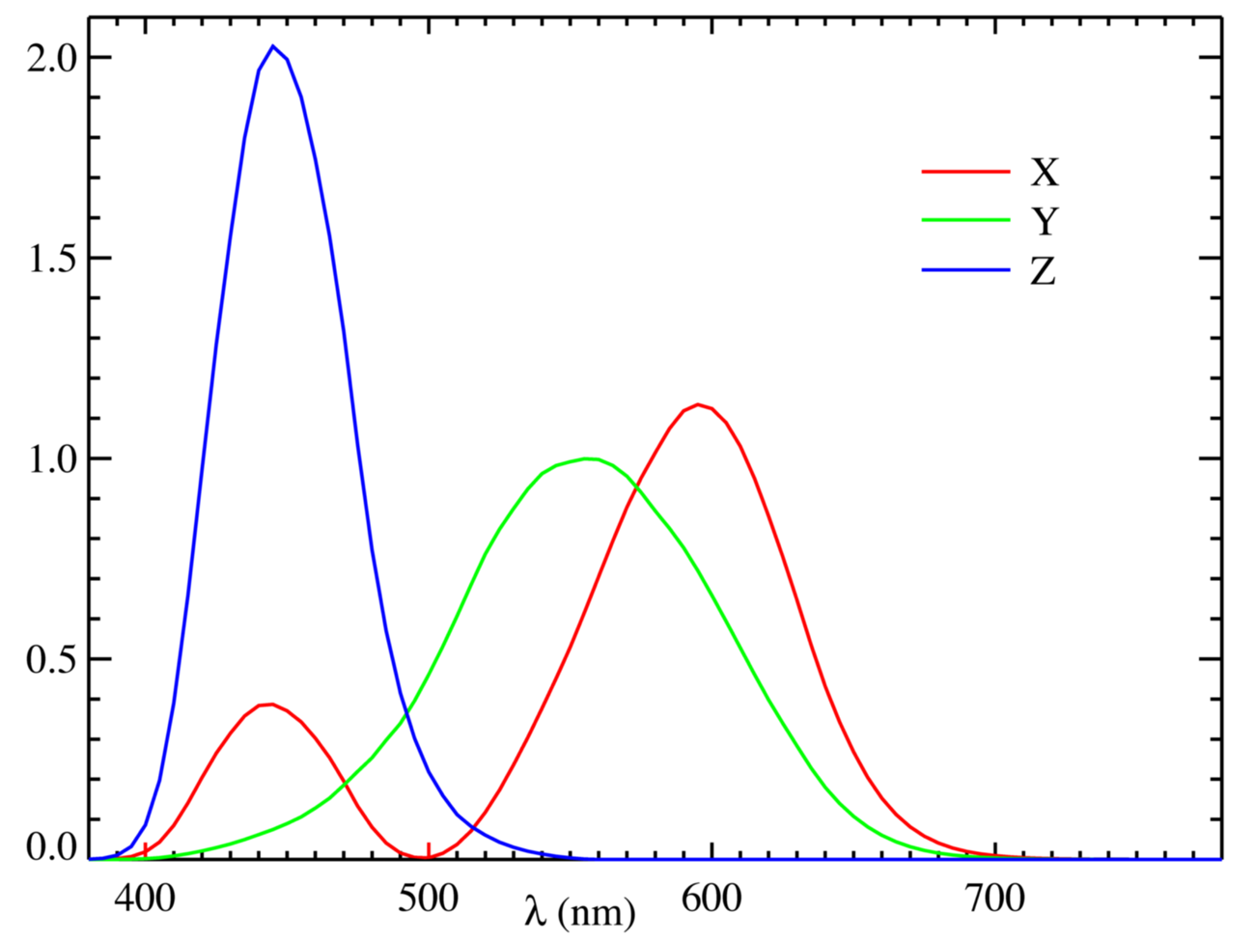
CIE XYZ – colour matching functions: a “standard” observer

Slide 30
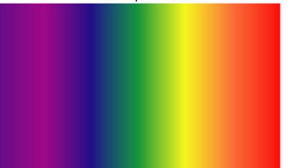
CIE XYZ and human colour perception
650 nm
Metamerism
500 nm
580 nm
500 nm
580 nm
650 nm
Metamerism

Slide 31
Vector notation for colours (2)
[ Primary1 Primary2 Primary 3 ]
[ R G B ] pink = [ 1 0.7 0.7]
[ H S V ] pink = [ 0 0.3 1 ]
[ C M Y ] pink = [ 0 0.3 0.3 ]

Slide 32
Colour picker experiment

Slide 33
Colour space conversion
Colours can be converted from one space to another
Conversion from RGB to CMY:
[ C M Y ] = [ 1 1 1 ] - [ R G B ]
Example: Convert green from RGB to CMY
[ C M Y ] = [ 1 1 1 ] - [ 0 1 0 ] = [ 1 0 1 ]

Slide 34
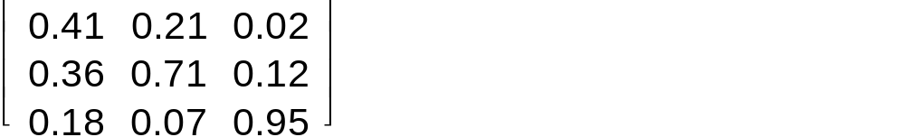
Conversion from RGB to XYZ
Each of the R, G and B primaries is a weighted sum of X, Y and Z primaries
Weights expressed in matrix notation, e.g.
The matrix values are characteristic for a given
graphics device

Slide 35
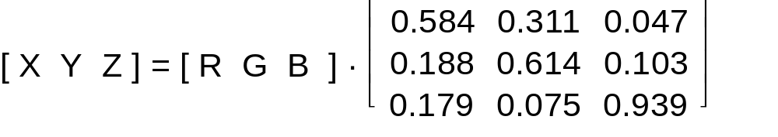
Conversion from RGB to XYZ
Conversion implemented as a matrix multiplication

Slide 36
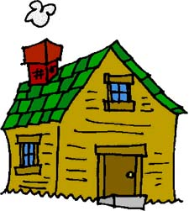
Homework
Specify colour definitions for the following colours in the RGB, HSV and CMY colour spaces:
  Black
  White
  Orange
  Pink
What colour will you get by illuminating a yellow surface with a green light?
What colour will you get by illuminating a magenta surface with a yellow light?
(You can check the answers to the last two questions by experimenting with Matlab code in ex4_lighting.m)

Slide 37
Colour (2)
Colours and their origin
- spectral characteristics
- human visual perception
Colour spaces
Raster data
- computer architecture for colour display
- colour models
- image representations
- single and multi-band (multi-channel) images
- colour lookup tables

Slide 38
Computer architecture for colour displays
Raster
conversion
Image
display
Graphics commands
Raster processor
Frame buffer
Display controller
Monitor
Colour lookup
table

Slide 39
Colour mapping
Frame
buffer
Display
Pixel value
Colour lookup
table
R
Colour
definition
G
B

Slide 40
Frame buffer
Frame (display) buffer
  A specially designated area of memory
  Direct access by a display processor (but not by an application)
  Display processor scans the display buffer and passes the contents to a DAC
  DAC converts values into voltages for individual R, G and B pixel cells
The colour lookup table is a block of fast RAM

Slide 41
Pixel cells
Each individual pixel is divided into three cells, or subpixels (R,G and B)
Each pixel cell receives a voltage from DAC
Pixel cells generate colour on a display monitor using various methodologies:
  Phosphors
  Filters
  Liquid crystals, etc

Slide 42
Raster data - pixel structure
Raster data - raster array - a rectangular array of picture elements (pixels)
Raster array forms a picture
The structure of a pixel depends on
  the colour space
  the colour model

Slide 43
Raster array
Pixel structure
values
index

Slide 44
Raster data - pixel structure
Binary images
  pixel represented by a single bit
Monochrome images
  pixel represented by a single byte (a one-dimensional vector)
Colour images
  usually represented by a 3-dimensional vector in a given colour space
  examples [ R G B], [H S V] or [C M Y]

Slide 45
Colour models
A colour model describes how pixels are mapped into colours.

Slide 46
Direct Colour (True Colour)
Image is an array of vectors
  three integers at each pixel location
Each vector directly encodes values of the three primaries
PixelValue(x,y) = [ R G B ]
e.g. red: [ FF 0 0 ]
(in hexadecimal notation)

Slide 47
Direct Colour (True Colour)
Image is represented by three colour planes (channels)
  three integer arrays, one for each primary
Each plane directly encodes values of one of the three primaries
PixelValue(x,y,r) = R
PixelValue(x,y,g) = G
PixelValue(x,y,b) = B
PixelValue = R
e.g. red
PixelValue = G
PixelValue(x,y,r) = 255
PixelValue = B
PixelValue(x,y,g) = 0
PixelValue(x,y,b) = 0

Slide 48
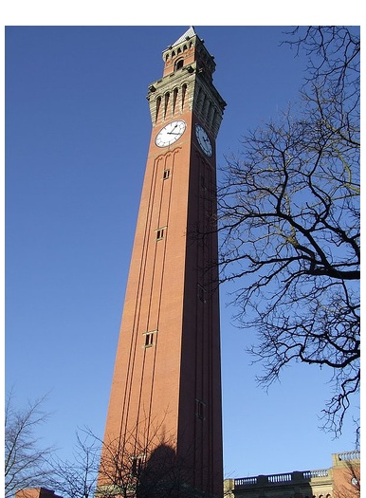
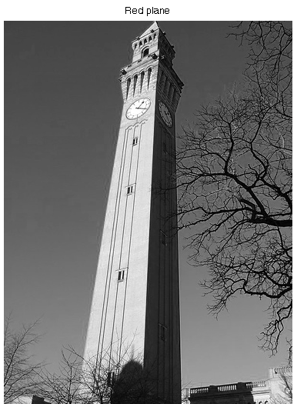
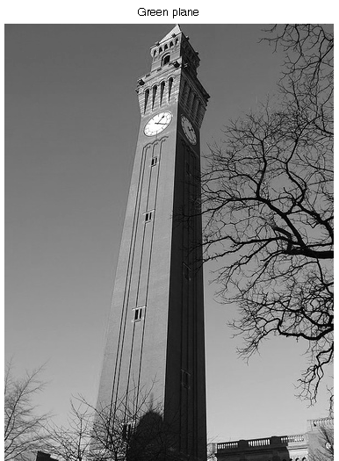
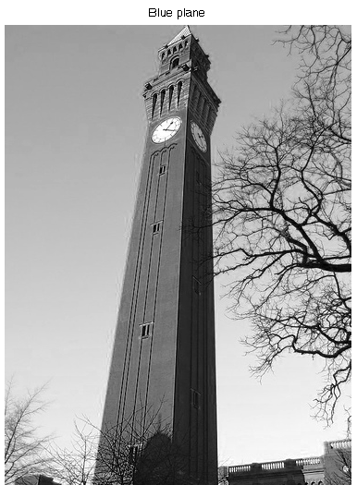

Slide 49
Packed Colour Model (Packed Array)
Image is an array of values, each encoding a colour
Examples:
  4-byte integer
aaaaaaaa bbbbbbbb gggggggg rrrrrrrr
  1-byte integer
rrrgggbb

Slide 50
Indexed Colour Model
A pixel value (or a value of a pixel component) is an index (a pointer) to a table containing colour definitions

Slide 51
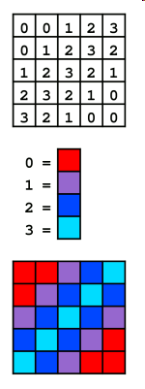
Colour Map
Synonyms:
  Colour Lookup Table
  CLUT
  LUT
Each location in a LUT stores a colour definition for a pixel with a given value
Raster array
LUT
Display
Source: Wikipedia

Slide 52
Colour mapping for 1-byte pixels
117
PixelValue(x,y) = 117
Raster array
Colour lookup
table
R
Display
G
B
0
117
255
0
1
1

Slide 53
Colour mapping for 1-byte pixels
Number of colours simultaneously available in one image?
2⁸ = 256
Gamut (total number of colours available for use)?
R
G
B
0
255
2^{3x8} = 2²⁴ = 16,777,216

Slide 54
Colour mapping for 3-dimensional pixel vectors
R
G
B
PixelVector(x,y) = [0 255 0]
Colour lookup
table
R
R = 1
G
G = 0.5
B
B = 0
0
255

Slide 55
Colour mapping for 3-dimensional pixel vectors
R
Number of colours simultaneously available in one image?
G
B
2²⁴ = 16,777,216
Gamut (total number of colours available for use)?
R
R
G
G
B
B
0
255
2²⁴ = 16,777,216

Slide 56
Colour channel / plane
Colour channel / plane - a component of a colour vector
RGB: red channel, green channel and blue channel
A pixel vector can have more than three channels
Examples
  alpha channel (often used to describe transparency of a pixel)
  z channel (in 3D graphics, the depth of the pixel, used in hidden surface removal)

Slide 57
Defining pixel colours
Changing pixel colours is very easy within the Indexed Colour Model
A raster array containing pixel values (or pixel vectors) stays unchanged.
Only colour definitions in the LUT are changing

Slide 58
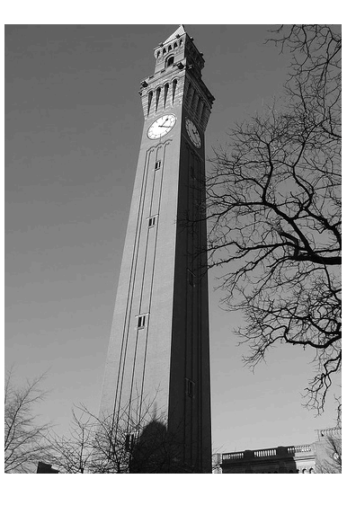
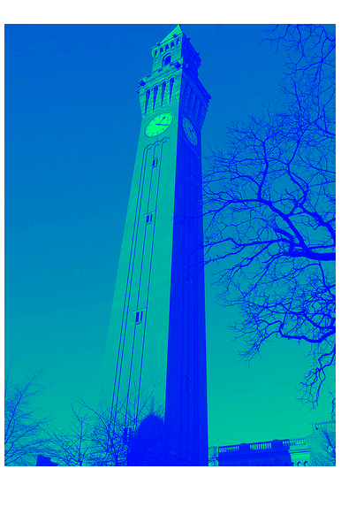
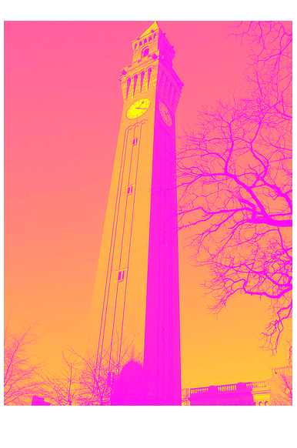
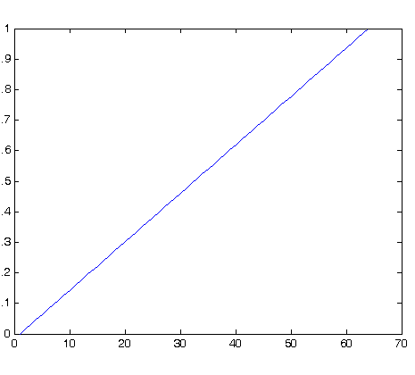
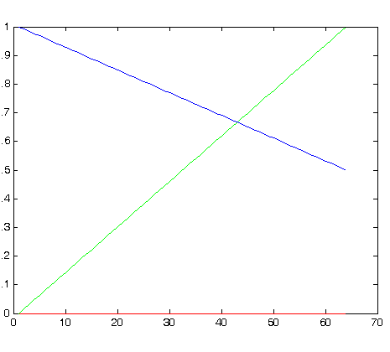
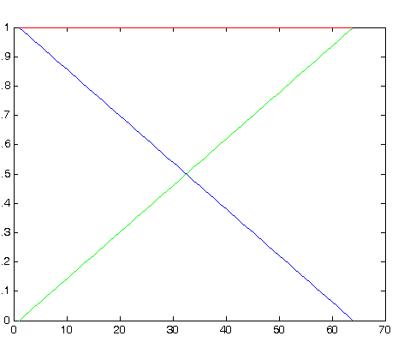
Colour mapping functions
Output
Input

Slide 59
Java image representation
BufferedImage
ColorSpace (e.g. RGB)
DataBuffer
SampleModel

Slide 60
Java image representation
BufferedImage
BufferedImage
Raster
ColorModel
SampleModel
ColorSpace
DataBuffer

Slide 61
Representations: Java terminology
Normal representation
  the amount of each primary defined by a number in the range [0,1]
  Example: pink (RGB): [1.0 0.5 0.5]
Logical representation
  Pixel representation as a vector
Physical representation
  depicted by the Colour Model

Slide 62
Homework
Specify colour definitions for the following colours in the RGB, HSV and CMY colour spaces:
  Black
  White
  Orange
  Pink
Define a 64-long colour map specifying rainbow colours
Define a 32-long colour map specifying red hue of decreasing saturation
Given a grey-scale image, compute its negative (i.e. black becomes white, white becomes black, dark colours become bright and vice versa).

Slide 63
Next lecture
Computing complete surface colour – class exercise
Following lecture:
Implementing virtual camera

